Slide 1
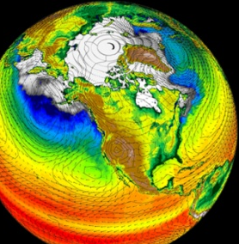
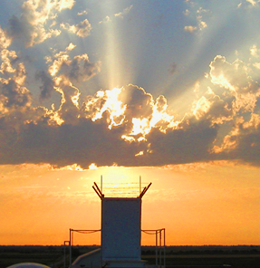
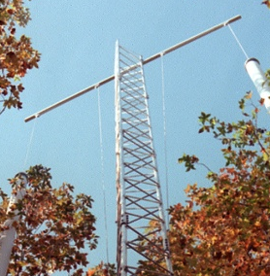
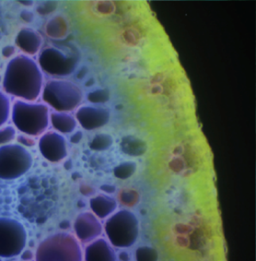
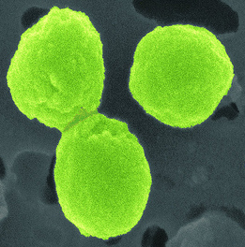


GOAmazon2014 - Green Ocean Amazon 2014
Wanda Ferrell
BERAC Meeting
October 7, 2011
Office
of Science
Office
of Science
Office
of Science
Office of Biological
and Environmental Research
Office of Biological
and Environmental Research
Office of Biological
and Environmental Research

Slide 2

Why the Amazon Basin
The Amazon Basin is one of the
Earth’s primary heat engines and must be incorporated robustly in earth system models.
Tropical deep convection in a natural state is poorly understood and modeled, with insufficient observational data sets for model constraint.
Furthermore, future climate scenarios show the possible drying and the eventual possible conversion of rain forest to savanna in response to global climate change.
Aerosols strongly influence cloud processes and in the Amazon aerosols are dominated by vegetative sources, there is a strong and little understood connection between terrestrial ecosystems and the atmosphere.
2 BERAC
Department of Energy • Office of Science • Biological and Environmental Research
2 BER BSSD
Department of Energy • Office of Science • Biological and Environmental Research
2 BER BSSD
Department of Energy • Office of Science • Biological and Environmental Research

Slide 3
Opportunity for CESD
In 2010 ARM approved the proposal to send the ARM Mobile Facility, an aerosol observing system, and the G-1 to Brazil in 2014.
Given the scientific importance of the location and key questions in the proposal, other BER program managers quickly identified the opportunity to design a more ambitious experiment.
The decision was to create an integrated activity that focused on addressing a key limitation in earth system models-- the difficulty in coupling land surface-atmospheric modules and the limited understanding of the physical and biological processes involved in that coupling.
3 BERAC
Department of Energy • Office of Science • Biological and Environmental Research
3 BER BSSD
Department of Energy • Office of Science • Biological and Environmental Research
3 BER BSSD
Department of Energy • Office of Science • Biological and Environmental Research

Slide 4
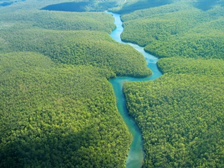
GOAmazon2014
The experiment will extend from
January 1 – December 31, 2014.
BER’s commitment is to provide a
dataset and associated research
needed to improve model representations of organic aerosols, cloud and convection schemes, and terrestrial vegetation components and how these are perturbed by pollution.
An integrated research effort is being developed by the Atmospheric System Research, Terrestrial Ecosystem Science, and Climate and Earth System Modeling programs.
4 BERAC
Department of Energy • Office of Science • Biological and Environmental Research
4 BER BSSD
Department of Energy • Office of Science • Biological and Environmental Research
4 BER BSSD
Department of Energy • Office of Science • Biological and Environmental Research

Slide 5
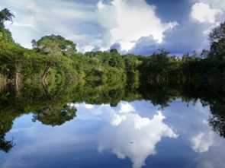
BER Climate Research Focus
The scientific focus is on atmospheric, terrestrial ecosystem, carbon cycle, and coupling questions dealing with tropical systems in the Amazon.
The experiment is being
designed to enable the study
of how aerosols and surface
fluxes influence cloud cycles
under clean conditions, as
well as how aerosol and
cloud life cycles, including
cloud-aerosol-precipitation
interactions, are influenced by pollutant outflow from a tropical megacity.
5 BERAC
Department of Energy • Office of Science • Biological and Environmental Research
5 BER BSSD
Department of Energy • Office of Science • Biological and Environmental Research
5 BER BSSD
Department of Energy • Office of Science • Biological and Environmental Research
Notes:
Given these model uncertainties our office decided to use this opportunity to

Slide 6
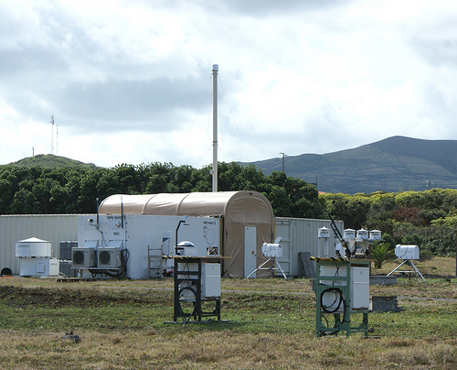
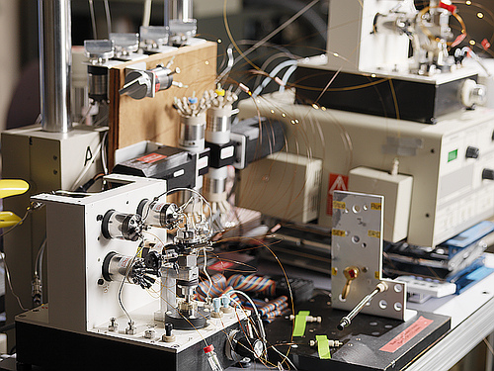
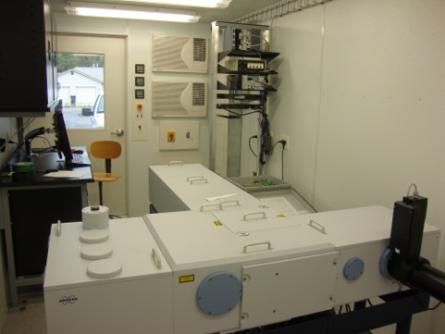
Observing Systems
ARM will send the ARM Mobile Facility, the G-1 aircraft and an aerosol observing system
EMSL will provide mass spectrometers and laboratory study support
Terrestrial Ecosystem Science will provide carbon cycle instruments and opportunities for supplementary support for complementary terrestrial ecosystem research
6 BERAC
Department of Energy • Office of Science • Biological and Environmental Research
6 BER BSSD
Department of Energy • Office of Science • Biological and Environmental Research
6 BER BSSD
Department of Energy • Office of Science • Biological and Environmental Research

Slide 7
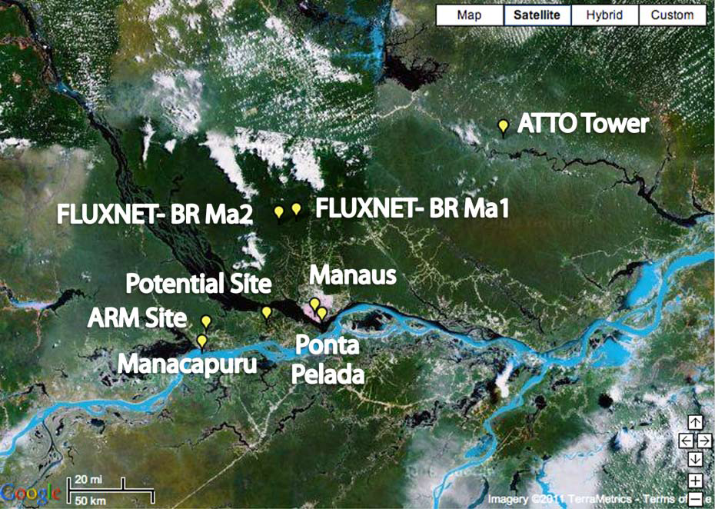
Experiment Locations
FLUXNET- BR Ma2
FLUXNET- BR Ma1
Manaus
Swimming Hole
Large Pasture Site
Swimming Hole
Swimming Hole
Ponta Pelada
Farm with Towers
Manacauru
7 BERAC
Department of Energy • Office of Science • Biological and Environmental Research

Slide 8
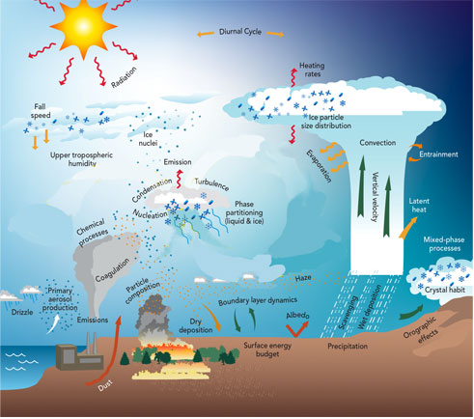
Research Support
The Climate and Earth System Modeling, Atmospheric System Research, and Terrestrial Ecosystem Science programs will support research using these data to evaluate and improve the representation of these coupling processes in the climate models.
Joint calls for proposals are being planned with a focus on integrated science.
8 BERAC
Department of Energy • Office of Science • Biological and Environmental Research
8 BER BSSD
Department of Energy • Office of Science • Biological and Environmental Research
8 BER BSSD
Department of Energy • Office of Science • Biological and Environmental Research

Slide 9
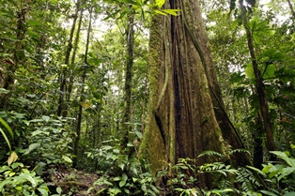
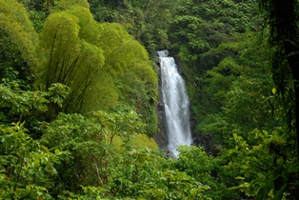
Getting Community Input
A planning workshop of atmospheric and terrestrial experts was conducted in Crystal City, VA, on July 26 & 27
The workshop included 27 process and modeling scientists with expertise in atmospheric and terrestrial ecosystem research
The charge was to identify key scientific challenges that should be addressed by GOAmazon2014 and to identify observational and modeling strategies for addressing these challenges.
9 BERAC
Department of Energy • Office of Science • Biological and Environmental Research
9 BER BSSD
Department of Energy • Office of Science • Biological and Environmental Research
9 BER BSSD
Department of Energy • Office of Science • Biological and Environmental Research

Slide 10
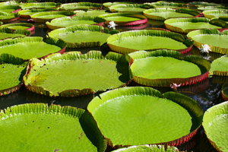
Workshop Goals
Identify important unresolved
science questions concerning
relationships between aerosols
and cloud properties under
pristine and polluted conditions
in the target region.
Identify and discuss observation and modeling strategy to address gaps in understanding
10 BERAC
Department of Energy • Office of Science • Biological and Environmental Research
10 BER BSSD
Department of Energy • Office of Science • Biological and Environmental Research
10 BER BSSD
Department of Energy • Office of Science • Biological and Environmental Research

Slide 11
Getting Community Input
What are the priority gaps in understanding related to the cloud-aerosol-precipitation interactions that can be addressed in GOAmazon2014?
What are the priority gaps in understanding related to the terrestrial ecosystem that can be addressed in GOAmazon2014?
What are the priority gaps in understanding related to the coupling of the land surface/terrestrial ecosystem-atmosphere that can be addressed in GOAmazon2014?
Consider the relative roles of large scale dynamical versus local biosphere-atmosphere effects on hydrology; also the potential influences of local pollution.
What measurement capabilities beyond those currently identified are needed to address each of these questions?
11 BERAC
Department of Energy • Office of Science • Biological and Environmental Research
11 BER BSSD
Department of Energy • Office of Science • Biological and Environmental Research
11 BER BSSD
Department of Energy • Office of Science • Biological and Environmental Research

Slide 12

Workshop Report
CESD program managers drafted the report
Participants reviewed the draft for accuracy
The report on the findings of the workshop is now available on the web, and CESD will publish in hardcopy.
12 BERAC
Department of Energy • Office of Science • Biological and Environmental Research
12 BER BSSD
Department of Energy • Office of Science • Biological and Environmental Research
12 BER BSSD
Department of Energy • Office of Science • Biological and Environmental Research

Slide 13

Interagency Coordination
May 2 BER met with program managers from the National Science Foundation (NSF), National Oceanic and Atmospheric Administration (NOAA), and National Aeronautics and Space Administration (NASA) to inform these agencies and seek collaborations.
Scientists will submit a proposal to NSF requesting the deployment of their S-Pol radar
NSF will accept proposals from scientists to conduct research using the data
NASA has entertained discussions with Pis concerning NASA support
Discussions with NOAA are ongoing
13 BERAC
Department of Energy • Office of Science • Biological and Environmental Research

Slide 14
International Participation
The Brazilians have been active partners in this endeavor and will provide the following:
Brazil will provide aerial measurements by the twin engine turboprop Embraer Bandeirante EMB-110B1
Existing Brazilian flux tower (K34) data will be used
CHUVA Measurements
  Several instruments from the K34 Tower Area
  Two additional radiosonde systems to be implemented to form a triangle with the AMF site.
Center for Weather Forecasting and Climate Studies (CPTEC) Model Contributions
  Operational mode (twice a day) results from a GCM (45 by 45 km) and the mesoscale model ETA (20 by 20 km) will be available for the experiment.
  Results from very detailed resolution (1 by 1 km) model (BRAM) centered at the AMF site
14 BERAC
Department of Energy • Office of Science • Biological and Environmental Research

Slide 15
International Participation
The German PI, Meinrat Andreae, for the tall tower is very enthusiastic about our future partnership
Bjorn Stevens (Max Planck Institute for Meteorology), who participated in the workshop, is planning to propose that Max Planck establish a site that would complement BER and Brazilian measurements.
15 BERAC
Department of Energy • Office of Science • Biological and Environmental Research

Slide 16
Further Outreach Actions
Atmospheric System Research
Three Brazilian scientists were invited to the ASR working group meeting
Special breakout session held to discuss experiment
Terrestrial Ecosystem Science
Dan Stover met with Brazilian terrestrial expert at ASR meeting to initiate planning for TES participation
Climate and Earth System Modeling
GOAmazon2014 PI was invited speaker during their science team meeting
Special breakout session was held for smaller group discussions.
16 BERAC
Department of Energy • Office of Science • Biological and Environmental Research

Slide 17
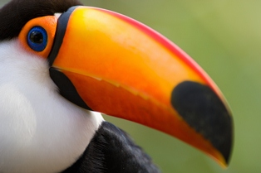

Planning Continues
BER program managers continue discussions in house
                We anticipate a successful, coordinated activity for GOAmazon2014
17 BERAC
Department of Energy • Office of Science • Biological and Environmental Research

