Slide 1
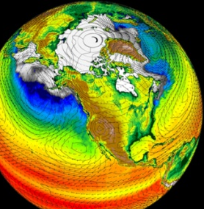
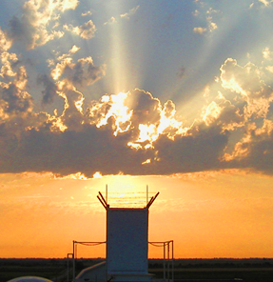
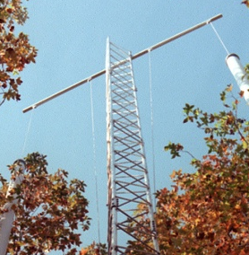
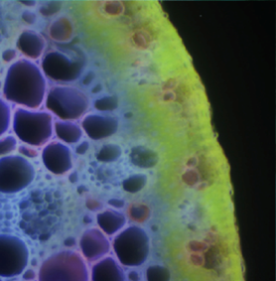
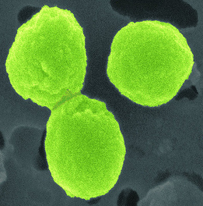

BERAC Meeting
Climate and Environmental Sciences Division Update
Gary Geernaert, Ph.D.
Director, Climate and Environmental Sciences Division
October 6, 2011
Office
of Science
Office
of Science
Office of Biological
and Environmental Research
Office of Biological
and Environmental Research

Slide 2
During the past year
Sense of the nation’s need for climate science
Listen to labs, universities, and others
Establish an integrating core Division goal
Establish linkages to DOE applied offices
Presence and serious player in USGCRP
Visibility at scientific conferences: town halls..
Build “science value” as part of outputs
Explore efficient management paradigms
2 BERAC Sep 2011
Department of Energy • Office of Science • Biological and Environmental Research

Slide 3
Unifying goal, strategic planning
Goal: Advance science to increase system predictability
Unifying themes
  (Extremes, thresholds, tipping points)
  Attribution to anthropogenic versus naturally varying signal
  Sensitive geographies
  Higher resolution with uncertainty characterization
  Science gaps that limit predictability
    Hydrology: (clouds, aerosols, precipitation, drought, ecology)
    Clouds, aerosols
    Cryosphere
    Carbon, heavy metals
  Data/model management: testbeds, diagnostics, UQ
Strategy principles
  Exploit unique DOE assets (ARM, EMSL, HPC, national laboratories)
  Tap into the largest talent pool possible
  Leverage other agency assets where possible
  Coordinate via e.g. USGCRP
  Create career opportunities for staff
3 BERAC Sep 2011
Department of Energy • Office of Science • Biological and Environmental Research

Slide 4
Management updates
Reviews of facilities
  ARM facility review (April 2011)
  ARM data quality (Nov 2011)
  EMSL review (Oct 2011)
More significant player
  USGCRP: vice chair, principal
  Stronger intra-agency and interagency collaborations
Outreach at scientific societies
  ESA town hall (August 2011)
  AGU town halls (Dec 2011): diagnostics, GOAMAZON
  AMS town hall (Jan 2012): AR6 and AR7
Notes:
Terrestrial Ecosystem Sciences program supports foundational science to improve our predictive understanding of terrestrial ecosystems in the context of a changing climate
TES follows the CESD template of evaluating gaps and needs in ecosystem to Earth system scale models and then directing coupled process research/modeling activities to provide improvements to the identified needs.
They manage a program of university research awards that are solicited annually and evaluated through peer panels; and National Laboratory SFA programs that are reviewed triennially by external peer panels.
The Next Generation Ecosystem Experiment (NGEE) for arctic permafrost is moving forward with a team lead by ORNL and including LANL, LBNL, BNL, SNL, University of Alaska- Fairbanks and the University of New Hampshire. FY 12 funding was approved based on a recent review of the program’s Phase I science plan.
The first annual TES PI meeting will take place in the downtown DC area on April 23 & 24. More information to follow.
TES conducted a successful town hall meeting at ESA in August. And has a second town hall accepted for AGU in December.

Slide 5
Management updates
SFA reviews
  PNNL / Subsurface
  SLAC/Subsurface
  LANL / COSIM
NGEE Phase 1 proposal
  Accepted, with revisions
Solicitations
  TES Annual university solicitation (9/12): 141 proposals received
  SBIR: 106 preproposals received
  Early Career preproposals: 46 proposals encouraged
  SCIDAC : Lab call just released
  AmeriFlux operations call for white papers to be released
Notes:
Terrestrial Ecosystem Sciences program supports foundational science to improve our predictive understanding of terrestrial ecosystems in the context of a changing climate
TES follows the CESD template of evaluating gaps and needs in ecosystem to Earth system scale models and then directing coupled process research/modeling activities to provide improvements to the identified needs.
They manage a program of university research awards that are solicited annually and evaluated through peer panels; and National Laboratory SFA programs that are reviewed triennially by external peer panels.
The Next Generation Ecosystem Experiment (NGEE) for arctic permafrost is moving forward with a team lead by ORNL and including LANL, LBNL, BNL, SNL, University of Alaska- Fairbanks and the University of New Hampshire. FY 12 funding was approved based on a recent review of the program’s Phase I science plan.
The first annual TES PI meeting will take place in the downtown DC area on April 23 & 24. More information to follow.
TES conducted a successful town hall meeting at ESA in August. And has a second town hall accepted for AGU in December.

Slide 6

SciDAC Laboratory Announcement: September 16, 2011
BER Climate modeling – ASCR partnership
Topics:
Development of physics and dynamics for atmosphere, ocean and land-ice to run efficiently and accurately using high resolution or unstructured grids
Development of efficient and accurate schemes for simulating atmospheric or oceanic chemical or biogeochemical tracers
Should also utilize:
New SciDAC Institutes
UQ and model validation methods
Develop community model

Slide 7
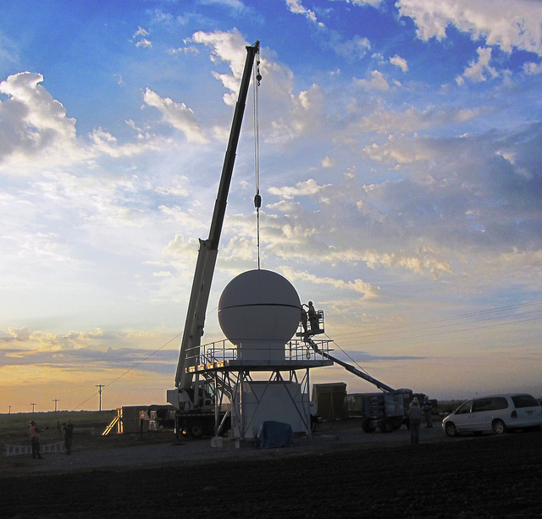
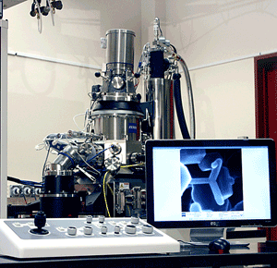
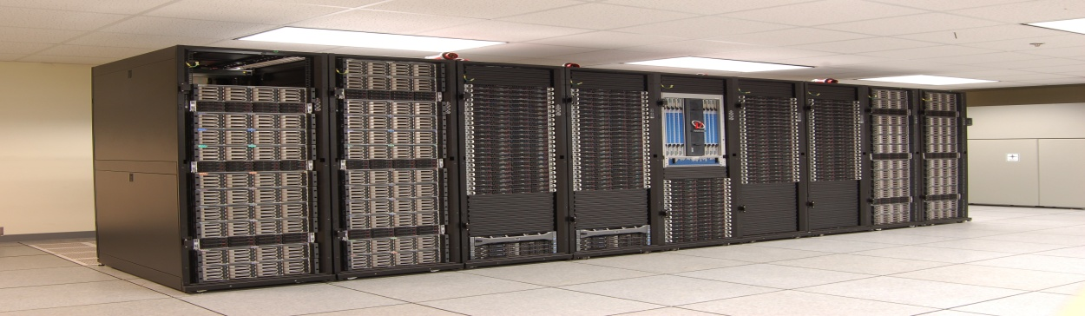
Status of CESD Recovery Act Projects
Atmospheric Radiation Measurement (ARM) Climate Research Facility - $60M
  Project nearly complete.
  99% of planned instruments available and in use.
  Wanda Ferrell
Environmental Molecular Sciences Laboratory (EMSL) - $60M
  Project nearly complete.
  All 36 experimental systems available and in use.
  Paul Bayer
Integrated Assessment Research Program - $4.9M
  Project complete.
  Mid-size cluster (Evergreen) supporting research.
  Bob Vallario
CESD Update
Department of Energy • Office of Science • Biological and Environmental Research

Slide 8
Science updates
High latitude: RASM, NGEE, …
Land surface: Carbon, Nitrogen, Water
Atmosphere: clouds, aerosols, ppt, dynamics
Modeling: physics, visualization, dynamics
Subsurface
EMSL
8 BERAC Sep 2011
Department of Energy • Office of Science • Biological and Environmental Research

Slide 9
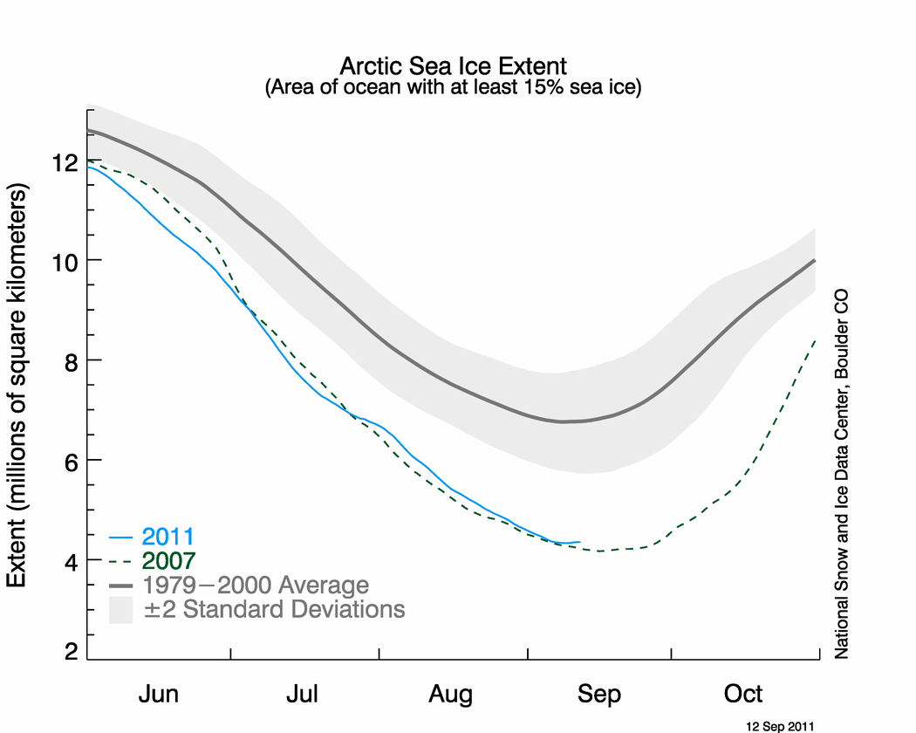
Arctic Sea Ice Extent – summer 2011
Area of ocean with at least 15% sea ice

Slide 10
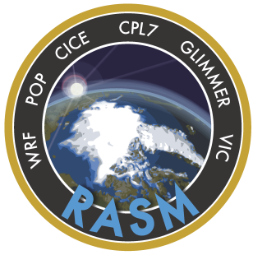
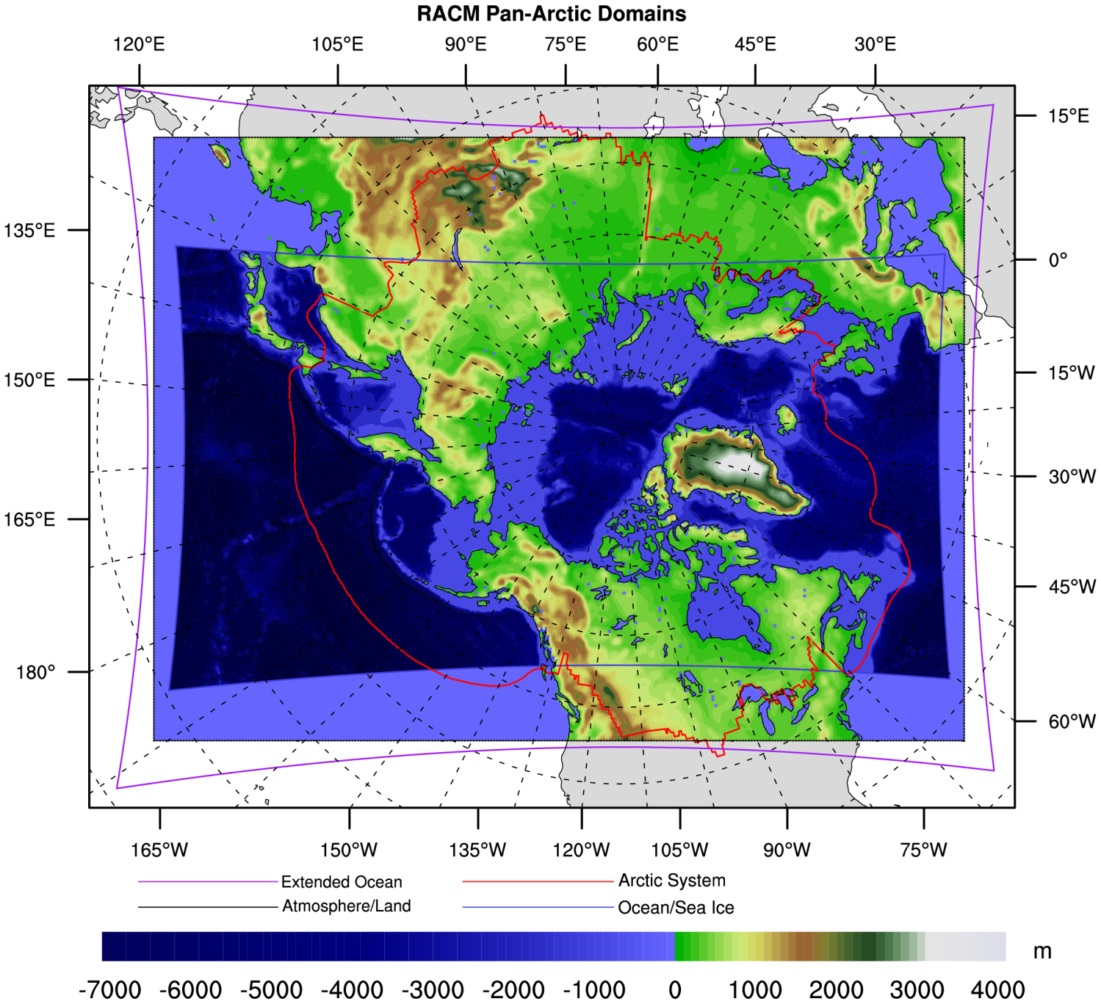
Regional Arctic System Model (RASM)
A 4-year (2011-2015) project funded through the NSF-DOE-USDA joint solicitation “Decadal and Regional Climate Prediction Using Earth System Models”
Develop a state-of-the-art Regional Arctic System Model (RASM)
To simulate regional features that cannot be done in Global Model
Facilitate focused regional studies of the Arctic climate
Improve representation of local physical processes & feedbacks (e.g. forcing & deformation of sea ice)
Minimize uncertainties and improve predictions of climate change in the pan-Arctic region
Atmosphere - Polar WRF (≤50km) -
Land Hydrology – VIC (same as WRF)
Ocean - LANL/POP (gridcell ≤10km)
Sea Ice - LANL/CICE (same as POP)
Flux Coupler – NCAR CPL7
Dynamic Vegetation – VIC(4.1.1) &CLM(4.0)
Dynamic Ice Sheet – Glimmer-CISM with Glacier and Ice Caps (GIC)
Notes:
The purpose of this slide is to indicate : 1) we do a joint solicitations with other agencies – We are currently working on the next EaSM solicitation 2) This is primarily a effort – indicates diversity 3) It is a good project that will provide and indicate processes that need special attention in the global models

Slide 11
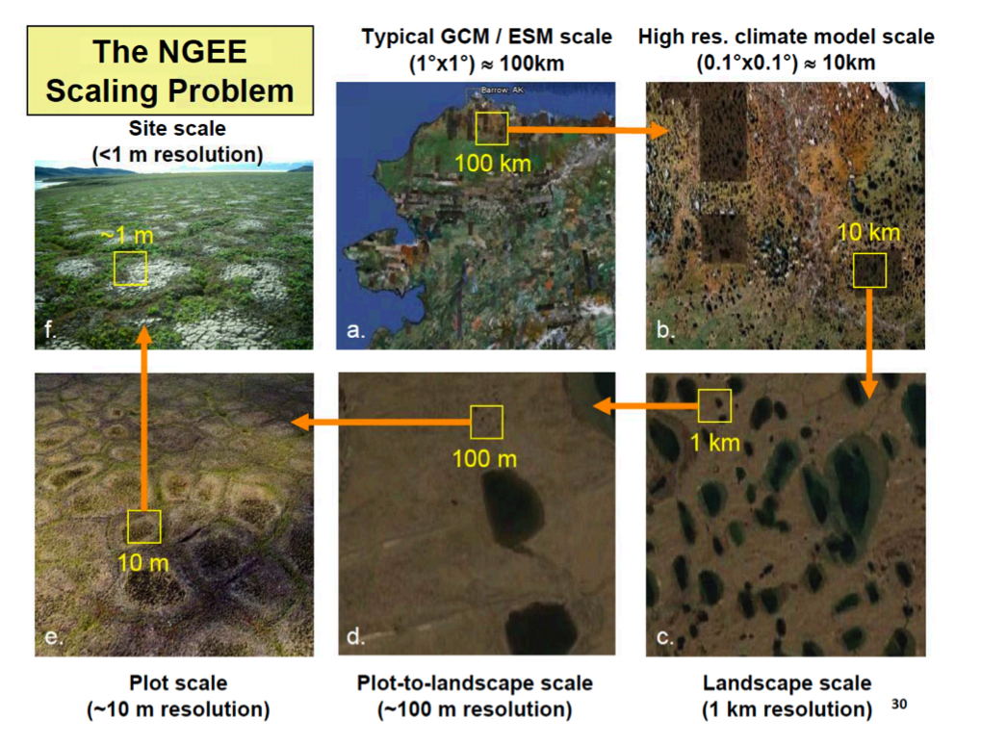
Challenges of Scale

Slide 12

NGEE-Arctic - Status
A 3-year, Phase I proposal was accepted (with revisions pending) last month for funding in FY-12
A mid-term review will be conducted in approximately 18 months
The result will include science advances as well as a peer-reviewable proposal for Phase II (currently envisioned as 10 years)
Approach
  Collaborative effort among DOE National Laboratories and universities, led by Oak Ridge National Laboratory
  Opportunities for leveraging through external collaboration (DOE and other agencies)
  Collaborative opportunities will be an emphasis for NGEE

Slide 13
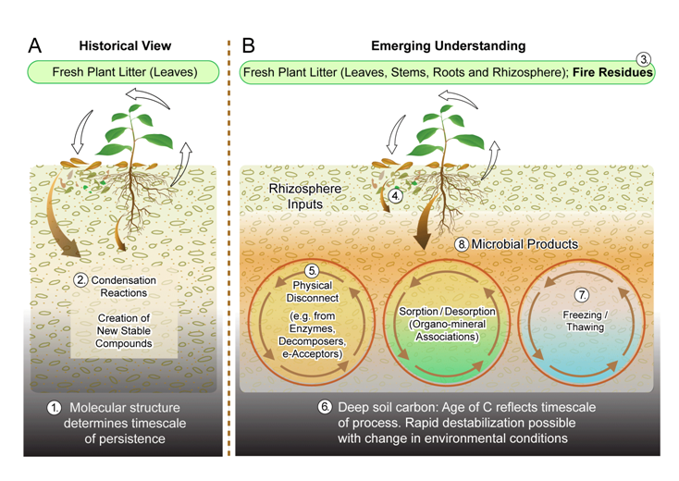
Soil Carbon Not as Protected as Previously Thought
Traditional view of soil carbon suggested that large fractions exist as complex (and thus recalcitrant) macromolecules
Recent analytical advances dispute this assumption suggesting a need for changes in model assumptions regarding soil carbon
New understanding that persistence of soil organic carbon is more of an ecosystem than a molecular mechanism
Schmidt et al., Persistence of soil organic matter as an ecosystem property, Nature Perspectives, September 2011 (in press)

Slide 14
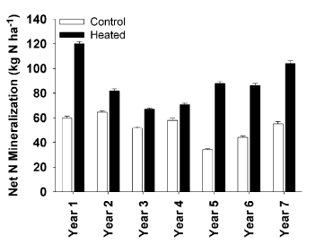
Soil Warming Alters C-N Budgets
A 7-yr, 5⁰C artificial soil warming study at the Harvard Forest site (MA) found increased soil C flux (13 Mg C ha⁻¹) to the atmosphere
This flux declined due to tree uptake of 54% of soil respired C
C gain (7 Mg C ha⁻¹) by trees was due to 45% increase in N mineralization induced by warming
By year 7, C loss was almost compensated by tree C gains
First empirical support of warming-induced redistribution of soil N to plants, altering
C-budgets in N limited forests
Melillo et al., 2011, Carbon-Nitrogen Interactions,
and forest carbon budgets, PNAS

Slide 15
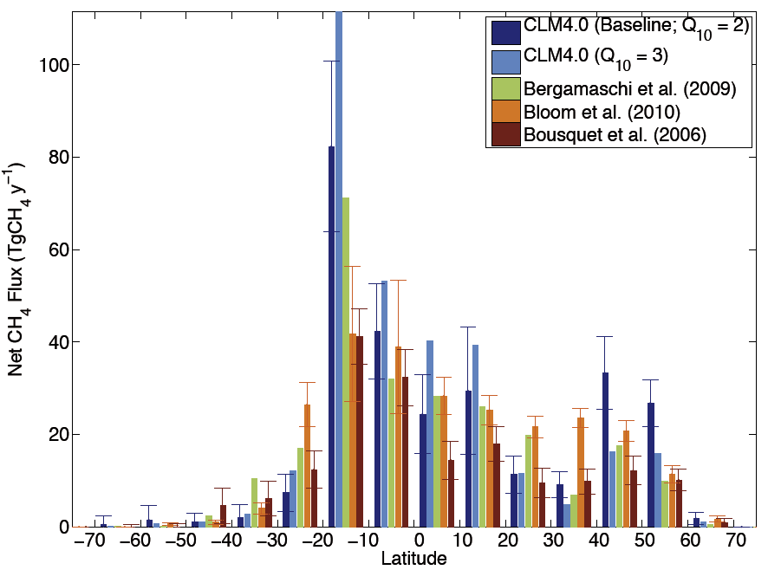
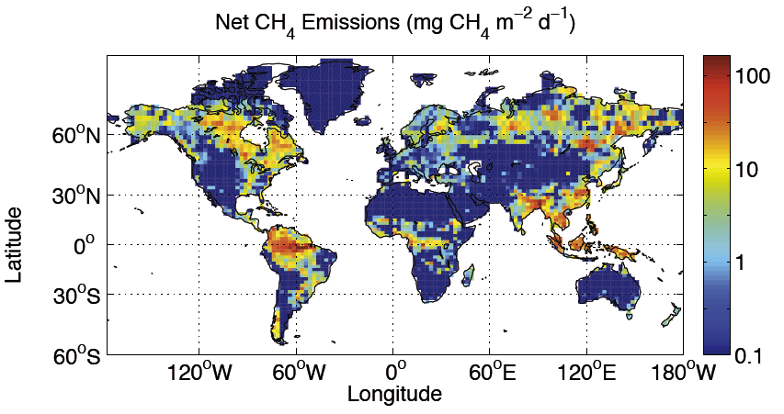
Global Methane Emission Model and Predictions
Terrestrial CH₄ emissions are uncertain, particularly for high-latitude systems.
A new global CH₄ biogeochemistry model (CLM4Me) was developed and tested in CESM to identify uncertainties and predict future CH₄ emissions.
Model CH₄ emissions were compared to site observations and atmospheric inversions
Methane emission is most sensitive to chemistry and temperature effects on its production
In a 21st century simulation, predicted declines in high-latitude inundation may limit increase in CH₄ emissions. However this and other model processes are not well-known or simulated.
CH₄ emissions from CLM4Me and atmospheric inversions.
Predicted current annual-average CH₄ emissions.
Reference: Riley, W. J., Z. M. Subin, D. M. Lawrence, S. C. Swenson, M. S. Torn, L. Meng, N. M. Mahowald, and P. Hess (2011): Barriers to Predicting Changes in Global Terrestrial Methane Fluxes: Analyses Using a Methane Biogeochemistry Model Integrated in CESM. Biogeosciences, 8, Pages: 1925–1953, doi:10.5194/bg-8-1925-2011.

Slide 16
Projections of Future Drought in the Continental United States and Mexico.
Objective: A warmer climate in the future is very likely to lead to major changes in water availability. This study quantifies the ability of climate models to simulate North American agricultural drought conditions and presents a projection of future conditions.
Multi-model projection of PDSI at the end of the 21st century. PDSI<-2 indicates “moderate drought”. PDSI<-3 indicates “severe drought”.
Research: Nineteen climate models were compared to observed 20th century US and Mexico drought statistics using the Palmer Drought Severity Index (PDSI). Model performance and projections were improved by bias correcting temperature and precipitation.
Impact: Due to substantial increases in evapotranspiration, conditions in the US that are currently considered “severe drought” will likely become the normal condition as measured by the Palmer Drought Severity Index. Droughts reminiscent of the 1930s Dust Bowl will be frequent by the end of the 21st century.
Michael Wehner, David R. Easterling, Jay H. Lawrimore, Richard R. Heim Jr., Russell S. Vose, Benjamin Santer (2011) Projections of Future Drought in the Continental United States and Mexico. Journal of Hydrometeorology. doi: 10.1175/2011JHM1351.1
Notes:
Projections of Future Drought in the Continental United States and Mexico.
The abilities of global climate models to reproduce the Palmer Drought Severity Index in North America are investigated in a forthcoming paper in the Journal of Hydrometeorology by BER-sponsored PI Michael Wehner at the Lawrence Berkeley National Laboratory. Co-authors include David Easterling, Jay Lawrimore, Richard Heim Jr., Russell Vose at NOAA’s National Climatic Data Center and Benjamin Santer at Lawrence Livermore National Laboratory. The models vary widely in their ability to simulate drought statistics of the recent past and benefit from a bias correction procedure. Future projections of drought towards the end of the 21st century under the IPCC SRES A1B emissions scenario are severe. The dust bowl conditions of the 1930s would become the normal condition for most of the western US and Mexico in this projection. This dramatic change is attributed to substantial increases in evapotranspiration due to elevated surface temperatures. Even in many regions where precipitation is projected to increase, this measure of drought shows increases in severity because of this effect.
Reference:
Michael Wehner, David R. Easterling, Jay H. Lawrimore, Richard R. Heim Jr., Russell S. Vose, Benjamin Santer (2011) Projections of Future Drought in the Continental United States and Mexico. Journal of Hydrometeorolgy. doi: 10.1175/2011JHM1351.1
Available via early release at http://journals.ametsoc.org/doi/abs/10.1175/2011JHM1351.1

Slide 17
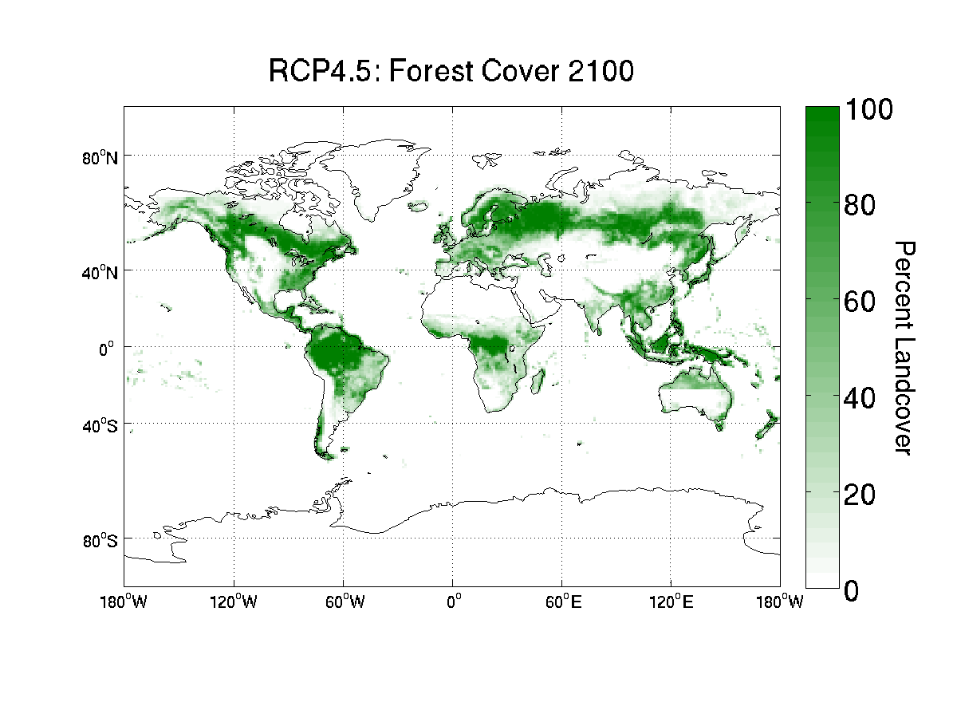
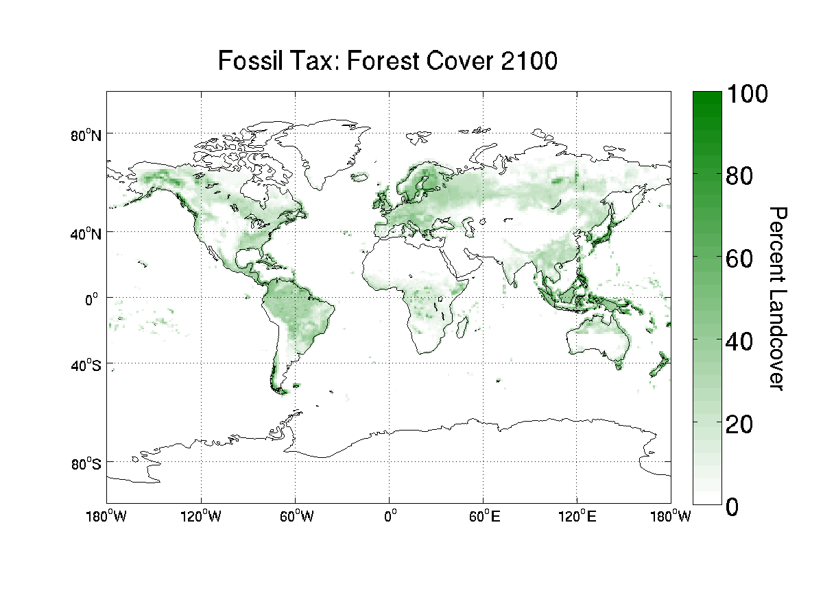
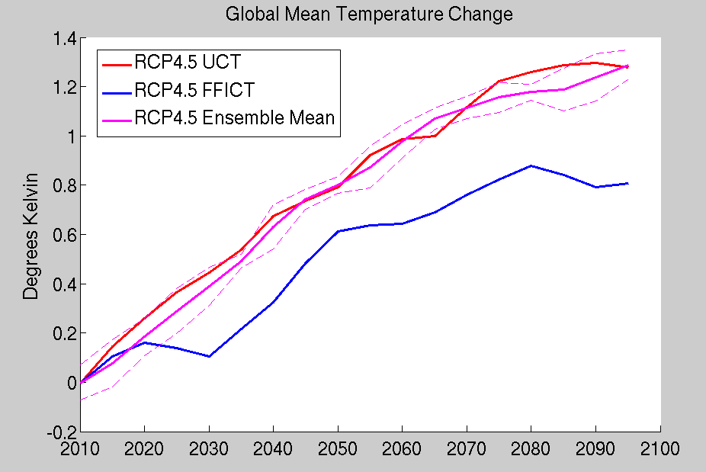
Integrated Assessment News: iESM Preliminary Results
Testing early results from “experiment 0” of an Integrated Earth Systems Model- combining an IA Model with an Earth System Model
Reflects one-way only coupling at this point, without return feedbacks of climate to land-use.
Example illustrates differences in how carbon management strategies can have large, sometimes unpredictable climate impacts when land is considered.
In case where only fossil fuel carbon is valued, shift toward deforestation creates a higher land-surface albedo, resulting in 1 degree cooling compared to the RCP simulation, but both are significantly warmer than the reference case (not shown).

Slide 18
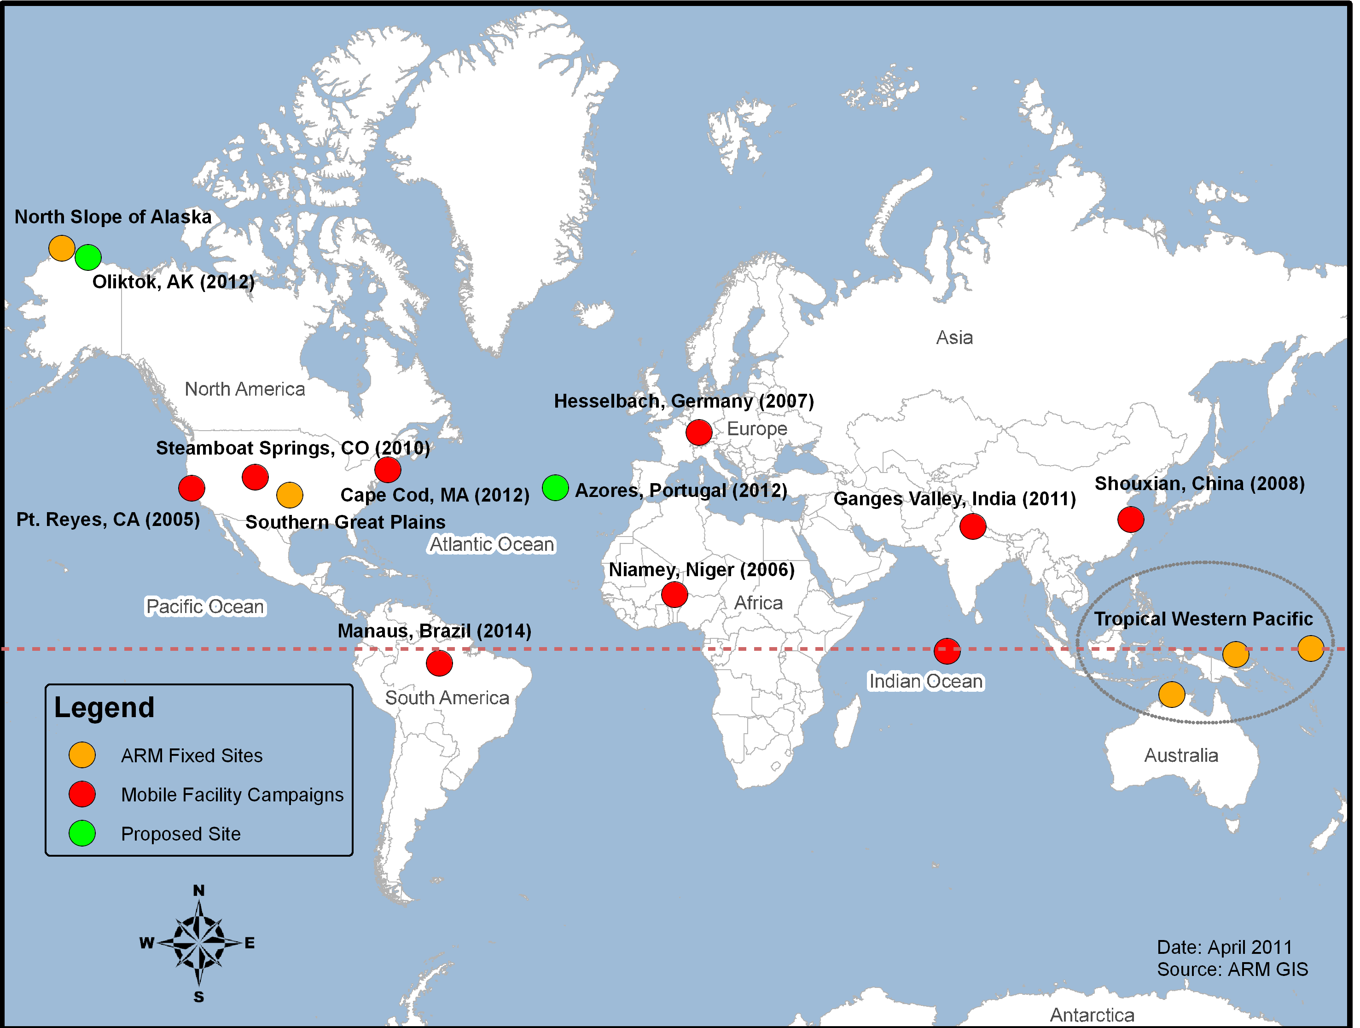

Slide 19

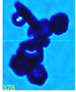


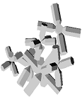
Determining how realistically shaped ice crystals scatter radiation
2. Aggregates of plates
Science Question
Left:
Real image
Right:
Idealized
model
How can the scattering of realistically shaped ice crystals be determined and represented?
Approach
Use high resolution images of ice crystals acquired by state-of-the-art cloud probes installed on aircraft flying through ice clouds
Develop idealized geometries of models resembling ice crystals
Calculate scattering properties of models using geometric ray tracing codes
3. Budding Bucky ball for small ice crystals
Left:
Real image
Right:
Idealized
model
Realistically shaped ice crystals studied
Key Accomplishment
Idealized models of realistic ice crystals were developed and their scattering properties calculated. This will improve the representation of cirrus radiative properties in climate models and in algorithms that retrieve ice cloud properties from ground- and satellite-based remote sensors.
1. Aggregates of bullet rosettes
Left:
Real image
Right:
Idealized
model
Publications
Um and McFarquhar, JAMC (2007), QJRMS (2009), ACP (2011)

Slide 20
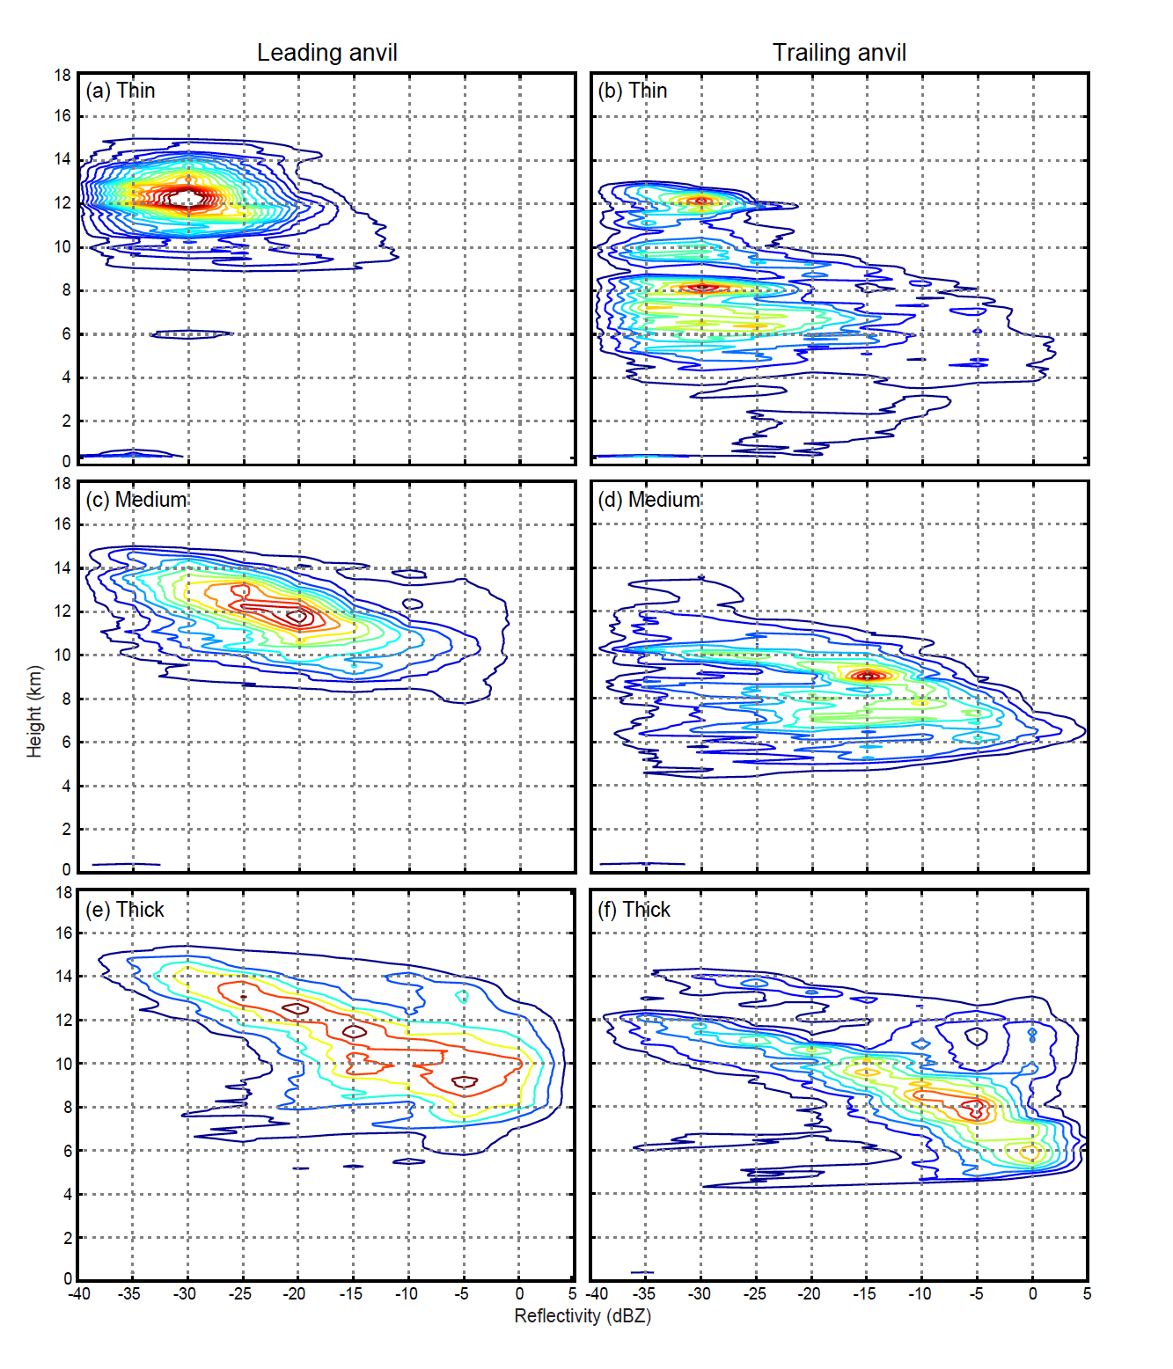
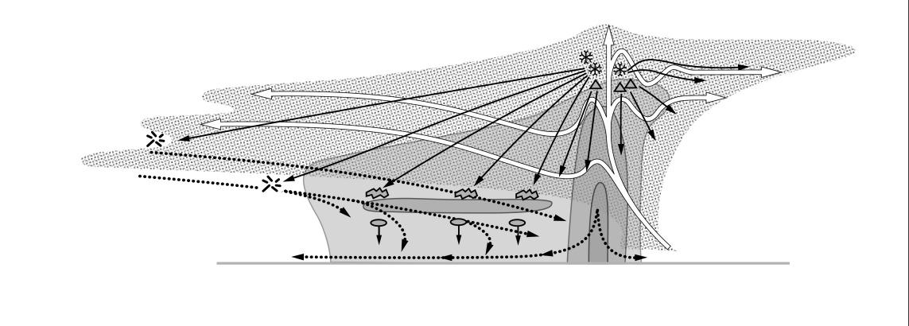

Observations of Anvil Clouds of Tropical Mesoscale Convective Systems
Science Question
Probability distributions of reflectivity in
thin anvils (<2 km deep)
How do tropical mesoscale convective systems, produce the extensive upper-level anvil clouds that dominate cloudiness in the tropics?
Approach
Used vertically pointing ARM cloud radar at Niamey in conjunction with scanning C-band precipitation radar
Used ARM cloud radar to characterize the structure of the anvils of squall-line systems moving over Niamey
Height (km)
Reflectivity (dBZ)
Thin anvils are concentrated at high levels in leading convective anvils & are at lower & more varied altitudes in stratiform anvils
Results for thick anvils (not shown) indicate graupel dominates in leading convective anvils & snow dominates in stratiform anvils
Conceptual Model
Key Accomplishment
Showed microphysical differences between anvils produced directly by convective regions and anvils produced by stratiform regions.
graupel
snow
convective rain
stratiform rain
Cetrone, J., and R. A. Houze, Jr., 2011: Leading and trailing anvil clouds of West African squall lines. J. Atmos. Sci., 68, 1114-1123.
20 BERAC
Department of Energy • Office of Science • Biological and Environmental Research
Notes:
Publication
Cetrone, J., and R. A. Houze, Jr., 2011: Leading and trailing anvil clouds of West African squall lines. J. Atmos. Sci., 68, 1114-1123.

Slide 21
Pollution from China increases cloud droplet number, suppresses rain over the East China Sea
Objective
Significant increase in aerosol loadings over the last 30 years in China due to due increased emissions of its precursors such as SO2 and Nox may affect winter clouds and precipitation over the East China Sea downwind. This study combined data and modeling to assess such effects.
Winter CDNC (upper) and rain frequency (lower) in the 1980s (left) and 2000s (right)
Research
Satellite derived cloud droplet number concentration (CDNC) and precipitation frequency from ship measurements over the East China Sea were analyzed.
Back trajectory analysis was performed to determine the source regions of the pollution
A regional climate model was used to simulate aerosol effects on clouds and precipitation.
Impact
Data analysis and numerical modeling found that Increasing CDNC and decreasing rain frequency in the East China Sea during winter are related to pollution from the Shanghai‐Nanjing and Jinan industrial areas.
Bennartz, R., J. Fan, J. Rausch, L.R. Leung, and A.K. Heidinger. 2011. “Pollution From China Increases Cloud Droplet Number, Suppresses Rain Over the East China Sea.” Geophys. Res. Lett., 38, L09704, doi:10.1029/2011GL047235
Notes:
Rapid economic growth over the last 30 years in China has led to a significant increase in aerosol loading, which is mainly due to the increased emissions of its precursors such as SO2 and NOx. Here it is shown that these changes significantly affect wintertime clouds and precipitation over the East China Sea downwind of major emission sources. Satellite observations show an increase of cloud droplet number concentration from less than 200 cm−3 in the 1980s to more than 300 cm−3 in 2005. In the same time period, precipitation frequency reported by voluntary ship observers was reduced from more than 30% to less than 20% of the time.
A back trajectory analysis showed the pollution in the investigation area to originate from the Shanghai‐Nanjing and Jinan industrial areas. A model sensitivity study was performed, isolating the effects of changes in emissions of the aerosol precursors SO2 and NOx on clouds and precipitation using a state‐of‐the‐art mesocale model including chemistry and aerosol indirect effects. Similar changes in cloud droplet number concentration over the East China Sea were obtained when the current industrial emissions in China were reduced to the 1980s levels. Simulated changes in precipitation were somewhat smaller than the observed changes but still significant

Slide 22
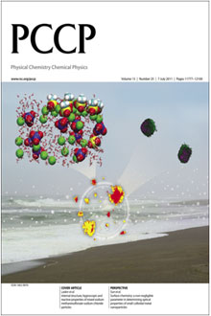
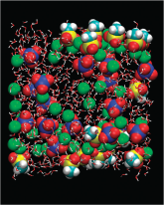
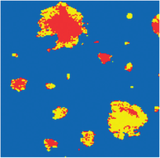
Experimentation and Simulation Used to Understand the Surfactant Properties of Sea Salt Particles
Particle structure influences reactivity
Objective
Understand the influence of anthropogenic oxidants on sea salt aerosols.
New Science
Unlike the surface of aqueous (deliquesced) sea salt particles, dry (effloresced) particles have a coating that changes the ability of the particle to absorb moisture.
Changes in the sea salt particles occur at two specific relative humidities.
Chemical imaging of sea salt, PCCP, July 7, 2011
Significance
Depending on the chemical composition of sea salt aerosols, select anthropogenic oxidants can cause these particles to absorb atmospheric moisture, which can influence Earth’s radiative balance.
The findings required a team approach involving scientists from the University of Southern California, the Czech Republic Academy of Sciences, LBNL, and EMSL who made use of multiple experimental techniques (SEM, TOF-SIMS, synchrotron-based x-ray microspectroscopy), and molecular dynamics simulation.
Liu, Y et al. 2011, “Internal Structure, Hygroscopic and Reactive Properties of Mixed Sodium Methanesulfonate-Sodium Chloride Particles.” PCCP 13: `11846-11857.
CESD Update
Department of Energy • Office of Science • Biological and Environmental Research

Slide 23
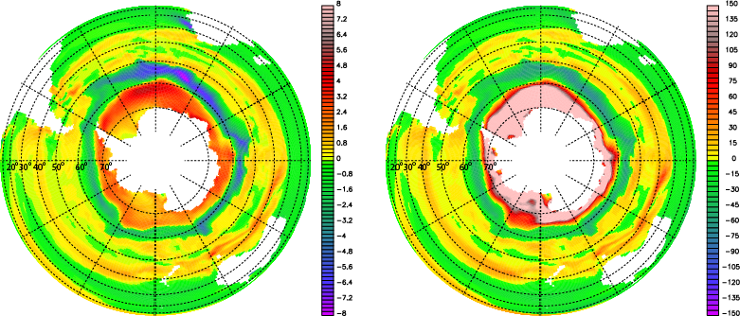
Climate warming enhances Dimethyl Sulfide (DMS): more sulfate cools South
Coupled ocean biogeochemical Community Earth System Model: climate warming from 2000 to 2100, DMS increases 200% around Antarctica due to ocean temperature change and sea-ice loss.
Increased DMS will increase atmospheric sulfate and clouds to cool the South.
2000 to 2100 change in DMS flux:
abs increase nmol/m²/s (left) , percentage increase (right)
Poleward shift in DMS emission by 2100.
DMS more sensitive to climate change than previously thought.
Potential for important local CLAW/Gaia climate feedbacks.
Highlighted in Nature Geosciences News & Views.
Reference: Cameron-Smith, P., S. Elliott, M. Maltrud, D. Erickson, and O. Wingenter (2011), Changes in dimethyl sulfide oceanic distribution due to climate change, Geophys. Res. Lett., 38, L07704, doi:10.1029/2011GL047069.
Notes:
Contact: Philip Cameron-Smith, pjc@llnl.gov
Published paper: http://www.agu.org/journals/gl/gl1107/2011GL047069/

Slide 24
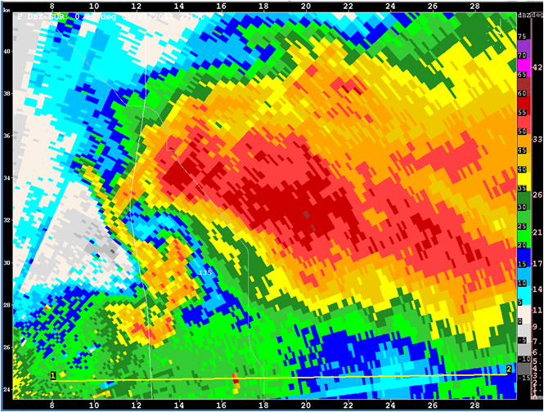
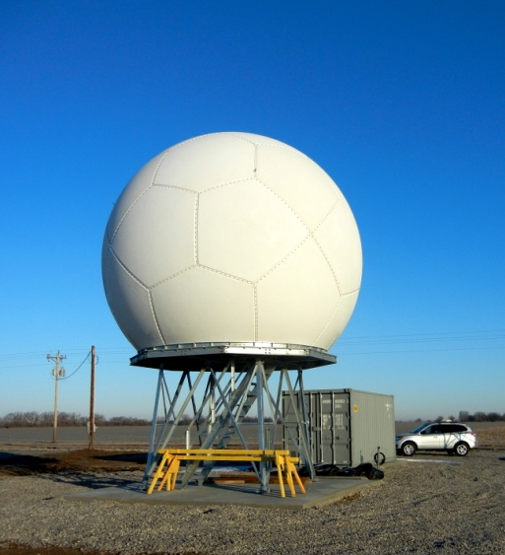
Joint ARM/NASA Campaign
Midlatitude Continental Convective Clouds Experiment (MC3E), a joint DOE and NASA field campaign, took place from 22 April – 6 June 2001 at the ARM Southern Great Plains site
Coordinated surface (particularly radar and radiosonde), aircraft (ER-2 and UND Citation) and satellite observations
First detailed observations from many of the new Recovery Act instrumentation
Hook echo (tornado signature) observed by the new ARM C-band radar on 23 May 2011.
Key Accomplishment
The collection of an important multi-platform, multi-agency dataset over a variety of conditions that will be useful for improving the representation of convective clouds in large-scale models.
24 BERAC
Department of Energy • Office of Science • Biological and Environmental Research
Notes:
C band shown in lower right hand corner

Slide 25
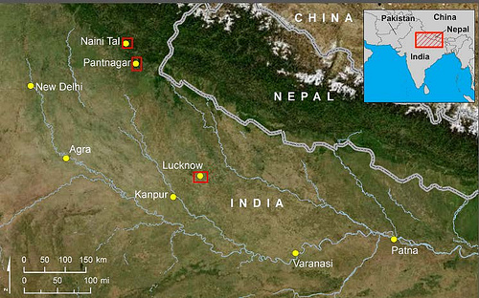
AMF - Ganges Valley Aerosol Experiment (GVAX)
Objective - obtain measurements of clouds, precipitation, and complex aerosols to study their impact on cloud formation and monsoon activity in the region.
AMF: June 2011 – March 2012
Aerosol measurement sites: January – March 2012
AMF in Naini Tal
Mobile Aerosol Observing System in Lucknow
Additional aerosol measurements In Pantanagar
25 BERAC
Department of Energy • Office of Science • Biological and Environmental Research
25 BER BSSD
Department of Energy • Office of Science • Biological and Environmental Research
25 BER BSSD
Department of Energy • Office of Science • Biological and Environmental Research

Slide 26
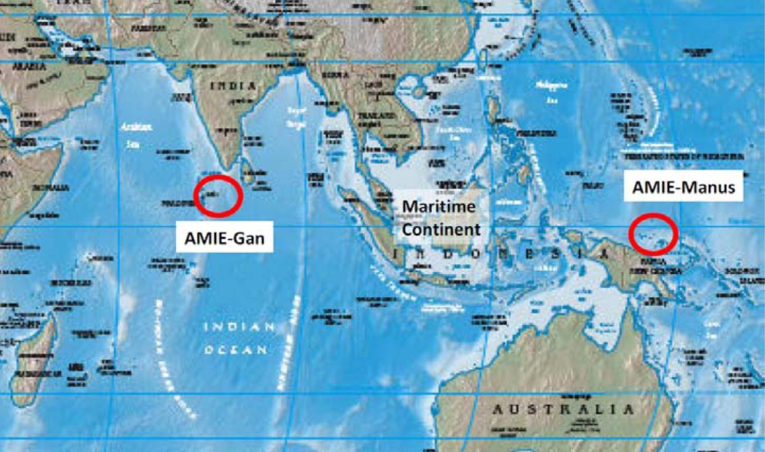
ARM / AMF / TWP - DYNAMO
Objective: understand dynamics of the Madden-Julian Oscillation.
Sites: AMF on In October 2011, the second mobile facility begins operations on Gan for the interagency, international campaign, DYNAMO for study of Madden Julian Oscillation. A companion experiment will be conducted in Manus.
Sponsoring Organizations:
National Science Foundation
Department of Energy
Office of Naval Research
National Oceanic and Atmospheric Administration
National Aeronautics and Space Administration
26 BERAC
Department of Energy • Office of Science • Biological and Environmental Research
26 BER BSSD
Department of Energy • Office of Science • Biological and Environmental Research
26 BER BSSD
Department of Energy • Office of Science • Biological and Environmental Research

Slide 27
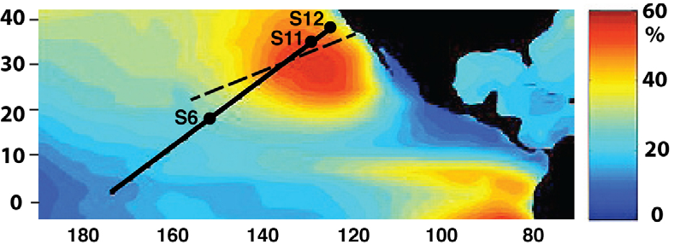
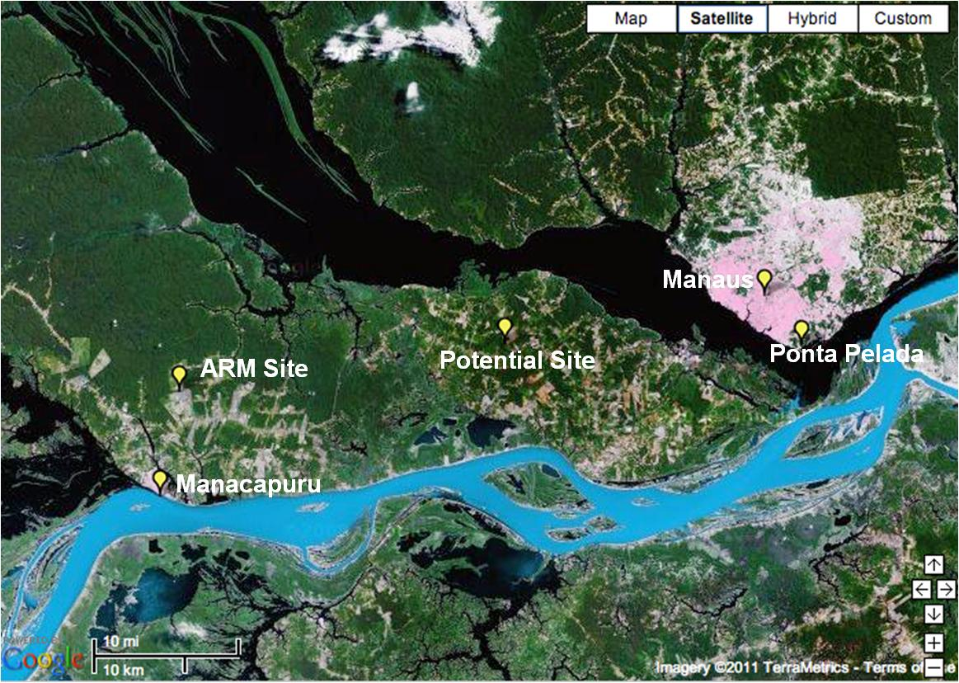
ARM Climate Research Facility
Future Campaigns (Land, air & sea)
Cape Cod. The mobile facility and G-1. Objective: investigate aerosol indirect effect (June 2012-May 2013)
Pacific transects (LA to HNL). Mobile facility on cargo ship
Objective: to understand and parameterize clouds and precipitation, aerosols, and radiation and the interactions among them.
October 2012 – Sept 2013)
GOAmazon. Mobile Facility.
Objective: examine coupling of land and atmosphere in tropics.
(Jan1-Dec 31, 2014)
27 BERAC
Department of Energy • Office of Science • Biological and Environmental Research
27 BER BSSD
Department of Energy • Office of Science • Biological and Environmental Research
27 BER BSSD
Department of Energy • Office of Science • Biological and Environmental Research

Slide 28

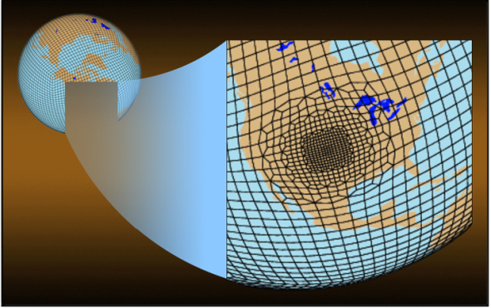
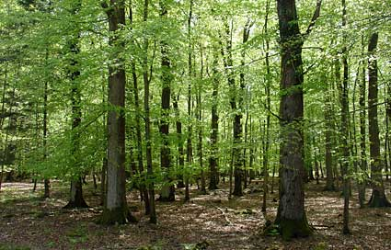
Climate Science for a Sustainable Energy Future
Cross-cutting Themes and Labs to advance CESM
to address high priority DOE climate research
8 Labs:
ANL
BNL
LANL
LBNL
LLNL
ORNL
PNNL
SNL
3 Science Themes:
Numerics
Testbeds
Uncertainty Quantification
3 Components:
Atmosphere
Land
Ocean and Sea-Ice
3 Research Directions:
Hydrologic simulation improvement
Variable-resolution numerical methods
Carbon cycle uncertainty reduction

Slide 29
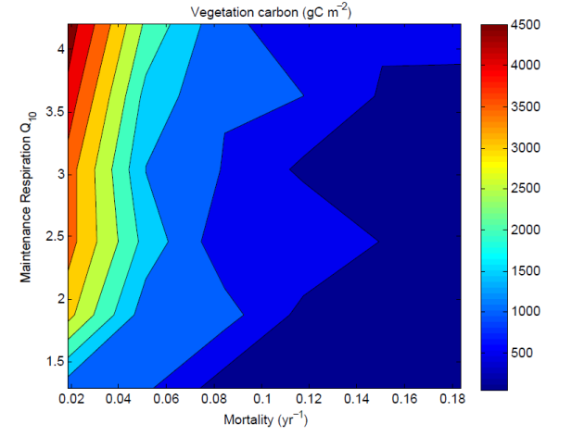
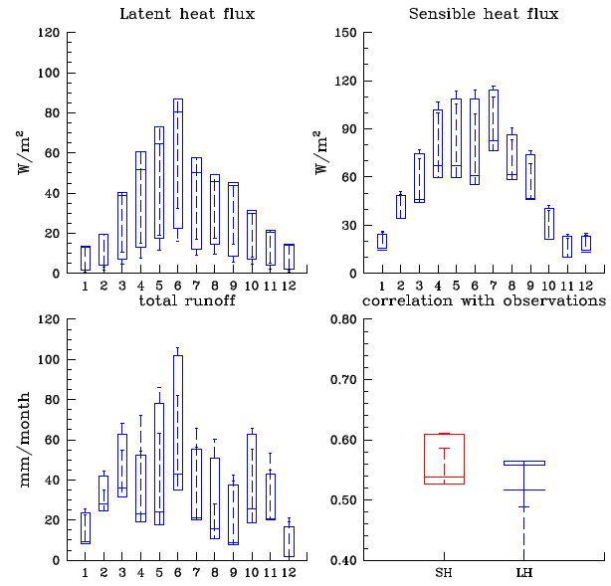
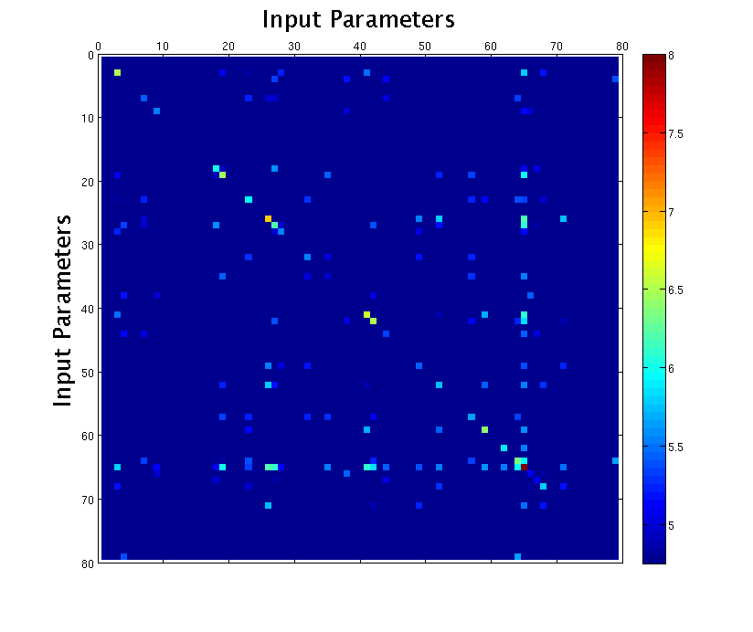
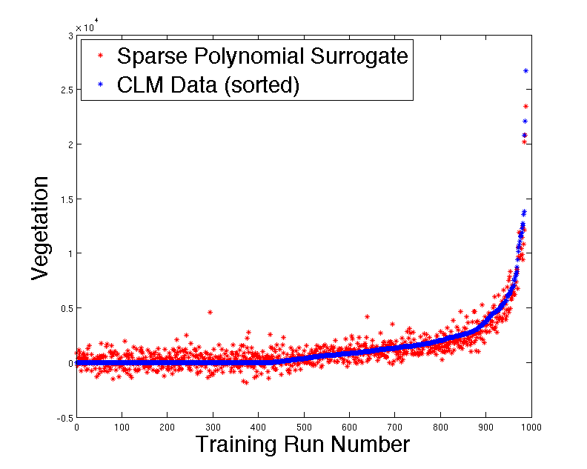
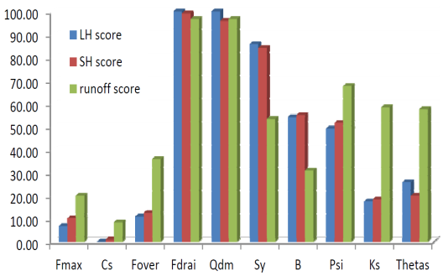
CSSEF: Early result
Land Carbon cycle UQ
Uncertainty Quantification
Land
Land Hydrology UQ
Initial simulations: multi-parameter perturbations
(~1000 runs, uniform parameter distributions)
Results at ARM-SGP
Latent heat flux
Sensible heat flux
Bayesian compressive sensing
(reduced number of linear and interaction terms)
Sparse polynomial surrogate model
Runoff
Surface fluxes and runoff are very sensitive to model parameters at ARM-SGP
Sparse quadrature parameter sampling
(~300 runs, targeted parameter distribution)
Refined coefficients for surrogate model
Larger sensitivity to parameters of subsurface processes
Application of surrogate model for rapid assessment of input/output uncertainty
Vegetation C (gC m⁻²)

Slide 30
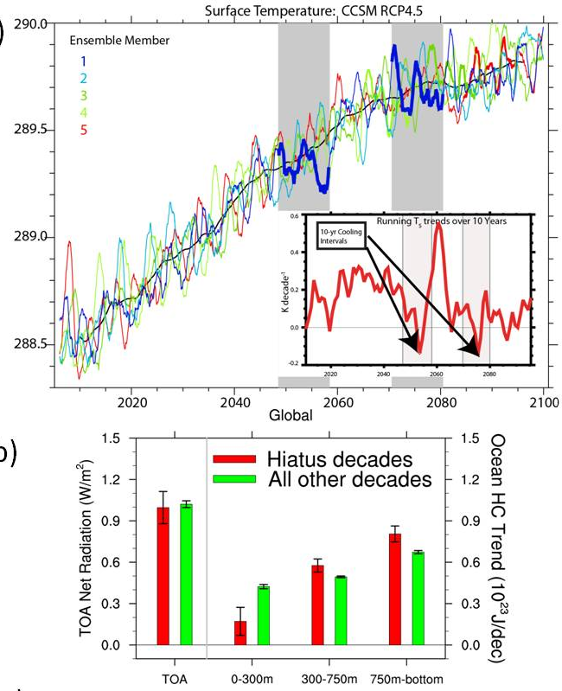
Where does heat go when the surface temperature trend is flat?
Objective: Examine Hiatus periods in climate models when the observed surface air temperature trend shows little increase such as the recent 2000-2009 period
Approach: * Analyzed ensemble of future climate simulations with CCSM4 with the RCP4.5 scenario and pick eight hiatus periods (top panel) with a net excess of energy (about 1 Wm⁻² ) retained by the climate system.
* This excess energy does not warm surface temperatures or significantly warm the upper ocean, but mostly goes into the deep ocean (larger red bars than green bars at right of middle panel).
Impact: A hiatus period is consistent with our physical picture of how the climate system works, and does not invalidate our basic understanding of greenhouse-gas-induced warming or the models used to simulate such warming.
UCAR Cooperative Agreement
Meehl, G.A., J.M. Arblaster, J.T. Fasullo, A. Hu, and K.E. Trenberth, 2011: Model-based estimates of deep-ocean heat uptake during surface-temperature hiatus periods. Nature Climate Change, doi:10.1038/NCLIMATE1229.
Notes:
Embargoed article:
Where heat goes when the surface temperature trend is flat: There have been decades, such as 2000 to 2009, when the observed globally averaged surface temperature time series shows little or even slightly negative trend (a hiatus period). However, the observed energy imbalance at the top-of-atmosphere for this recent decade indicates that a net energy flux into the climate system of about 1 Wm⁻² should be producing warming somewhere in the system. In a recent paper, BER-funded scientists at the National Center for Atmospheric Research analyzed 21st century climate model simulations which maintain a consistent radiative imbalance at the top-of-atmosphere of about 1 Wm⁻² as observed for the past decade. Eight decades with a slightly negative global mean surface temperature trend show the ocean above 300m takes up significantly less heat while the ocean below 300 m takes up significantly more compared to non-hiatus decades. The model provides a plausible depiction of processes in the climate system causing the hiatus periods, and indicates that a hiatus period is a relatively common climate phenomenon and may be linked to La Niña-like conditions. Thus, a hiatus period is consistent with our physical picture of how the climate system works, and does not invalidate our basic understanding of greenhouse-gas-induced warming or the models used to simulate such warming.
Reference: Meehl, G.A., J.M. Arblaster, J.T. Fasullo, A. Hu, and K.E. Trenberth, 2011: Model-based estimates of deep-ocean heat uptake during surface-temperature hiatus periods. Nature Climate Change, doi:10.1038/NCLIMATE1229.
When you discuss this slide, note- This is part of the UCAR cooperative agreement- a very productive group – has more than 30 publications in FY11 – Results are from the latest model CCSM4.

Slide 31
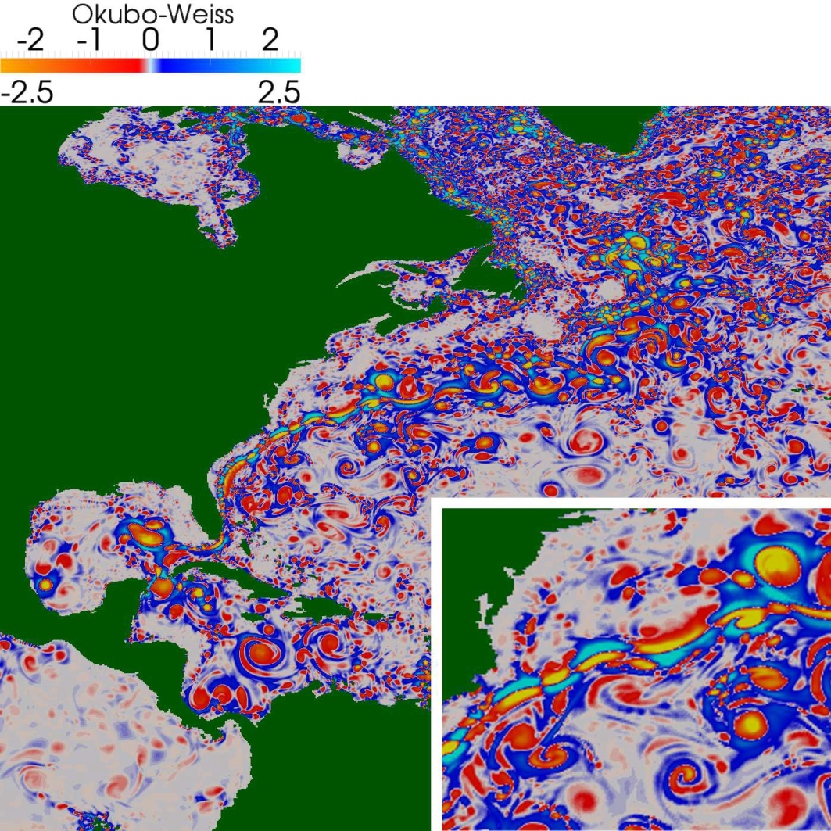
Higher resolution, scale interactions, HPC
Two dimensional surface vortices (Williams, et al., IEEE Symp. on Visualization 2011; DOI: 10.1111/j.1467-8659.2011.01948.x)
S. Williams, M. Hecht, M. Petersen, R. Strelitz, M. Maltrud, J. Ahrens1, M. Hlawitschka, and B. Hamann
)

Slide 32
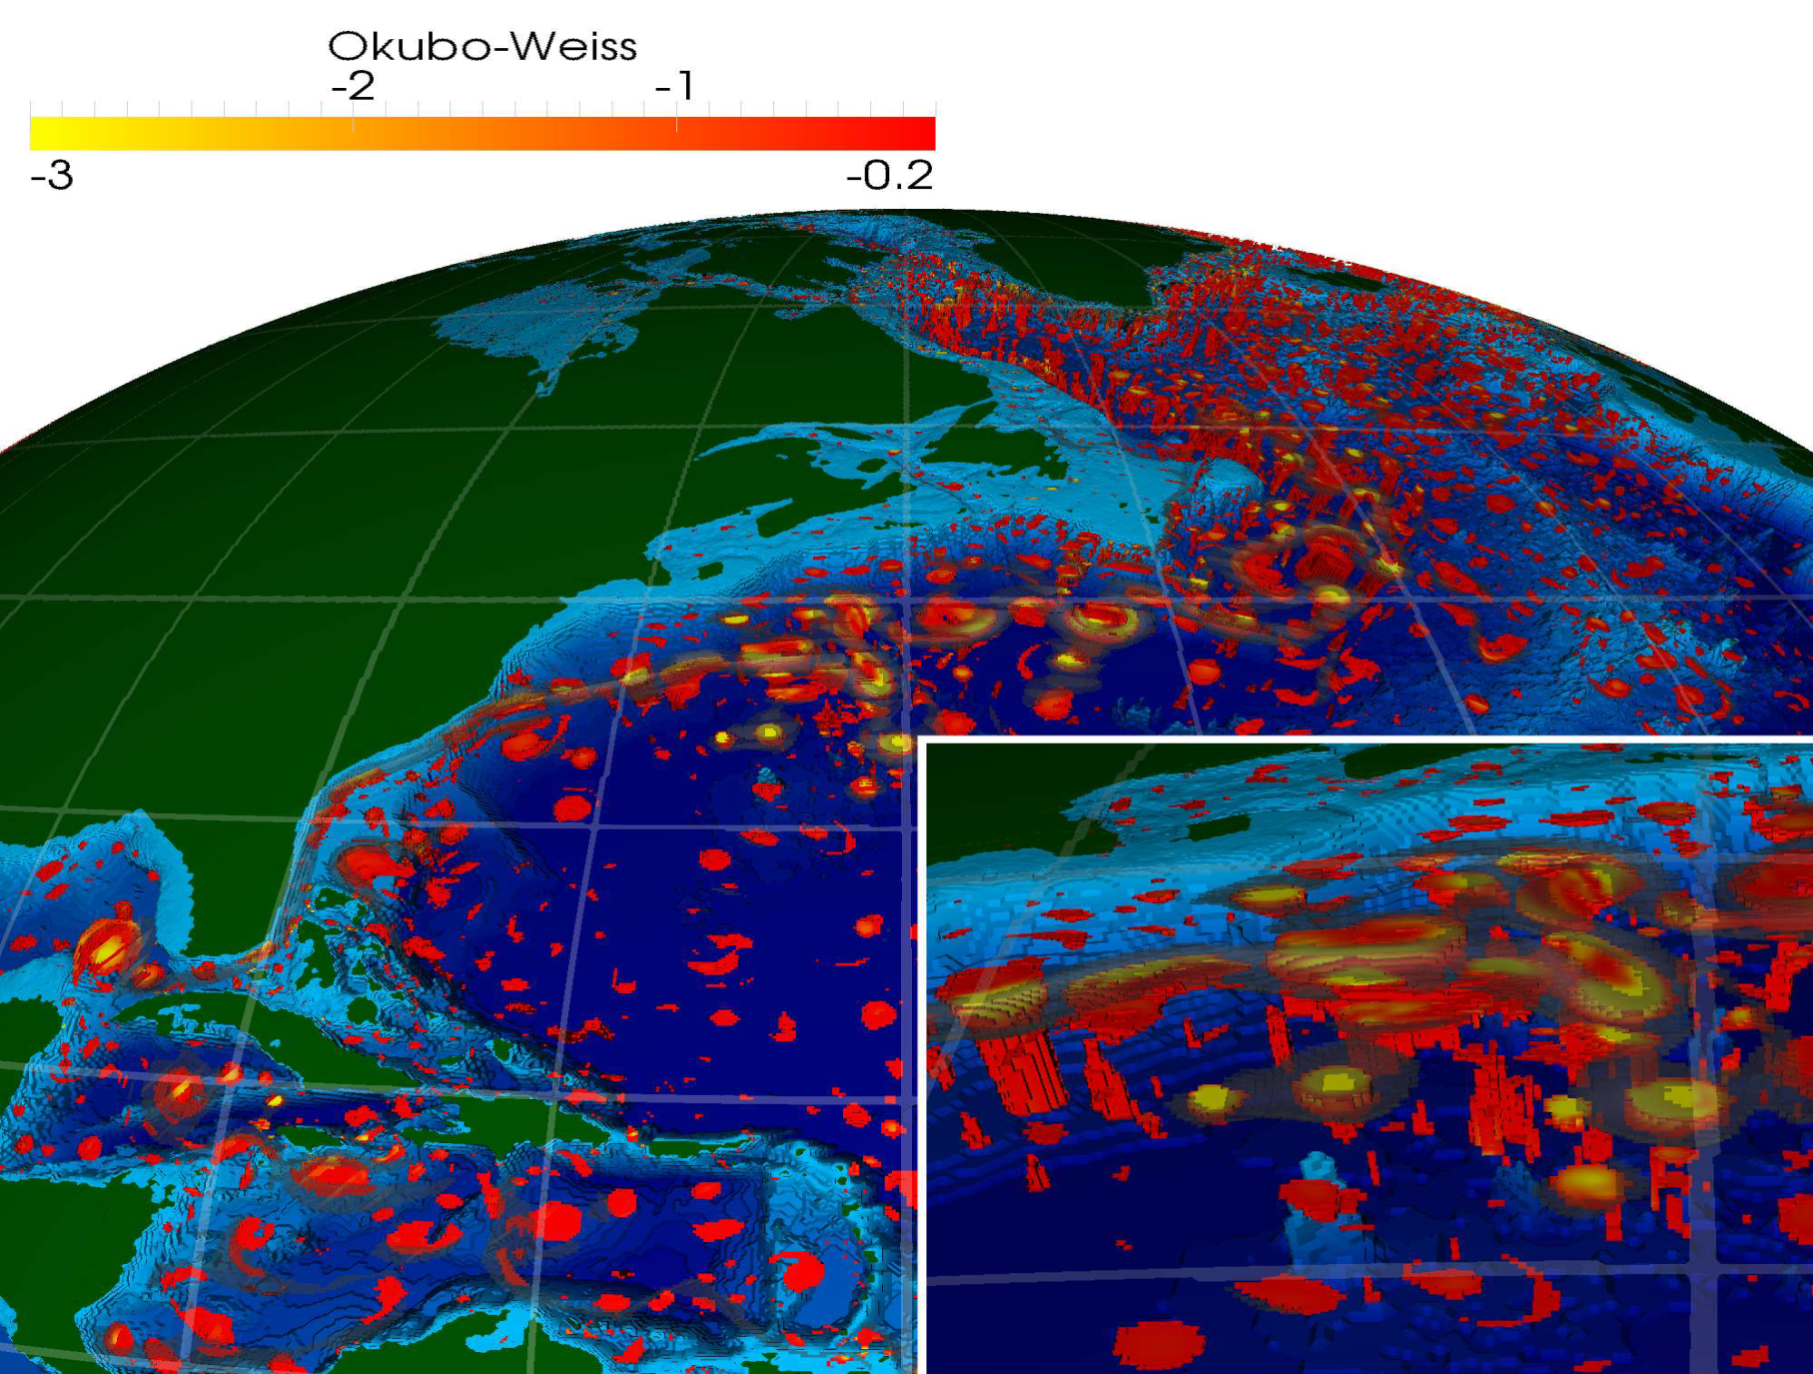
Higher resolution, scale interactions, HPC:
Larger 3D eddies at depth (Williams, et al., 2011)

Slide 33
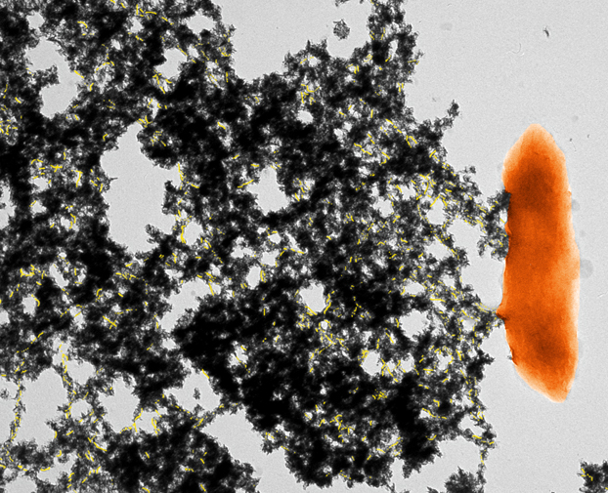
New Insights into Microbial Metal Reduction
Nanowires, conductive pili and conduits
Objective
Understand electron transport processes in dissimilatory metal-reducing bacteria.
New Science
Protein structures (pili) composed of amino acids behave like metal conductors.
Pili structures facilitate extracellular reduction of toxic metals such as uranium.
Multi-heme cytochromes facilitate electron transfer in outer cell membranes.
Significance
New insights from three manuscripts demonstrate how metal-reducing bacteria transport electrons from the oxidation of electron donors in the cell interior to the cell exterior to reduce iron oxide minerals and/or contaminants such as uranium. The results inform efforts to simulate, predict and/or control the activity of bacteria in the environment.
Pili with reduced uranium and G. sulfurreducens. Cologgi and Reguera (MSU)
Cologgi, DL, et. al. (2011) “Extracellular reduction of uranium via Geobacter conductive pili as a protective cellular mechanism”, PNAS ; published online September 6, 2011, doi:10.1073/pnas.1108616108 .
Malvankar, NS, et. al. (2011), “Tunable metallic-like conductivity in microbial nanowire networks,” Nature Nanotechnology, 6:573–579.
Clarke, TA et. al., (2011) “Structure of a bacterial cell surface decaheme electron conduit,” PNAS, 108 (23):9384-9389
33 SBR Highlight
Department of Energy • Office of Science • Biological and Environmental Research

Slide 34
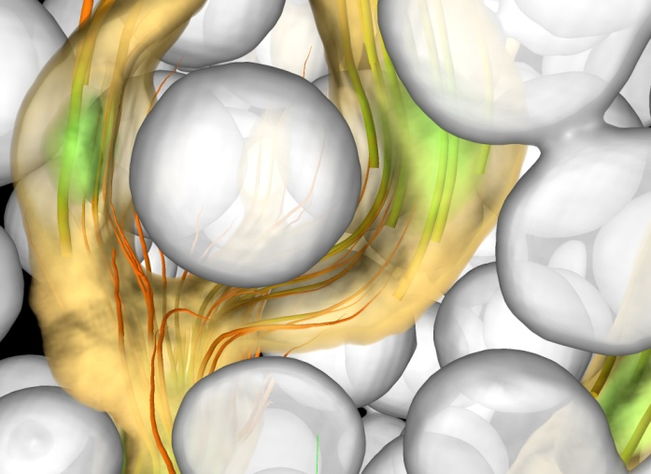
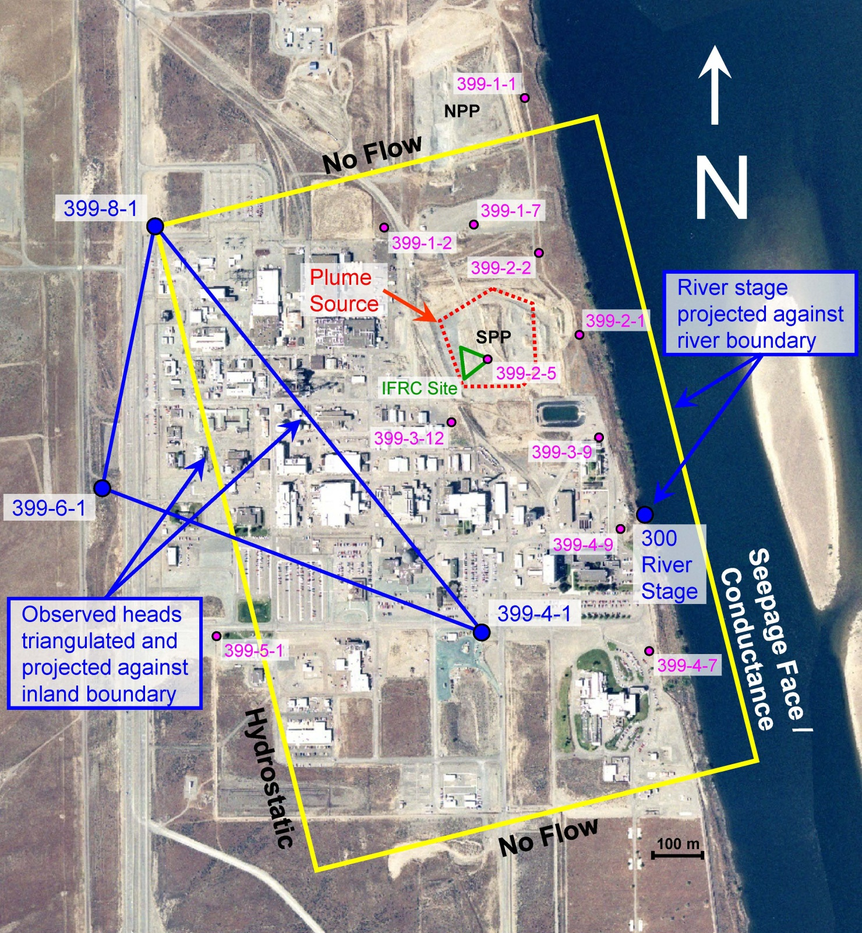
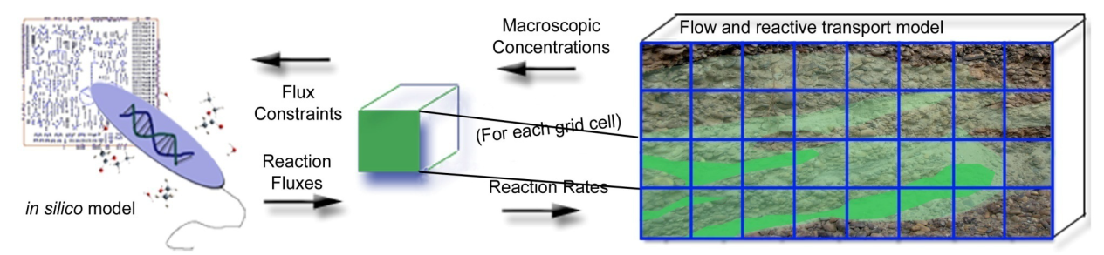
HPC Modeling of Coupled Biogeochemical Processes in Subsurface Systems
Models enable robust testing of understanding across scales
Pore-scale fluid flow computed using the parallel Smoothed Particle Hydrodynamics code Scheibe et al
Incorporating microbial metabolic models into reactive transport codes
Scheibe et al
PFLOTRAN modeling of the Hanford 300 Area
- 100 year simulations of uramium reactive transport.
Lichtner et al.
SciDAC Project Title: Hybrid Numerical Methods for Multiscale Simulations of Subsurface Biogeochemical Processes
PI: Timothy D. Scheibe (Pacific Northwest National Laboratory); Five Year Project: 2006 to 2011 (20 publications)
SciDAC Project Title: Modeling Multiscale-Multiphase-Multicomponent Subsurface Reactive Flows using Advanced Computing
PI: Peter C. Lichtner (Los Alamos National Laboratory); Five Year Project: 2006 to 2011 (13 publications)
The Subsurface Biogeochemical Research Program plans to release a SciDAC solicitation this year for 2012 funding.
Notes:
The major challenge for developing a robust predictive understanding of complex subsurface systems is characterizing and modeling the relevant processes that span from molecular to field (km) scales. The HPC models and approaches that have been developed through these two five-year SciDAC projects, led by Tim Scheibe at PNNL and Peter Lichtner at LANL, have significantly advanced our ability to incorporate coupled physical, chemical and biological processes into reactive transport models and to use these models to guide experimentation and observation from laboratory to field scales. The SBR program intends to issue a new SciDAC notice for FY12 funding this year.
SciDAC Project Title: Modeling Multiscale-Multiphase-Multicomponent Subsurface Reactive Flows using Advanced Computing
PI: Peter C. Lichtner (Los Alamos National Laboratory); Five Year Project: 2006 to 2011 (13 publications)
Developed the petascale code PFLOTRAN to model reactive transport using multiscale methodologies. These enhanced modeling capabilities have been used to model uranium fate and transport at the plume scale at the Hanford 300 Area. The EM funded ASCEM project has incorporated many aspects of PFLOTRAN in its architecture.
SciDAC Project Title: Hybrid Numerical Methods for Multiscale Simulations of Subsurface Biogeochemical Processes
PI: Timothy D. Scheibe (Pacific Northwest National Laboratory); Five Year Project: 2006 to 2011 (20 publications)
Biogeochemical reactions occurring at very small scales often control the subsurface mobility of contaminant metals and radionuclides but are poorly simulated at the field scale. Hybrid modeling methodologies adapted for use on high performance computers that address issues of scale will be developed and evaluated against benchmark data to provide more accurate descriptions of subsurface processes controlling the mobility of contaminants at DOE facilities.

Slide 35
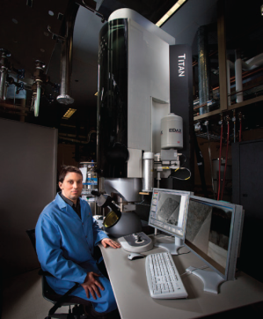

Recent and Upcoming Activities at EMSL
2011 Meetings and Workshops
Pore Scale Modeling Workshop (Aug 9-10, 2011) - Research needs for colloid and contaminant transport.
User Meeting focused on Microscopy (Sept 13-14, 2011) – Parallel sessions, posters and tutorial.
Triennial Science and Operations Review of EMSL
October 17-19, 2011, on-site.
New Instrumentation Arriving Fall /Winter 2011
Environmental TEM, NanoSIMS
High Resolution and Mass Accuracy Capability (HRMAC) Development Project
Development of a transformational mass spectrometry capability with unparalleled resolution and mass accuracy (110mm bore superconducting magnet and unique mass spectrometry system)
For biofuels and bioproducts characterization, aerosol particle characterization, proteomics, and microbial community analyses.
$17.5M Total Project Cost - Available 2015.
CESD Update
Department of Energy • Office of Science • Biological and Environmental Research

Slide 36
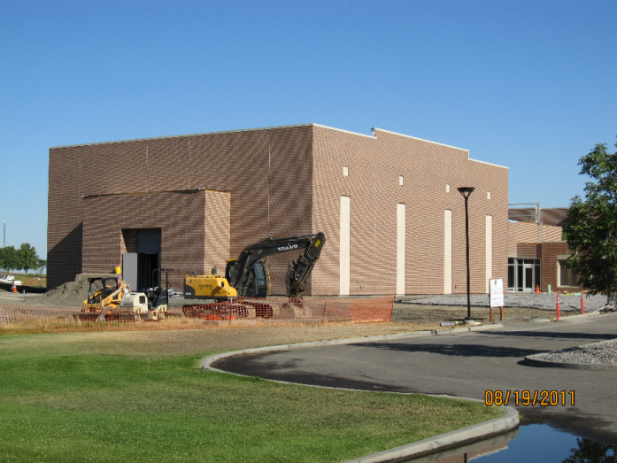



EMSL “Quiet Wing” Near Completion
Lab space for ultra-sensitive scientific research
Quiet Wing Need
Ultra-high resolution imaging instruments require extremely low electromagnetic field and vibrational interference as well as high temperature stability.
Science Enabled
S/TEM, Environmental TEM, Helium Ion Microscope, Ultra High Vacuum Low and Variable Temp Scanning Probe Microscopes.
Sub-Ångstrom resolution at 1-10 second exposure times.
Infrastructure Advances
Three-foot thick isolation slabs for each lab cell.
Two-inch thick foam barrier in the floor separates each lab cell from everything else.
Significance
Featured in September 2011 issue of Microscopy Today.
Lea, S, et. al. 2011 “Quietly Building Capabilities: New Instruments, Expertise, “Quiet Wing” Available at DOE User Facility.” Microscopy Today, 19(5): 48–53.
CESD Update
Department of Energy • Office of Science • Biological and Environmental Research

Slide 37
Next steps
Strategic plan, with specifics
Major projects that integrate across division
Concrete science and capability targets to guide investments
Serious player in USGCRP

Slide 38
Thank you!
38 BERAC Sep 2011
Department of Energy • Office of Science • Biological and Environmental Research

