Slide 1
Roland F. Hirsch
Biological Systems Science Division
Workshop:
Applications of new DOE National User Facilities in Biology
Biological and Environmental Research Advisory Committee Meeting
October 6, 2011
Rockville, MD

Slide 2
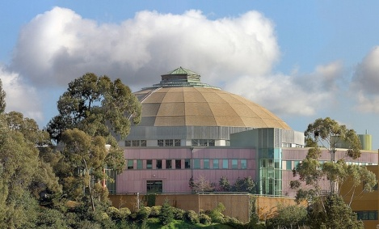
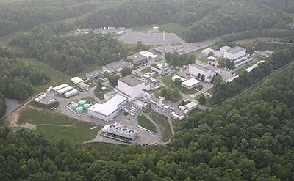
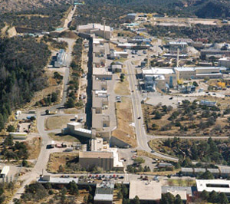
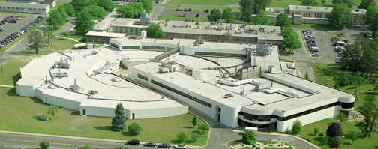
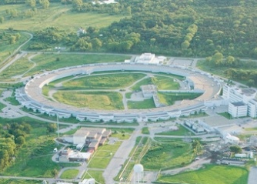
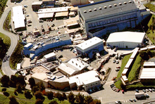
The BER structural biology activity
Supports access to DOE synchrotron light sources and neutron facilities by the biological research community
Funds development of new beamline technologies and their implementation
Began in 1990 when construction was initiated for the Advanced Light Source and Advanced Photon Source, and major improvements were underway at other facilities
BERAC subcommittees provided input with reports in 1992, 1995, 1997, 1998 and 2003
The experimental stations envisioned in 1990 are operational
Clockwise from lower left:
Advanced Photon Source (Argonne)
Advanced Light Source (Berkeley)
High Flux Isotope Reactor (Oak Ridge)
Los Alamos Neutron Science Center
National Synchrotron Light Source (Brookhaven)
Stanford Synchrotron Radiation Lightsource (SLAC)

Slide 3
New facilities
Now a new group of DOE-SC national user facilities have just been opened or are being constructed or planned
  Advanced Photon Source Upgrade (being planned at Argonne National Laboratory)
  Linac Coherent Light Source (phase I operating; Phase II being planned at SLAC National Accelerator Laboratory)
  National Synchrotron Light Source II (under construction at Brookhaven National Laboratory)
  Next Generation Light Source (being planned by the Berkeley Lab)
  Spallation Neutron Source (operating, with planning underway for expansion at Oak Ridge National Laboratory)
BER is considering the role it should play in ensuring that the biological community can take advantage of the new capabilities offered by these facilities
Several meetings and workshops focusing on one or another of the new facilities have been held jointly with other agencies, such as NIH, NSF and NIST, involving leaders in the biological sciences
BER decided to hold a workshop that would look at all of the facilities in a coordinated way

Slide 4
Purpose of the Workshop
Identify capabilities with potential for high impact in life sciences at the five new and planned DOE national user facilities
Identify major needs in biology for advanced facility-based instrumentation beyond what already exists and what the five new facilities currently plan to offer

Slide 5
Workshop plan
January 2011: Recruited scientists with expertise in biophysics and technologies for biology, as well as specialists in the major BER biological research fields (a list is on the next slide)
March 2011: The laboratories hosting the facilities submitted two ten-page papers, one on the facility capabilities and one on potential applications in biology
May 2011: The panel met to discuss the facilities and develop a report on them. Each laboratory sent a delegation that met with the panel for ~75 minutes. At the end of the meeting working groups were set up to prepare chapters on each facility.
June–September 2011: The facility chapters were prepared and discussed, and the papers from the laboratories were edited for inclusion in the report
September–November 2011: The report is being prepared
December 2011: The report is expected to be available

Slide 6
Members of the panel
David Eisenberg, University of California, Los Angeles (co-chair)
Dagmar Ringe, Brandeis University (co-chair)
J. Kent Blasie, University of Pennsylvania
Valérie Copié, Montana State University
Jennifer DuBois, University of Notre Dame
Joachim Frank, Columbia University
James Fredrickson, Pacific Northwest National Laboratory
Petra Fromme, Arizona State University
Sol Gruner, Cornell University
Janos Hajdu, Uppsala University
Steve Harrison, Harvard University*
Ken Keegstra, Michigan State University
Alfonso Mondragon , Northwestern University
Doug Rees, Cal Tech*
Christian Riekel, European Synchrotron Radiation Facility
Clemens Schulze-Briese,Dectris AG
Janet Smith, University of Michigan
Masaki Yamamoto, Spring8
*Did not attend, but assisted in preparing the report.

Slide 7
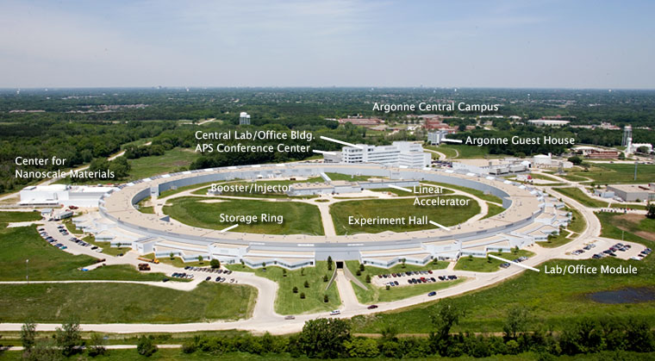
Advanced Photon Source Upgrade
Upgrade will improve operating characteristics of the light source substantially
This will enable significant advances in biologically-important technologies:
  Microfocus macromolecular crystallography of smaller crystals than can be handled by current stations
  X-ray fluorescence microscopy using nano-focussed beams (BioNanoProbe) will seek 20 nm spatial resolution with higher elemental sensitivity than now possible
  A dedicated station for small-angle and wide-angle x-ray scattering will be developed

Slide 8
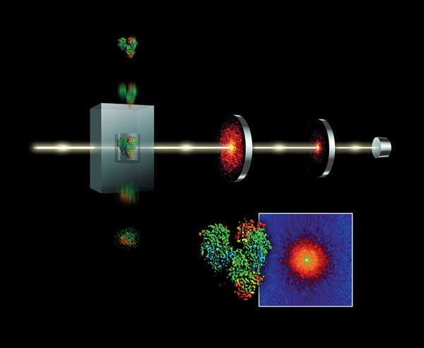
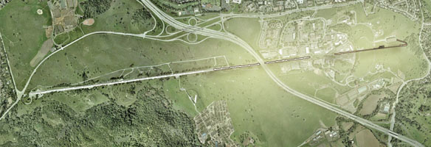
Linac Coherent Light Source
SLAC tunnel and
LCLS experimental stations
X-ray pulses (horizontal) and
sample particles (vertical) at AMO station
Four experimental stations are in operation
X-ray pulses as short as 10 fsec are produced by the x-ray free-electron laser with intensities as high as 10¹² photons/pulse
Atomic, Molecular and Optical Science (AMO) station has produced valuable new results for nanocrystal diffraction structures of proteins and coherent diffraction imaging of shapes of virus particles
Structural information may be obtained without radiation damage to sample
New data analysis methods a major need
Plans being developed for increasing x-ray energy range and peak brilliance of pulses

Slide 9
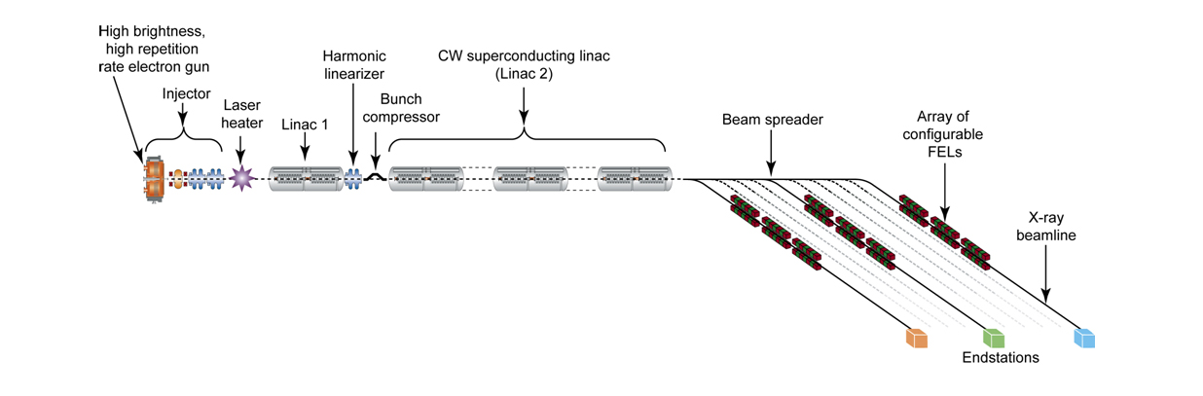
Next Generation Light Source
Schematic diagram of the x-ray laser
Facility is in early stages of planning for commissioning around 2022
Will focus on low energy (“soft”) x-rays as a complement to the LCLS
The ten free-electron lasers will provide ultrafast, high-brightness pulses to experimental stations with high rates of repetition
Overall, the facility as planned will be unlike any other in the world
Rapid imaging of individual biological cells, organelles and molecular machines will be possible in real time

Slide 10
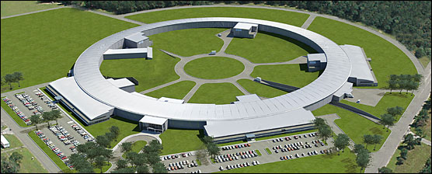
National Synchrotron Light Source II
This facility is under construction with commissioning planned in 2014
The facility will replace the existing NSLS and offer substantial improvements in all characteristics
Beams will be delivered with high brightness from the far infrared to the very hard x-ray region, and with the brightest x-ray beams in the world in the 2–10 keV range
Biological experimental stations are being developed for macromolecular crystallography, x-ray scattering, spectroscopy and imaging
A Biology Village is being designed to bring together scientists across the life sciences in a synergistic environment

Slide 11
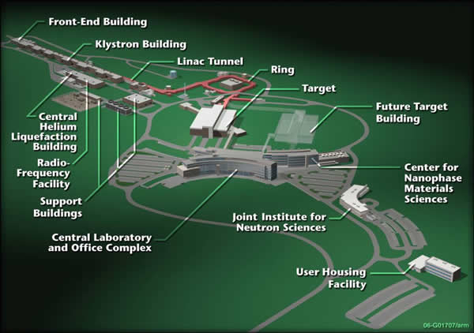
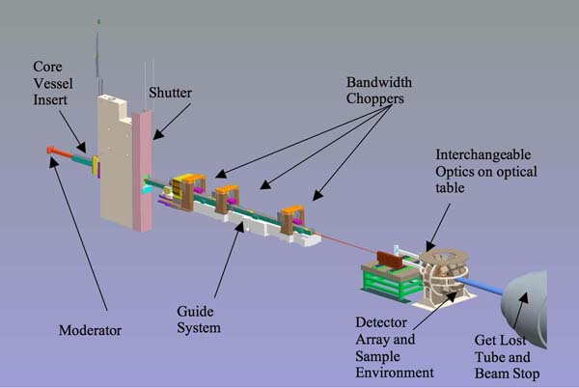
Spallation Neutron Source
MaNDi instrument schematic
Began full operation just over a year ago
Several instruments are either installed or in late stages of development
MaNDi (Macromolecular Neutron Diffractometer) is to be completed by 2013 and will offer unique capabilities for imaging protein structures using sub-millimeter-sized crystals at high resolution (down to 1~.5Å in favorable cases)
A second target is being planned to provide additional capacity as well as specialized instrumentation for biological research

