Slide 1
DOE-BER
Biosystems Design Workshop
Pablo Rabinowicz
Program Manager (IPA)
Biological Systems Science Division

Slide 2

BER Genomic Science Program
The Genomic Science program underpins the development of biotechnology solutions for energy, the environment, and carbon sequestration. The support of fundamental research on microbes and plants emphasizes understanding systems biology across multiple scales of organization from the molecular, cellular, to the community and ecosystem level. The goal is to gain insights about fundamental biological processes and, ultimately, a predictive understanding of how living systems operate, to enable functional design of biological systems for DOE mission needs.
Program Objectives
Determine the genomic properties, molecular and regulatory mechanisms, and resulting functional potential of microbes, plants, and biological communities central to DOE missions.
Develop the experimental capabilities and enabling technologies needed to achieve a genome-based, dynamic system-level understanding of organism and community functions.
Develop the knowledgebase, computational infrastructure, and modeling capabilities to advance the understanding, prediction, and manipulation of biological systems.

Slide 3
BERAC 2010 Long-Term Vision Report
Prioritize research to enable functional characterizations of systems and synthetic design
“By integrating with
computational science, synthetic biology can enable the design and construction of essentially new materials, organisms, pathways, or information processing Systems”

Slide 4
BER Biosystems Design Workshop
July 17-20, 2011
Bethesda North Marriott Hotel
Pablo Rabinowicz, Workshop Organizer
Todd Anderson, Former Acting Division Director, BER-BSSD
Joseph Graber, Program Manager, BER-BSSD
Susan Gregurick, Program Manager, BER-BSSD
Shireen Yousef, Scientific Program Specialist, BER-BSSD
Support from ORISE

Slide 5
BER Biosystems Design Workshop
Genomics and systems biology approaches to study microbes and plants from the molecular to the community scale lead to comprehensive understanding of fundamental biological processes, ultimately allowing us to predict the behavior of a given biological system under changing conditions. Such predictive knowledge will permit the design and re-engineering of biological systems for specific purposes. New biodesign tools and technologies will in turn help understand natural systems and their response to change.
DOE-BER seeks to support biosystems design research aimed at tailoring microbes, plants, and their communities to advance clean energy and environmental solutions
Identify general biological design principles
Develop new synthetic molecular toolkits to design, construct, and test new, multi-scale natural and hybrid biological systems

Slide 6
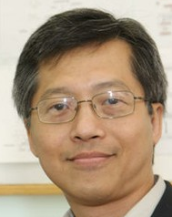

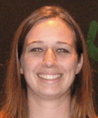
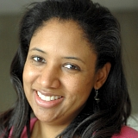
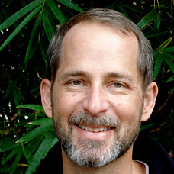
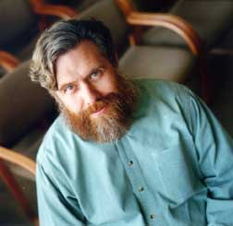
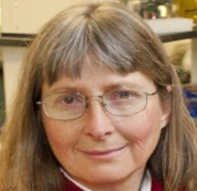
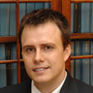

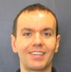

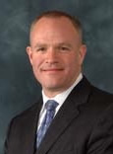
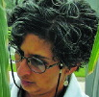
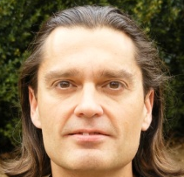
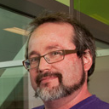
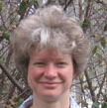
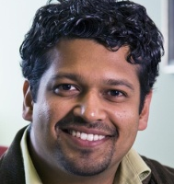
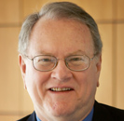

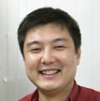



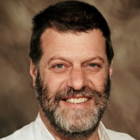


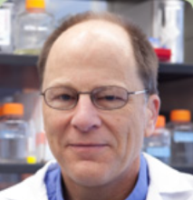



Workshop Participants
Co-Chairs:
James Liao
UCLA
Edward Eisenstein
U. of Maryland
Jennifer Reed
U. of Wisconsin
Kristala Jones-Prather
MIT
Kelly Dawe
U. of Georgia
George Church
Harvard U.
June Medford
Colorado State U.
Maciek Antoniewicz
U. of Delaware
David Gang
Washington State U.
Mattheos Koffas
SUNY Buffalo
Kechun Zhang
U. Minnesota
Jay Keasling
LBNL
Vipula Shukla
Dow Agrosciences
Costas Maranas
Penn State U.
Adam Arkin
LBNL
Sarah Assmann
Penn State U.
Nitin Baliga
Inst. for Systems Biol.
Gary Stacey
U. of Missouri
Ramon Gonzalez
Rice U.
Shota Atsumi
UC Davis
Gary Sayler
U. of Tennessee
Basil Nikolau
Iowa State U.
William Cannon
PNNL
Peter Greenberg
U. of Washington
Christina Smolke
Stanford U.
John Glass
JCVI
Erich Grotewold
Ohio State U.
Scott Banta
Columbia U.
Adam Guss
ORNL
Christoph Benning
Michigan State U.
Chris Henry
ANL

Slide 7
Observers from Other Offices and Federal Agencies
National Science Foundation
National Institutes of Health
U.S. Department of Agriculture
Department of Defense
Defense Advanced Research Projects Agency
Office of Science and Technology Policy
DOE Office of Energy Efficiency and Renewable Energy
DOE Office of Basic Energy Sciences

Slide 8
Workshop Structure
Plenary session
  Speakers (S. Assmann, A. Arkin, G. Church)
Breakout sessions
  Biological Design Principles
  Strategies, Methodologies, and Approaches for the Design of Biological Systems
  Predictive Biology at the System Level
Plenary session
  Breakout Leads’ Presentations
Writing session
  Co-Chairs only

Slide 9
Charge Questions
Breakout Session I: Biological Design Principles
1) What are the fundamental principles and approaches that are needed to enable the facile design of molecules, modules, organisms and communities?
2) What critical information is needed for biological systems (interactions among biological modules and processes, structures, mechanisms) to provide a robust foundation for biological design?
3) What are the biological concepts that must be understood to integrate hierarchical modules to generate more realistic/complex/useful functions of engineered biological systems?

Slide 10
Charge Questions
Breakout Session II: Strategies, Methodologies and Approaches for the Design of Biological Systems
1) What useful models could help establish general approaches for the design of complex biological systems at multiple levels of complexity (microbes; unicellular plant, e.g. algae, cell cultures; bioenergy crops; microbial communities; microbial-plant communities)?
2) What are the key gaps in our knowledge and what technological approaches are needed to design novel biomolecules, microbes, plants, and communities for specific purposes?
3) How can evolutionary processes be harnessed to accomplish forward engineering of biological systems from the gene to the community level?
4) What considerations of evolutionary or ecological dynamics are needed to effectively engineer systems with sustainable functionality?

Slide 11
Charge Questions
Breakout Session II (continued):
5) How can cellular communication modules (intra- and/or inter-species) be used to coordinate and control synthetic systems?
6) What is needed to more fully integrate systems biology approaches to inform biological design principles?
7) What is the role for computational biology in the design of novel biological systems?
8) What computational biology tools are needed to facilitate design of molecules, networks, cells and communities?
9) To what degree is compartmentalization (cellular, organismal, community) important for developing designed biological systems?
10) What critical data is needed to advance the design of biological systems?

Slide 12
Charge Questions
Breakout Session III: Predictive Biology at the System Level
1) What is on the short-, mid- and long-term horizon for biological design that would advance bioenergy, bioremediation and climate change research?
2) What are the basic and applied goals that bio systems research should pursue?
3) What major outcomes could be expected from research on biological design over the next decade?

Slide 13
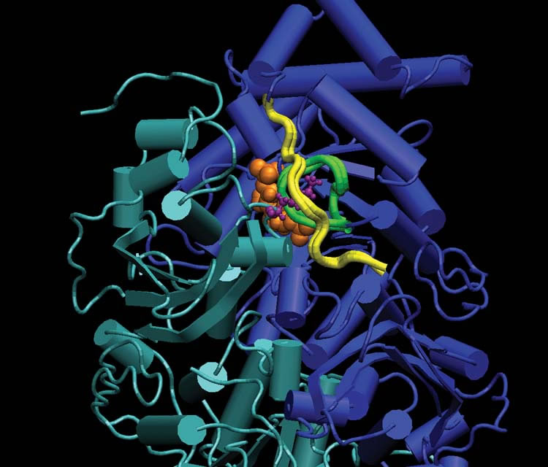
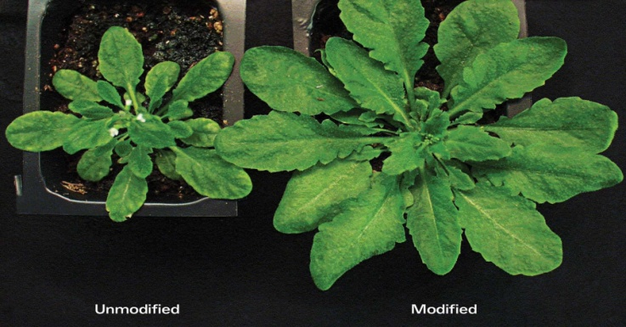
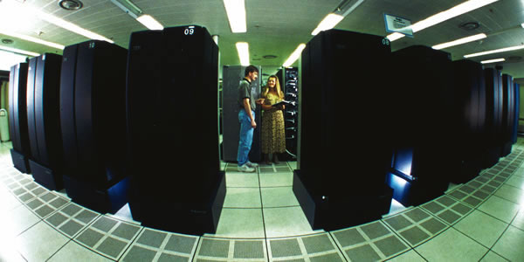
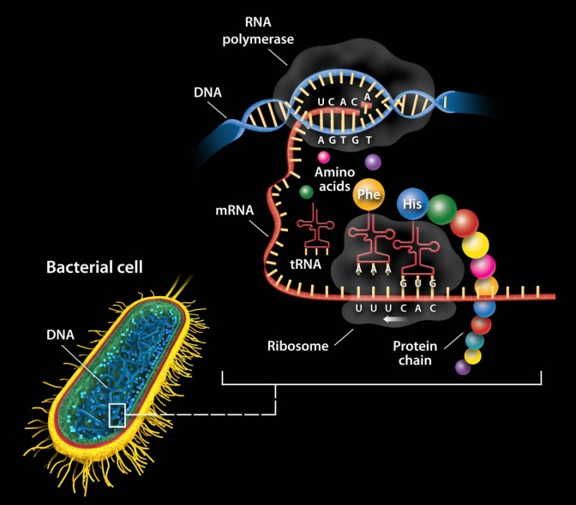
Discussion Topics
Biological Design Principles
  Molecules, modules, organisms, communities
Biological Design Strategies, Methodologies and Approaches
  Design from scratch
  Combine parts and modules
  Model systems
  Computational biology
Future Perspectives
  Systems Biology Knowledgebase
  Sustainability of synthetic systems
T A A
U T T

Slide 14
Thank you

