Slide 1
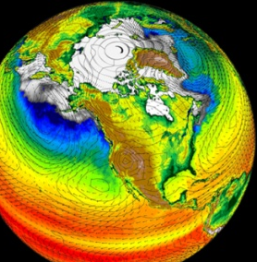
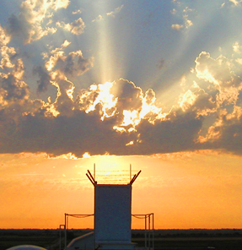
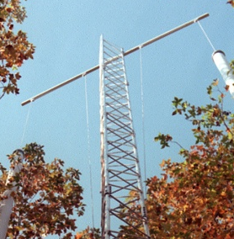



2010 Committee of Visitors (COV) Review of the Climate and Environmental Sciences Division
BER Response
R. Todd Anderson, Ph.D.
Program Manager
Climate and Environmental Sciences Division
March 9, 2011
Office
of Science
Office
of Science
Office of Biological
and Environmental Research
Office of Biological
and Environmental Research

Slide 2
Committee of Visitors (COV) Reviews
BERAC – led review of BER programs (every 3 three years)
Charged by the Director of the Office of Science to assess:
    processes used to solicit, review, recommend and monitor
    proposals for research in Office of Science programs
    the breadth, depth and national/international standing of portfolios
    management and oversight of DOE national user facilities
Review all program and facility management activities FY2007 – FY2009
( 14 Notices to Labs and Universities, >600 unique proposals)
Provided access to all program-related and facility documentation, including previous COV findings
COV Review Findings and Responses
COV Report presented to and approved by BERAC Sept 16, 2010
BER Response submitted to Office of Science Nov 1, 2010
COV Report and BER Response posted to Office of Science website at:
http://www.science.doe.gov/SC-2/COV-BER/BER_Reviews.htm
BERAC Briefing on the BER Response to the COV Report

Slide 3
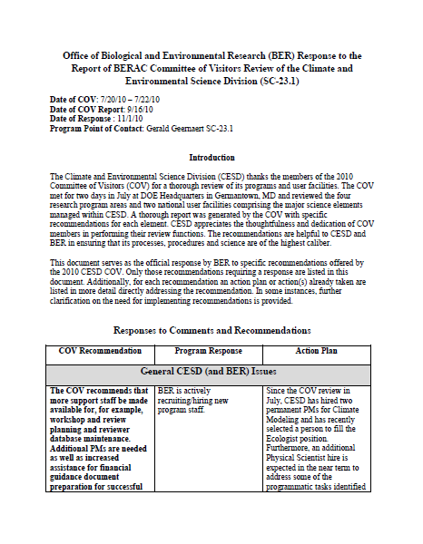
BER Response
COV Recommendation
Program Response
Action Plan
Organized into Sections
General CESD (and BER) Issues
Research Programs
Atmospheric Systems Research
Terrestrial Ecosystem Science/Terrestrial
Carbon Sequestration Research
Subsurface Biogeochemistry Research
Climate Modeling Programs
User Facilities
Atmospheric Radiation Measurement
(ARM) Climate Research Facility (ACRF)
Environmental Molecular Sciences
Laboratory (EMSL)
3 BERAC Mar 2011
Department of Energy • Office of Science • Biological and Environmental Research

Slide 4
General CESD (and BER) Issues
Recommendation: The COV recommends that more support staff be made
available for, for example, workshop and review planning and reviewer database
maintenance. Additional PMs are needed as well as increased assistance for
financial guidance document preparation for successful proposals.
Response: BER is actively recruiting/hiring new Program Staff
Action: New hires in Climate Modeling Programs: Renu Joseph and Dorothy Koch
New hire in Terrestrial Ecosystem Science: Dan Stover
New MS-level Physical Scientist hired : Patrick Horan
Position description for a new program manager in Atmospheric Systems Research
is pending
Recommendation: The COV recommends that more informative statements be included in declination letters.
Response: BER Agrees
Action: BER recently adopted an Office-wide measure to provide a short
summary of program decisions in declination letters to applicants.
This was discussed at the latest BER All Hand’s Meeting on Feb 1, 2011.
4 BERAC Mar 2011
Department of Energy • Office of Science • Biological and Environmental Research

Slide 5
Recommendation: Experience of other agencies, in particular NSF, suggests that the productivity of PMs and support staff can be enhanced by a well designed and maintained electronic grants information system. There appears to be room for improvement in the system in place at DOE.
Response: BER appreciates the finding of the COV.
Action:
Portfolio Analysis and Management System (PAMS)
• Web-based software in use at several Federal agencies including:
– Grants Management Support for DHS/FEMA, HHS/HRSA, Department
of Justice, Treasury
– Contracts and Loans Support for NASA and Overseas Private Investment
Corporation
– SBIR/STTR Support for NASA and DHS Science & Technology Directorate
• Support grants generated by Program Offices, SBIR/STTR, and the
National Labs funding process
• Automates the grant and lab funding processes
• Fully integrated with Grants.gov and STARS, STRIPES, etc
5 BERAC Mar 2011
Department of Energy • Office of Science • Biological and Environmental Research

Slide 6
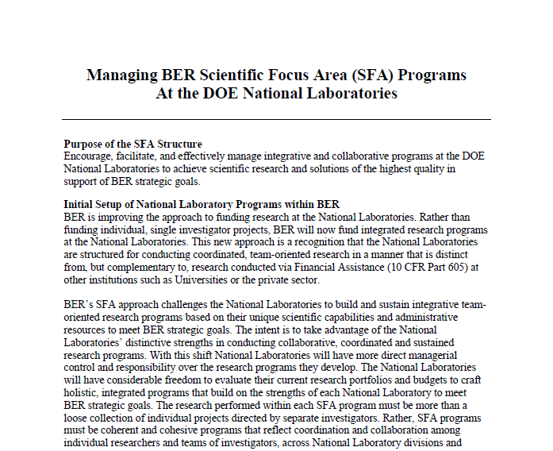
Recommendation: Because the SFA is a large program of research, its size may inhibit a nimble response of the National Lab to current and changing needs for information. Accountability of all scientists associated with an SFA must be carefully monitored. Because this structure is in its infancy, discrete deadlines and mechanisms for reapplication will prevent complacency. The COV recommends a plan for recompeting SFAs be put in place as soon as conveniently possible.
Response: BER agrees that vigorous oversight of the SFA programs at the Labs is required
to ensure accountability and prevent complacency.
Action: Re-competition of Lab programs is not the main intent of the SFA process.
Rather, BER is challenging the Labs to stand-up and maintain long-term, team-oriented,
mission-focused science within these programs that is distinct from financial assistance
awarded to academic and/or private research institutions.
  SFA programs are reviewed every 3 years
  Prospective and retrospective in scope
  Review results are consequential (Accept, Accept with
  Revisions, Partially Accept, Reject)
http://www.science.doe.gov/ober/sfareview.pdf
6 BERAC Mar 2011
Department of Energy • Office of Science • Biological and Environmental Research

Slide 7
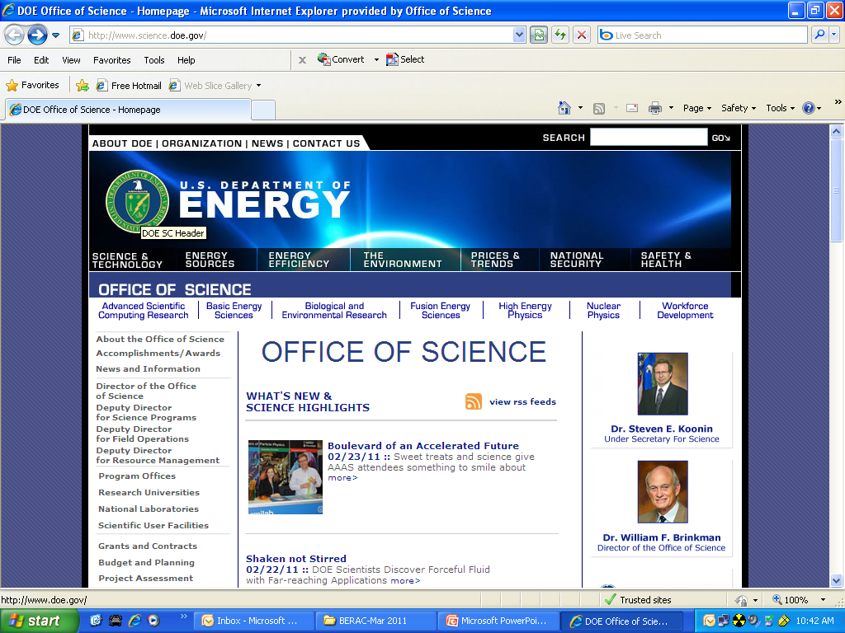
Recommendation: The COV would encourage more effort to showcase the contributions of DOE to the public.
Response: BER agrees with the COV and is in the process of developing more effective
communications and public relations materials.
Action: An internal communications team has been assembled within BER lead by the Chief
Scientist composed of program managers from across the BER programs to developing new
methods and communications products to showcase BER science.
  Highlights of BER-funded research collected weekly for transmittal within SC,
  DOE and the to the public.
-Increasing BER visibility at National Meetings
(e.g. hosting symposia, co-locating booths, etc.)
-Taking leadership roles in Interagency
activities
7 BERAC Mar 2011
Department of Energy • Office of Science • Biological and Environmental Research

Slide 8
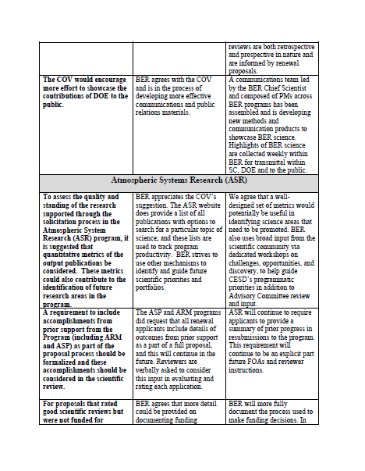
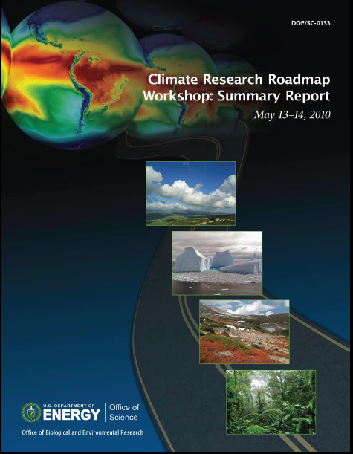
Research Programs
Page 3
Atmospheric Systems Research (ASR)
Recommendation: To assess the quality and standing of the research supported through the solicitation process in the Atmospheric System Research (ASR) program, it is suggested that quantitative metrics of the output publications be considered. These metrics could also contribute to the identification of future research areas in the program.
Response: The ASR website does provide a list of all
publications with options to search on particular topics to
track program performance.
http://asr.science.energy.gov/publications/
Action: BER agrees that a well designed set of metrics
would potentially be useful in identifying new science areas
but broad input the scientific community in the form of
workshops is also important.
8 BERAC Mar 2011
Department of Energy • Office of Science • Biological and Environmental Research

Slide 9
Recommendation: A requirement to include accomplishments from prior support from the Program (including ARM and ASP) as part of the proposal process.
Response: All renewal applicants were requested to include results obtained from prior
support. Reviewers were asked to consider prior progress when evaluating renewals.
Action: Renewal applicants will continue to be asked to provide a summary of past
research progress.
Recommendation: The programmatic issues used in funding decisions should be fully documented and suitably articulated.
Response: BER agrees that more detail could be provided on documenting funding decisions.
Action: BER will more fully document the funding decision-making process. All applicants
will receive reviewer comments and abbreviated discussion in the formal decision letter.
Program managers commonly communicate with applicants on declined proposals via
telephone
9 BERAC Mar 2011
Department of Energy • Office of Science • Biological and Environmental Research

Slide 10
Recommendation: Increasing attention to PI diversity and balance across career development
is strongly encouraged.
Response: Diversity is an objective of the ASR, implementation of policies on diversity is
directed by the Office of Science rather than the individual programs.
Action: Career development is a strong focus in ASR funding activities. ASR has four post-
doctoral fellows at national and international modeling centers and a fifth under consideration.
ASR (and BER In general) also participates in the Early Career Research program managed by
the Office of Science.
Recommendation: The definitions of conflict of interest should be more formally defined.
Response: DOE policies and rules on conflict of interest are set at the Office of Science
level.
Action: ASR will continue to articulate and implement these rules as clearly as possible
with reviewers and panelists in the review process.
10 BERAC Mar 2011
Department of Energy • Office of Science • Biological and Environmental Research

Slide 11
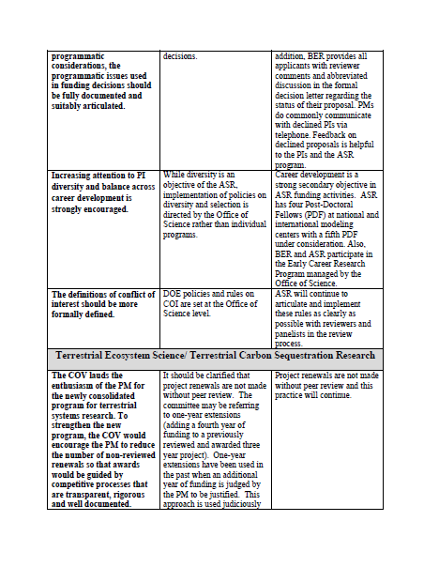
Page 4
Terrestrial Ecosystem Science/
Terrestrial Carbon Sequestration
Research
Recommendation: The COV lauds the enthusiasm of the PM for the newly consolidated program for terrestrial systems research. To strengthen the new program, the COV would encourage the PM to reduce the number of non-reviewed renewals so that awards would be guided by competitive processes that are transparent, rigorous and well documented.
Response: Project renewals are not made without peer review. The committee may be
referring to 1-year extensions (adding a fourth year of funding to a previously reviewed
and awarded three-year project). One year extensions have been used in the past when
an additional year of funding is judged by the program manager to be justified. This approach
is used judiciously and is not a routine funding mechanism.
Action: Project renewals are not made without peer review and this practice will continue.
11 BERAC Mar 2011
Department of Energy • Office of Science • Biological and Environmental Research

Slide 12
Recommendation: The COV recommends that the Terrestrial Ecosystem Science (TES) program consider bringing the state-of-the-art ecosystem models and climate modelers together to determine how ecosystem models can be better interfaced with climate models.
Response: BER agrees.
Action: The program will develop plans to conduct such a meeting, potentially in
conjunction with the next PI meeting.
Note: Program managers within CESD continue to discuss science integration within the
Division’s programs to foster exploration at the interfaces of our disciplines and
to promote collaboration among CESD PIs in large(r) environmental studies like the NGEE
project.
Recommendation: We recommend that the program rapidly transition to a system of solicitations for non-National Laboratory science that includes (1) an annual solicitation, (2) for the proposals that clearly have a term longer than three years, there should be fewer renewal proposals and more longer-term awards, and (3) funding for synthesis activities. We believe that such a system would better engage a broader research community in the program and improve the quality of the science. Additionally, funding synthesis activities is extremely worthwhile, especially in ecosystem science, and is very cost-effective research.
Response: BER agrees
Action: TES will follow general BER practice of soliciting 3-year projects from the academic
community, explore the use of longer term projects and promote science synthesis activities.
12 BERAC Mar 2011
Department of Energy • Office of Science • Biological and Environmental Research

Slide 13
Recommendation: We recommend the program consider a solicitation to fund collaborative work with the Spruce and Peatland Responses Under Climatic and Environmental Change (SPRUCE) and NGEE (Next Generation Ecosystem Experiment).
Response: BER agrees
Action: Both projects are intended to support external collaborators in addition to the core
experiment. TES solicitations will provide funding opportunities to participate on these
projects.
Recommendation: The program should consider an emphasis on model needs or deficiencies
as a selection criterion for proposals. This emphasis is an excellent tool for discrimination
among proposals and for steering the program.
Response: BER agrees
Action: This was highlighted in the program’s most recent (FY2010) solicitation and was an
important criteria for making funding decisions. This emphasis will continue in future
solicitations.
Recommendation: The program should consider soliciting shorter, lower cost proposals for high risk-high reward ideas for proof of concept.
Response: BER agrees
Action: Shorter term Exploratory proposals ($150k total, up to 2 years) were a component
of the program’s most recent solicitation (FY2010).
13 BERAC Mar 2011
Department of Energy • Office of Science • Biological and Environmental Research

Slide 14
Recommendation: Progress (publication and particularly syntheses) often occurs after final progress reports have been submitted. To keep the program informed on publications, a system such as electronic search capacity (Web of Science) or providing some incentive for funded scientists to contribute information should be considered.
Response: BER recognizes this challenge and agrees with the committee’s recommendation.
Action: With an additional TES program manager in place (Dan Stover) and a science
program specialist coming on-board (Patrick Horan) , TES should be able to allocate more
time to tracking progress/publications and program accomplishments.
Recommendation: The development of web pages that document the program and continue to update its impact should be considered a high priority while balanced with resource allocation needs.
Response: BER agrees with this recommendation.
Action: Web-based information about the TES program will be a priority.
Recommendation: The program is growing in stature and impact. That trajectory will be encouraged by continuing the transition from projects that are renewed with little review, to funding based on periodic solicitations for proposals and rigorous transparent reviews that are carefully organized to minimize bias and conflicts. The TES has made tremendous progress in this regard and should be encouraged to continue strides in this direction.
Response: BER agrees.
Action: BER intends that renewals will be an exception in the future. Yearly solicitations and
new awards will be the norm for university funding. All renewals undergo peer review.
14 BERAC Mar 2011
Department of Energy • Office of Science • Biological and Environmental Research

Slide 15
Recommendation: We recommend the program continue to solicit research on important topics in ecosystem response to global change that cannot be accomplished outside of the program.
Response: BER agrees.
Action: BER works closely with other Federal agencies through the Global Change Research
Program to ensure that its programs are appropriately integrated with and distinct form those of other agencies.
Recommendation: We recommend that a greater effort be made to recruit more highly qualified reviewers from outside the U.S., perhaps 20%.
Response: BER will continue to strive to recruit reviewers of the highest caliber regardless
of national origin.
Action: Recruiting qualified unconflicted reviewers is an ongoing and recognized challenge . BER seeks to achieve balance in its panels (gender, age, institution, etc.). Program managers will be encouraged to seek international representation as a form of review panel diversity.
15 BERAC Mar 2011
Department of Energy • Office of Science • Biological and Environmental Research

Slide 16
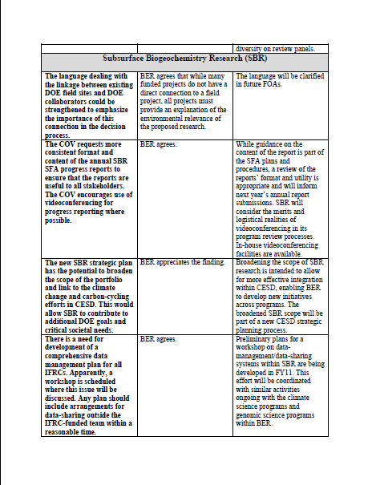
Subsurface Biogeochemical
Research (SBR)
Page 8
Recommendation: The language dealing with the linkage between existing DOE field sites and DOE collaborators could be strengthened to emphasize the importance of this connection in the decision process.
Response: While many funded projects do not have a direct connection to a field project, all projects must provide an explanation of the environmental relevance of the proposed research.
Action: The language will be clarified in future solicitations.
Recommendation: The COV requests more consistent format and content of the annual SBR SFA progress reports to ensure that the reports are useful to all stakeholders. The COV encourages use of videoconferencing for progress reporting where possible.
Response: BER agrees
Action: Guidance on report generation is provided in the SFA management documents but a review of the report format and utility is appropriate and will inform future submissions. BER will consider the videoconferencing. Facilities are available in-house.

Slide 17
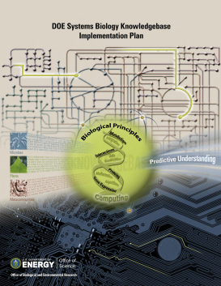

Recommendation: The new SBR strategic plan has the potential to broaden the scope of the portfolio and link to the climate change and carbon-cycling efforts in CESD. This would allow SBR to contribute to additional DOE goals and critical societal needs.
Response: BER appreciates the finding
Action: Broadening the scope of the program is intended to allow for more effective integration within CESD, enabling BER to develop new initiatives across programs. This is a part of the new strategic planning process within CESD.
Recommendation: There is a need for development of a comprehensive data management plan for all IFRCs. Apparently, a workshop is scheduled where this issue will be discussed. Any plan should include arrangements for data-sharing outside the IFRC-funded team within a reasonable time.
Response: BER agrees
Action: Preliminary workshop plans are being developed. A mini-workshop will be conducted on this topic immediately following the SBR PI meeting April 26-28, 2011. This topic obviously extends well beyond SBR and could include several other programs within BER, including the ARM program, TES field sites and the Knowledgebase effort in BSSD.
17 BERAC Mar 2011
17 BERAC Mar 2011
Department of Energy • Office of Science • Biological and Environmental Research
Department of Energy • Office of Science • Biological and Environmental Research

Slide 18
Recommendation: Plans for re-competing IFRCs should be developed soon.
Response: BER agrees
Action: After successful mid-term reviews, the IFRC projects have been extended a year to complete ongoing projects. The program will request proposals for new research in FY12 for FY13 funds.
18 BERAC Mar 2011
Department of Energy • Office of Science • Biological and Environmental Research

Slide 19
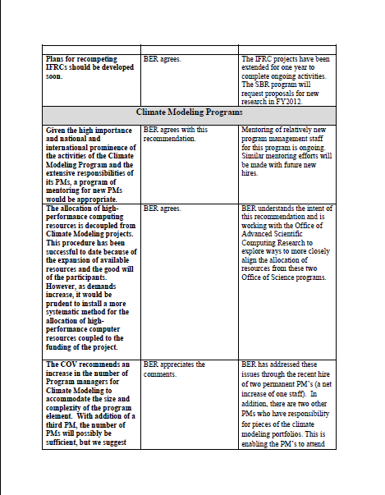
Climate Modeling Programs
Page 9
Recommendation: Given the high importance and national and international prominence of the activities of the Climate Modeling Program and the extensive responsibilities of its PMs, a program of mentoring for new PMs would be appropriate.
Response: BER agrees with this recommendation
Action: Mentoring of relatively new program management staff for this program is ongoing. Similar mentoring efforts will be made with future new hires.
Recommendation: The allocation of high-performance computing resources is decoupled from Climate Modeling projects. This procedure has been successful to date because of the expansion of available resources and the good will of the participants. However, as demands increase, it would be prudent to install a more systematic method for the allocation of high-performance computer resources coupled to the funding of the project.
Response: BER agrees
Action: BER understands the intent of this recommendation and is working with the Office of Advanced Scientific Computing Research (ASCR) to explore ways to more closely align the allocation of resources from these two Office of Science programs.
Note: BER does actively manage (with ASCR) allocations at the NERSC facility at LBNL.
19 BERAC Mar 2011
Department of Energy • Office of Science • Biological and Environmental Research

Slide 20
Recommendation: The COV recommends an increase in the number of Program managers for Climate Modeling to accommodate the size and complexity of the program element. With
addition of a third PM, the number of PMs will possibly be sufficient, but we suggest
that one-to-two additional (4-5 total) managers would allow for PMs to have more time
to interact with PIs, stay up to date in the science, allow engagement in long-range
planning activities, and participate in interagency activities.
Response: BER appreciates the comments.
Action: As mentioned earlier, BER recently hired two full time program managers (PM) for Climate Modeling, Renu Joseph and Dorothy Koch (net gain of one PM). BER is continuously evaluating its staffing needs and will share these needs with the Office of Science.
20 BERAC Mar 2011
Department of Energy • Office of Science • Biological and Environmental Research

Slide 21
Recommendation : Long-term support for vital high-profile activities is needed but lacking.
o PCMDI: Serving of climate model results and the maintenance and development
of associated software are crucial activities, vital for national and international
climate research. Support for this project is moving from SciDAC to the Climate
Modeling Program, which reduces funds available for other program activities and
has the potential to reduce the stability of PCMDI support. International partners
are seeking a decadal commitment to support for the availability of climate model output.
o Computing for IPCC and Coupled Model Intercomparison Project (CMIP): The
development and integration of climate models takes several years. In order to plan
effectively, climate modelers must know what computing resources will be available.
For example, planning for CMIP6/IPCC AR6 should be underway now.
Response: BER agrees.
Action: The comment about PCMDI (Program for Climate Model Diagnosis and Intercomparison) is related to the Earth System Grid (ESG) program. BER agrees with comment and is working with ASCR to identify mechanisms to maintain ESG without negatively impacting CESD modeling programs.
BER also agrees with the need for advanced planning to support national and international modeling needs. It is anticipated that BER will work together with other Federal and international agencies to insure that effective planning for future modeling needs is in place.
21 BERAC Mar 2011
Department of Energy • Office of Science • Biological and Environmental Research

Slide 22
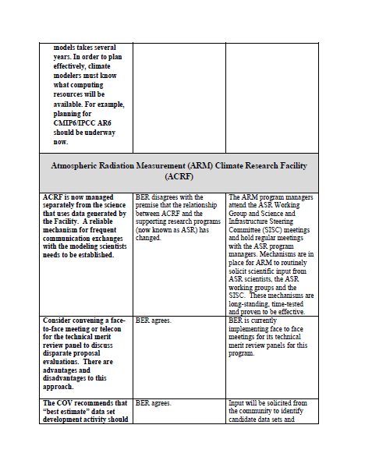
National User Facilities
Page 11
Atmospheric Radiation Measurement (ARM) Climate Research Facility (ACRF)
Recommendation: ACRF is now managed separately from the science that uses data generated by the Facility. A reliable mechanism for frequent communication exchanges with the modeling
scientists needs to be established.
Response: BER disagrees with the premise that the relationship between ACRF and the supporting research programs (now known as ASR) has changed.
Action: ARM program managers attend ASR Working group and Science and Infrastructure Steering Committee (SISC) meetings with ASR program managers. Mechanisms are in place to routinely solicit scientific input from ASR scientists, the ASR working groups and the SISC. These mechanisms are long standing, time-tested and proven to be effective.
Recommendation: Consider convening a face-to-face meeting or telecon for the technical merit review panel to discuss disparate proposal evaluations. There are advantages and disadvantages to this approach.
Response: BER agrees
Action: This program is implementing face-to-face meetings for its merit review panels .
22 BERAC Mar 2011
Department of Energy • Office of Science • Biological and Environmental Research

Slide 23
Recommendation: The COV recommends that “best estimate” data set development activity
should be continued and broadened to include measurements/data from other areas of earth
science research.
Response: BER agrees
Action: Input will be solicited from the community to identify candidate sets and establish priorities for their development.
Recommendation : Assess whether the ACRF measurement suites deliver sufficient chemical
and biogeochemical data to support the “basic development of climate model components,
with an emphasis on incorporating missing physical and biogeochemical processes in Earth
System Models”.
Response: BER agrees
Action: This will be accomplished through a workshop (TBA) and developed jointly with ARM, ASR and Climate Modeling program managers.
Recommendation : We recommend that ARM implement an agreement (“terms of use”) on
the data registration web page to include a standard one-sentence acknowledgment
statement in all publications or presentations that make use of ARM/ACRF data. The
statement should include “ARM/ACRF” and/or other unique keywords to facilitate citation
searches and assessment of the stature and scientific impact of ACRF.
Response: BER agrees
Action: The recommendation will be implemented as soon as possible.
23 BERAC Mar 2011
Department of Energy • Office of Science • Biological and Environmental Research

Slide 24
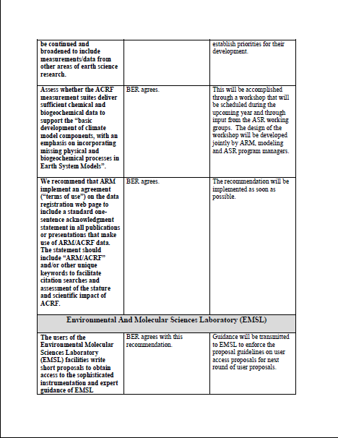
Environmental Molecular
Sciences Laboratory (EMSL)
Page 12
Recommendation: The users of the Environmental Molecular Sciences Laboratory (EMSL) facilities write short proposals to obtain access to the sophisticated instrumentation and expert guidance of EMSL personnel. The COV strongly recommends that proposal guidelines be firmly enforced to prevent the perception of, or actual, inequitable treatment.
Recommendation: The program is effective with an appropriate external and internal review process which, if conducted in the future in a manner that enforces the proposal requirements, will make the appropriate allocation of facilities time.
Response: BER agrees with both of these recommendations
Action: Guidance has been transmitted to enforce the proposal guidelines.
24 BERAC Mar 2011
Department of Energy • Office of Science • Biological and Environmental Research

Slide 25
Recommendation: The definition of “distinguished” user should clearly indicate recognition of the highest level of scholarship and research accomplishment.
Response: BER agrees with the spirit of this recommendation.
Action: BER will work with EMSL to evaluate a way to clearly distinguish scientific from organizational recognition.
Recommendation: BER and EMSL are encouraged to attempt to attract more industrial users.
The panel recommends that the facility work hard and encourage more “partner proposals”
with individuals and groups of users.
Response: BER agrees with this recommendation.
Action: BER has asked EMSL to propose outreach mechanisms and/or incentives that would increase the potential for industrial users.
Recommendation: Continue to maintain support to allow continued acquisition of state-of-the-art equipment.
Response: BER agrees
Action: BER will continue to develop capitalization plans for EMSL and maintain support for state-of-the-art equipment.
25 BERAC Mar 2011
Department of Energy • Office of Science • Biological and Environmental Research

Slide 26
Recommendation: Include in the FY2011 science and operational review of EMSL a comprehensive assessment of ES&H.
Response: BER agrees with this recommendation.
Action: The next EMSL review will include an ES&H component.
Recommendation: The travel budget for the program manager should be increased by
50% to allow travel to scientific meetings as well as additional travel to EMSL.
Response: BER recognizes the potential travel needs of program managers with responsibilities for facilities.
Action: Each division within BER holds a reserve for travel needs beyond a standard allocation. Facility program managers are given higher priority in travel allocation from this reserve. To date, BER has been able to accommodate all necessary travel through this mechanism.
26 BERAC Mar 2011
Department of Energy • Office of Science • Biological and Environmental Research

Slide 27
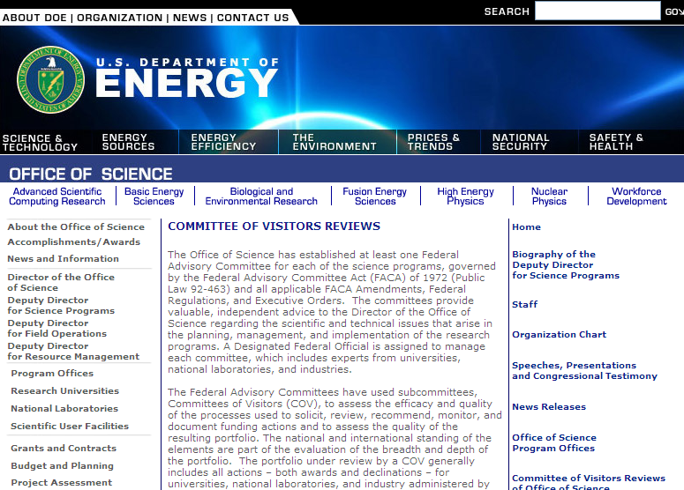
Thank You
COV report and BER response posted to the SC website
http://www.science.doe.gov/SC-2/COV-BER/BER_Reviews.htm
27 BERAC Mar 2011
Department of Energy • Office of Science • Biological and Environmental Research

