Slide 1
FY 2012 budget Presentation for DOE’s Office of Science
March 9, 2011
Dr. W. F. Brinkman
Director, Office of Science
U.S. Department of Energy
www.science.doe.gov

Slide 2

Office of Science
Science to Meet the Nation’s Challenges Today and into the 21st Century
The Frontiers of Science
  Supporting research that led to over 100 Nobel Prizes during the past 6 decades—22 in the past decade alone
  Providing 45% of Federal support of basic research in the physical sciences and key components of the Nation’s basic research in biology and computing
  Supporting over 27,000 Ph.D.s, graduate students, undergraduates, engineers, and support staff at more than 300 institutions
21st Century Tools of Science
  Providing the world’s largest collection of scientific user facilities to over 26,000 users each year

Slide 3
Science, Innovation, and DOE’s Office of Science
  Science is the basis of technology and underpins all of the work of DOE.
  Science of the 20th century brought us the high standard of living we now enjoy. Today, we are laying the foundations for the new technologies of the coming decades.
  Progress in science and technology depends on continuing advances in, and replenishment from, basic research, which is the federal government’s—and SC’s—special role.
  A highly trained work force is required to invent the future—scientists and engineers trained in the most modern science and technologies and with access to the best tools.

Slide 4
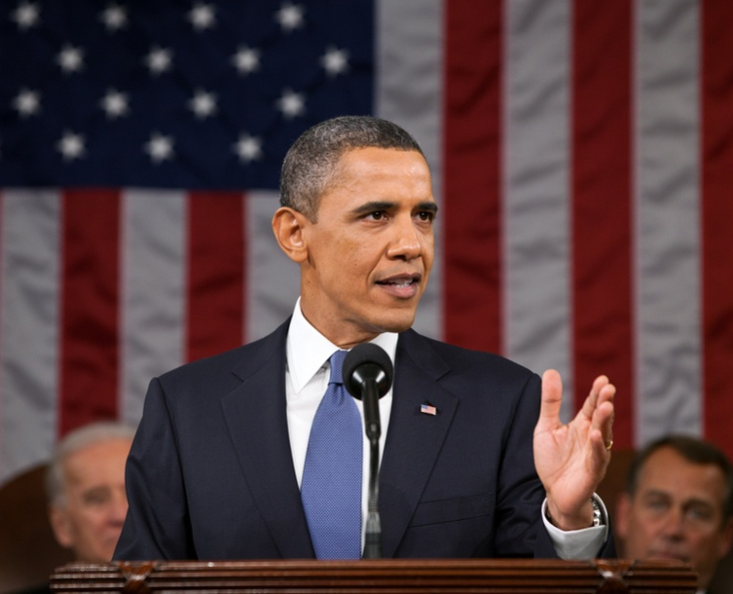
Our Generation’s Sputnik Moment
  “This is our generation's Sputnik moment. Two years ago, I said that we needed to reach a level of research and development we haven't seen since the height of the Space Race.
  …[this] budget to Congress helps us meet that goal. We'll invest in biomedical research, information technology, and especially clean energy technology—an investment that will strengthen our security, protect our planet, and create countless new jobs for our people.”
Remarks of President Barack Obama
State of the Union Address to the Joint Session of Congress
Tuesday, January 25, 2011

Slide 5
Office of Science Research Underpins the President’s Goals
  The Office of Science commands an arsenal of basic science capabilities—major scientific user facilities, national laboratories, and university researchers—that we are using to break down the barriers to new energy technologies.
  We have focused these capabilities on critical national needs, e.g., through the Bioenergy Research Centers, the Energy Frontier Research Centers, and the new Energy Innovation Hub—the Joint Center for Artificial Photosynthesis.

Slide 6
New in FY 2012: Science for Innovation and Clean Energy
  Applications of 21st century science to long-standing barriers in energy technologies: employing nanotechnology, biotechnology, and modeling and simulation
  Examples:
    Materials by design: Using nanoscale structures, simulation and syntheses of materials for carbon capture; radiation-resistant and self-healing materials for the nuclear reactor industry; highly efficient photovoltaics; and white-light emitting LEDs and other energy applications.
    Biosystems by design combining the development of new molecular toolkits with testbeds for the design and construction of improved biological components or new biohybrid systems and processes for improved biofuels and bioproducts.
    Modeling and simulation to facilitate materials and chemistry by design and to address technology challenges such as the optimization of internal combustion engines using advanced transportation fuels (biofuels).

Slide 7
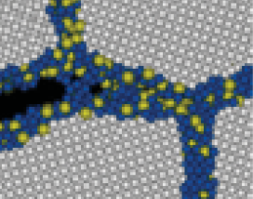
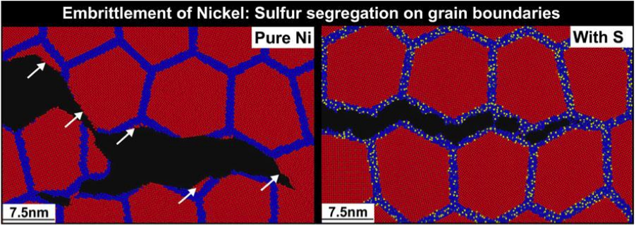


Stress Corrosion Cracking
Molecular Dynamics Simulation Reveals Mechanisms of Nickel Fracture
Fracture simulations for nanocrystalline nickel without and with amorphous sulfide grain- boundary phases, showing ductile, transgranular tearing and brittle, intergranular cleavage.
The performance and lifetime of materials used in nuclear technology and in advanced power generation are severely limited by corrosive environments and extreme conditions.
Premature failure of materials can result from undetected stress corrosion cracking.
Annually, corrosion costs about 3% of the U.S. gross domestic product.
48-million-atom simulation on Argonne Leadership Computing Facility showed a link between sulfur impurities segregated at grain boundaries of nickel and embrittlement. An order-of-magnitude reduction in grain-boundary shear strength, combined with tensile-strength reduction, allows the crack tip to always find an easy propagation path in this configuration. This mechanism explains an experimentally observed crossover from microscopic fracture to macroscopic cracks due to sulfur impurities.
Notes:
A multidisciplinary team of physicists, chemists, materials scientists, and computer scientists made innovations in simulation methods and parallel computing technologies to perform the largest-ever (48 million atoms), chemically reactive molecular dynamics simulation on 65,536 IBM Blue Gene/P processors at the Argonne Leadership Computing Facility. The team answered a fundamental question encompassing chemistry, mechanics, and materials science: How a minute amount of impurities segregated to grain boundaries of a material essentially alters its fracture behavior. The researchers simulated the introduction of small amounts of sulfur into the boundaries between nickel grains to investigate a material property known as “embrittlement.” Seeing how different configurations of nickel function at these exceptionally small scales helps them understand the basic chemistry that will expedite the development of next-generation nuclear reactors. The study was published in Physical Review Letters (April 2010).
Figure Caption: Closeups of fracture simulations for nanocrystalline nickel without and with amorphous sulfide grain- boundary phases, where red, blue, and yellow colors represent nickel atoms inside grains (>0.5 nanometers from grain boundaries), nickel atoms within 0.5 nm from grain boundaries, and sulfur atoms, respectively. The figure shows a transition from ductile, transgranular tearing to brittle, intergranular cleavage. White arrows point to transgranular fracture surfaces.

Slide 8
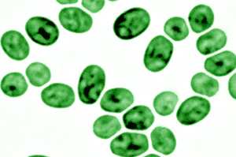
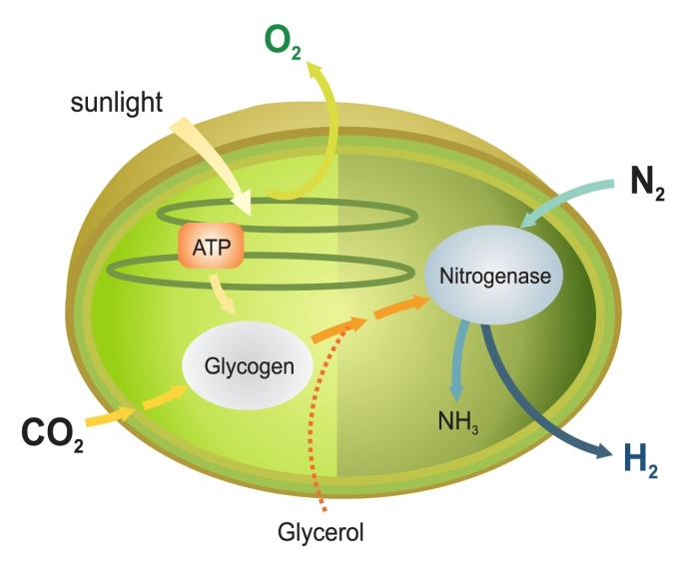
Systems Biology for Bioenergy Production
Systems biology techniques were used to dissect how the common microbe Cyanothece balances photosynthesis with carbon, nitrogen, and hydrogen metabolism.
Although oxygen is toxic to the enzymes involved in ammonia and hydrogen production, Cyanothece is unique in generating both in the presence of air and while producing O₂ as a byproduct of photosynthesis.
These results suggest metabolic engineering this microbe for enhanced production of hydrogen, biodiesel, or other biofuels using only water and sunlight and without the need for added fertilizers.
Bandyopadhyay, A., J. Stockel, H. Min, L. Sherman, & H. Pakrasi. 2010. “High Rates of Photobiological Hydrogen Production Under Aerobic Conditions “ Nature Communications DOI:10.1038/ncomms1139

Slide 9
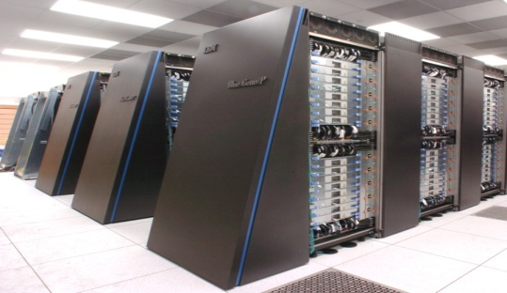
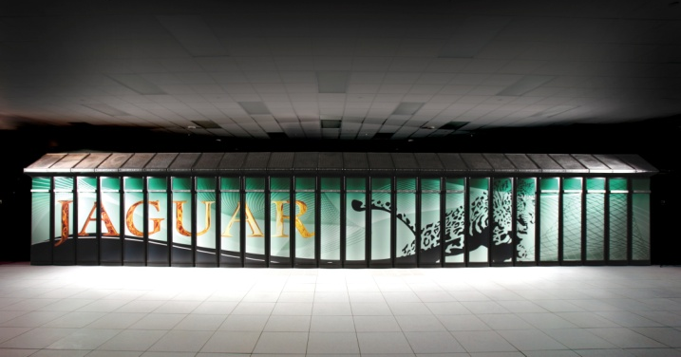
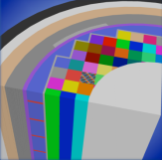

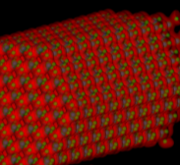
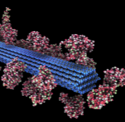
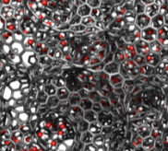
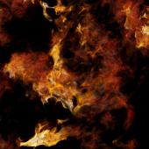

Modeling and Simulation at the Petascale
The Cray XT5 ("Jaguar") at ORNL and the IBM Blue Gene/P ("Intrepid") at ANL will provide ~2.3 billion processor hours in FY12 to address science and engineering problems that defy traditional methods of theory and experiment and that require the most advanced computational power.
Peer reviewed projects are chosen to advance science, speed innovation, and strengthen industrial competitiveness.
Demand for these machines has grown each year, requiring upgrades of both.
Among the topics in FY2011:
Advancing materials for lithium air batteries, solar cells, and superconductors
Exploring carbon sequestration
Improving combustion in fuel-efficient, near-zero-emissions systems
Understanding how turbulence affects the efficiency of aircraft and other transportation systems
Designing next-generation nuclear reactors and fuels and extending the life of aging reactors
Developing fusion energy systems
Understanding the roles of ocean, atmosphere, land, and ice in climate change
Argonne Leadership Computing Facility
Oak Ridge Leadership Computing Facility
In FY 2012, the Argonne LCF will be upgraded with a
10 petaflop IBM Blue Gene/Q. The Oak Ridge LCF will continue site preparations for a system expected in FY 2013 that will be 5-10 times more capable than the Cray XT-5.
Nuclear Reactor Simulation
Fusion Plasmas
Nanoscale Science
Biofuels
Energy Storage Materials
Turbulence

Slide 10
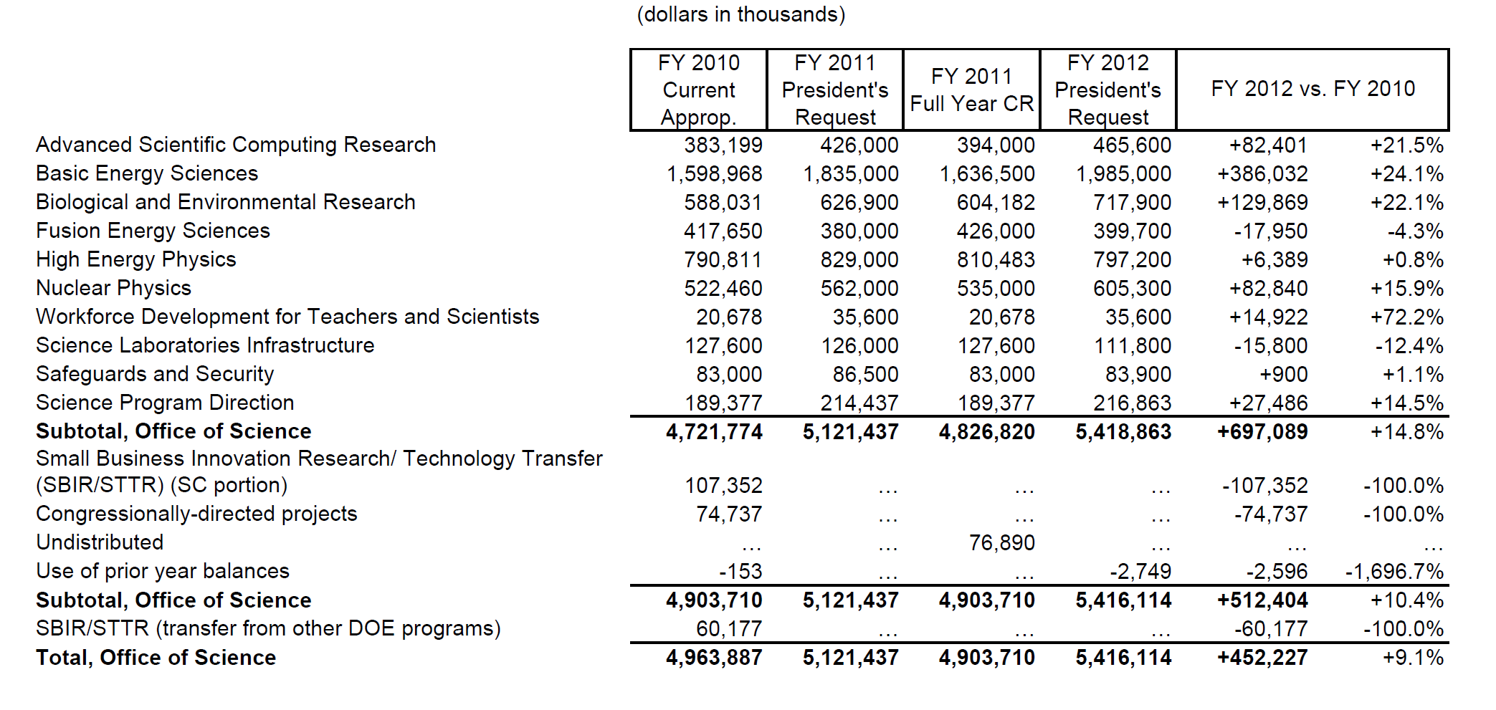
Office of Science FY 2012 Budget Request to Congress
Continuing Resolution (CR) column reflects the current CR (P.L. 111-322), annualized to a full year. Funding amounts reflect the FY 2010 appropriation level prior to the SBIR/STTR transfer. Funding on the undistributed line reflects FY 2010 Congressionally directed project funding prior to the SBIR/STTR transfer.

Slide 11
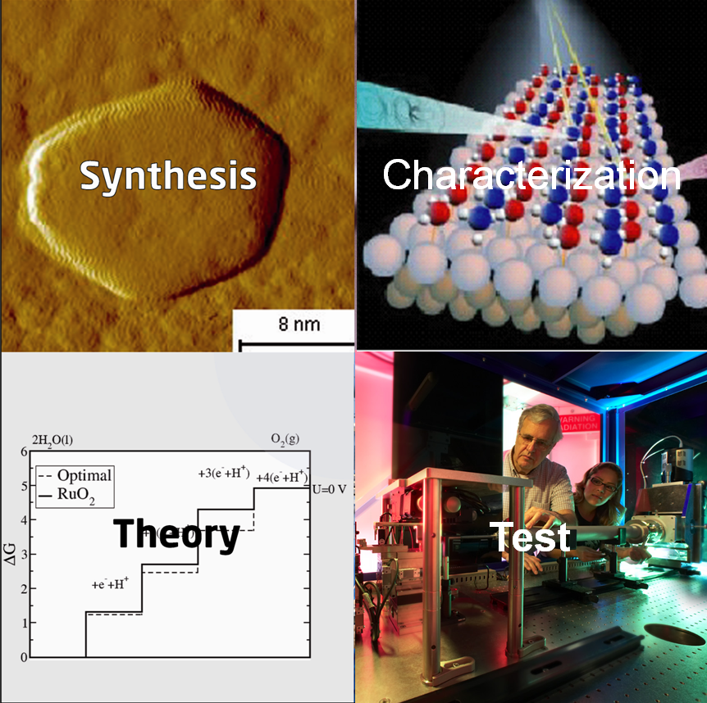
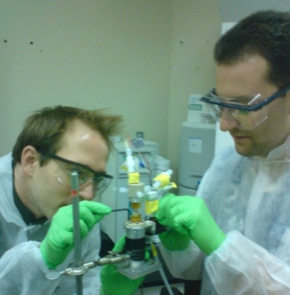
Science for Clean Energy: Materials by Design
Research to establish materials design rules to launch an era of predictive modeling, changing the paradigm of materials discovery from serendipity to rational design.
Discovery of new materials has been the engine driving science frontiers and fueling technology innovations. The U.S. has the world’s most powerful suite of tools for materials synthesis, characterization, and computation.
Research Focus:
  Synthesis: Rational molecular-scale design guided by simulation.
  Characterization and Testing: Verify & validate computational designs and software, including in situ measurements using x-ray, neutron, microscopy, and nanoscience facilities.
  Theory/Simulation: New methods and algorithms for complex, multi-scale systems. Development of software and toolkits through a networked, broad community. Emphasis areas include: catalysis, light-weight materials, and materials for energy applications including radiation-resistant materials, carbon capture, batteries, liquid fuels, and photocatalysis.
Test
11

Slide 12

Science for Clean Energy: Biosystems by Design
Research to establish biological design rules to enable the predictive design of innovative natural and hybrid systems for clean energy production.
Discovery and synthetic redesign of plant and microbial systems pushes science frontiers and paves the way for sustainable production of advanced biofuels and bioproducts. Leverages strong U.S. resources and leadership in fundamental biological research and industrial biotechnology.
Research focus:
Synthesis: New methods for high-throughput data acquisition to catalogue components of biological systems. Develop genetic toolkits to measure rates and magnitudes of processes, and identify regulatory control points in metabolic pathways and cellular networks. Apply fundamental biological design rules for predictive integration of components and processes, including potentially new cellular functions.
Characterization & Testing: Verify & validate computer-aided design toolkits for improved genetic manipulation of plants and microbes and design of hybrid biosystems , building on knowledge of the natural world. Develop new testbeds to prototype and validate performance and function.
12

Slide 13


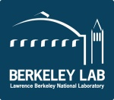
JCAP Collaborating Energy Frontier Research Centers
Harry Atwater | Light-Material Interactions in Energy Conversion | California Institute of Technolog, Pasadena,CA
Friedric B. Prinz | Center on Nanostructuring for Efficient Energy Conversion | Stanford University, Stanford, CA
Berend Smit | Center for Gas Separations Relevant to Clean Energy Technologies | UC Berkeley, Berkeley, CA
John Bowers | Center on Materials for Energy Efficiency Applications | UC Santa Barbara, Santa Barbara, CA
James Spivey | Computational Catalysis and Atomic-Level Synthesis of Materials: Building Effective Catalysts from First Principles | Louisiana State University, Baton Rouge, LA
Thomas Russell | Polymer-Based Materials for Harvesting Solar Energy | University of Massachusetts, Amherst, MA
Peter Green | Solar Energy Conversion in Complex Materials | University of Michigan, Ann Arbor, MI
Victor Klimov | The Center for Advanced Solar Photophysics | Los Alamos National Labs
Hector Abruna | Nanostructured Interfaces for Energy Generation, Conversion, and Storage | Cornell University, Ithaca, NY
Kenneth Reifsnider | Science Based Nano-Structure Design and Synthesis of Heterogeneous Functional Materials for Energy Systems | University of South Carolina, Columbia, SC
Devens Gust | EFRC Center for Bio-Inspired Solar Fuel Production | Arizona State University, Tempe, AZ
Neal R. Armstrong | Center for Interface Science: Hybrid Solar Electric Materials | University of Arizona, Tucson, AZ
Vidvuds, Ozolins | Molecularly Assembled Material Architectures for Solar Energy Production, Storage, and Carbon Capture | UC Los Angeles, Los Angeles, CA
Daniel Dapkus | Emerging Materials for Solar Energy Conversion and Solid State Lighting | University of Southern California, Los Angeles, CA
Alex Zunger | Center for Inverse Design | National Renewable Energy Laboratory, Golden, CO
Michael Thackeray | Center for Electrical Energy Storage: Tailored Interfaces | Argonne Nat'l Labs, Argonne, IL
Michael Wasielewski | Argonne-Northwestern Solar Energy Research Center | Northwestern University, Evanston, IL
Thomas Meyer | Solar Fuels and Next Generation Photovoltaics | University of North Carolina, Chapel Hill, NC
David Wesolowski | Fluid Interface Reactions, Structures and Transport Center | Oak Ridge National Labs, Oak Ridge, TN
Morris Bullock | Center for Molecular Electrocatalysis | Pacific Northwest National Laboratory, Richland, WA
13

Slide 14
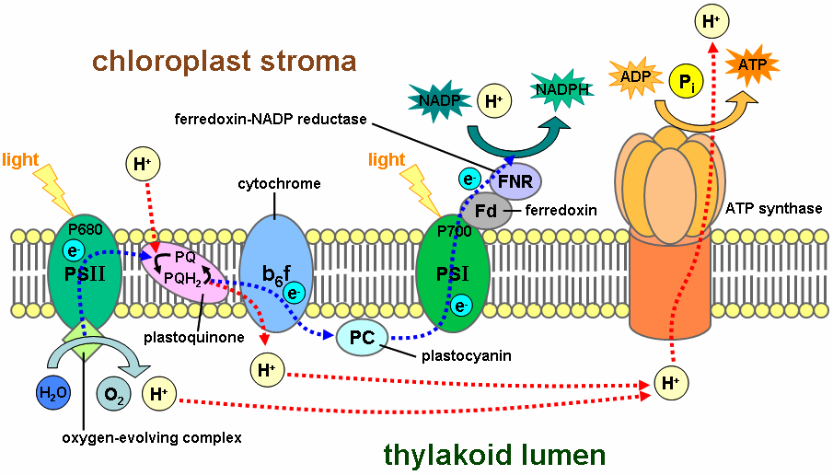
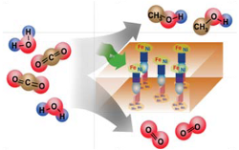
Fuels from Sunlight Energy Innovation Hub:
Joint Center for Artificial Photosynthesis (JCAP)
The design of highly efficient, non‐biological, molecular‐level “machines” that generate fuels directly from sunlight, water, and carbon dioxide is the challenge.
Basic research has provided an understanding of the complex photochemistry of the natural photosynthetic system and the use of inorganic photo‐catalytic methods to split water or reduce carbon dioxide – key steps in photosynthesis.
JCAP Mission: To demonstrate a scalable, manufacturable solar-fuels generator using Earth-abundant elements, that, with no wires, robustly produces fuel from the sun 10 times more efficiently than (current) crops.
JCAP R&D focuses on:
      Accelerating the rate of catalyst discovery for solar fuel reactions
      Discovering earth-abundant, robust, inorganic light absorbers with optimal band gap
      Providing system integration and scale-up
Begun in FY 2010, JCAP serves as an integrative focal point for the solar fuels R&D community – formal collaborations have been established with 20 Energy Frontier Research Centers.
14
Natural photosynthesis
Artificial photosynthesis

Slide 15
Batteries and Energy Storage Energy Innovation Hub
Transform the Grid and Electrify Transportation
Improved energy storage is critical for the widespread use of intermittent renewable energy, electric vehicles, and efficient and reliable smart electric grid technologies.
The Hub, proposed for FY 2012, will develop electrochemical energy storage systems that safely approach theoretical energy and power densities with very high cycle life.
These are systemic challenges requiring new materials, systems, and knowledge.
The Hub will address key fundamental questions in energy storage including:
  Can we approach theoretical energy density?
  Can we safely increase the rate of energy utilization?
  Can we create a reversible system with minimal energy loss?
The Hub will link fundamental science, technology, and end-users, and it will collaborate with relevant Energy Frontier Research Centers, ARPA-E and EERE
15

Slide 16
R&D Coordination
  The FY 2012 budget request includes funding for integrated R&D activities across the Office of Science and the DOE technology programs.
  The Office of Science will address topics for which an understanding of fundamental phenomena is required to achieve game-changing discoveries for mid-to-long-term technological innovation.
  The DOE technology programs will address topics in applied research, development, and deployment to gain and apply knowledge to achieve identified near-to-mid-term clean energy goals.
16

Slide 17

Secretary
Steven Chu
Deputy Secretary
Daniel B. Poneman
Advanced Research Projects Agency – Energy
Arun Majumdar
Under Secretary for Nuclear Security/Administrator for National Nuclear Security Administration
Thomas P. D’Agostino
Under Secretary
for Science
Steven E. Koonin
Under Secretary
Cathy Zoi (A)
Defense Nuclear Nonproliferation
Office of Science
William Brinkman
Patricia Dehmer
Energy Efficiency & Renewable Energy
Cathy Zoi
Defense Programs
Basic Energy Sciences
Harriet Kung
High Energy Physics
Mike Procario (A)
Naval Reactors
Fossil Energy
Victor Der (A)
Counter-terrorism
Advanced Scientific Computing Research
Dan Hitchcock (A)
Nuclear Physics
Tim Hallman
Nuclear Energy
Pete Lyons (A)
Defense Nuclear Security
Biological & Environmental Research
Sharlene Weatherwax (A)
Fusion Energy Sciences
Ed Synakowski
Electricity Delivery
& Energy Reliability
Pat Hoffman
Emergency Operations
SBIR/STTR
Manny Oliver
Workforce Develop. for Teachers & Scientists
Bill Valdez
Notes:
17

Slide 18
Continuum of Research, Development, and Deployment
Applied
Research
Technology
Maturation
& Deployment
Discovery
Research
Use-Inspired
Basic Research
Office of Science
Applied Programs
ARPA-E*
Goal: new knowledge / understanding
Focus: phenomena
Metric: knowledge generation
Goal: practical targets
Focus: performance
Metric: milestone achievement
Basic research to address fundamental limitations of current theories and descriptions of matter in the energy range important to everyday life – typically energies up to those required to break chemical bonds.
Basic research for fundamental new understanding on materials or systems that may revolutionize or transform today’s energy technologies
Basic research for fundamental new understanding, usually with the goal of addressing scientific showstoppers on real-world applications in the energy technologies
Proof of new, higher-risk concepts
Prototyping of new technology concepts
Explore feasibility of scale-up of demonstrated technology concepts in a “quick-hit” fashion.
Research with the goal of meeting technical milestones, with emphasis on the development, performance, cost reduction, and durability of materials and components or on efficient processes
Scale-up research
Small-scale and at-scale demonstration
Cost reduction
Manufacturing R&D
Deployment support, leading to market adoption
High cost-sharing with industry partners
* ARPA-E: targets technology gaps, high-risk concepts, aggressive delivery times

Slide 19
R&D Continuum for Energy Storage (Batteries/Vehicles)
Discovery
Research
Use-Inspired
Basic Research
Applied
Research
Technology
Maturation
& Deployment
Office of Science
ARPA-E
Applied Programs
BES
Understand and predict interfacial charge transfer and multi-body effects
Predict and control dynamics of phase transitions
Control of chemistry and its dynamics at electrified interfaces
Physicochemical consequences of nano-dimensions
Fundamentals of solvation dynamics and ionic transport
Retrosynthetic approaches to high performance new materials
Design of new materials capable of multi-electron storage per redox center
Understand design criteria for electrolytes that enable higher voltages
Tailor nanoscale electrode architectures for optimal transport
Novel chemistries for scavenging impurities and self-healing
Generation of knowledge and computational and experimental tools to predict properties, performance evolution, and lifetime of materials
ARPA-E
Quick scale-up feasibility tests of demonstrated new-generation battery technology concepts
Rapid development of new technology concepts—demonstration within 1-2 years
EERE: Significant focus on batteries and capacitors for vehicle applications
Development of full battery systems and advanced materials for those systems
Systems analysis which includes thermal analysis and simulation, various simulations to determine battery requirements, life modeling, and recycling studies
Research, development, and engineering of higher energy advanced materials and cell chemistries that simultaneously address the life, performance, abuse tolerance, and cost issues.
Research on inherent thermal and overcharge abuse tolerance of different Li-ion cell materials, components, and cell chemistries.
Batteries/ Vehicle Energy Storage
Battery and Energy Storage Hub*
ARPA-E (Individual Awards)
Demonstration
Individual Awards
Individual Awards
Individual Awards
Individual Awards
Individual Awards
Small Groups: EFRCs
Small Group Awards
BES User Facilities: New tools & techniques
* Proposed
Development & Test Facilities

Slide 20
R&D Continuum for Energy Storage (Grid)
Discovery
Research
Use-Inspired
Basic Research
Applied
Research
Technology
Maturation
& Deployment
Office of Science
ARPA-E
Applied Programs
BES
Understand and predict interfacial charge transfer and multi-body effects
Predict and control dynamics of phase transitions
Control of chemistry and its dynamics at electrified interfaces
Physicochemical consequences of nano-dimensions
Fundamentals of solvation dynamics and ionic transport
Retrosynthetic approaches to high performance new materials
Design of new materials capable of multi-electron storage per redox center
Understand design criteria for electrolytes that enable higher voltages
Tailor nanoscale electrode architectures for optimal transport
Novel chemistries for scavenging impurities and self-healing
Generation of knowledge and computational and experimental tools to predict properties, performance evolution, and lifetime of materials
ARPA-E
Focus on storage technology for short-duration variability in renewable generation.
Proof of concept storage-component projects; advanced system prototypes that address known shortcomings of existing systems
OE: Focus on decreasing cost and size while increasing performance of storage systems
Advanced research in new or scaled batteries systems, flywheels, electrochemical capacitors, superconducting magnet energy storage, power electronics, and control systems, working closely with industry partners.
Collaborative projects with utilities and state energy organizations on pioneering storage installations at the several megawatt size
Analytical studies on technical and economic performance of grid storage technologies
Demonstration of storage technologies on intermittency issues.
Grid Energy Storage
Battery and Energy Storage Hub*
ARPA-E (Individual Awards)
Demonstration
Individual Awards
Individual Awards
Individual Awards
Individual Awards
Individual Awards
Small Groups: EFRCs
Large-Scale Demonstration
BES User Facilities: New tools & techniques
* Proposed

Slide 21
R&D Continuum for Biofuels
Discovery
Research
Use-Inspired
Basic Research
Applied
Research
Technology
Maturation
& Deployment
Office of Science
ARPA-E
Applied Programs
BER:
Systems biology towards understanding the principles underlying the structural and functional design of living systems
Predictive capability to model and engineer optimized plants, microorganisms and enzymes
BES:
Rational catalyst design and chemical transformation control
Structure-activity relationships of inorganic, organic, and hybrid catalytic materials in solution or solids
BER:
Genetic properties, molecular and regulatory mechanisms and resulting functional potential of microbes & plants for novel approaches to new biofuels
Mining for natural environments for new biological catalysts.
Characterization of microbial soil communities
BES:
Biochemical and biophysical principles determining assembly and architecture of biopolymers and protein complexes
Mechanisms of biological energy transduction, bioinspired solar energy conversion
Synthesis of robust, functional catalysts that mimic biological processes
Solar conversion into oils and biofuels in plant and algal systems
ARPA-E
Non-photosynthetic electrofuels – using microbial use of electric currents (from solar PV) to convert CO₂ & H₂O to fuels; engineering of H₂-using microbes to convert CO₂ liquid fuels and other hydrocarbons
Production of isobutanol from seaweed
EERE:
Validate and demonstrate biorefinery technologies at pilot through commercial scale; integrated biorefineries employing combinations of feedstocks and conversion technologies, main focus is biofuels, but side products (chemicals, heat, power) allowed
Sustainable feedstock production; cellulosic bioenergy crop selection and inventory – updating the “Billion Ton Study,” replicated field trials
New technologies for sustainable commercialization of algal biofuel
Process improvement of industrial enzymes and microbial biofuel fermentation; performers take strains to a commercial scale and have a business strategy to market the organism/process.
Development and testing of biofuels and fuel mixes for performance, emissions, engine longevity, also combined with different vehicle technologies
ARPA-E (Individual Awards)
Demonstration
Individual Awards
Individual Awards
Individual Awards
Individual Awards
Individual Awards
Individual Awards
Small Group Awards
DOE Bioenergy Research Centers
Small Group Awards
Joint Genome Institute
Development & Test Facilities

Slide 22
Funding Overview
Office of Science
Applied Programs
ARPA-E
Funding Source
Funding
Small Groups [e.g., EFRCs]
Large, Multi-disciplinary Groups [e.g., Hubs]
Facilities
Large-Scale Demonstrations
Funding Modality
Individual
Awards
Funding
Universities
National Labs
Small Businesses
Large Corporations/
Utilities
Performer

Slide 23

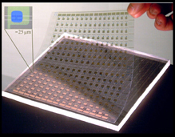


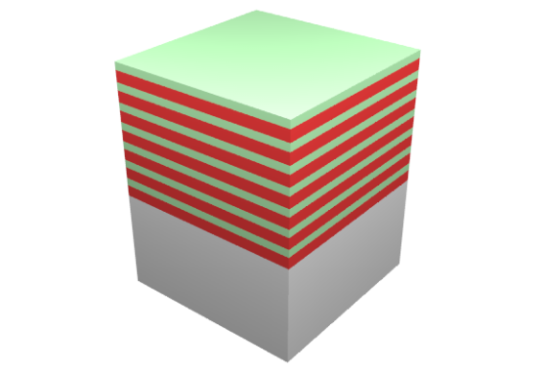





Low Cost Solar Cells:
From Fundamental Research to Commercialization
Basic Science
Applied R&D
Manufacturing/
Commercialization
EERE Solar America Initiative: Established new materials strategies & manufacturing methods for low-cost, high performance photovoltaic modules
John Rogers, Ralph Nuzzo (co-founders)
Micro-Contact Printed Solar Cells
Industrial collaborations
GaAs epi-stacks for
solar microcells
Basic research focused on materials-centric aspects of a micro-transfer printing process for single crystalline silicon and other semiconductors, dielectrics and metals.
release; transfer print
AlAs release
layers
GaAs wafer
etch in HF
regrow
23

Slide 24
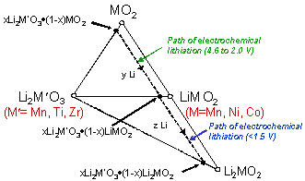


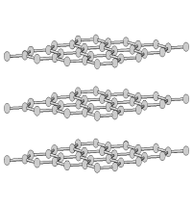


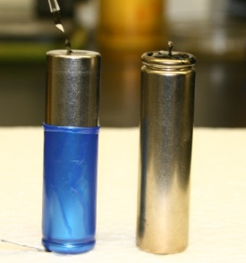

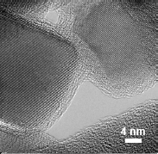


High-Energy Lithium Batteries:
From Fundamental Research to Cars on the Road
Basic Science
Applied R&D
Manufacturing/
Commercialization
Li_{x}C₆
(Anode)
xLi₂MnO₃•(1-x)LiMO₂
(Cathode)
e⁻
Li⁺
Discovered new composite structures for stable, high-capacity cathodes
Created high energy Li-ion cells…
Nanoparticle TiO₂ anode/C coating
EFRC research
…with double cathode capacity, enhanced stability
Tailored electrode-electrolyte interface using nanotechnology
Licenses to materials and cell manufacturers and automobile companies
24

Slide 25
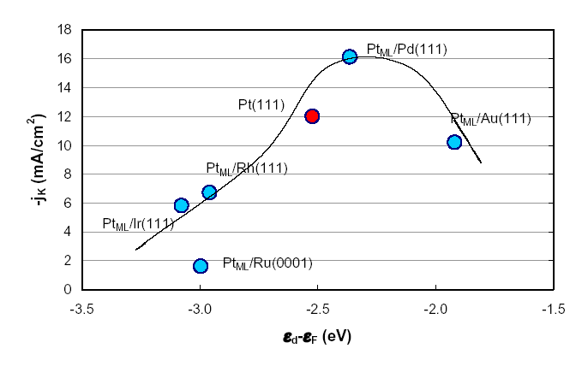
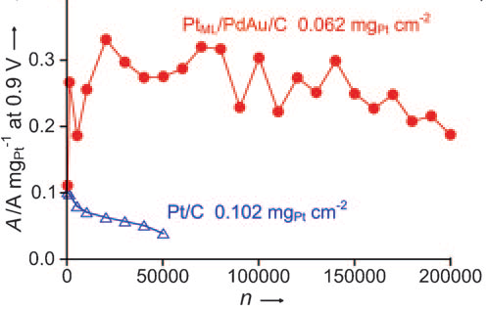
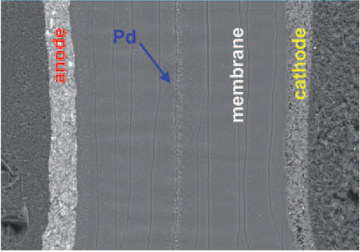
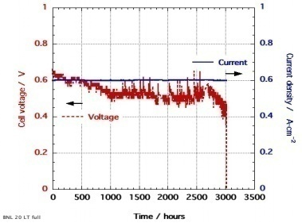
Platinum Monolayer Electro-Catalysts:
Stationary and Automotive Fuel Cells
Basic Science
Applied R&D
Manufacturing/
Commercialization
BES
BES → EERE
BNL-Toyota CRADA
Two research advances
Core-Shell Nanocatalysts
Scale-up synthesis: Pt-ML/Pd₉Au₁/C
Excellent fuel Cell durability 200,000 cycles
Pt Monolayer catalysis – high activity with ultralow Pt mass
Active Pt ML shell – Metal/alloy core
Core tunes activity & durability of shell
Core-shell catalyst
Model and HAADF image of a Pt Monolayer on Pd nanoparticle
Standard catalyst
Pt
Membrane Electrode Assembly >200K cycles
Very small Pt diffusion & small Pd diffusion
Pd
Pt stabilized against corrosion in voltage cycling by Au clusters
Pt-mass weighted activity enhanced 20x
3000 hr Fuel Cell Durability
Performance
Angewandte Chemie 49, 8602 (2010)
Fuel Cell Catalyst readied for automotive application
25
Science 315, 220 (2007)

Slide 26
Program Details

Slide 27
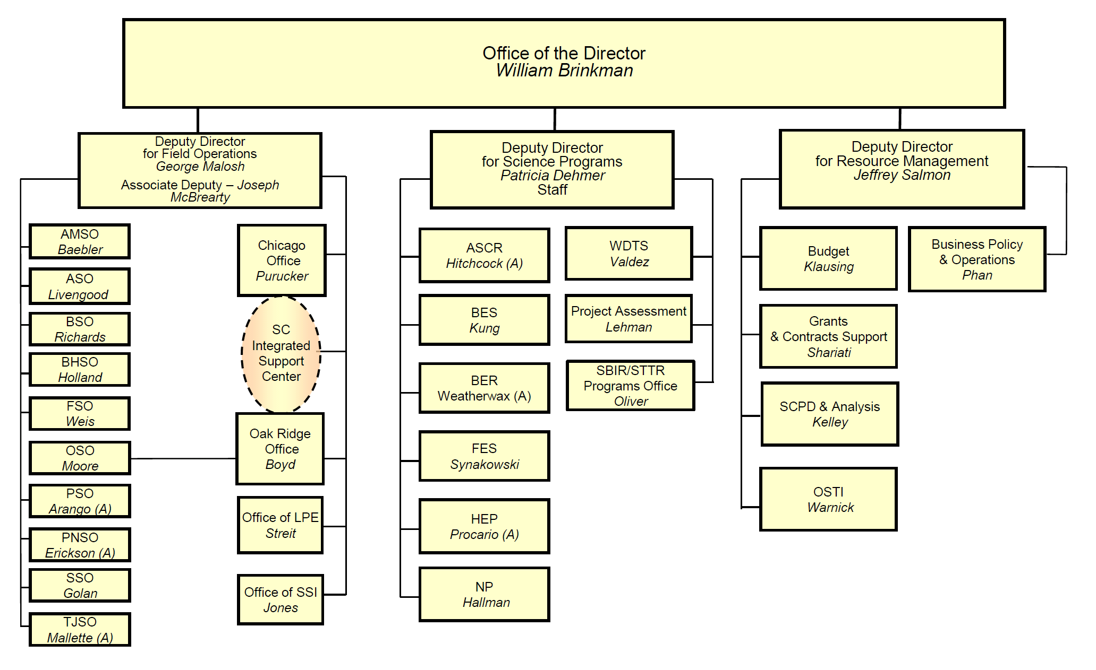
Notes:
27

Slide 28
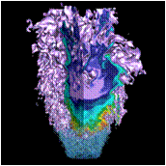
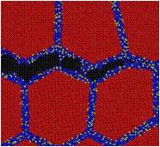
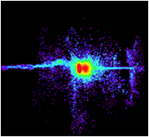
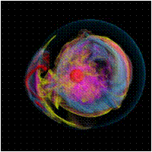
Advanced Scientific Computing Research
Delivering world leading computational and networking capabilities to extend the frontiers of science and technology
The Scientific Challenges:
Deliver next-generation scientific applications using today’s petascale computers.
Discover, develop and deploy tomorrow’s exascale computing and networking capabilities.
Develop, in partnership with U.S. industry, next generation computing hardware and tools for science.
Discover new applied mathematics and computer science for the ultra-low power, multicore-computing future.
Provide technological innovations for U.S. leadership in Information Technology to advance competitiveness.
FY 2012 Highlights:
Research in uncertainty quantification for drawing predictive results from simulation
Co-design centers to deliver next generation scientific applications by coupling application development with formulation of computer hardware architectures and system software.
Investments in U.S. industry to address critical challenges in hardware and technologies on the path to exascale
Installation of a 10 petaflop low-power IBM Blue Gene/Q at the Argonne Leadership Computing Facility and a hybrid, multi-core prototype computer at the Oak Ridge Leadership Computing Facility.

Slide 29
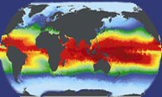
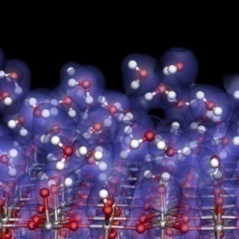
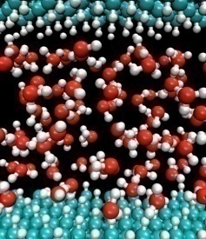
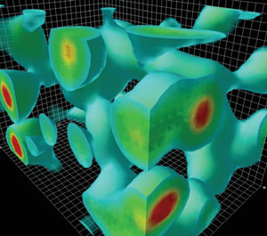
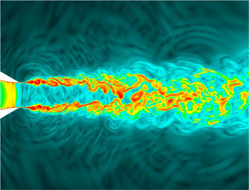
Investments for Exascale Computing
Opportunities to Accelerate the Frontiers of Science through HPC
Why Exascale?
SCIENCE: Computation and simulation advance knowledge in science, energy, and national security; numerous S&T communities and Federal Advisory groups have demon-strated the need for computing power 1,000 times greater than we have today.
U.S. LEADERSHIP: The U.S. has been a leader in high performance computing for decades. U.S. researchers benefit from open access to advanced computing facilities, software, and programming tools.
BROAD IMPACT: Achieving the power efficiency, reliability, and programmability goals for exascale will have dramatic impacts on computing at all scales–from PCs to mid-range computing and beyond.
DOE Activities will:
Leverage new chip technologies from the private sector to bring exascale capabilities within reach in terms of cost, feasibility, and energy utilization by the end of the decade;
Support research efforts in applied mathematics and computer science to develop libraries, tools, and software for these new technologies;
Create close partnerships with computational and computer scientists, applied mathematicians, and vendors to develop exascale platforms and codes cooperatively.

Slide 30
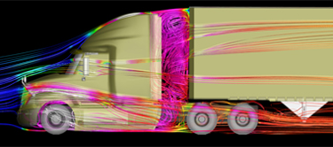
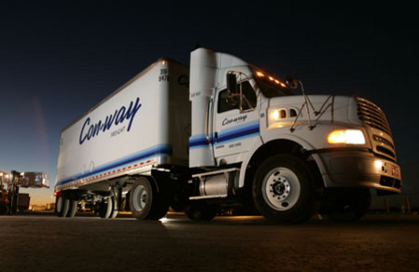







High Performance Computing: SmartTruck/DOE Partnership
Aerodynamic forces account for ~53% of long haul truck fuel use.
Class 8 semi trucks (300,000 sold annually) have average fuel efficiency of 6.7 MPG
Used ORNL’s Jaguar Cray XT-5 2.3 petaflop computer for complex fluid dynamics analysis – cutting in half the time needed to go from concept to production design
Outcome: SmartTruck UnderTray add-on accessories predict reduction of drag of 12% and yield EPA-certified 6.9% increase in fuel efficiency.
If the 1.3 million Class 8 trucks in the U.S. had these components, we would save 1.5 billion gallons of diesel fuel annually (~$4.4B in costs and 16.4M tons of CO₂)
Awarded as one of the “Top 20 products of 2010” from Heavy Duty Trucking magazine
Con-way Freight Inc. is the first corporation to install the SmartTruck UnderTray system.

Slide 31
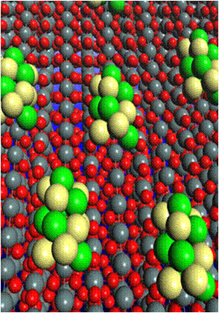
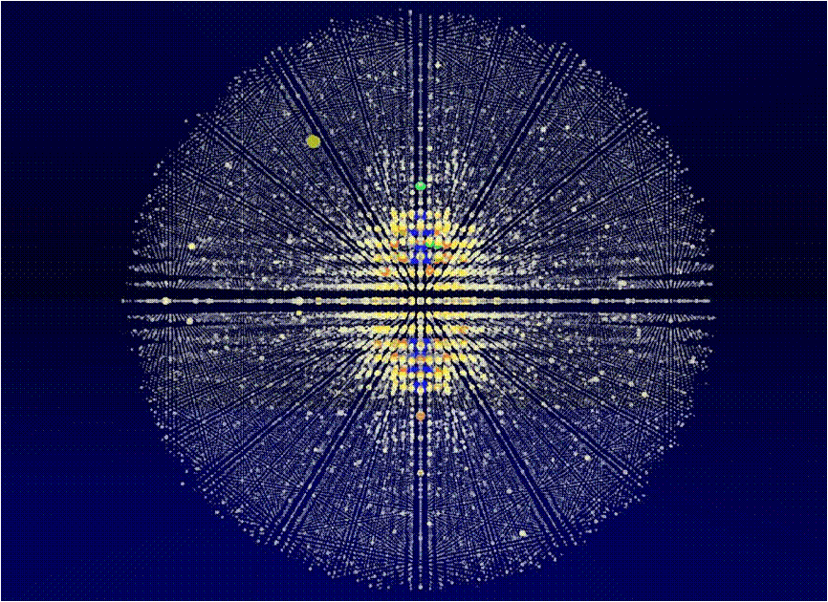
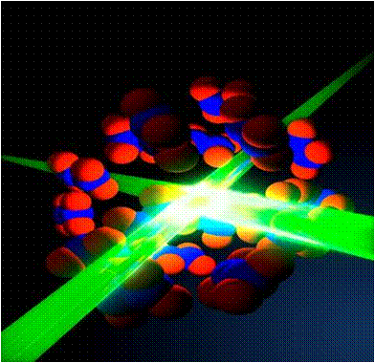
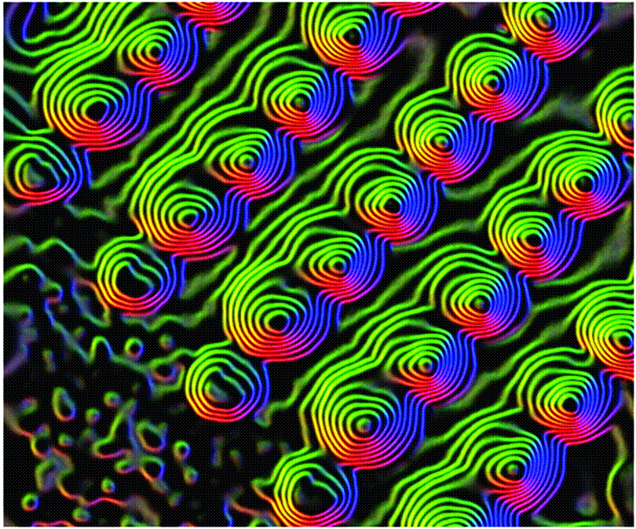
Basic Energy Sciences
Understanding, predicting, and ultimately controlling matter and energy flow at the electronic, atomic, and molecular levels
The Scientific Challenges:
Synthesize, atom by atom, new forms of matter with tailored properties, including nano-scale objects with capabilities rivaling those of living things
Direct and control matter and energy flow in materials and chemical assemblies over multiple length and time scales
Explore materials functionalities and their connections to atomic, molecular, and electronic structures
Explore basic research to achieve transformational discoveries for energy technologies
FY 2012 Highlights:
  Science for clean energy
      Batteries and Energy Storage Hub
      Interface sciences for high efficiency PV & next- generation nuclear systems; molecular design for carbon capture and sequestration; enabling materials sciences for transmission and energy efficiency; predictive simulation for combustion
Computational Materials and Chemistry by Design and Nanoelectronics research with inter-agency coordination.
Enhancements at user facilities:
  LCLS expansion (LCLS-II); NSLS-II EXperimental Tools (NEXT); APS Upgrade (APS-U); TEAM II (aberration-corrected microscope); upgraded beamlines and instruments at the major facilities

Slide 32
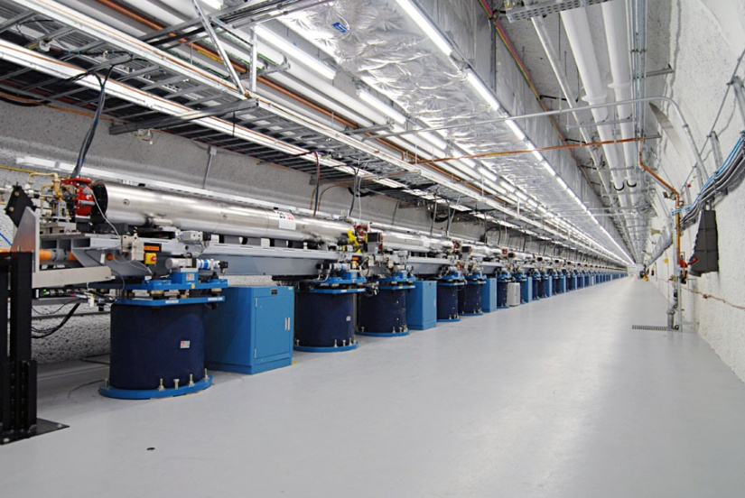
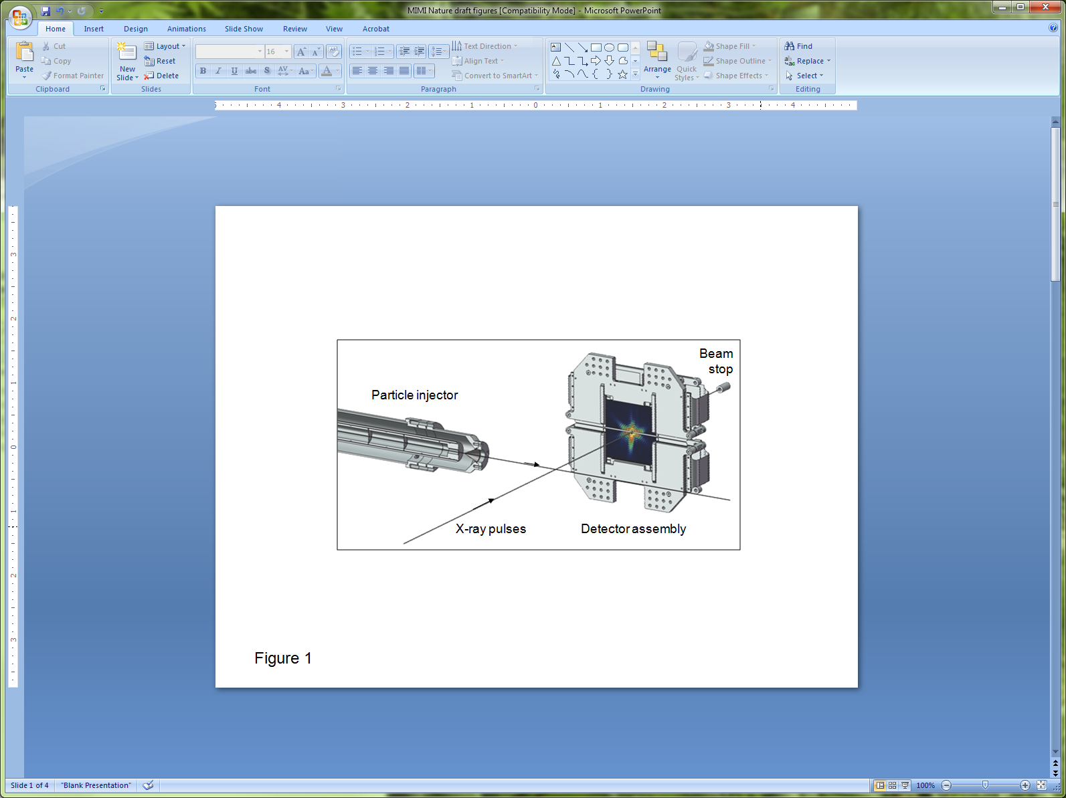
Nature Publishes First Bioimaging Results from the LCLS
The World’s First Hard X-ray Laser
Within 6 months of completion, LCLS is being used to study a wide array of science topics, including:
Hollow atoms
Magnetic materials
Structure of biomolecules in nano-crystals
Single shot images of viruses and whole cells
LCLS instruments provide new approach to x-ray bioimaging:
Liquid or aerosol injection
Very low noise, high-frame-rate CCD detectors
Integrated computing infrastructure to manage gigabytes of data per day

Slide 33
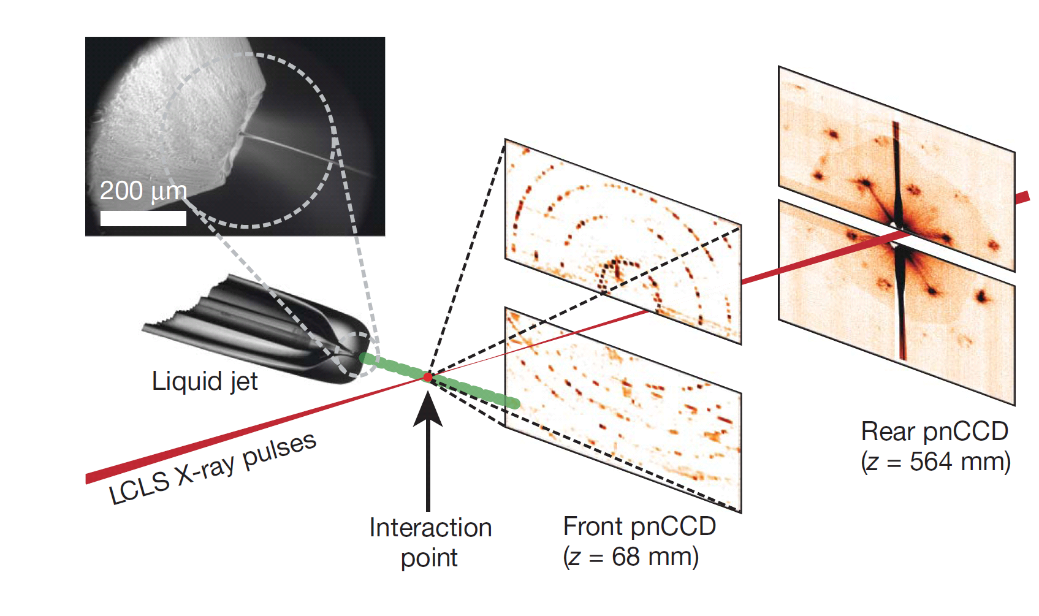
Femtosecond X-ray Protein Nanocrystallography
Nanocrystals flow in their buffer solution in a gas-focused, 4-μm-diameter jet at a velocity of 10m/sec perpendicular to the pulsed X-ray FEL beam that is focused on the jet.
Chapman, H. N., et al. Nature, Feb 3rd, 2011.

Slide 34
Femtosecond X-ray Protein Nanocrystallography
Photosystem I plays key role in photosynthesis.
Difficult to crystallize and use standard x-ray crystallography to obtain structure.
Single shot images from LCLS of nanocrystals used to build up full 3-D diffraction pattern.
Low resolution (~9 Å) shows structural details (e.g., helix density).
Single shot diffraction pattern
Combined 3D diffraction pattern
Reconstructed 3-D Structure
Chapman, H. N., et al. Nature, Feb 3rd, 2011.

Slide 35
High-Energy Lithium Batteries:
From Fundamental Research to Cars on the Road
Basic Science
Applied R&D
Manufacturing/
Commercialization
Li_{x}C₆
(Anode)
xLi₂MnO₃•(1-x)LiMO₂
(Cathode)
e⁻
Li⁺
Discovered new composite structures for stable, high-capacity cathodes
Created high energy Li-ion cells…
Nanoparticle TiO₂ anode/C coating
EFRC research
…with double cathode capacity, enhanced stability
Tailored electrode-electrolyte interface using nanotechnology
Licenses to materials and cell manufacturers and automobile companies
35

Slide 36
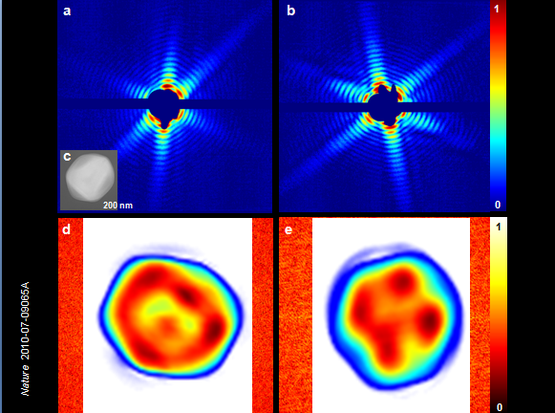
Single Mimi Virus Particles Intercepted and Imaged
Mimi virus is the largest known virus. Its size is comparable to the size of the smallest living cells – 45μm.
Cannot be crystallized or imaged by conventional techniques.
Reconstructions of single shot images from LCLS (32 nm resolution) reveal inhomogeneous interior structure of virion.
Future enhancements will improve resolution and enable visualization of contents of living cells.
Single shot scattering patterns (above) and reconstructed images (below)
Seibert, M. M., et al. Nature, Feb 3rd, 2011

Slide 37
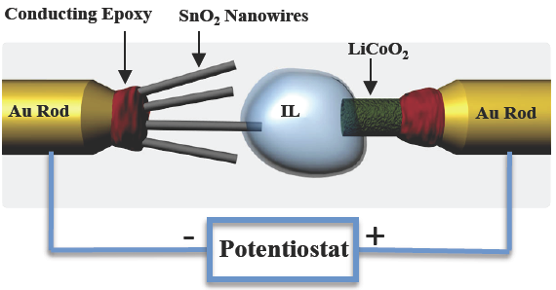
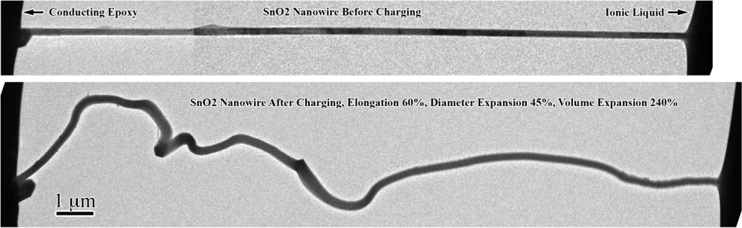







Advancing Energy Technologies through Energy Frontier Research Centers
World’s smallest battery placed inside an electron microscope yields images of electrochemistry at atomic scales
New insight into electrochemical processes at the nanoscale:
    Nanowires can sustain large stresses (>10 GPa) caused by Li⁺ transport without breaking—good candidate for battery
    Elongation and twisting of nanowires during charging may lead to a short circuit and failure of the battery, a key factor to consider during design
    Research at SNL supported by the Center for Science of Precision Multifunctional Nanostructures for Electrical Energy Storage (an EFRC led by University of Maryland) and in collaboration with PNNL and university contributors
Jian Yu Huang, et al., Science 330, 1515 (2010)

Slide 38





EFRC Research Predicts Radiation Damage Resistant Materials
Simulations reveal why nanostructured materials with a large number of grain boundaries exhibit increased tolerance to radiation damage
New interstitial emission and vacancy recombination mechanism critical to self-healing of radiation damaged material
    At very short times, interstitial atoms are concentrated on the grain boundary, but at longer times they re-emit and annihilate trapped vacancies many atomic distances away
    Grain boundaries loaded with interstitials reduce the barrier for vacancy diffusion and promote defect recombination
    Designed nanostructured grain boundaries could slow down the accumulation of radiation damage
Research supported by the Center for Materials at Irradiation and Mechanical Extremes (an EFRC led by Los Alamos National Laboratory)
Radiation damage
Interstitials quickly move to grain boundary
Vacancies trapped in bulk material
interstitial emission
Interstitials
emit from grain boundary
Interstitials
and vacancies recombine
Diffusion of remaining vacancies very slow
Xian-Ming Bai et al. Science, 327, 1631 (2010)

Slide 39




Biological and Environmental Research
Understanding complex biological, climatic, and environmental systems across vast spatial and temporal scales
The Scientific Challenges:
Understand how genomic information is translated with confidence to redesign microbes, plants or ecosystems for improved carbon storage, contaminant remediation, and sustainable biofuel production
Understand the roles of Earth’s biogeochemical systems (atmosphere, land, oceans, sea ice, subsurface) in determining climate so we can predict climate decades or centuries into the future, information needed to plan for future energy and resource needs.
FY 2012 Highlights:
Clean energy biodesign on plant and microbial systems through development of new molecular toolkits for systems and synthetic biology research.
Research and new capabilities to develop a comprehensive Arctic environmental system model needed to predict the impacts of rapid climate change.
Continue support for the three DOE Bioenergy Research Centers, and operations of the Joint Genome Institute, the Environmental Molecular Sciences Laboratory, and the Atmospheric Radiation Measurement Climate Research Facility.

Slide 40






Advancing Energy Technologies through Bioenergy Research Centers
In the first three years of operations, the BRCs together had 66 inventions in various stages of the patent process, from disclosure to formal patent application, and over 400 peer-reviewed publications.
Developed modified switchgrass that enable a 30% improvement in the yield of ethanol
Used synthetic biology toolkit to construct the first microbes to produce an advanced biofuel (biodiesel) directly from biomass.
Characterized impacts of
biomass crop agriculture on marginal lands, studying shifts
in microbial community and
potential for changes in
greenhouse gas emissions.

Slide 41



Tackling Major Climate Uncertainties:
The Atmospheric Radiation Measurement Climate Research Facility (ACRF)
The ACRF provides the world’s most comprehensive 24/7 observational capabilities for obtaining atmospheric data for climate change research.
ARM data have transformed our understanding of aerosol-cloud interactions and built the most advanced parameter-izations of atmospheric radiative transfer.
The ARM Facility operates highly instrumented ground stations worldwide to study cloud formation and aerosol processes and their influence on radiative transfer.
In FY 2012, ARM will deploy its new suite of measurement capabilities to regions of high scientific interest, e.g., the Azores (marine clouds) and Alaska (Arctic clouds and aerosols over land, sea, and ice).
Scanning Cloud
Radar with Data Plot
The challenge of studying radiative transfer on land-ice-atmosphere-water in the Arctic

Slide 42




Fusion Energy Sciences
Understanding matter at very high temperatures and densities and building the scientific foundations for a fusion energy source
The Scientific Challenges:
Control a burning plasma state to form the basis for fusion energy
Develop materials that can withstand the harsh heat and neutron irradiation in fusion facilities
Manipulate and control intense transient flows of energy and particles
Control the interaction of matter under extreme conditions for enabling practical inertial fusion energy
FY 2012 Highlights:
ITER construction is supported
DIII-D, Alcator C-Mod, and NSTX operate and investigate predictive science for ITER
HEDLP investments continue in basic research on fast ignition, laser-plasma interaction, magnetized high energy density plasmas, and warm dense matter
International activities are increased
SciDAC expands to include fusion materials
The Fusion Simulation Program pauses to assess now-completed planning activities

Slide 43


Progress on the ITER Project
ITER’s goal: first demonstration of high-gain fusion energy production—fusion power 10 times greater than that used to heat the plasma.
  The U.S. is a member to the ITER partnership, formed by seven governments representing
  more than half the world’s population. It is a 10-year construction activity in France.
This past year, the U.S. led initiatives to put in place a world-leading management team for the construction phase of ITER and to establish the cost and schedule baselines.
Site construction is underway in Cadarache, France
The ITER Device

Slide 44



Stabilization of High-Temperature Plasmas
U.S. researchers at the DIII-D tokamak invented a new method for mitigating potentially damaging transient heat fluxes (Edge Localized Modes) by precision manipulation of the magnetic field.
This can have an enormous positive impact for ITER if the results can be verified.
Researchers at the Max Planck Institute (Garching, Germany) recently made major modifications to the ASDEX-U tokamak and reproduced these results.
DIII-D
Time (ms)
ITER: ELM coil design

Slide 45




Nuclear Physics
Discovering, exploring, and understanding all forms of nuclear matter
The Scientific Challenges:
Understand:
  The existence and properties of nuclear matter under extreme conditions, including that which existed at the beginning of the universe
  The exotic and excited bound states of quarks and gluons, including new tests of the Standard Model
  The ultimate limits of existence of bound systems of protons and neutrons
  Nuclear processes that power stars and supernovae, and synthesize the elements
  The nature and fundamental properties of neutrinos and neutrons and their role in the matter-antimatter asymmetry of the universe
FY 2012 Highlights:
12 GeV CEBAF Upgrade to study exotic and excited bound systems of quarks and gluons and for illuminating the force that binds them into protons and neutrons.
Design of the Facility for Rare Isotope Beams to study the limits of nuclear existence.
Operation of three nuclear science user facilities (RHIC, CEBAF, ATLAS); closure of the Holifield Radioactive Ion Beam Facility at ORNL.
Research, development, and production of stable and radioactive isotopes for science, medicine, industry, and national security.

Slide 46

Discovery of Element 117
A new super heavy element (SHE) with atomic number 117 was discovered by a Russian-U.S. team with the bombardment of a Berkelium target by 48-Ca. The existence and properties of SHEs address fundamental questions in physics and chemistry:
How big can a nucleus be?
Is there a “island of stability” of yet undiscovered long-lived heavy nuclei?
Does relativity cause the periodic table to break down for the heaviest elements?
Experiment conducted at the Dubna Cyclotron (Russia) with an intense 48-Ca beam
Berkelium target material produced and processed by the Isotopes Program at ORNL
Detector and electronics provided by U.S. collaborators were used with the Dubna Gas-Filled Recoil Separator
Rare short-lived 248-Bk was produced at HFIR and processed in Isotope Program hot cell facilities at ORNL to purify the 22 mg of target material used for the discovery of element 117.

Slide 47

New Antimatter Detected at RHIC’s STAR Detector
Discovery of the heaviest known antinucleus and first antinucleus with an anti-strange quark, from gold nuclei collisions at RHIC.
Opens further exploration of fundamental symmetries and understanding the dominance of matter over antimatter in the universe
Has implications for our understanding of the structure of collapsed stars
Discovery extends 3-D chart of the nuclides and suggests even heavier antinuclei exist.
The STAR collaboration observed the first antimatter hypernucleus: antihypertriton. This nucleus contains an antiproton, an antineutron, and an antilambda hyperon, which is made up of an up quark, a down quark, and a strange quark. The discovery extends our knowledge of the nuclear terrain, represented by a three-dimensional graph with axes Z, the number of protons in a nucleus; N, the number of neutrons; and S, the degree of strangeness. Each axis has positive and negative sections, representing particles and antiparticles. This latest result extends the nuclear terrain below the N–Z plane for the first time.
Results highlighted at the American Physical Society Meeting, Feb 13-16, 2010; Over 500 related news articles published worldwide.

Slide 48





Isotope Development and Production Program
Making hundreds of isotopes available to the community for science, medicine, industry and national security.
  Decision-making guided by strategic planning with federal agencies, community, and peer review mechanisms
  Coordinating with other federal agencies on addressing shortages of critical isotopes such as He-3 and Mo.
  Broadening the suite of isotope production facilities to include university facilities and other laboratory facilities.
50 mCi of purified Ac-225 from new isotope R&D program–important for medical trials
Production of Ni-63 for trace explosives detection systems
Cf-252 production for well logging and research

Slide 49
Production Sites of the Isotope Program
Brookhaven – BLIP:
Ge-68 – Calibration sources for PET equipment; Antibody labeling
Sr-82 – Rb-82 gen used in cardiac imaging
Cu-67 – Antibody label for targeted cancer therapy
Richland:
Sr-90 – Y-90 gen for cancer therapy
Idaho – ATR:
Co-60 – Sterilization of surgical equipment and blood
NIH - Cyclotrons:
Collaborative supplier for research isotopes (e.g. Br-76)
Washington Univ:
Collaborative supplier for research isotopes
(e.g. Cu-64)
20%
Science Research
20%
Industry
Oak Ridge – HFIR:
Se-75 - Industrial NDA; Protein studies
Cf-252 - Industrial source
W-188 - Cancer therapy
Stable Isotopes Inventory:
Top 10 stable isotopes sold over the last 5 years:
Ca-48, Ga-69, Rb-87, Cl-37, Pt-195, Nd-146, Sm-149, Ru-99, Zr-96
Inventory:
Ac-225 - Cancer therapy
60%
Medical: Clinical
Diagnostic, & Research
UC Davis/McClellan:
Collaborative supplier for research isotopes (e.g. At-211)
Columbia – MURR:
Collaborative supplier for research isotopes
(e.g. As-72)
Los Alamos – LANSCE/IPF:
Ge-68 – Calibration sources for PET equipment; Antibody labeling
Sr-82 – Rb-82 gen used in cardiac imaging
As-73 – Biomedical tracer
Savannah River – Tritium Facility:
(NNSA)
He-3 – Neutron detection
– Fuel source for fusion reactors
– Lung testing

Slide 50




High Energy Physics
Understanding how the universe works at its most fundamental level
The Scientific Challenges:
  Determine the origins of mass in terms of the fundamental particles and their properties
  Exploit the unique properties of neutrinos to discover new ways to explain the diversity of particles
  Discover new principles of nature, such as new symmetries, new physical laws, or unseen extra dimensions of space-time
  Explore the “dark” sector that is 95% of the Universe (Dark Matter and Dark Energy)
  Invent better and cheaper accelerator and detector technologies to extend the frontiers of science and benefit society
FY 2012 Highlights:
Support for U.S. researchers at the LHC
Research, design, and construction for NOvA, LBNE, and Mu2e experiments as part of a program of high energy physics at the intensity frontier
Research in accelerator technologies including superconducting radio frequency and plasma wakefield acceleration.
U.S. participation in international collaborations pursuing dark matter, dark energy and neutrino physics; the Reactor Neutrino Experiment in China and the Dark Energy Survey in Chile begin operations in FY 2012

Slide 51




Fermi Gamma-Ray Space Telescope (FGST)
Many Unexpected Findings about the Gamma-ray Sky
March 2010: Results show that less than 1/3 of gamma-ray emission arises from black-hole-powered jets in active galaxies. Particle acceleration occurring in normal star-forming galaxies or gamma-ray production from dark matter particle interactions may be the cause.
October 2009: 1 year map of the gamma-ray sky, showing the rate at which the LAT detects gamma-rays above 300 MeV. Brighter colors represent higher rates. Blue denotes the extragalactic gamma-ray background.
The 2011 Bruno Rossi Prize in Astrophysics is being awarded to Bill Atwood (SLAC) and Peter Michelson (Stanford) and the FGST/LAT team for enabling, through the development of the LAT, new insights into variety of high energy cosmic phenomena.
August 2010: The Fermi LAT detected gamma-rays from a nova for the first time overturning the long-held assumption that novae explosions lack the power to emit such high-energy radiation.
DOE partnered with NASA on the fabrication of the Large Area Telescope (LAT), with contributions from France, Japan, Italy and Sweden. The LAT is the primary instrument on NASA’s FGST, launched in June 2008. SLAC managed the fabrication and now hosts the LAT Instrument Science Operations center.

Slide 52


The Energy Frontier: Tevatron (FNAL) and the LHC
The Tevatron at FNAL has been running extremely well.
  Experiments now significantly limit the allowed values of the Standard Model (SM) Higgs Boson. These limits will continue to improve, ruling out a larger range of SM Higgs masses.
The LHC is also running extremely well.
  LHC is expected to discover or rule out the Higgs Boson across the entire SM mass range by the end of 2012.
An extended Tevatron run was considered
  Though shutdown was planned after FY 2011, the High Energy Physics Advisory Panel (HEPAP) was asked to advise the Office of Science on extension of running. In light of potential impacts on the rest of the HEP program, particularly the Intensity Frontier activities, HEPAP recommended that the Tevatron run be extended for three years only if additional funds could be secured.
  The FY 2012 President’s Request does not include running the Tevatron beyond 2011.
Tevatron
LHC

Slide 53
The Intensity Frontier: Neutrinos and Rare Processes
The Intensity Frontier uses intense particle beams to uncover properties of neutrinos and observe rare processes that point to new paradigms of physics.
The U.S. is poised to make significant advances at the Intensity Frontier.
The FY 2012 budget request builds on unique capabilities at Fermilab and supports associated research in Intensity Frontier physics.
Neutrino Physics
Mixing: Experimental evidence that neutrinos can switch (“mix”) from one type to another proved that these elementary particles have non-zero mass, which violates the predictions of the Standard Model of particle physics.
More detailed measurements of mixing in neutrinos and other elementary particles could reveal differences between matter and antimatter and discover new physics.
Rare Processes
The Mu2e experiment will search for the conversion of a muon to an electron in the field of a nucleus.
This is expected to be a very rare event, and an intense source of muons and a large detector will be required.
This experiment searches for fundamentally new symmetries in the laws of nature.

Slide 54

The Neutrino Physics Program
Neutrinos from the Main Injector (NuMI) is the most intense neutrino beamline in the world.
Experiments using this beamline use a detector near the neutrino source at Fermilab and also a far detector, hundreds of kilometers away.
Experiments seek to quantify neutrino mixing; measure the neutrino masses; and detect the effects of matter on neutrinos as they pass through the earth.
Summary of key experiments:
MINOS – This experiment has produced the most precise measurement of one of the neutrino mass differences. Operations continue to collect data for initial measurements of neutrino and antineutrino behavior.
NuMI Off-Axis Electron Neutrino Experiment (NOvA) – Results from MINOS and other experiments worldwide helped determine the design specifications for this experiment. NOvA will provide precision measurements of neutrino mixing and will determine the relative masses of neutrinos. Funds are requested to continue construction in FY 2012. Operations are planned to being in 2013.
Long Baseline Neutrino Experiment (LBNE) – Like NOvA, the specific design will be determined by the results of currently active experiments. LBNE should be sensitive to differences between neutrinos and antineutrinos to test our assumptions about the symmetries between matter and antimatter and will deliver more precise measurements of neutrino mixing.
The trajectory of the NuMI beam and far detectors
The NuMI horn, part of the neutrino sources

Slide 55

Long Baseline Neutrino Experiment (LBNE)
A high priority experiment at the intensity frontier
LBNE will explore the interactions and transformations of neutrinos from the world’s highest intensity neutrino beam at FNAL.
Precision measurements from LBNE could explain why there is more matter than antimatter in the Universe and bring us closer to a Grand Unified Theory of the fundamental forces of nature.
Tau neutrino
ν
τ
Electron neutrino
ν
ν
e
Muon neutrino
μ

Slide 56
Deep Underground Science and Engineering Laboratory (DUSEL)
The FY2012 Request includes $15 M ($10 M in HEP and $5M in NP) to maintain the viability of DUSEL, including dewatering and maintaining security, while DOE assesses options for an underground research program.
DOE has plans for Long Baseline Neutrino, Dark Matter, and Double Beta Decay experiments.
A DOE assessment will identify options to carry out the planned research program in a cost effective way, including an alternatives analysis for the location of individual experiments.
The DOE assessment will seek input from the DOE, NSF, and the DUSEL stakeholder communities as well as the Sanford Laboratory in Lead, South Dakota.

Slide 57



Accelerator Technologies Developed for
Basic Research Have Far-Reaching Benefits
Higher field magnets using new superconductors enable new applications
  High frequency NMR by Oxford Instruments using materials developed by HEP
  Compact cyclotrons for making medical isotopes
  ITER will use new superconducting cables first developed by HEP
Higher gradient superconducting RF cavities for new accelerators
  HEP R&D led to new US companies producing high performance superconducting RF cavities.
Entirely new methods of accelerating
particles using plasmas could make
Accelerators 10-100x smaller.

Slide 58


HEP & NP Superconducting Radio Frequency (SRF) Development
The U.S. is now the leader in SRF technology
Superconducting electron gun, developed at BNL by DOE in cooperation with DOD and industry.
World's most advanced
superconducting accelerator
cavity developed at ANL.
A large variety of RF cavities are used in particle accelerators. Historically they have been made of copper and operated near room temperature with water cooling. In the past two decades, though, there has been a growing number of accelerator facilities for which SRF cavities were desirable or necessary.
Several U.S. laboratories have world-leading capabilities in SRF technology: ANL, BNL, FNAL, TJNAF.
U.S. industries are commercializing SRF: Advanced Energy Systems (Medford, NY) and Niowave, (Lansing, MI)
Other potential applications include high-power lasers, naval defense, disposal of long-lived nuclear waste, “clean” accelerator-driven-systems nuclear energy

Slide 59




Workforce Development for Teachers and Scientists
Encouraging and supporting the next generation of scientific talent
Program Goals:
Increase the pipeline of talent pursuing research important to the Office of Science
Leverage the resources of the DOE national laboratories for education and training
Increase participation of under-represented students and faculty in STEM programs
Improve methods of evaluation of effectiveness of programs and impact on STEM workforce
FY 2012 Highlights:
Office of Science Graduate Fellowships—
3-year fellowships to pursue advanced degrees in areas of research important to the Office of Science
150 Fellowships in FY10 (1st year of the program); 450 in steady state
National Science Bowl (NSB)—
Regional and national middle school and high school competitions to encourage education and careers in science, with 22,000 students from 1,500 schools
Research Experiences at DOE Labs—
Science Undergraduate Laboratory Internship
Community College Institutes
Academies Creating Teacher Scientists for middle school and high school educators

Slide 60


Supporting and Encouraging Next Generation Scientists
The National Science Bowl
Middle School and High School Students
Begun in 1991, DOE’s National Science Bowl® is a nationwide academic competition that tests students' knowledge in all areas of science. High school and middle school students are quizzed in a fast paced question-and-answer format similar to Jeopardy.
22,000 students from 1,500 schools; 6000 volunteers
Office of Science Graduate Fellowship
Graduate Students
  Begun in 2009 with ARRA funding, the SCGF program provides 3-year fellowship awards totaling $50,500 annually.
  The awards provide support towards tuition, a stipend for living expenses, and support for expenses such as travel to conferences and to DOE user facilities.
First Lady Michelle Obama and Secretary of Energy Steven Chu congratulate Albuquerque Academy, Albuquerque, NM, First Place winner in the 2010 NSB Middle School competition .
DOE SCGF Cohort 2010 at the SCGF Annual Meeting at Argonne National Laboratory.

Slide 61





Science Laboratory Infrastructure
Supporting infrastructure and fostering safe and environmentally responsible operations at the Office of Science laboratories
Program Goals:
  Support scientific and technological innovation at the Office of Science laboratories by providing state-of-the-art research space in modern, safe, and sustainable laboratory facilities.
  Correct longstanding infrastructure deficiencies while ensuring laboratory infrastructure provides a safe and quality work environment.
  Support stewardship responsibilities for the Oak Ridge Reservation and the Federal facilities in the city of Oak Ridge, and provide payments in lieu of taxes to local communities around the Argonne, Brookhaven, and Oak Ridge National Laboratories.
FY 2012 Highlights:
Continuation of funding for five ongoing line item construction projects at ANL, BNL, LBNL, SLAC and TJNAF
Supports one new construction start at SLAC for the Science & User Support Building which will bring together many of the laboratory’s visitors, users, and administrative services
Modernization of Laboratory Facilities at ORNL project is scheduled to complete construction in 1QFY12
Building 74 Renovation at LBNL is scheduled for completion in 1QFY12
ANL
ORNL
LBNL
BNL
SLAC
TJNAF

Slide 62
Safeguards and Security
Supporting appropriate levels of protection against unauthorized access, theft, or destruction of DOE assets and hostile acts
Program Goals:
Provide physical and cyber security controls at Office of Science national laboratory facilities to mitigate risks to facilities and laboratory employees to an acceptable level while enabling the mission.
Assure site security programs result in the secure workplace required to facilitate scientific advances.
Align accountability for performance through National Standards, rigorous peer review, and Federal oversight through mature contractor assurance systems.
Protect special, source, and other nuclear materials, radioactive material, and classified and unclassified controlled information at Office of Science laboratories.
FY 2012 Highlights:
The baseline level of protection to provide mission tailored security
Full recovery for S&S services to non-DOE customers to reduce pressure on overhead burdens and S&S budgets
Oversight through mature contractor assurance systems to minimize duplicative audits and assessments.
Investments in infrastructure and automation technology to reduce reliance on personnel for routine security functions and long-term costs

Slide 63
Program Direction
Supporting a skilled workforce to oversee the Office of Science investments in world-leading scientific research
Program Goals:
  Ensure the recruitment and retention of a highly skilled workforce to provide the planning, execution, oversight, and management of the Office of Science’s research programs and world-leading facilities
  Provide an effective modernized business infrastructure to support the scientific mission
  Provide public access to DOE-supported research results
  Support professional development opportunities for the Office of Science workforce
FY 2012 Highlights:
Supports salaries and benefits of over 1,000 FTEs across the Office of Science complex.
Supports the development of an improved internal grants management system through best-in-class software development.
Supports development of an integrated, transparent information technology system between HQ and Field operations looking to cloud computing and other cost efficiency gains.

Slide 64
America COMPETES Reauthorization Act of 2010
Section 103:
Establishes a working group under the National Science and Technology Council to coordinate Federal science agency research and policies related to the dissemination and long-term stewardship of the results of unclassified research, including digital data and peer reviewed scholarly publications, supported wholly, or in part, by funding from the Federal science agencies.

Slide 65
New NSAC Charge
To submit a report describing current policies and practices for disseminating research results in the fields relevant to the Nuclear Physics Program.
The report should:
Describe current policies and practices for disseminating research results, including written findings and digital data, in the fields relevant to the Nuclear Physics Program.
Identify which dissemination models, if any, successfully maximize the potential benefit of research results in a way that is sustainable within the research community.
Identify any opportunities where public access policies or practices could enhance the discovery potential of Office of Science research results.
The report should be finalized by July 1st, 2011.

