Slide 1
Climate and Environmental Sciences Division
--update--
G. L. Geernaert
Director, CESD
BERAC
March 9-10, 2011

Slide 2
Outline
Vision and culture
Personnel
Division-wide: ARRA, workshops, etc.
Scientific highlights

Slide 3
Vision, Culture
CESD is the lead federal organization for federal, state, and local stakeholders requiring highly innovative and cost-effective climate-environment science solutions that can be rapidly developed in response to national challenges.
We utilize a business model that maximizes the return on federal investment, e.g., we strive for the most efficient use of taxpayer investment. We focus on both existing and anticipated challenges that exploit the best talent, facilities, and institutional relationships.
We earn the enthusiasm of stakeholders through continuous creativity, innovation, and responsiveness, driven by the integrity, teamwork, commitment, responsiveness, and agility of DOE/SC/BER/CESD staff.

Slide 4



Updates: new hires
Dorothy Koch
Climate modeling
Renu Joseph
Climate modeling
Dan Stover
Terrestrial
ecology

Slide 5
New priorities bridging programs and divisions towards efficient production of innovative science
Build on historical strengths: user facilities, HPC; field work; modeling; major campaigns
Arctic (NGEE): subsurface BGC/genomics, ecology, upscalable local modeling
Natural variability: MJO, seasonal hydrology, etc.
Revolutionary experimental methodologies
Efficiently managing massive continuous data acquisition
Uncertainty quantification: benchmarks; systems dynamics and UQ pdf’s; potential ROI

Slide 6
Workshops/meetings of value to CESD
Arctic permafrost and climate science
  Fairbanks workshop: Oct 2010
  AGU follow-up: Dec 2010
  Permafrost data at Argonne: Feb 2011
Uncertainty quantification
  UQ methodologies: Jan 2011
Climate prediction
  Interagency, w/ US Navy: Oct 2010
  National Research Council: climate modeling - ongoing
ARM review: Feb 2011
Various programmatic interactions: EERE, EM, NSF, NOAA, Navy, DOD, USGCRP, OMB, …

Slide 7
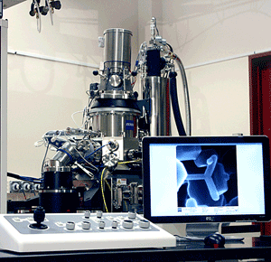
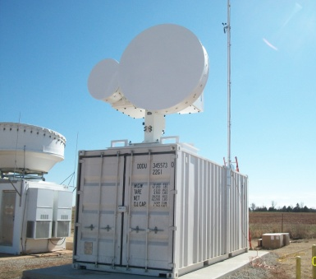

Status of CESD Recovery Act Projects
Environmental Molecular Sciences Laboratory (EMSL) - $60M.
  NMRs, mass specs, imaging capabilities, nano-characterization.
  All 36 new capabilities accepted or in acceptance phase.
Atmospheric Radiation Measurement (ARM) Climate Research Facility - $60M
  3-D cloud and precipitation characterization
  New aerosol and surface characterization measurements
Integrated Assessment Research Program - $4.9M
  Mid-size cluster (Evergreen) in place and supporting research.
7 BER Overview
Department of Energy • Office of Science • Biological and Environmental Research
Notes:
EMSL instrument is the helium ion microscope.
ARM image is the dual frequency scanning cloud radar on right and the vertically pointing upgraded cloud radar on left. These examples are installed at Southern Great Plains site.
Evergreen is located at the University of Maryland, College Park campus.

Slide 8
Program scientific highlights

Slide 9
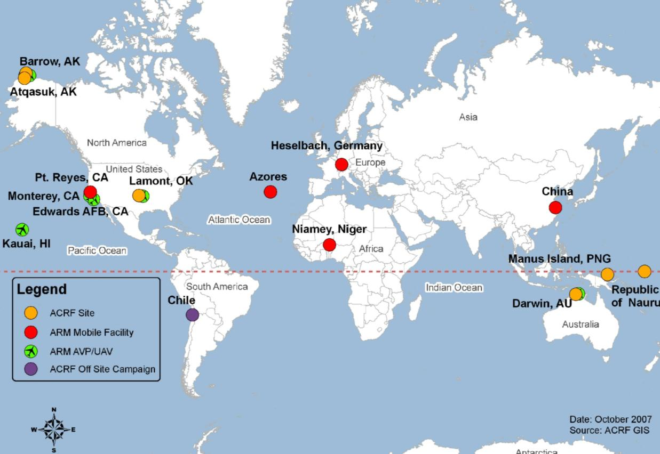
DOE Scientific User Facility
ARM Climate Research Facility
2 mobile & 3 fixed sites
Provides continuous field measurements and data products that improve cloud science in climate models
Notes:
The Atmospheric Radiation Measurement (ARM) Facility establishes and operates field research sites, both fixed and mobile. The fixed site locations represent a range of climate conditions that need to be studied to improve the climate models. Each site has been heavily instrumented to gather massive amounts of climate data. Data are collected 24 7 and are available for use typically within a day. Using these data, scientists are studying the effects and interactions of sunlight, radiant energy, and clouds to understand their impact on temperatures, weather, and climate.
The mobile facility experiments target science questions critical for improving the models.
The slide shows the location of the fixed sites as well as the locations of the mobile facility deployments.

Slide 10
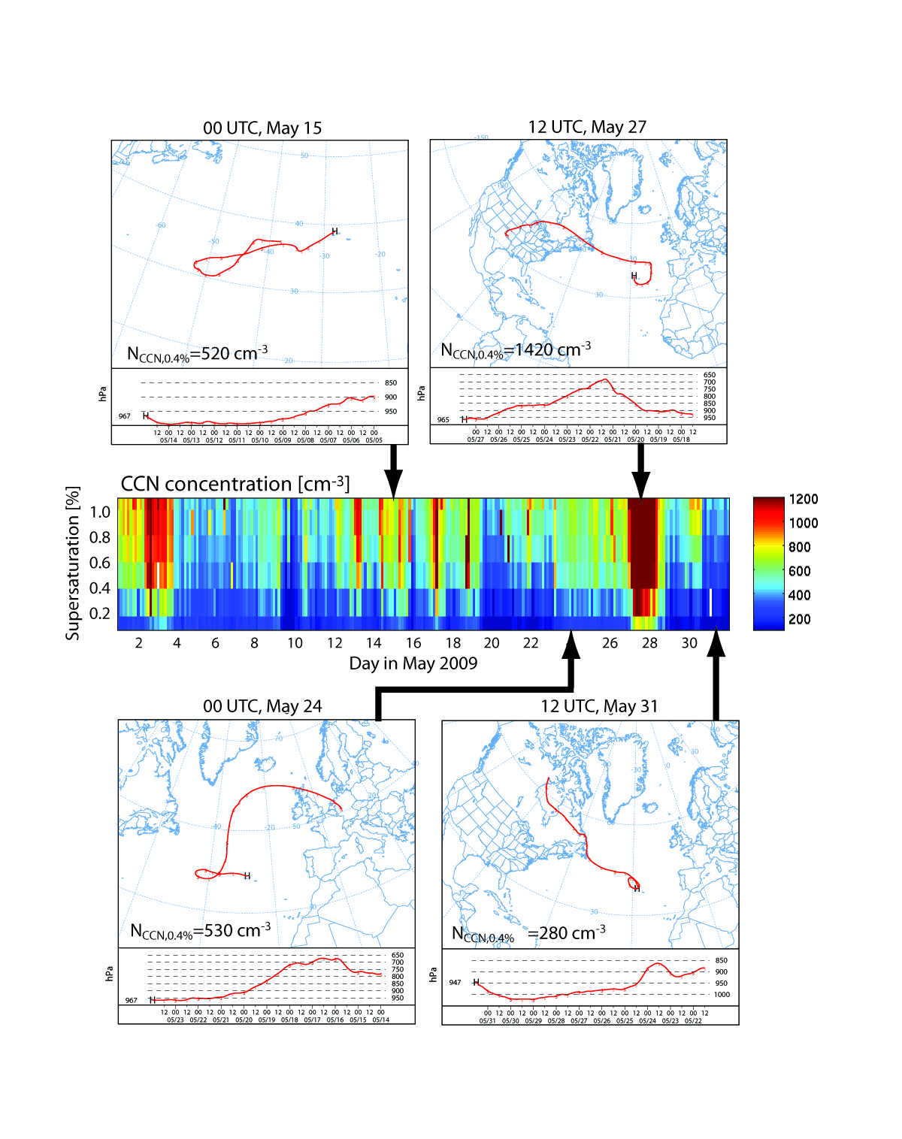
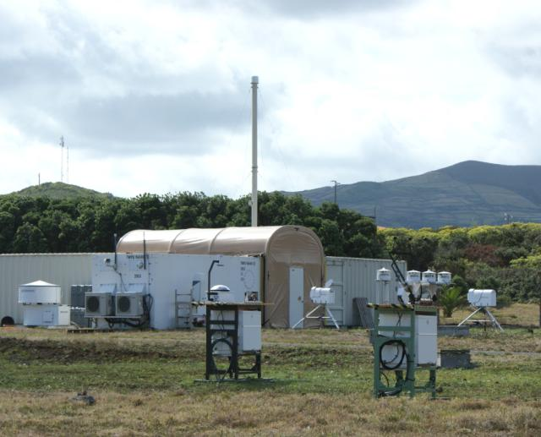
ARM Mobile Facility Completes Azores Campaign
December 31, 2010, marked the last official day of data collection for the ARM Mobile Facility campaign in the Azores.
The campaign produced a data set of high statistical significance compared to previous field studies.
It provides important new information about the structure and variability of the remote marine boundary-layer cloud system and the factors that influence it.
Data reveal the dynamic structures within clouds responsible for precipitation. A sensitive new method has been developed to detect the early product of drizzle droplets and subsequent growth and evaporation of drizzle droplets in the cloud and subcloud layers respectively
Notes:
Data gathered during CAP-MBL illustrate the impact of drizzle on low clouds.
At times, strongly drizzling open cell convection across Graciosa resulted in the
near-complete removal of cloud-forming nuclei. These “extreme drizzle” events
have been documented elsewhere, but little is known about the interactions
between clouds and aerosols in these events, and the impact that the feedback
between aerosols and precipitation has on the susceptibility of clouds to
anthropogenic aerosols.
These unique data are invaluable for constraining process models and will be critical for developing new parameterizations for climate models.

Slide 11
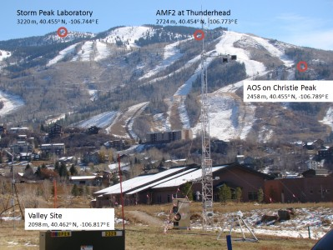
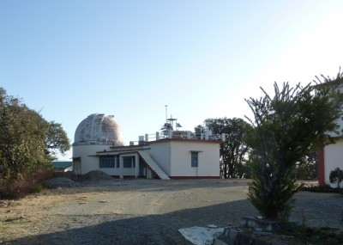


Upcoming ARM Experiments
AMF 2 continues in Colorado to measure cloud and aerosol properties from various levels on the mountain
AMF 1 begins Ganges Valley Aerosol Experiment in late spring
Joint ARM/NASA Midlatitude Continental Convective Cloud Experiment begins in April at Southern Great Plains site
“Observations of the Madden Julian Oscillation for Modeling Studies” will be conducted in Manus and with AMF2 on Gan in October.

Slide 12
ARM Mobile Facility in Germany
The ARM Mobile Facility (AMF) was deployed and operated in the Black Forest area during the Convective and Orographically-induced Precipitation Study (COPS) in summer 2007. The objective was to improve public safety by better forecasts of convective precipitation.
A special issue in QJRMS; in press; will present 22 articles in March Quarterly Journal of the Royal Meteorological Society on the advances in the understanding of convective processes and precipitation over low-mountain regions through the Convective and Orographically-induced Precipitation Study (COPS)

Slide 13
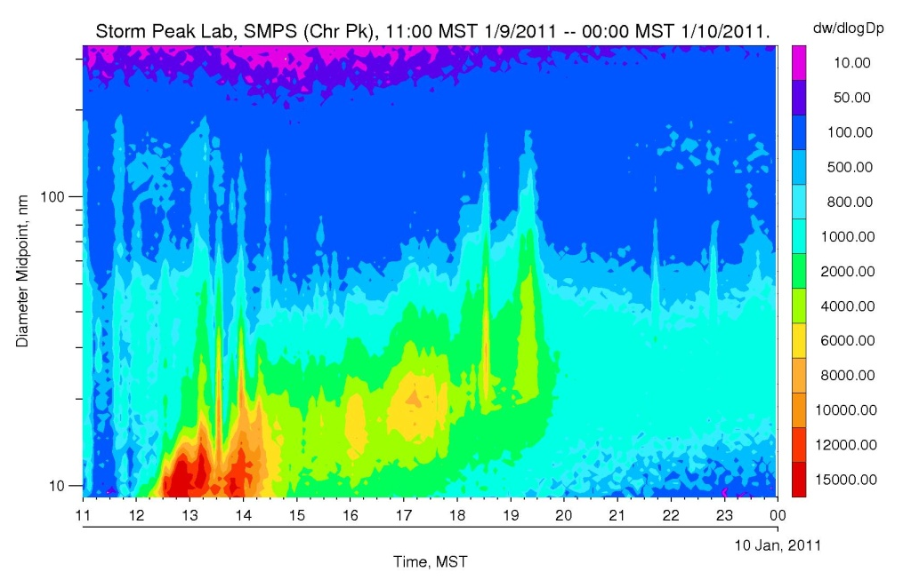
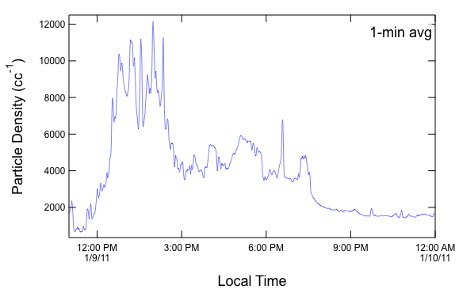
Aerosol Nucleation Observed Below Cloud at Aerosol Observing System and In Cloud at Storm Peak Laboratory
Guest instrumentation and AOS instrumentation are beginning to unravel the aerosol microphysical and optical properties at Christie Peak.
For example, Scanning Mobility Particle Sizer (SMPS; guest instrument) and Condensation particle counter (CPC; AOS instrument) have captured several new particle formation events. Likely source is SO₂ emissions.
hν
O₃ + H₂0 2OH
OH + SO₂ + M H₂SO₄ (s)

Slide 14
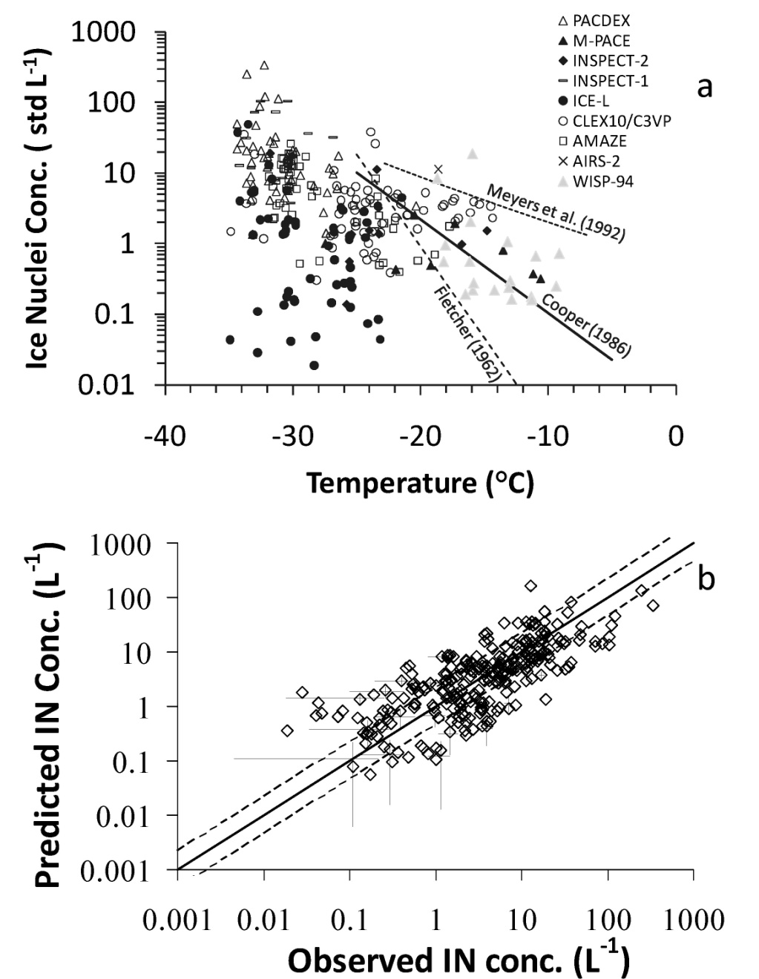
Atmospheric System Research
Ice Nucleation treatment for GCMs
Formation of ice in clouds is a key process for precipitation initiation, but poorly characterized – 10³ variability in data and current parameterizations
Ice nuclei concentration data was assembled from nine field studies from Arctic to Amazon
Simple predictive relation with temperature, aerosol concentration reduces error two orders of magnitude
In CAM shows significant impacts on cloud forcing, liquid water path
DeMott PJ, et al., 2010. "Predicting global atmospheric ice nuclei distributions and their impacts on climate." Proceedings of the National Academy of Sciences, 107(25), doi:10.1073/pnas.0910818107.

Slide 15

Identifying Human Influence on Extreme Precipitation
Objective
To search for anthropogenic influence on the observed changes in extreme precipitations that can have devastating impact on human society and the environment
Research
We compared observations and multiple climate model simulations forced with observed green-house gas increase using an optimal fingerprinting technique
We find consistent increasing trends between observed and model simulated extreme precipitations over the large part of Northern Hemisphere lands during 1951-1999
Impact
This provides the first scientific evidence that human-induce increase in greenhouse gases have contributed to the observed intensification of heavy precipitation events. Featured as the main story and cover picture in the Feb. 17, 2011 issue of Nature
Min, S.-K., X. Zhang, F. W. Zwiers, and G. C. Hegerl, 2011: Human contribution to more-intense precipitation extremes. Nature, 470, 378-381, doi:10.1038/nature09763
Notes:
Examples of efforts we have co-funded with NOAA and other partners. This is an example of Global analysis we do in RGCM program- i.e. Study of extremes
Given that atmospheric water-holding capacity is expected to increase roughly exponentially with temperature and that atmospheric water content is increasing in accord with this theoretical expectation, it has been suggested that human influenced global warming may be partly responsible for increases in heavy precipitation.
This paper made the cover of Nature on Feb 17th.
On the cover, the southern Bavarian village of Eschenlohe in August 2005, partially evacuated after the river Loisach flooded following heavy rain. A significant effect of anthropogenic activities has already been detected in observed trends in temperature and mean precipitation. But to date, no study has formally identified a human fingerprint on extreme precipitation, and it has proved difficult to assess the human impact on specific types of weather events. Two groups now present evidence that anthropogenic greenhouse gases have significantly increased the probability of heavy precipitation and local flood risk. Min et al. compare observations and simulations of rainfall between 1951 and 1999 in North America, Europe and northern Asia. They find a statistically significant effect of increased greenhouse gases on the incidence of extreme precipitation events over much of the Northern Hemisphere land area. Pall et al. use publicly contributed climate simulations to show that increased greenhouse-gas emissions substantially increased the risk of flood occurrence during the extensive flooding in England and Wales in autumn 2000. Both these papers were efforts were partially supported by DOE.

Slide 16
Identifying Human Influence on Extreme Precipitation
Objective
To search for anthropogenic influence on the observed changes in extreme precipitations that can have devastating impact on human society and the environment
1951-99 Trends
Annual max. 1-day precipitation
OBS
Human
Research
We compared observations and multiple climate model simulations forced with observed green-house gas increase using an optimal fingerprinting technique
We find consistent increasing trends between observed and model simulated extreme precipitations over the large part of Northern Hemisphere lands during 1951-1999
Factors
ALL
Impact
This provides the first scientific evidence that human-induce increase in greenhouse gases have contributed to the observed intensification of heavy precipitation events.
Min, S.-K., X. Zhang, F. W. Zwiers, and G. C. Hegerl, 2011: Human contribution to more-intense precipitation extremes. Nature, 470, 378-381, doi:10.1038/nature09763
Notes:
Influence of anthropogenic forcings on observed changes in precipitation extremes
Understanding and predicting changes in climate extreme events is very critical due to high impact of the events on society and economy. In particular, very few studies evaluated the role of greenhouse gas increases, if any, in changes in heavy precipitation because of the limited availability of daily observations. Using an optimal fingerprinting technique, this study compares observed and multi-model simulated extreme precipitation changes during the latter half of the 20th century over large Northern Hemisphere land areas. It provides the first scientific evidence that anthropogenic greenhouse gas increases have contributed to the observed intensification of heavy precipitation events. It is also suggested that climate models used in this study underestimate the observed changes, indicating that future change in extreme precipitation and its impact may also be underestimated.
Reference: Min, S.-K., X. Zhang, F. W. Zwiers and G. C. Hegerl (2011) Human contribution to more-intense precipitation extremes. Nature, 470, Pages: 378-381, doi:10.1038/nature09763.
Featured as the main story and cover picture together with Pall et al. paper in the February 17, 2011 issue of Nature

Slide 17
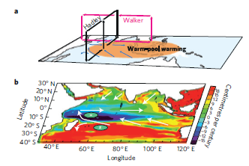
Patterns of Indian Ocean sea-level change in a warming climate
Objective
Observations of sea level rise over the Indian Ocean indicate that changes have not been geographically uniform.
Atmospheric circulation changes (top) affect
regional sea level rise (bottom, greater increase
in red, less increase blue)
Approach
Systematically document the non-uniform sea level change in the Indian Ocean region in observations
Investigate the causes using two ocean models, two atmospheric models, and a simple ocean model
Analyze climate model projections (from DOE-supported PDM and CCSM3) for possible future changes
Impact
Future projections suggest that changes in atmospheric circulation will affect regional sea level rise, with greater increases in the eastern Indian Ocean, and less sea level rise in the western Indian Ocean
Results
Sea level has decreased in the southern Indian Oceans while it has increased elsewhere.
Han, W., G.A. Meehl, B. Rajagopalan, J.T. Fasullo, A. Hu, J. Lin, W. Large, J.-W. Wang, X. Quan, L.L. Trenary, A. Wallcraft, T. Shinoda, and S. Yeager, 2010: Indian Ocean sea level change in a warming climate, Nature Geoscience, DOI:10.1038/NGEO901.
Notes:
A example of the work produced by Warren Washington’s co-operative agreement funded through Regional and Global Climate Modeling. Again an example of global analysis.
Patterns of Indian Ocean sea-level change in a warming climate: Observations of sea level rise over the Indian Ocean region since the 1950s indicate that changes, a result of thermal expansion of the warming ocean and freshwater addition from melting continental ice, have not been geographically uniform, and the reasons for this have been a mystery to the climate science community. It is imperative to determine the factors that affect the pattern of future changes because sea-level rise affects the lives of millions of people in coastal and island regions of the Indian Ocean. In a recent paper, BER-funded scientists at the National Center for Atmospheric Research, and researchers from the University of Colorado, Ohio State University, and the Naval Research Laboratory, systematically documented the non-uniform sea level change in the Indian Ocean region in observations, then investigated the causes using two ocean models, two atmospheric models and a simple ocean model. They found that changes in atmospheric circulation have mostly caused the pattern of sea-level rise, with greater increases in the eastern Indian Ocean and lower amplitude increases in the west. Analysis of two global coupled climate models, both run with projected increases of greenhouse gases, indicate this observed pattern is likely to continue into the future, with more sea-level rise than the global mean, and thus greater impacts, on mid-ocean islands such as the Mascarenhas archipelago, coasts of Indonesia, Sumatra and the north Indian Ocean, and less sea-level rise than the global mean, and thus less severe impacts, on the Seychelles islands, and the coasts of Kenya and Tanzania.
Reference: Han, W., G.A. Meehl, B. Rajagopalan, J.T. Fasullo, A. Hu, J. Lin, W. Large, J.-W. Wang, X. Quan, L.L. Trenary, A. Wallcraft, T. Shinoda, and S. Yeager, 2010: Indian Ocean sea level change in a warming climate, Nature Geoscience, DOI:10.1038/NGEO901.

Slide 18
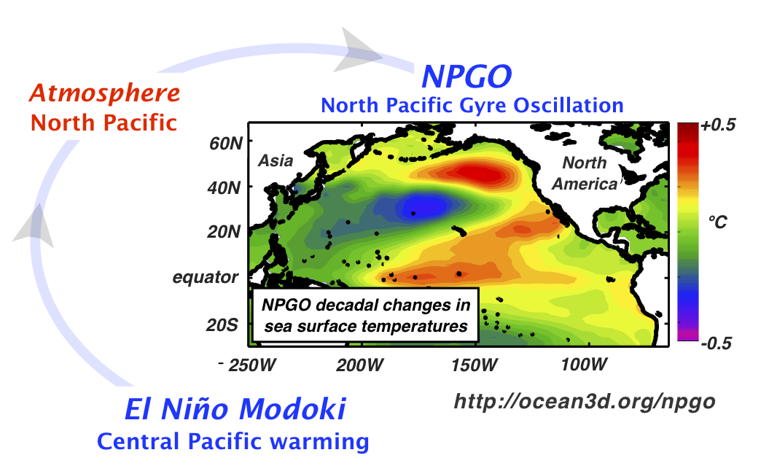
Decadal climate change of the North Pacific forced by Central Pacific El Niño.
Objective
Recent studies show that an important fraction of North Pacific low-frequency variability is linked to the North Pacific Gyre Oscillation (NPGO). This study examines how the NPGO climate mode is linked to El Niño and climate change.
Approach
Multiple ensemble simulations from a coupled ocean-atmosphere model are used to to show that central Pacific sea surface temperature anomalies associated with El Niño Modoki force changes in the extra-tropical atmospheric circulation that drive the Pacific ocean decadal fluctuations of the NPGO climate mode.
Impact
Suggestions for more frequent El Niño events under greenhouse forcing scenarios are consistent with a more energetic late 20th century NPGO and imply that NPGO may play an increasingly important role in shaping Pacific climate and marine ecosystems in the 21st century.
Di Lorenzo, K. M. Cobb, J. Furtado, N. Schneider, B. Anderson, A. Bracco, M. A. Alexander, and D. Vimont , 2010: Central Pacific El Niño and decadal climate change in the North Pacific. Nature Geosciences, 3 (11), 762-765, doi: 10.1038/NGEO984.
Notes:
An Example of Global Analysis
Decadal fluctuations of the ocean and atmosphere over the North Pacific Ocean significantly affect the weather and climate of North America and Eurasia. They also cause transitions between different states of marine ecosystems across the Pacific Ocean^{1, 2, 3}. An important fraction of North Pacific low-frequency variability is linked to the North Pacific Gyre Oscillation⁴, a climate pattern associated with decadal fluctuations of the ocean circulation. Decadal variations in the North Pacific Gyre Oscillation are characterized by a pattern of sea surface temperature anomalies that resemble the central Pacific El Niño, a dominant mode of interannual variability with far-reaching effects on global climate patterns^{5, 6, 7}. Here we use an ensemble of simulations with a coupled ocean–atmosphere model to show that the sea surface temperature anomalies associated with central Pacific El Niño force changes in the extra-tropical atmospheric circulation. These changes in turn drive the decadal fluctuations of the North Pacific Gyre Oscillation. Given that central Pacific El Niño events could become more frequent with increasing levels of greenhouse gases in the atmosphere⁸, we infer that the North Pacific Gyre Oscillation may play an increasingly important role in shaping Pacific climate and marine ecosystems in the twenty-first century.

Slide 19
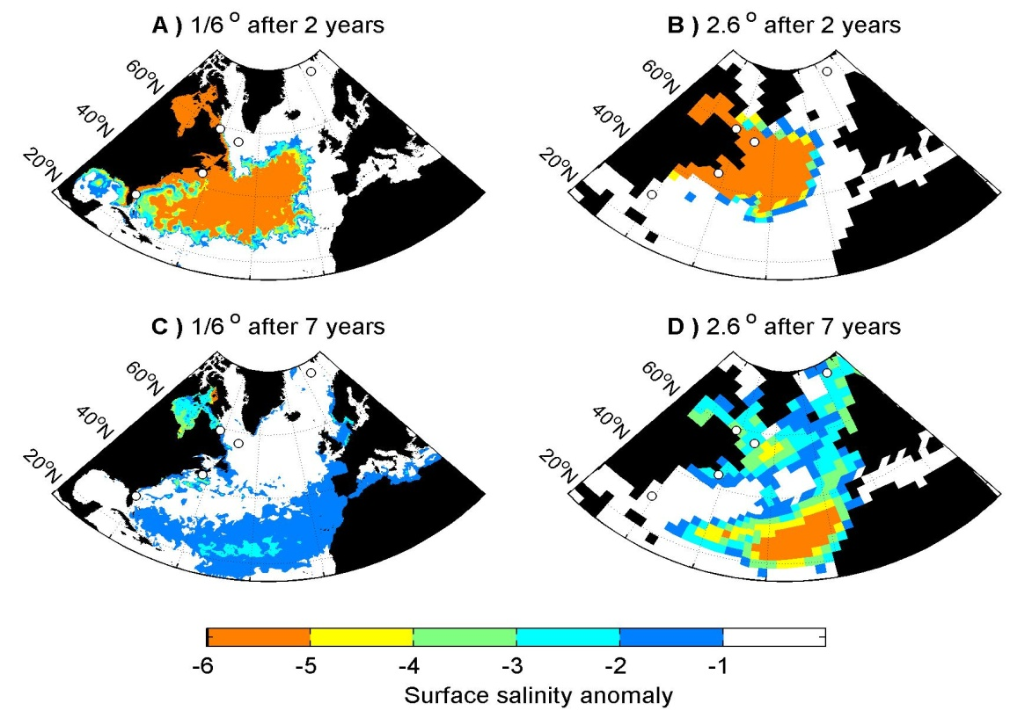
ESM Program
Modeling glacial outburst floods
Previous studies indicate that past massive meltwater floods covered the northern North Atlantic and weakened the oceans transport of heat to Europe. These models had resolution too coarse to resolve the circulation of the ocean, and the pathway of these floods.
High resolution (18-km) global ocean sea-ice numerical model used to simulate a meltwater flood and follow its pathway.
Meltwater transported into the subtropical North Atlantic, ~3000-km further south than previously thought.
hi-res.
low-res.
2 years
7 years
Impact
The simulation was repeated with a coarser resolution configuration of the same model, confirming that previous coarse climate-freshwater “hosing” experiments inaccurately describe freshwater pathways.
Condron, A., and P. Winsor (2011), A subtropical fate awaited freshwater discharged from glacial Lake Agassiz, Geophys. Res. Lett., 38, L03705, doi:10.1029/2010GL046011.
Notes:
Wanda says that this is a general slide with no specific reference

Slide 20

Climate Modeling Programs
Greenhouse gas mitigation can reduce sea-ice loss and increase polar bear persistence
Can GHG mitigation save polar bears from extinction?
Is sea-ice loss irreversible, i.e. is there a tipping point? (bad for bears!)
Using CCSM3 simulations and several scenarios, sea ice and habitat metrics vary smoothly with temperature, without tipping points.
September sea ice in CCSM3 can disappear rapidly, but it can recover if GHG levels are held fixed and prevented from increasing.
(Amstrup SC, ET DeWeaver, DC Douglas, BG Marcot, GM Durner, CM Bitz, & DA Bailey, Nature 12/16/2010)

Slide 21
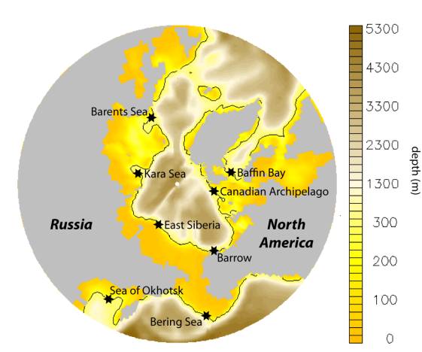
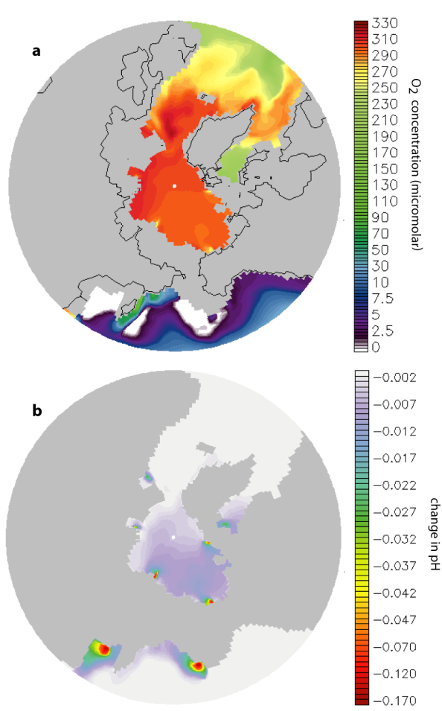
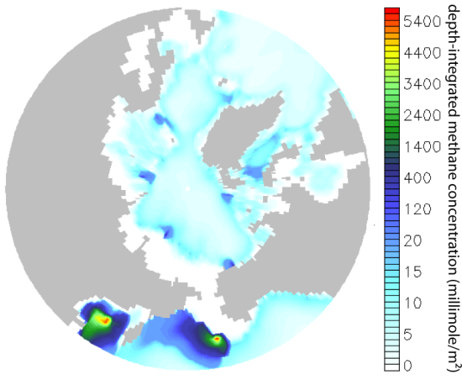
ESM Program
Clathrates and the Global Marine Methane Cycle
High-latitude continental shelves are warming, leading to methane from clathrates.
Developed POP model of global natural biogeocycling for marine CH₄
Arctic clathrate destabilizations implemented in likely locales
Competition between
Bio-consumption of CH4
But the waste products deplete O₂ and trace metals, acidify, rob ecosystems and increases CH4 plume
oxygen
methane
pH change
Impact
Resource limitations may reduce the mitigating effect of methane oxidation
Ecological consequences of release may be as significant as climate feedbacks
Elliott, S.M., Maltrud, M., Reagan, M.T., Moridis, G.J., Cameron-Smith, P.J., “Marine Methane Cycle Simulations for the Period of Early Global Warming,” LBNL-4239E, J. Geophysical Res. Biogeo., 116, G01010, 2011.
Notes:
Wanda says that this is a general slide with no specific reference

Slide 22

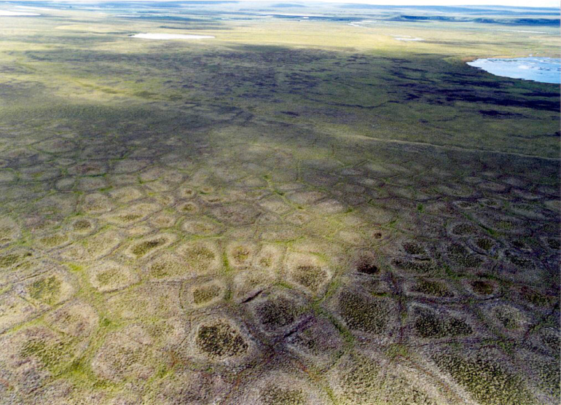
Climate Change and Permafrost Ecosystems
Goal: advance the predictive understanding of the structure and function of Arctic terrestrial ecosystems in response to climate change
Objectives:
  Understand processes/feedbacks governing these complex systems
  Design and deploy combination of observations and manipulative experiments to test model-inspired hypotheses
  Resulting knowledge improves models, resulting in improved climate predictions
Approach
  Collaborative effort among DOE National Laboratories and universities, led by Oak Ridge National Laboratory
  Interdisciplinary, multi-scale approach to advance predictive understanding through iterative experimentation and modeling
  Opportunities for leveraging through external collaboration (DOE and other agencies)

Slide 23

Carbon “fertilization” limited by nitrogen availability
Increasing atmospheric CO2 has been predicted to result in enhanced plant uptake and growth, providing a dampening influence on climate change
This negative feedback process is represented in most coupled earth system models and has been shown to be an area of sensitivity for future climate projections
Free-Air CO2 Enrichment (FACE) experiment at Oak Ridge National Laboratory
strong CO2 “fertilization” effects for the first five years of the experiment, in subsequent years that effect declined dramatically
Experiment suggests that decline was the result of nitrogen limitation
Reference: Norby RJ, Warren JM, Iversen CM, Medlyn BE, McMurtrie RE. 2010, CO2 enhancement of forest productivity constrained by limited nitrogen availability. Proceedings of the National Academy of Sciences (107:5)

Slide 24
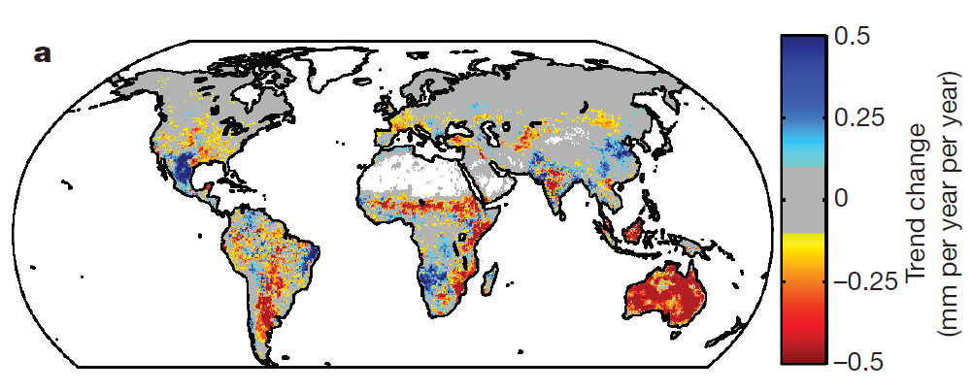
AmeriFlux contributes new insights into evapotranspiration
Large scale changes in the earth's water cycle have been hypothesized to result from global warming
Combination of long-term data records (including AmeriFlux) and model results show systematic increase in global land evapotranspiration from 1982 to 1997
From 1998 to 2008, this trend appears to have declined or leveled off
The authors suggest that soil moisture limitations, particularly in the southern hemisphere are responsible for the change
May indicate that climate-driven changes in terrestrial hydrological cycles exist and that there are limits to the ability of these cycles to respond to changing climate
Reference: Jung, M., et al. Recent decline in the global land evapotranspiration trend due to limited moisture supply, Nature (467, 951-954)

Slide 25
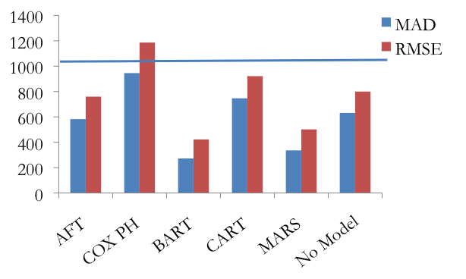
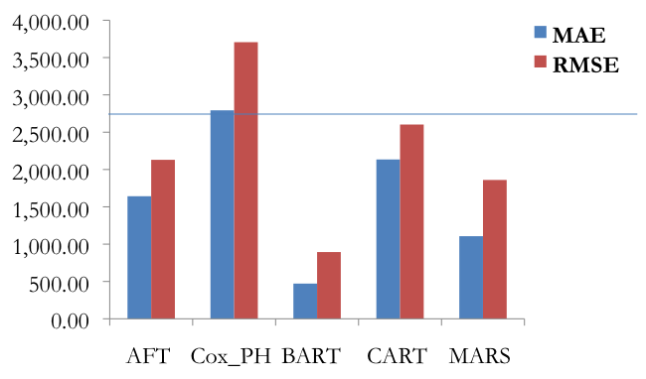
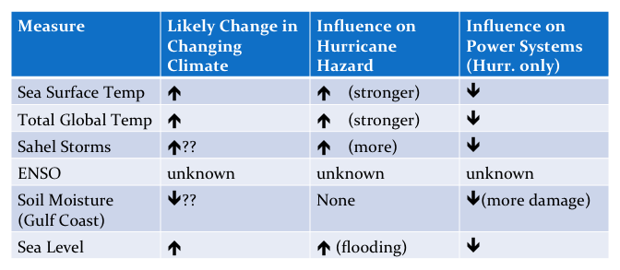
Integrated Assessment
Hurricane power outages (locations & durations) can be accurately predicted
Seasonal hurricane count forecast accuracy substantially improved by use of more complete climate data and flexible statistical methods
Climate change induced changes in hurricane hazards likely will lead to increased outages and longer outages
Estimated climate impacts on hurricane
Power outage risk
Guikema et al. , AMS Annual Meeting, 2011
Errors in outage duration predictions,
Hurricanes Ivan (top) and Dennis (bottom)
Nateghi et al., Risk Analysis, (under review)
Errors in outage duration prediction
For Hurricane ivan. Flat line is the
mean outage duration.
Nateghi et al., Risk Analysis (under review)
25 BERAC Sep 2010
Department of Energy • Office of Science • Biological and Environmental Research
Notes:
Picked up by AP, Washington Post, Chicago Tribute, LA Times and featured in NY Times and NPRs On Point show.

Slide 26
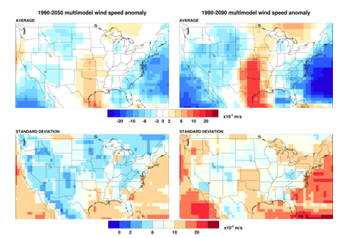
Integrated Assessment:
Impact of Climate Change on the US Wind Energy Resource
Anthropogenic climate forcing is associated with significant changes in wind power, relative to both model spread and model variability.
The changes are predominantly due to changes in transient features; the stationary wind field tends to experience only slight changes.
Results from dynamical down-scaling experiments shows strong sensitivity to both model features and boundary forcing.
(Barrie, D.B., and D.B. Kirk-Davidoff, manuscript in prep.)
26 BERAC Sep 2010
Department of Energy • Office of Science • Biological and Environmental Research
Notes:
Picked up by AP, Washington Post, Chicago Tribute, LA Times and featured in NY Times and NPRs On Point show.

Slide 27

Dual Role for Organic Matter in Mercury Cycling
Objective
Understand how microbial reduction of Hg(II) species and dissolved natural organic matter (DOM) in anoxic environments are coupled.
New Science
DOM plays a dual role in Hg chemistry: it reduces Hg(II) to Hg(0) but it also strongly complexes Hg, thereby affecting Hg(0) production.
Ligand-induced oxidative complexation of Hg(0) with DOM exerts a significant control on Hg(0) oxidation and sequestration in anoxic environments.
Significance
The redox state of sulfur in DOM and the DOM:Hg ratio critically influence the transformation of Hg and thereby, the potential microbial production of toxic methylmercury (CH₃Hg⁺).
Initial Hg(II)=10 nM
Hg(II) reduced (%)
Humics in solution (mg/L)
Depending on the sulfur redox state:
2R–SH + Hg(0) →R–S–Hg(II)–S–R + 2H⁺ + 2e⁻
or
R–S–S–R’ + Hg(0) →R–S–Hg(II)–S–R’
Gu B., Y, Bian, C. L. Miller, W. Dong, X. Jiang, and L. Liang. 2011. Proc. Natl. Acad. Sci. USA. 108, (in press).
27 BER Overview
Department of Energy • Office of Science • Biological and Environmental Research
Notes:
An examination of the interactions between Hg and DOM in anoxic environments. This work was published in Proceedings of the National Academy of Sciences in January 2011.
Note for the first point under new science: the balance of these two reactions result in the observation that at low DOM, Hg(0) increases with DOM, but beyond the DOM concentration at which Hg(0) reaches peak production, Hg(0) decreases with DOM.

Slide 28



EMSL User Program Developments
2011 Call for User Proposals
  Open through April 1, 2011.
  http://www.emsl.pnl.gov/access/calls/2011call/
EMSL Users Meeting
  May 10-13, 2011 at EMSL
  http://www.emsl.pnl.gov/news/conferences/
Triennial Science/Operations Review
  Planning for mid October 2011.
Two Research Campaigns Selected
  Experimental and computational research focused on data integration:
    Increasing isoprene yields from biomass (WSU, PNNL/EMSL).
    Catalytic reactions on metal oxide surfaces (UCB, Penn State, PNNL/EMSL).
New EMSL Instruments (Recovery Act)
  http://www.emsl.pnl.gov/capabilities/arra/instruments.jsp

Slide 29

EMSL Highlight: Multiple analytical approaches for studying organic aerosols
Understanding the formation and aging of organic aerosols (OA) is a major challenge for atmospheric research.
Soft-ionization methods combined with high-resolution mass spectrometry (HR-MS) shed light on the molecular content of OAs.
Integrating HR-MS with UV/Vis absorption spectroscopy and chromatography enables separation of OA compounds by polarity and their ability to absorb solar radiation.
EMSL’s new nanospray desorption electrospray ionization (nanoDESI) system key to understanding OA chemistry.
Supported by EMSL’s capability development efforts, BES and NSF.
Nizkorodov, SA, J Laskin and A Laskin. 2011. “Molecular Chemistry of Organic Aerosols through the Application of High Resolution Mass Spectrometry.” Phys. Chem. Chem. Phys. 13: 3612-3629.
Notes:
This “Perspectives” article is highlighted on the inside cover of the March 7, 2011 issue of Physical Chemistry Chemical Physics. At least one of the authors, Alex Laskin, is supported by the ASR program.

Slide 30
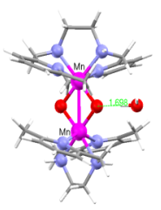
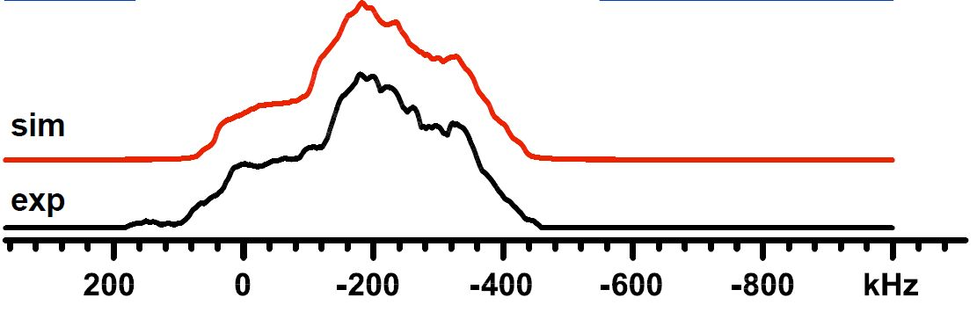
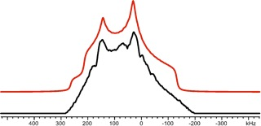
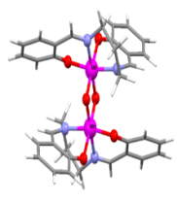
EMSL Highlight: Cryogenic NMR, theory help prove validity of photosynthesis model
Scientists at EMSL, PNNL, U. Michigan and UC Davis used cryogenic NMR and theory to understand the oxygen-evolving complex, a central part of photosynthesis.
Mn₂(III,III)
Key is understanding photoactive protein complexes.
Electronic and molecular structure of the oxygen-evolving complex is unknown.
Under cryogenic conditions, the system’s electrons are antiferromagnetically coupled.
With the molecules in this ground state, the NMR signal could be measured and compared with theoretical predictions.
Based on first-principles, the calculated geometrical and electronic structures are in agreement with experimental measurements.
Mn₂(IV,IV)
 |  | C_{Q}(MHz) | η_{Q}
Mn₂(III,III) | Expt. | 25.1 / 28.8 | 0.60 / 0.55
 | Calc. | 17.8 / 18.5 | 0.82 / 0.79
Ellis, PD, JA Sears, P Yang, M Dupuis, TT Boron III, VL Pecoraro, TA Stich, RD Britt, and AS Lipton. 2010. “Solid-State ⁵⁵Mn NMR Spectroscopy of Bis(μ-oxo)dimanganese(IV) [Mn₂O₂(salpn)₂], a Model for the Oxygen Evolving Complex in Photosystem II.” J. Am. Chem. Soc. 132, 16727-16729.
Supported by EMSL’s capability development efforts.
Notes:
Scientific Impact: The research combines challenging experiments with tricky theory to advance understanding of important parts of the molecular machinery needed for photosynthesis. With greater confidence in calculated models, scientists can extend experimental studies to actual clusters that enable the photosynthesis process. The new technique of using cryogenic NMR equipment and theory to study molecular structures can be applied more broadly to help scientists understand other magnetic materials.
This study marked the first time cryogenic NMR was used to study the molecules with multi-spin sites, which is typical of energy materials. Researchers hope to use an even more powerful NMR instrument currently being installed at EMSL to further this research and learn more about the OEC and its role in solar energy harvest.

Slide 31
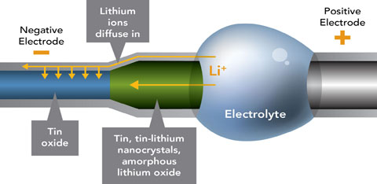
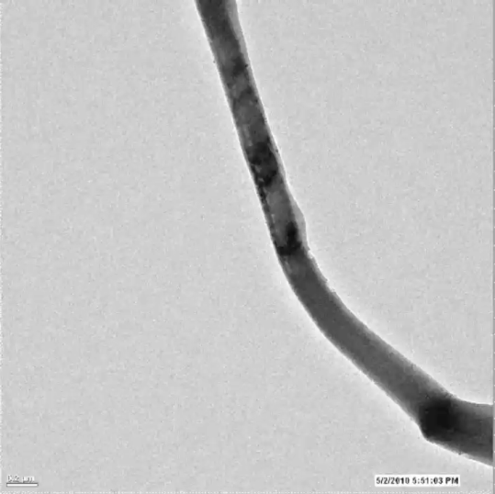

EMSL Highlight: Charging makes nano-sized electrodes swell, elongate and spiral
High-resolution images of electrode wires shows them contorting as they become charged with electricity
The thin, nano-sized wires writhe and fatten as lithium ions flow in during charging - suggesting how rechargeable batteries give out and might offer insights for building better batteries
Thin wires of tin oxide, which serve as the negative electrode, fatten by a third and stretch twice as long due to lithium ions coursing in
In addition, the lithium ions change the tin oxide from a neatly arranged crystal to an amorphous glassy material.
Reference: JY Huang, Li Zhong, C Wang, JP Sullivan, W Xu, Lqi Zhang, SX Mao, NS Hudak, X Liu, A Subramanian, HY Fan, L Qi, A Kushima, J Li, In situ observation of the electrochemical lithiation of a single SnO₂ nanowire electrode, Dec. 10, 2010, Science.
Supported by EMSL and DOE Office of Science.
Notes:
Battery developers know that recharging and using lithium batteries over and over damages the electrode materials, but these images at nanometer scale offer a real-life glimpse into how. Rechargeable lithium ion batteries work because lithium ions love electrons. Positively charged lithium ions normally hang out in the positive electrode, where a metal oxide shares its electrons with lithium. But charging a battery pumps free electrons into the negative electrode, which sits across a lake of electrolytes through which lithium ions can swim but electrons can't. The lithium desires the electrons on the negative side of the lake more than the electrons it shares with the metal oxide on the positive side. So lithium ions flow from the positive to the negative electrode, pairing up with free electrons there. But electrons are fickle. Using a battery in a device allows the electrons to slip out of the negative electrode, leaving the lithium ions behind. So without free electron companions, the lithium ions return to the positive electrode and the metal oxide's embrace.
When the team charged the miniature battery at a constant voltage, lithium ions wicked up through the tin oxide wire, drawn by the electrons at the negative electrode. The wire fattened and lengthened by about 250 percent in total volume, and twisted like a snake.
In addition, the microscopy showed that the wire started out in a crystalline form. But the lithium ions changed the tin oxide to a glassy material, in which atoms are arranged more randomly than in a crystal. The researchers concluded the amount of deformation occurring during charging and use might wear down battery materials after a while. Even so, the tin oxide appeared to fare better as a nanowire than in its larger, bulk form.

Slide 32
Thank you

