Slide 1


Energy Grand Challenges:
Past, Present, Future
George Crabtree, Mark Ratner, John Sarrao
July 29,2014

Slide 2
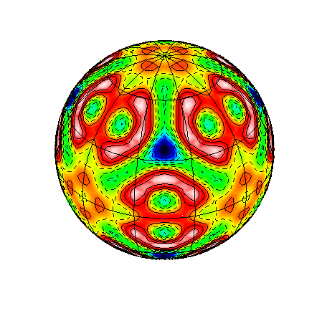
BESAC Subcommittee:
Science Grand Challenges
August 3-5, 2006
Co-Chairs:
Graham Fleming and Mark Ratner

Slide 3
Our (originally understood) Job -
BESAC Sub-Committee:
Science Grand Challenges
To create a set (~ 10?) of Grand Challenges that define the Discovery Science Portfolio of Basic Energy Sciences
To be the “Fifth Column”

Slide 4
Our (ORIGINAL) Sub-Committee
BESAC Sub-Committee:
Science Grand Challenges
Co-Chairs
Fleming, Graham (UCB/LBNL)
Ratner, Mark (Northwestern)
Aeppli, Gabe (London Nanotech Center)
Bishop, David (Bell Labs)
Breslow, Ronald (Columbia)
Bucksbaum, Phil (Stanford/SLAC)
Groves, Jay (UCB/LBNL)
Horn, Paul (IBM)
Kohn, Walter (UCSB) BESAC
Marks, Tobin (Northwestern)
McEuen, Paul (Cornell/Nanosys)
Moore, Tom (ASU)
Murray, Cherry (LLNL)
Nocera, Dan (MIT)
Odom, Teri (Northwestern)
Phillips, Julia (Sandia)
Schultz, Pete (Scripps/GNF)
Spence, John (ASU) BESAC
Silbey, Robert (MIT)
Williams, Stan (HP) BESAC
Ye, Jun (U. Colorado/JILA)
Hemminger, John [ex officio]
(UC Irvine) BESAC

Slide 5
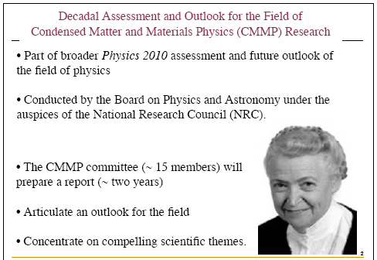
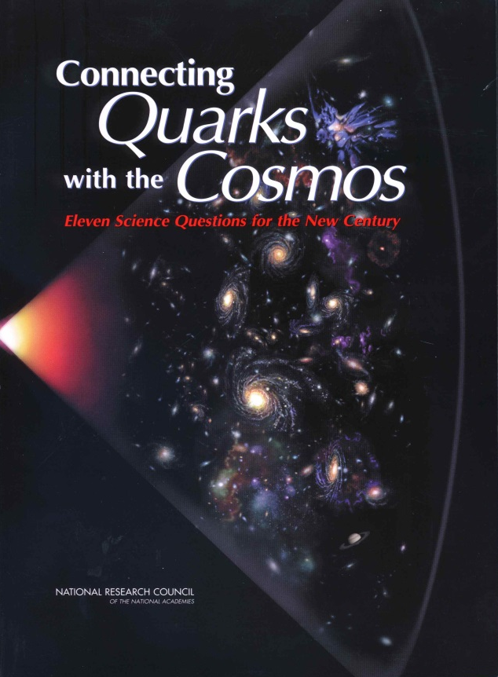
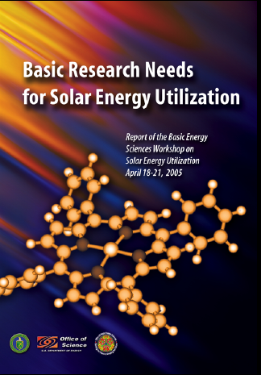

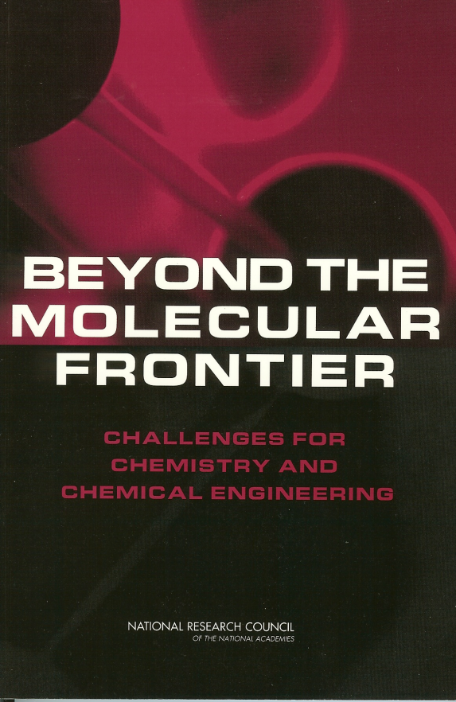

What Had Been Done

Slide 6
First Step: Define the Challenges
Grand Challenges for Future BES Science:
Initial Sub-committee Request
What is/are your Big Question(s)? Please create 1-3 such questions
and state each in one sentence.
2) What are the issues surrounding your Big Question? Please describe
in one paragraph (250 words or less) for a non-specialist audience.
3) Please provide a full description of your Big Question and include
a) its relevance to other fields and b) Its relevance to BES and DOE
(BES Mission statement is appended)
4) Is there science infrastructure (including workforce issues) that needs
to be developed to address this Big Question? Please describe.
5) Describe any specialized funding mechanisms that could be useful or
necessary to address this Big Question.

Slide 7
First Meeting
26-27 June 2006 Berkeley, CA
Attending: Agenda:
Phil Bucksbaum, Stanford
Graham Fleming, LBNL
John Hemminger, UC Irvine
Tobin Marks, Northwestern
Cherry Murray, LLNL
Dan Nocera, MIT
Julia Phillips, Sandia
Mark Ratner, Northwestern
John Spence, Arizona State
Stan Williams, HP Palo Alto
Monday, June 26, 2006
Welcome and Charge: Hemminger
Background and Process: Fleming/Ratner
Overview of Grand Challenges: Fleming/Ratner
Working Lunch: Review Grand Challenges themes
Science Infrastructure and Funding Mechanisms
Wrap up and assignments
Working Dinner: Future Research Programs
Tuesday, June 27, 2006
Review of previous day: Gaps? Anything overlooked?
Consolidation of Challenges
Deliverables and timeline
12 noon Adjourn

Slide 8
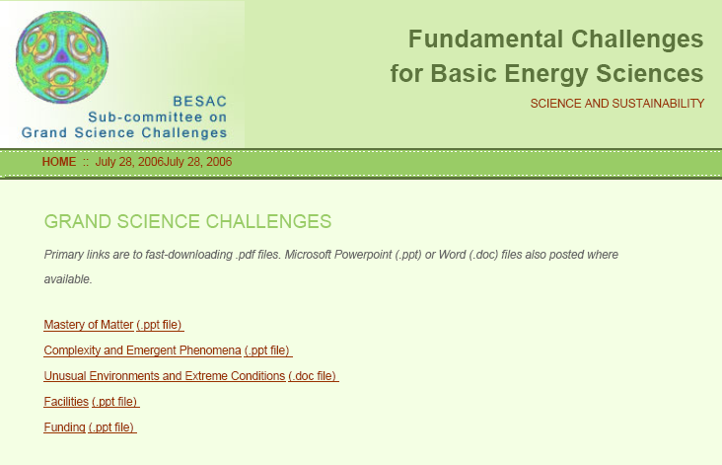
Meeting results: A Sampling

Slide 9
Meeting results: A Sampling

Slide 10
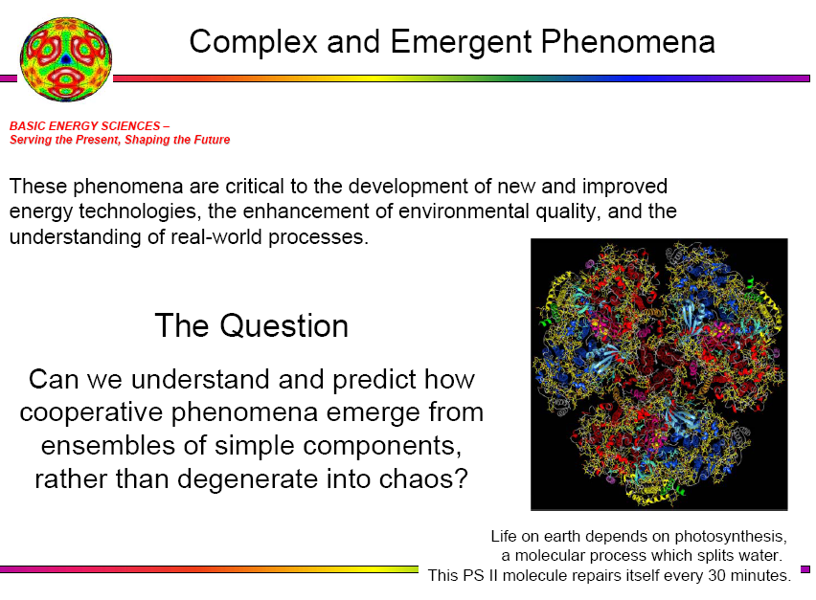

Slide 11
BESAC Subcommittee –
Science Grand Challenges
After talking with Pat….

Slide 12
Grand Challenges—Process
We collected suggestions for grand challenge questions from
members of BESAC & the Grand Challenge subcommittee.
Some of the many examples:
Can we create complex functional materials that can be fully disassembled and re-assembled?
Can we design and build self-regulating, self-repairing molecular devices?
Actively enhancing our predictive understanding of strongly-correlated electronic materials.
Can we build devices that fully integrate living and nonliving components?
The dynamics of interacting finite mass nuclei and electrons, far outside the Born-Oppenheimer approximation caused by high energy and high frequency incident radiation and particles.

Slide 13
A True Grand Challenge Must…
Be scientifically deep and demanding
Be clear and well-defined
Be relevant to the broad portfolio of BES
Promise real dividends in devices or methods that can significantly improve the quality of life and a secure energy future for the United States.

Slide 14
Winnowing the Grand Challenges
Certain scientific areas were re-occurring…
we go to the very small
2) we go far from equilibrium
3) we encounter strongly correlated systems & systems with emergent properties
4) we want to define the limits of material properties
5) we want to manipulate energy and information ever more rapidly and efficiently
6) we want to recreate in synthetic systems properties and capabilities we find in nature

Slide 15
Five New Topics
Creating a new language for Electronic Structure -
Real-Time Dynamics of Electrons in Atoms and Molecules
Cardinal Principles of Behavior -
Science of Matter beyond Equilibrium
The Basic Architecture of Nature -
Directed Assembly, Structure and Behavior of Matter
Primary Patterns in Multiparticle Phenomena-
Emergent, Strongly Correlated and Complex Systems
Nanoscale Communication
BESAC Subcommittee –
Science Grand Challenges

Slide 16
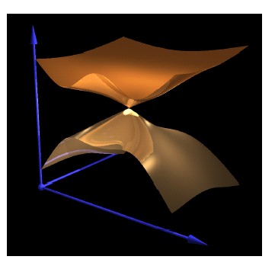
Creating a New Language for Electronic Structure –
Real-Time Dynamics of Electrons in Atoms and Molecules
BESAC Subcommittee –
Science Grand Challenges
Walter Kohn: | The dynamics of interacting finite mass nuclei and electrons, far outside the Born-Oppenheimer approximation, caused by high energy and high frequency incident radiation and particles.
Mark Ratner: | What are electrons doing in molecules - attosecond imaging for electronic intramolecular dynamics?
Jun Ye: | Can we coherently control matter – field interactions at ever increasing energy scales?
Bob Silbey: Create an ultra-fast, coherent X- Ray Laser User Facility that will support a large number of users.
Cherry Murray: Can we control transition states in chemical reactions/phase transitions to create novel compounds/materials?

Slide 17
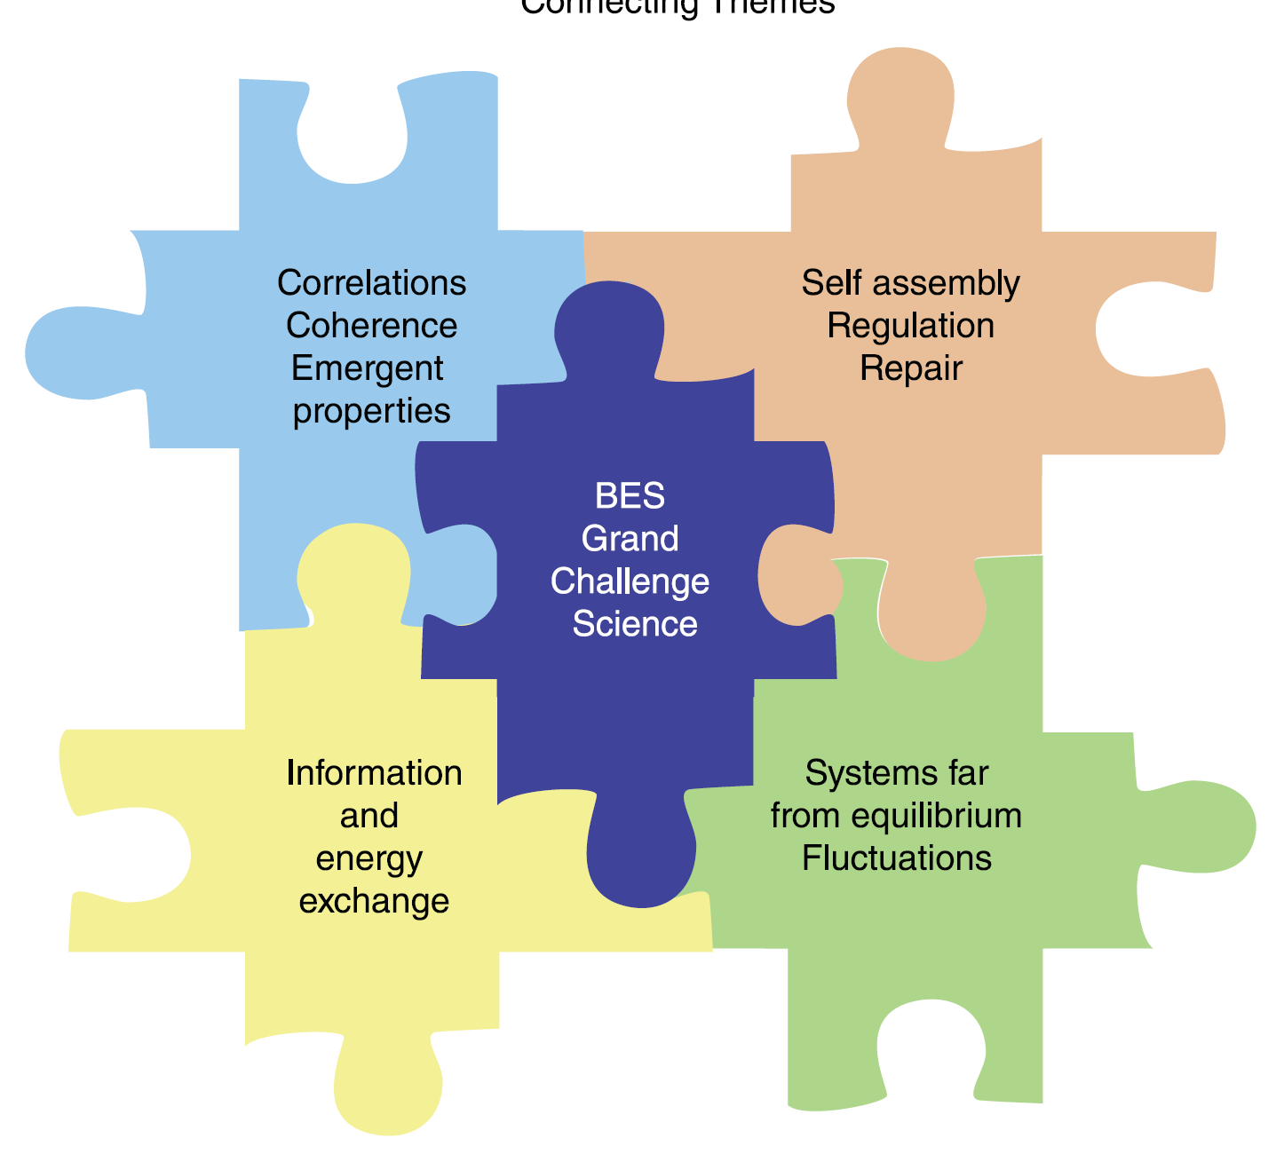
Connecting Themes
An underlying set of
concepts emerged.
Our ideas suggested
that we are on the
threshold of a transition from
observation science to control
science at a much deeper level
than is currently possible.
These two ideas led us
to construct five
large challenges.

Slide 18

Directing Matter and Energy: Five Challenges for Science and the Imagination
Graham Fleming and Mark Ratner
September 20, 2007
**Please note: this material has not yet been reviewed or approved
by BESAC

Slide 19
Five Grand Challenges
for Science and the Imagination
How do we control materials and processes at the level of electrons?
How do we design and perfect atom-and energy-efficient synthesis of new
forms of matter with tailored properties?
How do remarkable properties of matter emerge from complex correlations of atomic and electronic constituents and how can we control these properties?
Can we master energy and information on the nanoscale to create new technologies with capabilities rivaling those of living systems?
How do we characterize and control matter away—especially very far away—
from equilibrium?

Slide 20

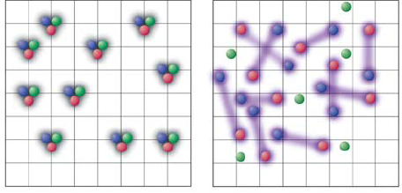
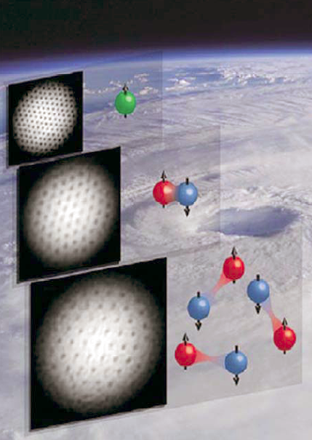
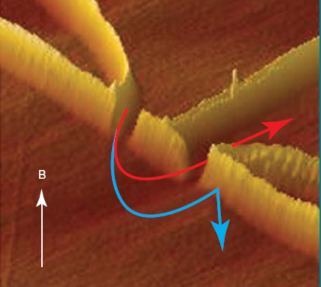
Grand Challenge: How do we control materials and
processes at the level of electrons?
Making quantum systems work for us
⬥ Attosecond optical pulses, high intensity
excitation
--Failure of Born-Oppenheimer Approx.
--Conical intersections
⬥ Control of spins (spintronics)
Quantum computing and
the use of coherence in
devices.
⬥ Quantum simulators

Slide 21
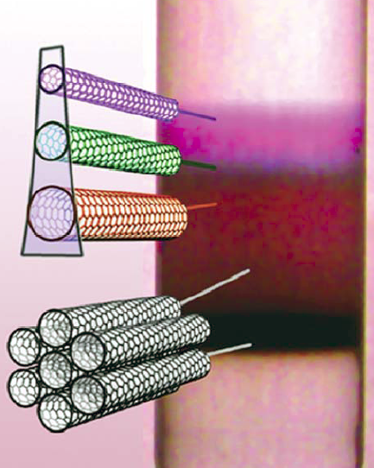
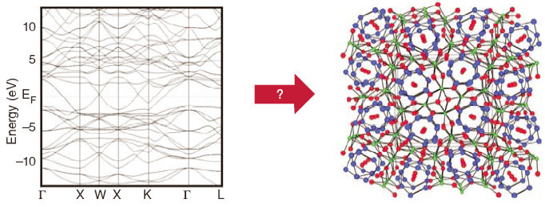
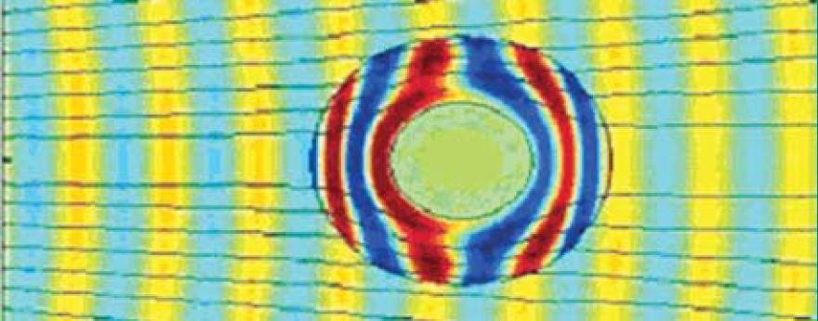
Grand Challenge: How do we design and perfect atom-
and energy-efficient synthesis of new forms of matter with tailored
properties?
Directing the “un-glueing” and “re-glueing” of electrons
Design for a particular electronic structure by finding the
optimum combination of crystal structure & elements that
yields (e.g. a specified band structure).
Design for self regulation and even self repair
of catalysts
Low cost efficient solar cells
Designing molecular logic
Contra indicated properties (e.g. transparent
conductors).
Meta materials: perfect lenses, invisibility cloaks in the
visible range.

Slide 22
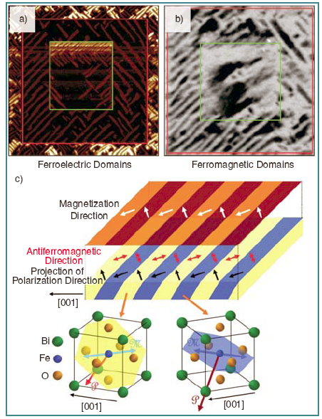
Grand Challenge: How do remarkable properties of
matter emerge from complex correlations of atomic and electronic
constituents and how can we control these properties?
Uncovering the fundamental rules of
correlations and emergence & learning to control them
Create successor to current semiconductors
from strongly correlated materials (e.g.
multiferroics combine and couple electric &
magnetic action—electrical control of
magnetism)
Quantum correlated liquids
--Quantum spin liquids: artificial photons,
fractional quasi particle (error free
quantum computing)
Strongly correlated atoms
--quantum emulators & simulators (e.g.
tests of the Hubbard Model for cuprates)
Soft matter
Biology

Slide 23
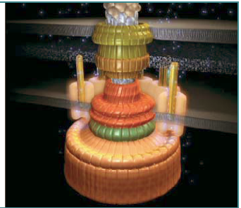
Grand Challenge: Can we master energy and information on the nanoscale?
Creating new technologies with capabilities rivaling those of living systems
Tap the existing world of biological nanotechnology by
constructing interfaces between living cells and synthetic
technology
Fabricate devices with functionalities approaching
those of living systems, but with different hardware
implementation.
Nano-macro junctions: covering the gap from a few
tenths to a few hundred nanometers (photonic, electrical &
magnetic, mechanical)
⬥ Defects and the end of Moore’s law
--adaptive probabilistic computing
⬥ Energy transduction at the nanoscale
--stochastic processes, signals & noise)
⬥ Ad hoc networking among nanoscale devices

Slide 24
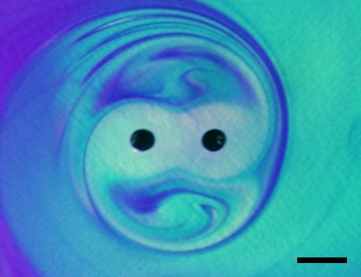
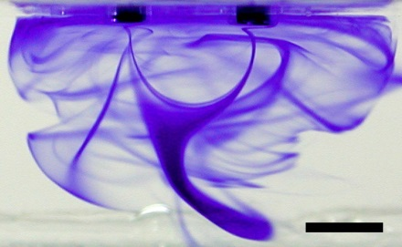
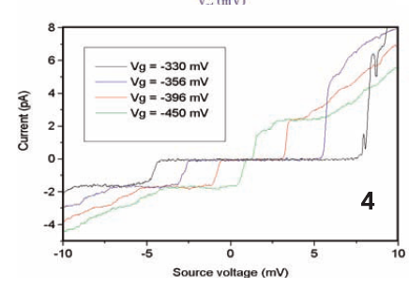
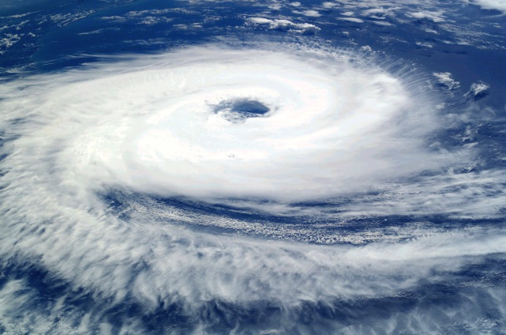
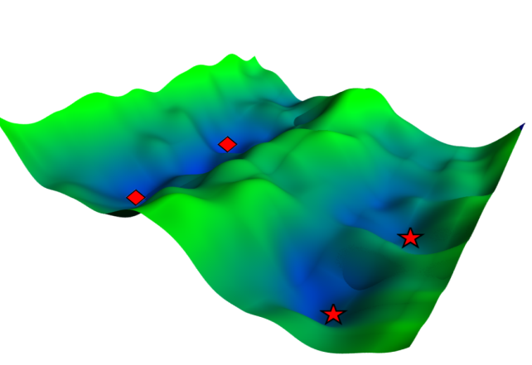
Grand Challenge: How do we characterize and control matter away—especially very far away—from equilibrium?
Magnetohydrodynamic
self-assembly
Making non-equilibrium systems work for us
⬥ Nanoscale thermodynamics
⬥ Molecular transport junctions
⬥ Fluctuations; Design, complexity,
robustness
--energy-capture & energy-storage
capabilities, mitigate environmental
damage
⬥ Exploring rough landscapes
⬥ Jamming
⬥ Science of life
Shewanella
Molecular transport
junction
cyclone

Slide 25
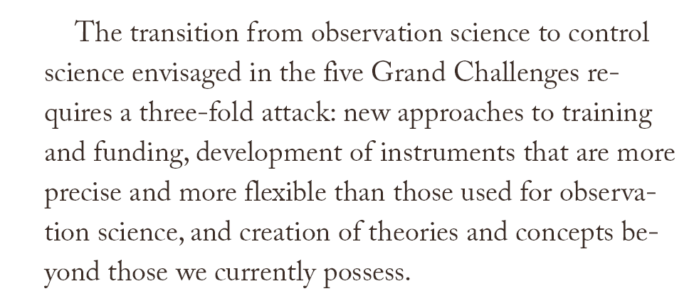
What’s Needed?
Page 111, Grand Challenges Report

Slide 26
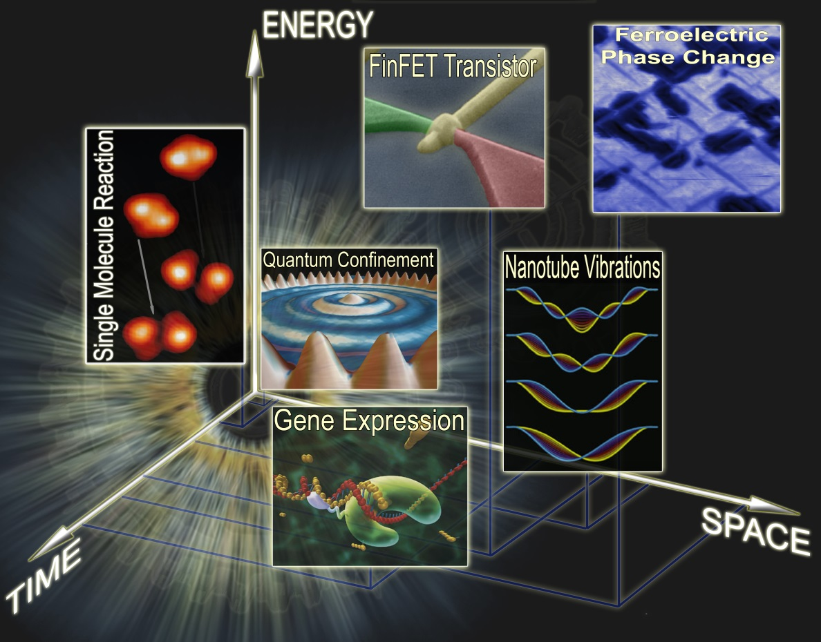
Overall Challenge: Making the Leap from Observation Science to Control Science
The things we want to do (i.e. designing materials to have the properties
we want & directing synthesis to achieve them) require the ability to see functionality at the relevant time, length & energy scales.
We will need to develop & disseminate new tools capable of viewing the inner workings of matter—transport, fields reactivity, excitations & motion
This new generation of
instruments will naturally lead to
devices capable of directing
matter at the level of electrons,
atoms, or molecules.

Slide 27
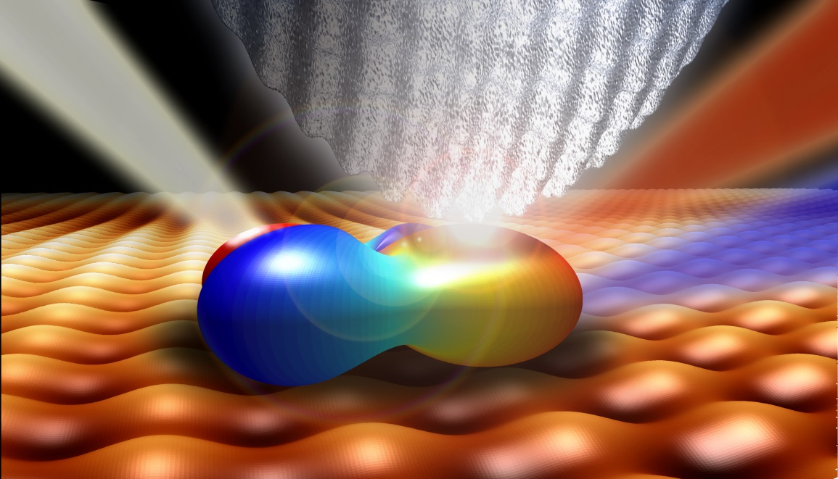
Next Generation of Instruments
We must interrogate matter at a level much deeper than the macroscopic
average to observe and control the properties of individual molecules or
microscopic domains of materials
The biggest challenge lies ahead…….
Combining sub molecular spatial resolution with femtosecond time
resolution
Future single-molecule dynamic measurements

Slide 28
Next Generation of Instruments
What machines could have the broad impact of synchrotrons?
Higher time resolution
Improved imaging methods
Improved and new kinds of detectors
Average brightness versus pulse
duration for storage ring, ERL, and
FEL sources. Values are shown for
optimized brightness at the photon
energies indicated, based on available data.

Slide 29
Grand Challenges & Theory
Theoretical challenges described in this report cannot simply
be reduced to ever larger computations….
…in many cases we do not know how to
formulate theory well enough to compute anything
We need to create a culture for high-risk, high-reward theoretical exploration of grand challenge topics (coherence, correlations, inter-conversion of energy and information, non-equilibrium phenomena)
We need to attract the brightest, most theoretically inclined minds to basic energy sciences.
these individuals will discover/produce the new laws and concepts necessary for understanding and controlling matter & energy with precision

Slide 30
Energy Scientists of the Future
“Energy is at the core of virtually every problem facing humanity.
We cannot afford to get this wrong.”
--R. Smalley
We need the best people:
  Sustained efforts over long periods
  New support and
  training structures
  Interdependent science
Grand Challenges Mountain

Slide 31
The Next Generation: Their Training and the Support of Interdependent Science
Innovation in basic energy science is critical to the nation and requires the engagement and support of our most creative scientists
Sustained effort over long periods
  The DOE Energy Institute
Awareness of the technological, industrial and policy implications
The Energy Sciences Study Group
Firmly anchored in one or two areas and able to communicate effectively across physics, chemistry, engineering, and biology
The DOE Fellows Program

Slide 32
Grand Challenge Science
“These capabilities will transform basic energy sciences, play a critical role in securing our energy future, and produce applications not yet imagined.”

Slide 33
Facility and Infrastructure Needs
What machines could have the broad impact of synchrotrons?
A balance between equipment for individual investigators, mid-scale and large-scale facilities is needed
Requirements for Grand Challenge Science include:
  Higher time resolution
  Improved imaging methods
  Improved and new kinds of detectors
  Materials, especially crystal growth facilities
  Computation and algorithm development
A creative instrumentation program that supports design, construction and application of entirely new instruments
  Single PI/small group level

Slide 34
The DOE Energy Institute
Modeled after HHMI investigators; Energy Science Senior Fellows would have unrestricted, long-term support to allow the best minds to focus on Grand Challenge science and enhance the prestige and visibility of DOE Basic Energy Science Support
Selection by blue –ribbon committee of DOE, national lab, and university leaders
I got a DOE!!
Provide (for 5 years) part of normal
year funding

Slide 35
The Energy Sciences Study Group
A two-year mentored program in energy policy, global energy needs, and related R&D
  Mentors and advisors would come from the energy industry, energy and environmental policy
Create a group of young faculty and national laboratory scientists
Keep pace with evolving technology
Convey understanding of the scientific and technical aspects of national energy security issues along with an appreciation of the multidisciplinary nature of energy research
Lead workshops to define science challenges, underpinning energy and environmental issues, in conjunction with the Energy Sciences Network

Slide 36
New Approaches to Training:
The Energy Sciences Network
Expand science training at Universities & Nanoscience centers (model: Cold Spring Harbor)
Hold short series of Grand Challenge-focused workshops with two days of training in key issues for students followed by two days of forefront Grand Challenge science
Create Grand Challenge Training Networks: collaborations between teams of scientists with early stage scientists spending time in more than one team
  Early stage scientists can:
    Customize their training
    See multiple viewpoints
    Begin their own collaborations

Slide 37
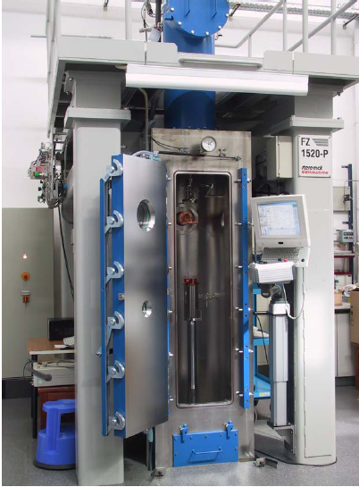
Crystal Growth Facilities
Crystals are a platform for truly novel states of matter such as quantum liquids, spin ice, and composite fermions
Currently a mismatch between demand and supply of crystalline materials
Current infrastructure needs expansion and renewal
New facilities for materials created at extreme pressure or temperature, very large crystals, etc.
  Fluorides for topological spin matter
  Thalates for negative pressure superconductors and magnets
  Oxides for the THz frequency conversion
SmScO₃
FZ Silicon
Crystals
Pressure floating zone apparatus
Images from Institut fur KristallZuchtung, Berlin

Slide 38
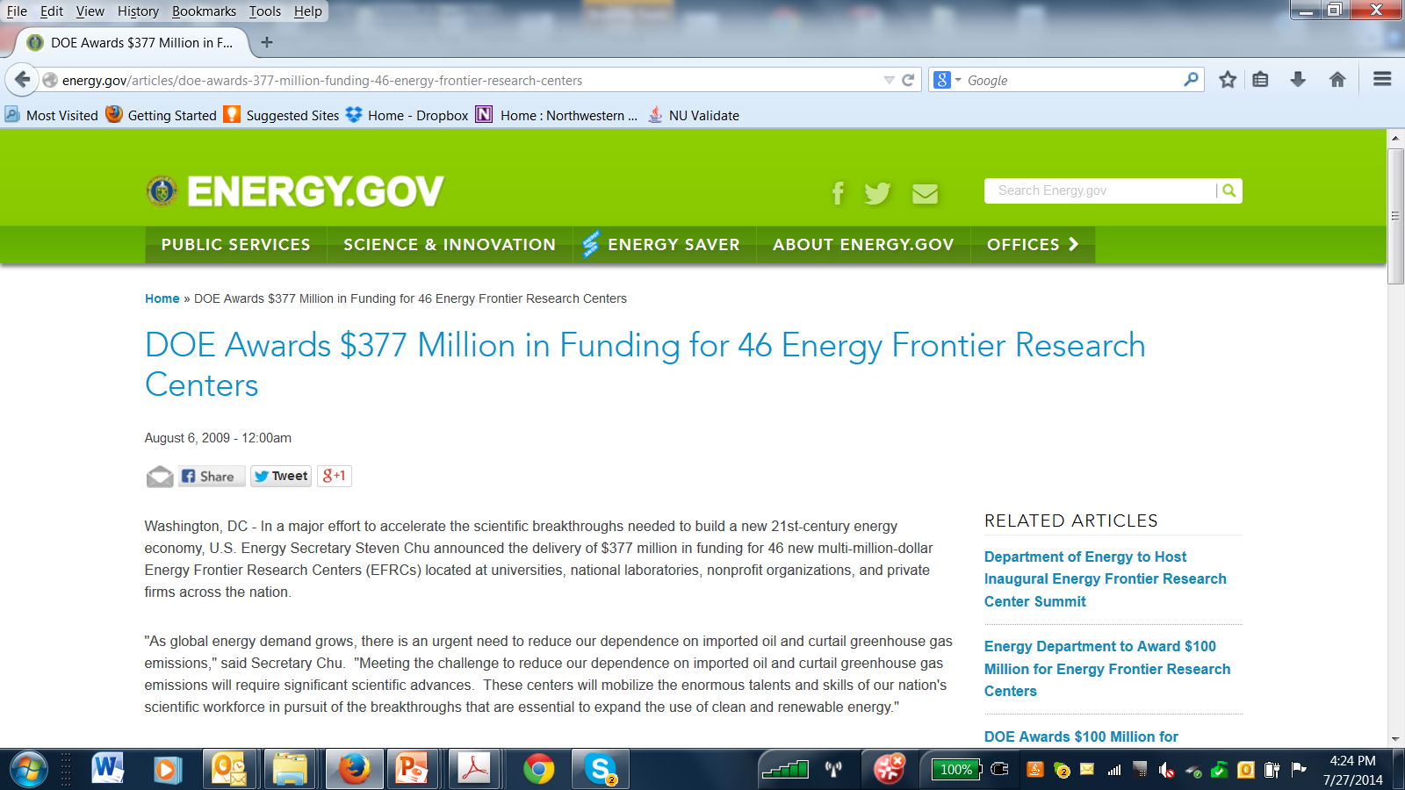
Substantive Result #1: EFRC’s
August 6, 2009

Slide 39
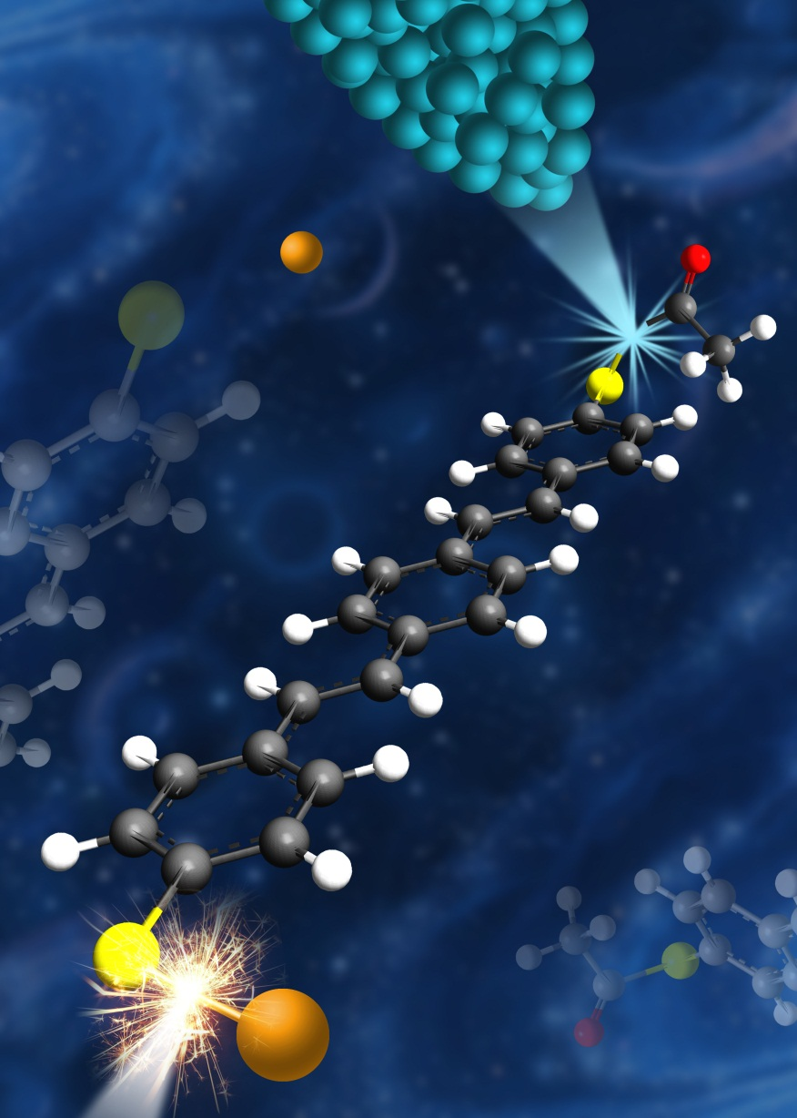
Understanding and Control of Chemistry at the Single-Bond Level.
Scientific Achievement
  By injecting energy-tunable tunneling electrons from a scanning tunneling microscope (STM) into a single thiol-based π-conjugated molecule, selective abstraction of functional groups was demonstrated. Here, it was possible to form a single Au-S bond by manipulating and attaching a single gold atom to the sulfur atom exposed at each end of the molecule.
Significance and Impact
Bond selective chemistry is one of the ultimate goals of chemistry. Achieving bond-selectivity in a complex molecule with different functional groups is particularly important for demonstrating control of chemistry. Ultimately, these results lead to the understanding and control of chemistry at the single bond level.
Work was performed at University of California – Irvine
Y. Jiang, Q. Huan, L. Fabris, G. C. Bazan and W. Ho, Nature Chemistry 5, 36 (2013).

Slide 40
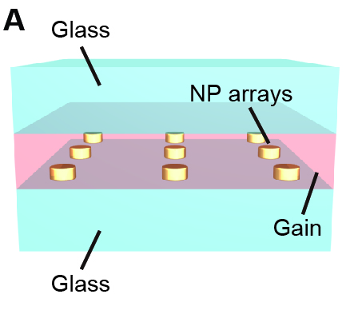
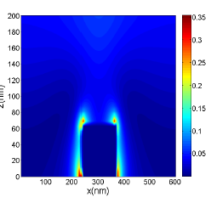
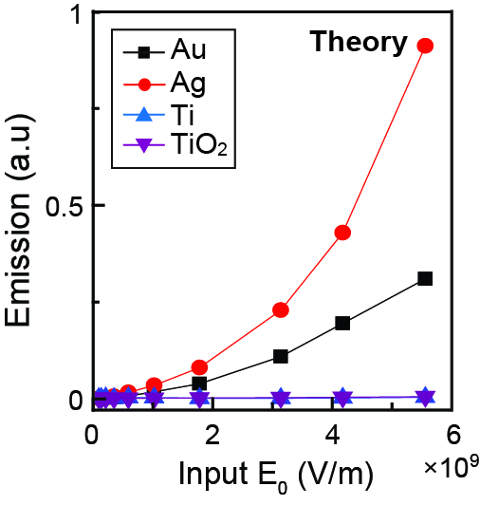
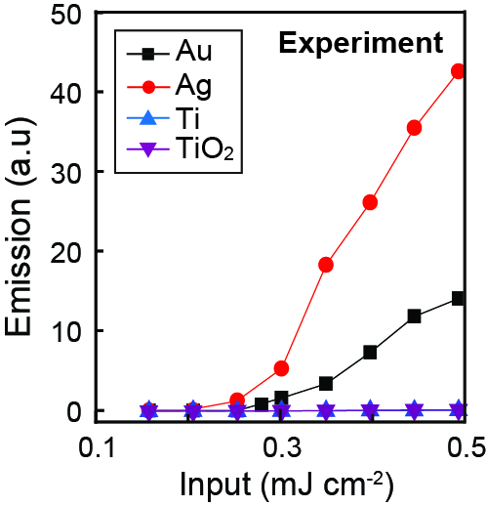

Plasmon Enhancement for Subwavelength Lasers
Scientific achievement
  Plasmon excitation in silver and gold nano-particles enhances absorption and emission, enabling a subwavelength laser
Significance and Impact
  Plasmon enhanced stimulated emission is relevant to the fabrication of new devices that utilize less energy due to small size
Research Details
  A detailed theoretical model was developed which couples electrodynamics and rate theory. This theory provides a detailed description of the plasmon enhancement and laser photophysics, leading to predictions of new laser structures.
  Experiment/theory collaboration predicted nanoparticle structures and laser dye properties which optimized laser performance.
Top left: schematic of laser, which consists of an array of nanoparticles surrounded by the gain medium. Top right: calculation showing gain near one of the gold nanoparticles. Bottom panels:: Comparison of theory and experiment for laser emission as a function of pump power, including results for plasmonic nanostructures (Ag, Au) and for the nonplasmonic materials (Ti, TiO₂) which don’t lase.
Reference: Montacer Dridi and George C. Schatz, J. Opt. Soc. Am. B 30, 2791-7 (2013). W. Zhou et al, Nature Nano 8, 506-511 (2013)
Worked performed in a collaboration of T. Odom and G. Schatz, Northwestern University
Notes:
Notes: Plasmon-enhanced lasers are a new type of laser in which plasmon excitation of silver or gold nanoparticles is used to enhance the absorption and emission of light in dye molecules located close to the particles. Such lasers have the capability of being smaller than the wavelength of light and therefore are of interest to making smaller light sources in a variety of applications. There are many structures possible for such lasers, but it is a challenge to produce a structure that optimizes enhancement at incident and emitted wavelengths, and which minimizes losses from absorption or amplified spontaneous emission. The structure described here is the first which has clearly demonstrated laser properties. A new theoretical model that we developed provides detailed modeling in support of the observations, and which points the way to other structures for such lasers.

Slide 41
What’s New?
What did we miss?: Data Science,…
What changed the game?: Nano,…
What didn’t change?: ?????
What is important now? ?????

Slide 42
Grand Challenge Candidate
BESAC Grand Challenge 2014
Grand Challenge Statement
Approaches to Solving Grand Challenge
• What’s the short question that captures the spirit of the GC (e.g., How do we control material processes at the level of electrons?)
• What are the 2-3 bullets that elaborate the scope?
• Characterization tools
• Computational tools
• Synthesis tools
• Intellectual tools
• . . .
Timeliness of Grand Challenge
Impact of Solving Grand Challenge
Why is this a grand challenge now and not earlier?
• New tools are now available (e.g, nanoscience, ultrafast, computation)
• Supporting grand challenges have been advanced/solved (e.g., mapping genome → gene therapy)
• . . .
• Enables understanding new classes of behavior (e.g., solving far from equilibrium → weather, fracture, traffic jams . . .)
• Enables new control of phenomena (e.g., principles of self-assembly → new classes of functional materials)
• . . .

