Slide 1
Basic Energy Sciences Update
BES Advisory Committee Meeting
August 2, 2011
Harriet Kung Director, Basic Energy Sciences
Office of Science, U.S. Department of Energy

Slide 2
Outline
FY 2011 Budget Update
Program Highlights
FY 2012 Appropriation Status
Upcoming Activities
BES Staffing
2

Slide 3
History of the Energy and Water Development Appropriation
FY 2011 – a new record!
The budget uncertainty associated a significant delay in the appropriation creates havoc with agency planning and budget execution.
3

Slide 4
FY 2011 BES Budget Appropriation
Core research
$100M for Energy Frontier Research Centers
Core research largely flat with FY 2010
EPSCoR funded at $8.5M per request
Scientific user facilities operations
Modest increase in operations funding:
Synchrotron light sources
Neutron scattering facilities
Nanoscale Science Research Centers
Construction and instrumentation
Funding for:
National Synchrotron Light Source-II
Spallation Neutron Source instruments
SNS Power Upgrade
Appropriation
$ 1,678 M
GPP/SBIR/Other
44.9
SUF Research
29.8
MIE 19.4
JCAP
22
Construction
152.8
NSRC 106.9
EFRC
Facilities
Ops
Neutron
Sources
257.1
100
770.1
MSE & CSGB Research
537.2
Light
Sources
406.1
4
Notes:
4

Slide 5
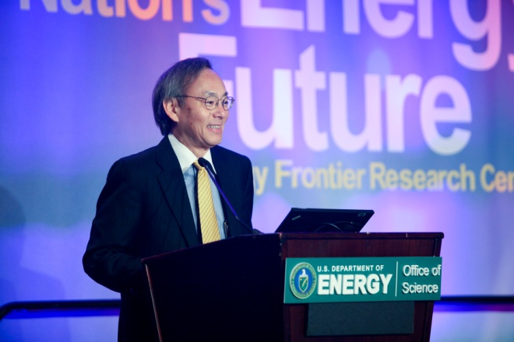
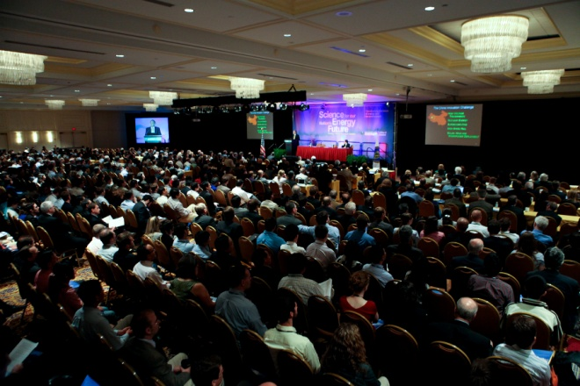
Science for Our Nation’s Energy Future: EFRC Summit & Forum May 25-27, 2010 at the Renaissance Penn Quarter Hotel in Washington, D.C.
Explored the challenges and opportunities in applying America’s extraordinary scientific and technical resources to critical energy needs
Highlighted early successes of the Office of Science Energy Frontier Research Centers
Promoted collaboration across the national energy enterprise
Participants
Over 1,060 science and policy leaders from universities, national laboratories, industry and government
More than 700 EFRC members, including 300 early career scientists
195 Institutions, 6 countries, and 36 States + Washington, D.C.
EFRC Summit & Forum Highlights
Over 35 plenary speakers including Secretary Chu, Senator Jeff Bingaman, Congressman Daniel Lipinski, and Congresswoman Zoe Lofgren
Screened the winners of the Life at the Frontiers of Energy Research video contest
Summit poster reception featured the 46 Energy Frontier Research Centers
Nine parallel technical sessions (46 hours of talks), three topical lunch discussions, two poster sessions on EFRC research (300 posters), and one networking poster reception with other DOE offices

Slide 6
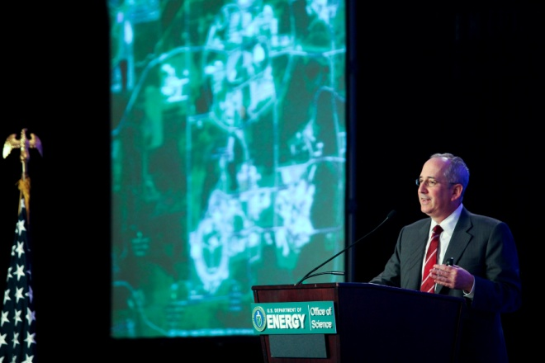
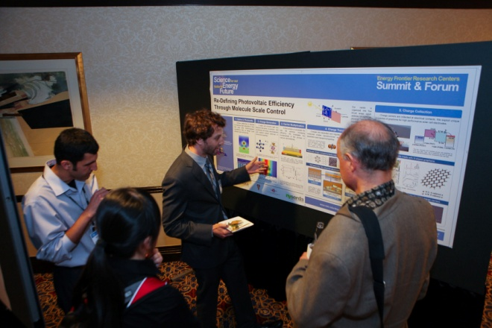
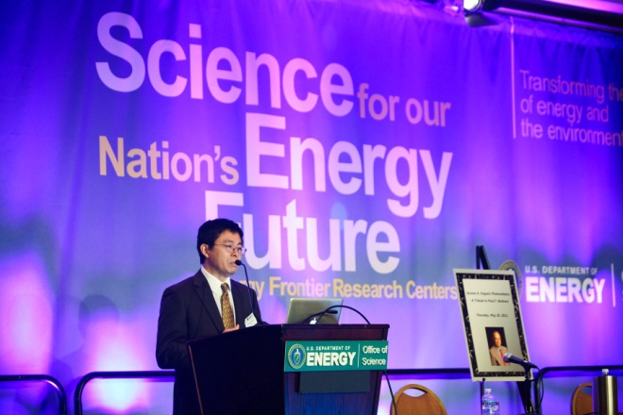
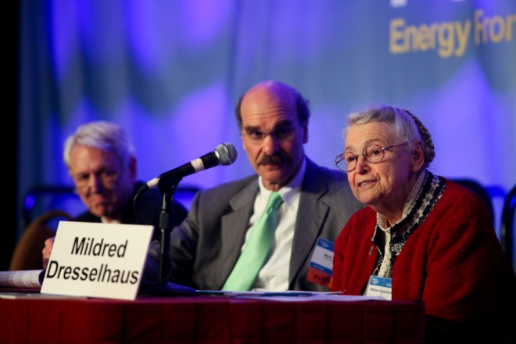
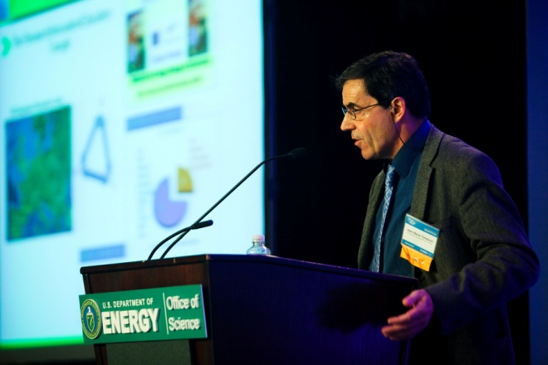
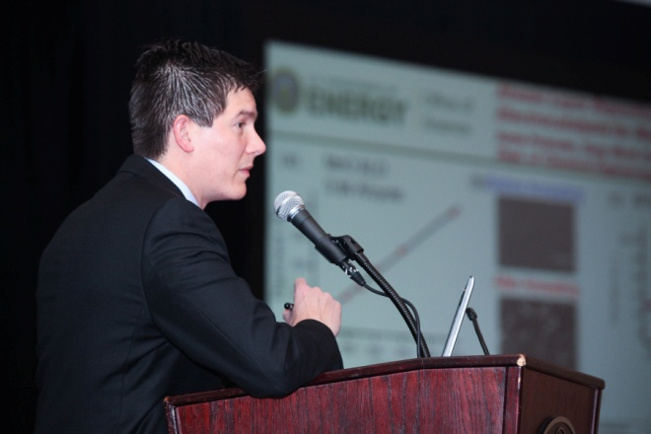
Eric Isaacs, Director of Argonne National Laboratory, spoke at the EFRC Summit
EFRC Summit Poster Session and Reception
Xiaoyang Zhu remembered the life and science of the late Paul F. Barbara
"EFRCs: A Response to Five Challenges for Science and the Imagination“ panel
Jean-Marie Tarascon talked about European electrical energy storage research
Each EFRC shared recent results during the EFRC Forum scientific sessions

Slide 7
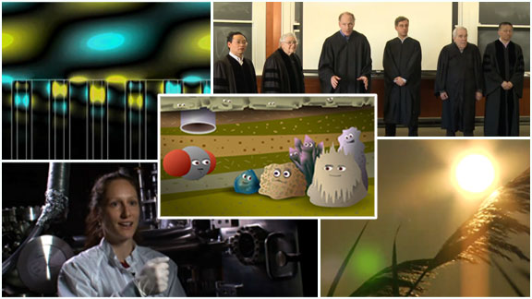
Life at the Frontiers of Energy Research Video Contest
Twenty-six EFRCs created short, engaging films that educate, inspire, and entertain an intelligent but not expert audience about the extraordinary science, innovation and people in their centers
Five winners selected by judges; Over 8,000 votes for the People’s Choice Award
Contest highlighted on the Office of Science news, C&E newscript blog, DOE Facebook, and DOE blog
EFRC Brochure
Contains overview of the EFRC program and a one page summary with early achievements for each center. Available in print and on-line.
Resources on the www.energyfrontier.us website
Slides and videos of plenary talks including Secretary Chu’s and Pat Dehmer’s presentations (www.energyfrontier.us/content/agenda)
Pat Dehmer’s talk is widely used by the EFRCs for education and outreach
Photo gallery, full schedule, and electronic abstract book
Life at the Frontiers of Energy Research videos (www.energyfrontier.us/video-contest)
ScienceCinema, the DOE OSTI multimedia search tool, will archive videos
http://science.energy.gov/~/media/bes/efrc/pdf/EFRC_Brochure_05132011.pdf

Slide 8
FY 2012 EFRC Science Reviews
Dates and Location:
January – April 2012, the third year of the five-year award period
Off-site in lower-cost regional cities near major airport hubs
Baltimore, Charlotte, Chicago, Denver, and Philadelphia
Reviews clustered according to both topical and regional considerations
Science Review Process:
Comprehensive review document addressing:
Strategic vision, scientific plans and progress, and technical accomplishments.
Management; synergy that makes an EFRC “greater than the sum of its parts.”
One full day of scientific presentations, posters, and small group discussions for each EFRC
Review by a panel of three to four expert peer reviewers with complementary email reviews if needed to ensure coverage of the technical breadth of the EFRC
EFRC participants: 12 to18 people including the EFRC Director(s), EFRC Leadership, and a mix of senior investigators, postdoctoral staff, and graduate students
Already underway:
Date and location of review communicated to each EFRC
Instructions for documentation and typical schedule for a review distributed;
Website, including FAQs, established for the review
Reviewer comments and DOE-BES analysis and recommendations may be used in future EFRC funding decisions.

Slide 9
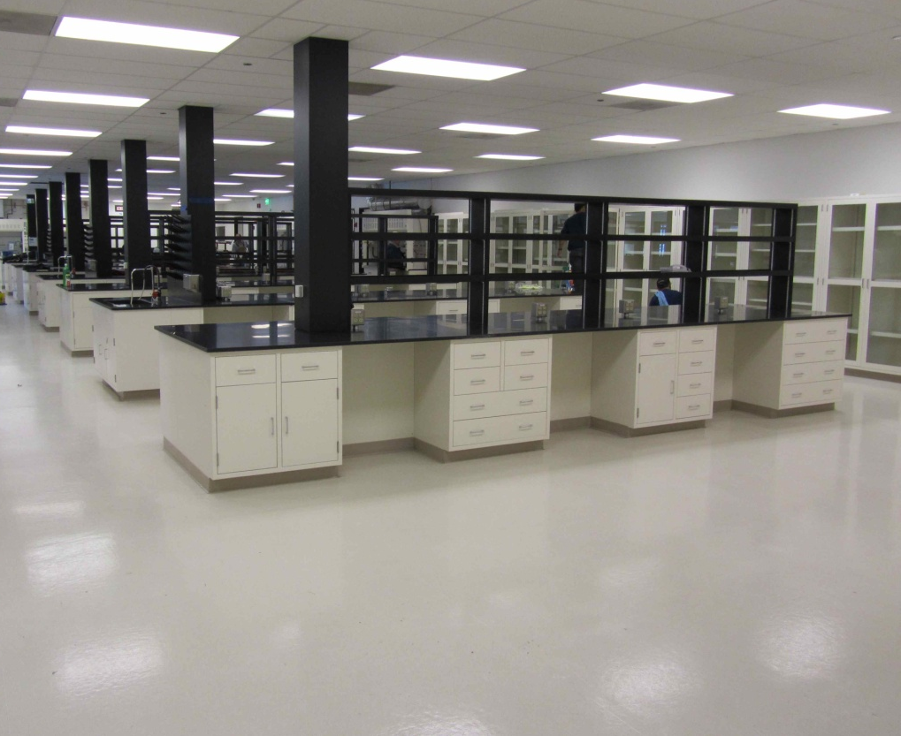
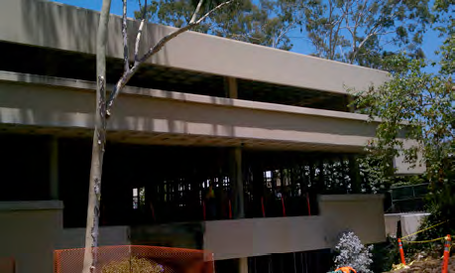
Fuels from Sunlight Hub Update
Space:
JCAP North (LBNL) occupying 14,000 sq. ft. leased space.
JCAP South (Cal Tech) occupying temporary space; renovation of permanent space complete March 2012.
BES management/operations review of JCAP in April. JCAP on track with no major issues.
Staffing proceeding well at all levels (senior staff, postdocs, students).
Science: Two publications and three invention disclosures. JCAP internal IP plan finalized.
JCAP North main lab
Outreach: JCAP will host Artificial Photosynthesis Futures Meeting at LBNL on Sept. 15-16, 2011 with ~30 EFRC participants.
JCAP South (Jorgensen Hall) under renovation
www.solarfuels.hub
9
Notes:
Space: rapidly equipping and staffing temporary space in North and South. In North, about 20 postdocs and grad students are working in the lab, mainly installing equipment. In South, situation is similar, but temp space is in 3 labs. Rennovation of Jorgensen on track for March 2012 completion.
Review: basically strong; minor corrections that JCAP is heeding.
Staffing: going very well, though it has taken longer than we’d like for some key senior positions – associate director and department head (to replace Atwater). JCAP says these will be soon.
Science: two papers in press – one on water splitting using the vapor phase, which is very intriguing as it gets around some serious multiphase issues (e.g., bubbles) when it’s done in the liquid phase. The other on new homogeneous water splitting catalyst. Three invention disclosures – two at LBNL and one at Cal Tech. Internal IP agreement (for JCAP partners) is “finalized” but not quite fully signed off. Very close.
Outreach and Communications: AP Futures meeting in Sept. with lots of EFRC participation. JCAP brochure and new website, which is vastly improved and worth a visit.

Slide 10
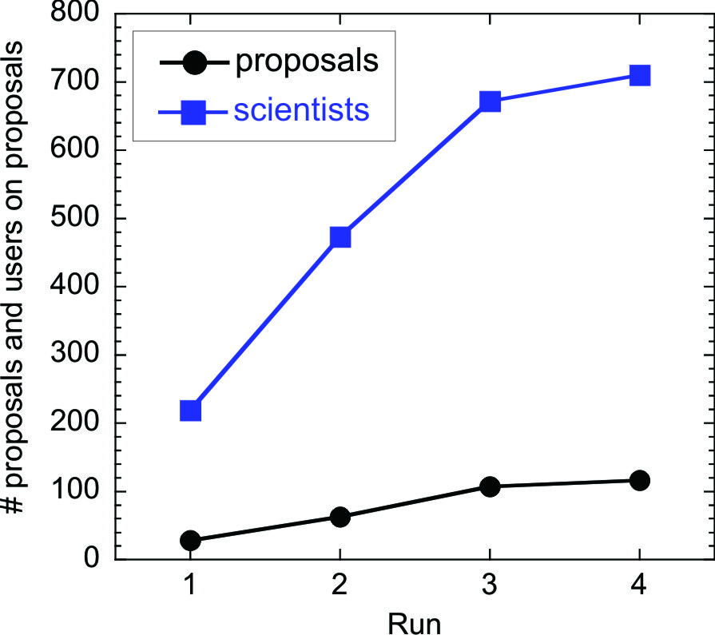
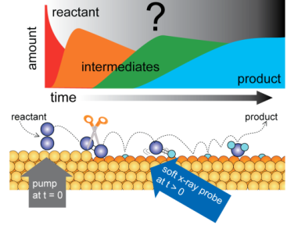
LCLS Early Science Success Draws Rapid User Growth
Oct. 2009 May 2010 Oct. 2010 May 2011
427 proposals submitted to date
1,297 unique scientists from 28 countries listed as collaborators on proposals Sept. 2008 - Jan. 2011
~15 collaborators on average (largest collaboration team is 60)
10
Notes:
UWE:
Rearrange order, reword:
1 = Concept...
2 = Single shot (reword)
3 = emerging multi-photon (reword) Need lighter logo

Slide 11
~28% of LCLS proposals received beam time
Proposals Received | Fall Run 2009 | Spring Run 2010 | Fall Run 2010 | Summer Run 2011
AMO/CAMP | 28 | 24 | 16 | 25
SXR |  | 38 | 32 | 31
XPP |  |  | 59 | 35
CXI |  |  |  | 25
Total Received | 28 | 62 | 107 | 116
“User Assisted Commissioning”
Dedicated User Facility > August 2010
Proposals Scheduled | Fall Run 2009 | Spring Run 2010 | Fall Run 2010 | Summer Run 2011
AMO/CAMP | 11 | 13 | 5 | 8
SXR |  | 10 | 5 | 7
XPP CXI |  |  | 16 | 6 6
Total Scheduled | 11 | 23 | 26 | 27
11

Slide 12
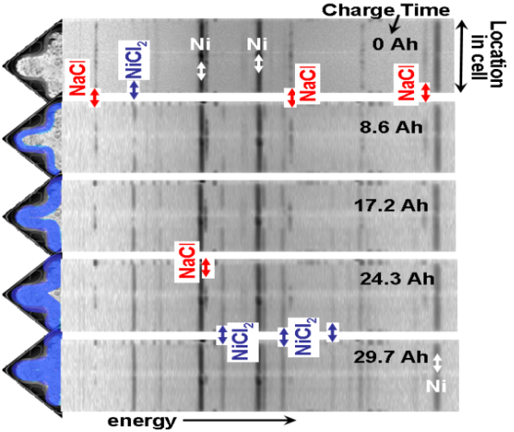
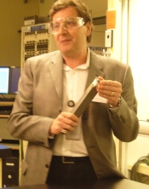
Light Source Industry Usage Example #1:
Studying Commercial Batteries in Action
Energy dispersive x-ray diffraction (EDXRD) provides an excellent platform for 4D-mapping (3D-spatial plus time/charge-state evolution) measurements of the internal electrochemistry of functioning commercial batteries.
In situ studies were performed on prototypes of batteries designed by GE for hybrid diesel locomotives. EDXRD measurements revealed local electrochemical kinetics in unprecedented levels of detail deep inside of commercial-size batteries.
GE has recently announced that it will build a 100 Millions manufacturing facility in upstate New York to produce Sodium metal halide battery, and will use EDXDR at the NSLS to improve the performance of them.
Cross-sectional x-ray diffraction patterns taken at various times during charging of a Na/MCl₂ ⇔ NaCl/M battery
GE chemical engineer
Charles Iacovangelo,
advanced battery project leader, holds a sodium metal halide battery cell.
12

Slide 13
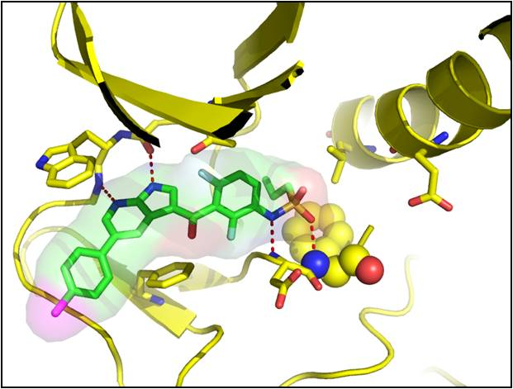
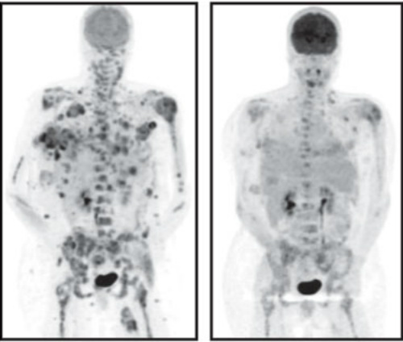
Light Source Industry Usage Example #2:
X-ray crystallography leading to new melanoma drug development
X-ray crystallography at ALS, SSRL and APS has enabled Plexxikon Inc. to develop new drug against malignant melanoma.
The company targeted a mutant protein found in half of all melanoma patients. They examined over 500 crystallized protein samples at the 3 DOE facilities to find a drug molecule that blocks the runaway cell growth triggered by the mutation.
For patients in recent Phase III clinical trials who had late-stage malignant melanoma and the gene mutation and received vemurafenib, the risk of dying was 63 percent less than for those who received conventional treatment – a dramatic improvement.
Tumors shrank significantly in many patients -- a clear victory for the targeted drug development process.
13

Slide 14
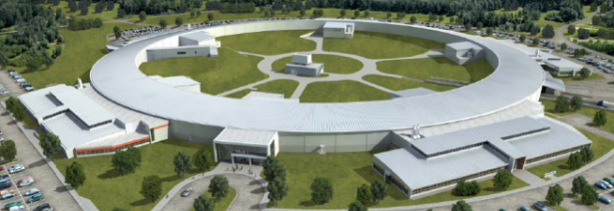
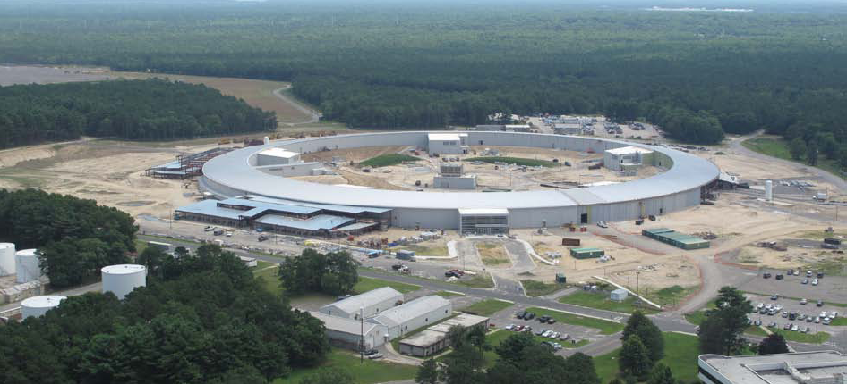
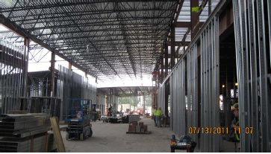
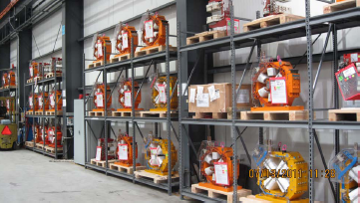
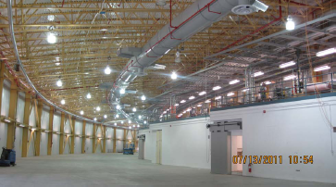
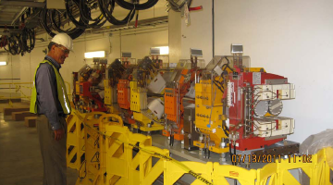
NSLS-II Project 56% Complete
Aug 2005 CD-0, Approve Mission Need (Complete)
Jul 2007 CD-1, Approve Alternative Selection and Cost Range (Complete)
Jan 2008 CD-2, Approve Performance Baseline (Complete)
Jan 2009 CD-3, Approve Start of Construction (Complete)
Feb 2009 Contract Award for Ring Building (Complete)
Aug 2009 Contract Award for Storage Ring Magnets (Complete)
May 2010 Contract Award for Booster System (Complete)
July 2011 Beneficial Occ of 1st & 2nd Pentants, RF Building; Start Accelerator Installation (Complete)
LOB #1
Magnet Inventory
1st girder of storage ring magnets
Pentant 2
Notes:
Image on right shows a real picture of the actual first girder, fully outfitted with magnets, vacuum chamber, and diagnostic components.

Slide 15
FY 2012 BES Budget Request
Research programs
Energy Innovation Hubs
Energy Frontier Research Centers
Core Research: increases in basic research for energy; materials by design; nanoelectronics; methane hydrates
Scientific user facilities operations
Synchrotron light sources
Neutron scattering facilities
Nanoscale Science Research Centers
Instrumentation for clean energy
FY 2012 Request:
$ 1,985M
SBIR & GPP
45.3
SUF Research
27.1
Construction
& OPC
MIE
97
Hub 58.3
NSRC 121.6
EFRC
100
159.1
Neutron Sources
276.9
Facilities
Ops
825.4
CSGB
Research
317.2
Light Sources
426.9
MSE
Research
355.6
Construction and instrumentation
National Synchrotron Light Source-II and instrumentation (NEXT)
Spallation Neutron Source instruments & power upgrade
Advanced Photon Source upgrade
Linac Coherent Light Source-II
TEAM-II
15

Slide 16
FY 2012 HEWD Mark vs. Request
(in $K) | FY 2011 Approp. | FY 2012 Request | FY 2012 House | FY 2012 House vs. FY 2012 Request
BES Total | 1,678,195 | 1,985,000 | 1,688,145 | -296,855 | -15.0%
Research | 1,526,898 | 1,833,600 | 1,547,343 | -286,257 | -15.6%
Construction | 151,297 | 151,400 | 140,802 | -10,598 | -7.0%
16

Slide 17
FY 2012 House Energy and Water Development Appropriations
The Committee recommends $1,688,145,000 for Basic Energy Sciences, $9,950,000 above fiscal year 2011 and $296,855,000 below the request.
Within available funds, the recommendation includes $20,000,000 to establish an Energy Innovation Hub for Batteries and Energy Storage.
…the Department should not assume that all, or even most, Energy Frontier Research Centers will be continued beyond their fifth year in fiscal year 2013. …the Department is directed to provide to the Committee, not later than March 1, 2012, a report including the five-year research goals for each EFRC, each center’s current status towards reaching those goals, and the Department’s latest rating of each EFRC’s performance as they pass their half-way point and the Committee considers funding for the last year of the initial five-year awards.
The recommendation provides no funds, $8,520,000 below the request, for the Experimental Program to Stimulate Competitive Research (EPSCoR).
17

Slide 18
FY 2012 House Energy and Water Development Appropriations
Terminations of Underperforming Projects
However, the Committee is concerned that Basic Energy Sciences is not holding its research groups accountable in the same way, and that it is not terminating underperforming grants.
The Department is therefore directed to create a performance ranking of all ongoing multi-year research projects across Basic Energy Sciences, including those at universities, national laboratories, Energy Frontier Research Centers, Energy Innovation Hubs and other recipients, by comparing current performance with original project goals. The Department is directed to terminate the lowest-ranking awards within Basic Energy Sciences in the amount of $25,000,000, and to report to the Committee, not later than March 15, 2012, on the results of the ranking exercise and selected terminations.
18

Slide 19
BES Communications Plan
A new and improved communications plan is called for –
Build on past successful models of communication
Take advantage of new media tools, including web-based approaches
Streamline the collection of inputs, formats of reporting, etc.
Tailor the level of technical details to suit different stakeholder groups
Establish a process for periodic updates
Deliverables (archival and searchable):
- Annual program report
- Annual project summaries
- Impact brochure (e.g., Science serving the Nation report)
(Details in Eric Rohlfing’s talk on 8/3)
19

Slide 20
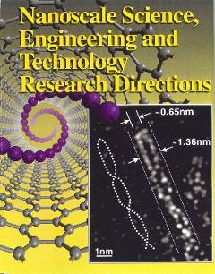
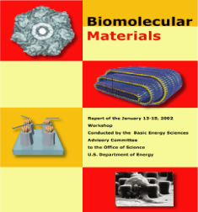
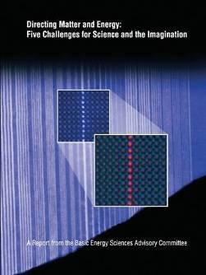
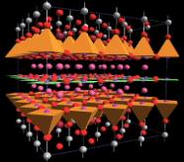
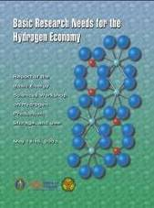
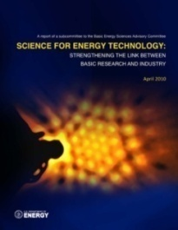
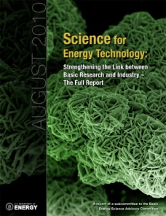
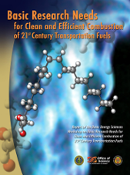
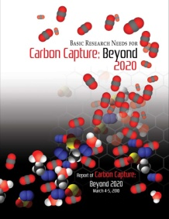
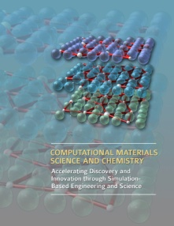
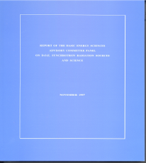
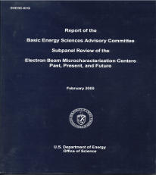
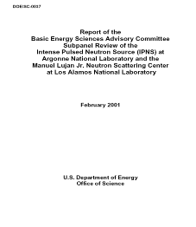
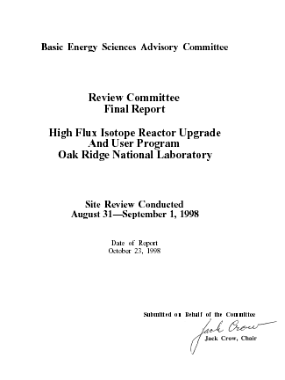
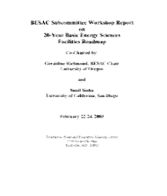
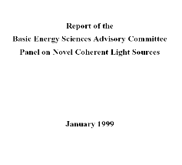
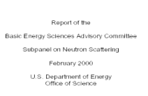
BES Strategic Planning Activities
Science for Discovery
Complex
Systems
Mesoscale Science
Science for National Needs
National Scientific User Facilities, the 21st century Tools of Science & Technology
Notes:
20
ERL, FEL, Ring, Cathode, novel sources, enabling technologies;

Slide 21
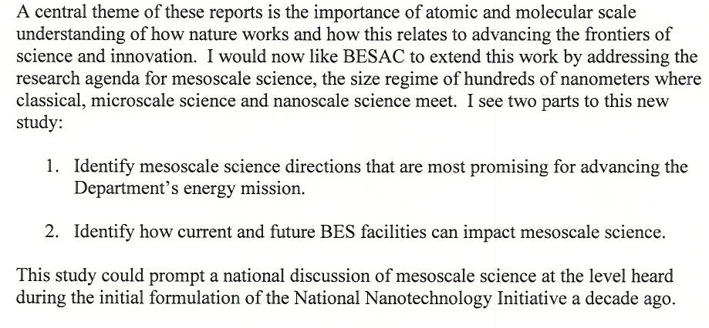
A New BESAC Charge on Mesoscale Science
Excerpts from Dr. Brinkman’s charge letter:
21

Slide 22
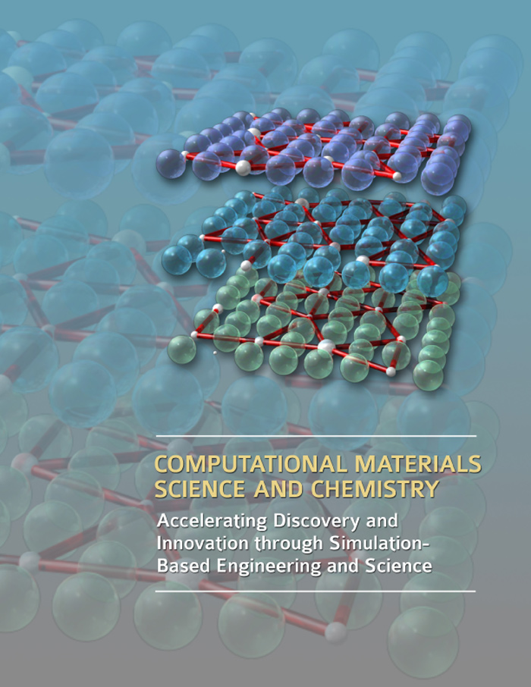
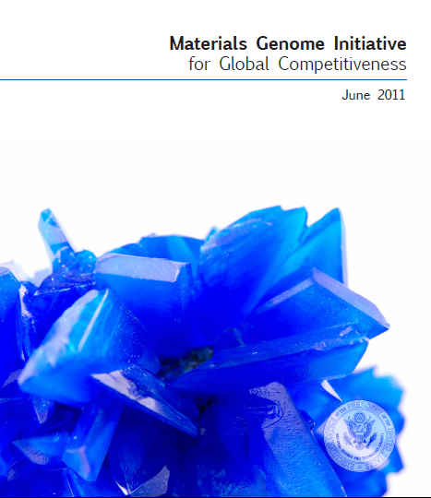
Materials by Design – Materials Genome Initiative
“We are at the threshold of a new era where predictive modeling will transform our ability to design new materials and chemical processes, thereby enabling rational discovery strategies for systems that were not tractable a few years ago.”
This whitepaper and initiative were prepared by the ad-hoc interagency Group on Advanced Materials and formally approved through the National Science and Technology Council, Committee on Technology. This group had substantive contributions from representatives in the following organizations: White House Office of Science and Technology Policy; Department of Energy: Office of Science, Basic Energy Sciences, and Office of Energy Efficiency and Renewable Energy; Department of Defense: Office of the Assistant Secretary of Defense for Research and Engineering, Army Research Laboratory, Office of Naval Research, Air Force Research Laboratory; National Science Foundation: Directorate for Mathematical & Physical Sciences, Directorate for Engineering; and Department of Commerce’s National Institute of Standards and Technology.
http://www.whitehouse.gov/sites/default/files/microsites/ostp/materials_genome_initiative-final.pdf
22
Notes:
Each workshop had three common goals: (1) to summarize, prior to the workshop, the current state of technology and the associated R&D challenges in a Technology Perspectives Factual Document, which was used as a resource document for the basic research community at the workshop and well into the future; (2) to define a set of proposed research directions that address the technology R&D challenges, the so-called technology show stoppers; and (3) to define a set of grand challenges that, if solved, might result in transformational changes in energy technologies. The DOE technology offices participated in the plenary sessions of these workshops to provide perspectives of their programs along with their current targets, goals, and milestones; and often assisted in preparing the technology perspective factual documents prior to the workshops.

Slide 23
A Renaissance in American Manufacturing
President Obama Speech on June 24, 2011
President Obama kicks off the Advanced Manufacturing Partnership (AMP), a national collaboration between the government, industries, and universities to invest in cutting-edge technologies, create new jobs and bring about a renaissance in American manufacturing. As part of his new AMP, the President is announcing an ambitious plan, the Materials Genome Initiative, to double the speed with which we discover, develop, and manufacture new materials.
23

Slide 24
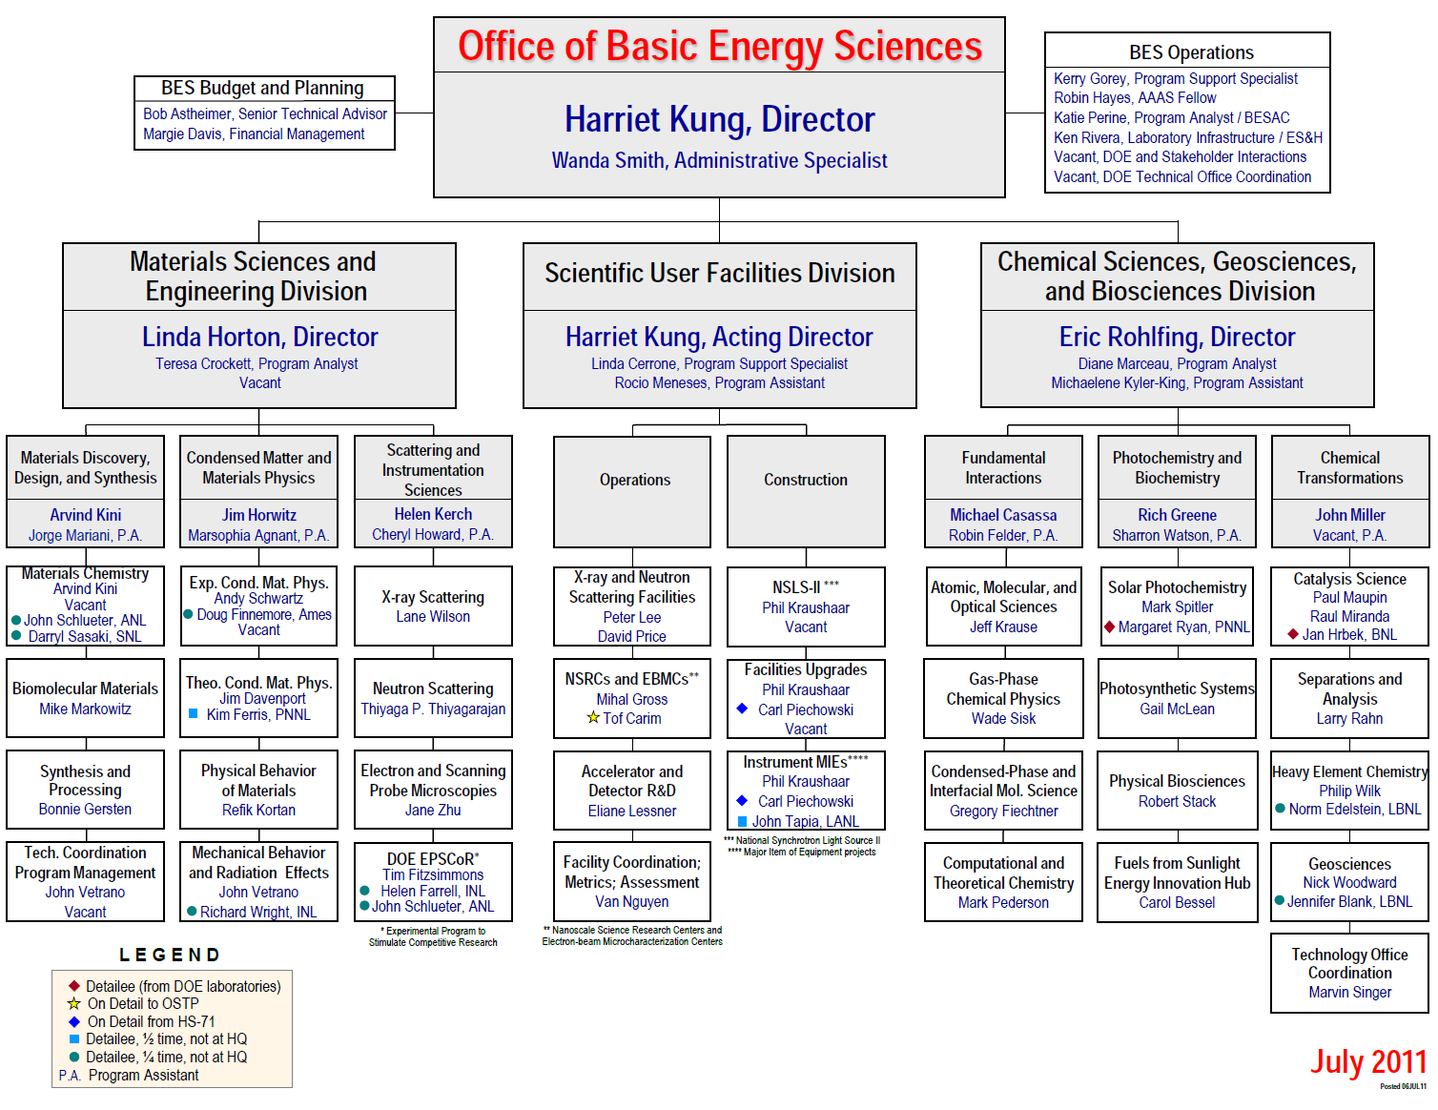
Linda Horton
Vacant
Jeff Krause
Thiyaga P. Thiyagarajan
Gail McLean
John Vetrano
Carol Bessel
New
EFRC
OSTP Detail
Vacancy

