Slide 1
Status of International Light Sources:
Today and in the Near Future presented to the
BESAC Meeting
25 July 2013
Persis S. Drell
SLAC/Stanford
James B. Murphy, Director
BES Scientific User Facilities Division

Slide 2
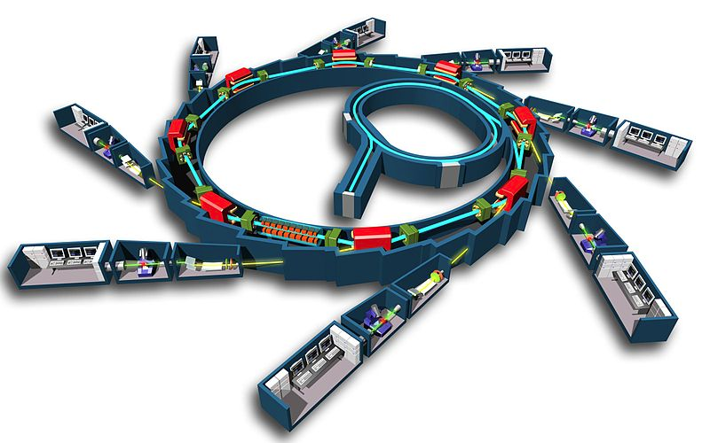
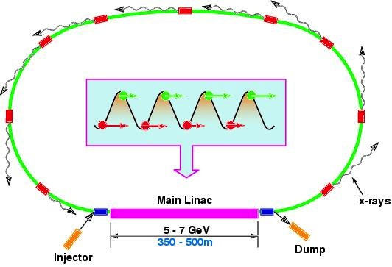
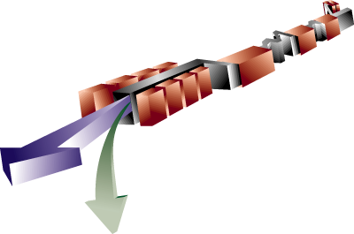
Light Sources: ERL, FEL & Storage Ring
Storage Ring
ERL
Spontaneous Emission
approx. 500m
FEL
Stimulated Emission

Slide 3
What Do We Care Most About in Light* Sources?
Wavelength Range
  Determines the kind science you can access—atomic or electronic structure and dynamics
Brightness: Average and Peak
  Determines sensitivity of measurements
Pulse Width
  fs pulses opens the window on ultrafast dynamics and ‘probe before destroy’ technology
Coherence
  Allows new techniques (e.g. coherent imaging)
  Leads to high brightness of the beams; transform limited pulses are possible
Stability
  Source stability in energy, position, time, intensity
Number of Undulators/Beamlines/Endstations
  Determines the number of users in parallel that can be accommodated and ultimately how much science gets delivered

Slide 4
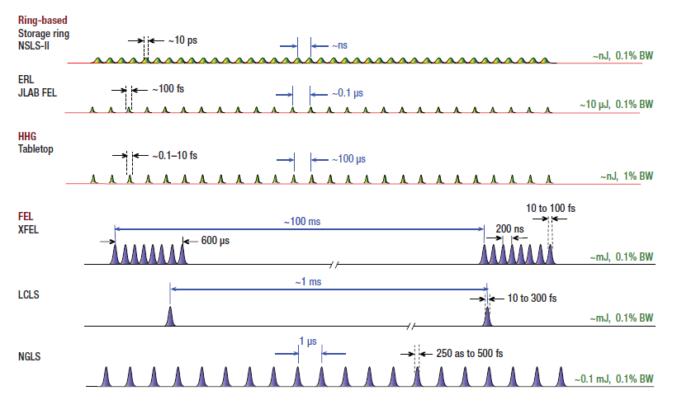
Light Source Pulse Structures
Burst Mode
Pulsed
CW

Slide 5
X-Ray Light Source Comparison
Parameter | Storage Rings | FEL | ERL
Wavelength Range | + | + | +
Peak Brightness |  | + | ~
Pulse Structure | CW | Pulsed/Burst CW in future | CW
fs Pulse Width |  | + | ~
Coherence | ~ | + | ~
Stability | + |  | +
Number of Beamlines | + |  | +

Slide 6
What is the Science?
Science Goals will drive technology decisions. What is the science we want to target?
  Electron dynamics?
  Atomic scale imaging?
  Structure vs Dynamics?
To achieve science goals, more than x-ray sources will be needed
  Pumps: Lasers, THz, etc….
  Technology: Optics, Detectors, ….
  Other infrastructure for science
Bottom line focus must be on science delivery!
  But the focus of this talk is status of the light source tools we have to do the science

Slide 7
BES Light Sources & Key Worldwide Competitors
Circa 2013
MAX IV
PSI SLS
PETRA III
PAL XFEL
SWISSFEL
XFEL
ALS
ESRF,U
FLASH-I,II
NSLS-I,II
APS,U
SPRING8,U
SSRL
LCLS-I,II
SACLA XFEL
SIRIUS
Storage Rings in Blue
FELs in Red
There are many more UV/X-ray rings, IR/UV FELs & a few ERLs

Slide 8
How do Storage Rings and FELs Compare Today?
Parameter | Storage Rings | X-ray FEL
Wavelength Range | 2-3+ decades typically | 1+ decades (multiple undulators)
Peak Brightness (ph/s/mr²/mm²/0.1%BW) | 10²² – 10²⁴ | 10³¹ – 10³³ (10⁹ times higher than SR)
Average Brightness (ph/s/mr²/mm²/0.1%BW) | 10¹⁹– 10²¹ | 10²⁰– 10²²
Minimum Pulse Width (fs) | ~10,000 | ~5
Coherence | Limited transverse spatial coherence | Transverse spatial coherence, limited temporal coherence without seeding
Energy Position Time | <.01% (with ~0.1% energy spread) < 0.1 σ (~10 μm H, ~0.3 μm V) < 0.1 σ (~1 ps, ~0.2 ps low α) | 0.01-0.03% wo / self seeding ~0.1 σ ~100 fs
Number of Beamlines | Large (~30-60) | Limited (6 endstations per undulator)
Stability

Slide 9
Frontiers of FEL and Storage Ring Development
Storage Rings
  ‘Ultimate Storage Ring’ technology
    Diffraction limited emittance resulting in:
      higher peak brightness
      higher average brightness
      enhanced coherence
Free Electron Lasers
  Seeding → Higher brightness (peak and average), better energy stability, reduction of temporal and intensity fluctuations
  More undulators per injector
  Higher rep rate → Higher average brightness
  Shorter pulses
  Multiple colors

Slide 10
How will Storage Rings and FELs Compare in the Future?
Parameter | Storage Rings | FEL
Wavelength Range | 2-3 decades typically | 1-2 decades (multiple undulators)
Peak Brightness (ph/s/mr²/mm²/0.1%BW) | 10²⁴ – 10²⁶ (x 100 increase but still modest compared to FEL) | 10³¹ – 10³³
Average Brightness (ph/s/mr²/mm²/0.1%BW) | 10²¹– 10²³ (x 100 increase) | 10²³– 10²⁵ (x 1000 increase)
Minimum Pulse Width (fs) | ~1000 | Below ~1 fs
Coherence | High spatial coherence | Full coherence
Energy Position Time | <.01% (with ~0.1% energy spread) < 0.1 σ (~0.3 μm H, V) < 0.1 σ (~0.5 ps ) | < 0.1 eV (seeded) ~0.1 σ ~10 fs
Number of Beamlines | Large (~30-60) | Limited (~3-6 endstations per undulator), multiple undulators per facility
Stability

Slide 11
Path to the Future…
Europe, Asia and the US are taking different approaches to deliver capability and capacity
  Hard x-ray facilities vs. soft x-ray facilities
  Storage Ring vs FEL vs ERL
  Balance investments in ~1B$ class tools and ~100M$ class infrastructure to exploit the tools
  What’s the best (affordable) idea?

Slide 12
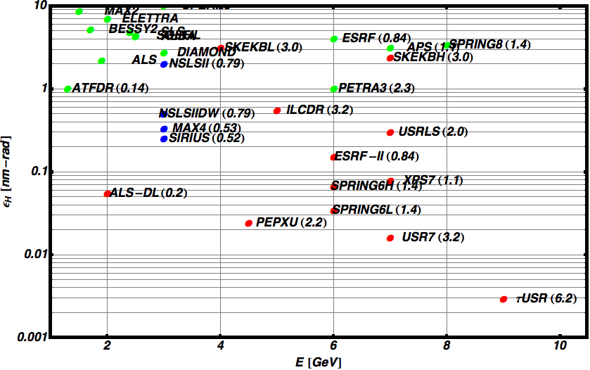
Ring Horizontal Emittance vs Ring Energy
Ring Name (Circumference in km)
Achieved
Construction
Design
Diffraction Limit @1Å
ε ~ λ/4π ~ 8 pm

Slide 13

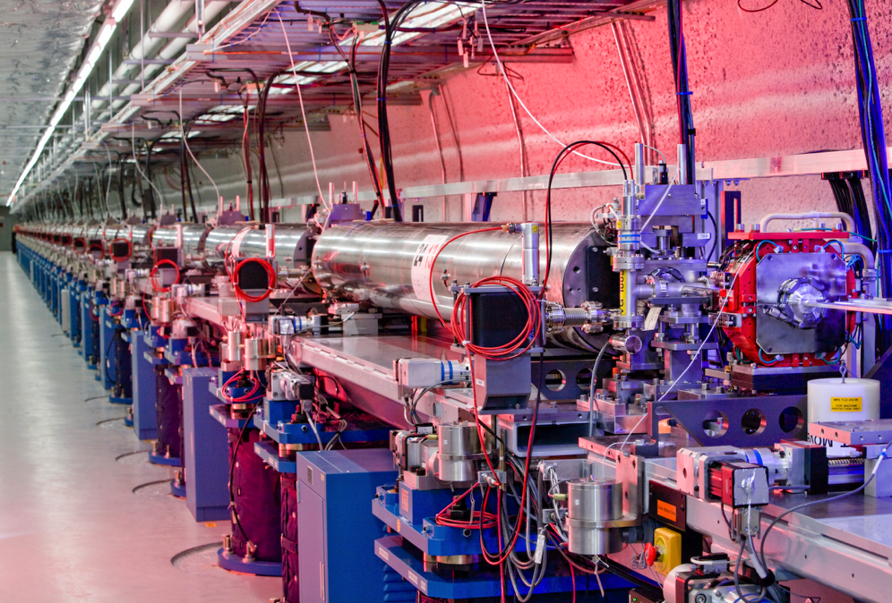

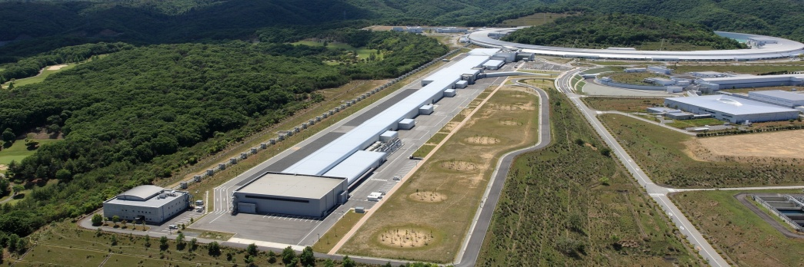
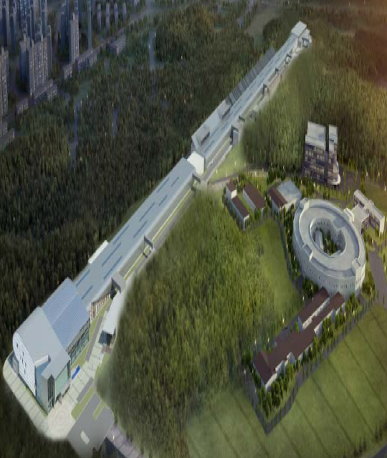

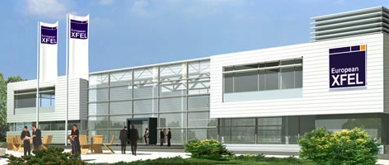

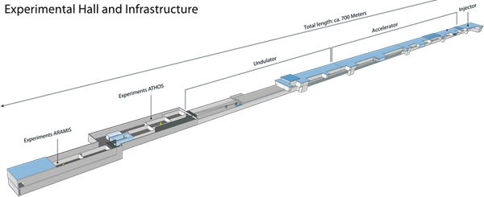

Hard X-Ray FELs in Operation & Under Construction
LCLS-I, II 2009, 2018
14.5 GeV, 120 Hz NC
SACLA 2011
8.5 GeV, 60 Hz NC
XFEL 2015
17.5 GeV, 3000 x 10 Hz SC
PAL XFEL 2015
10 GeV, 100 Hz NC
SWISS FEL 2017
5.8 GeV, 100 Hz NC
Four normal conducting (NC) linacs
One pulsed superconducting (SC) linac
How low can E_{e} & $ go without dashing performance?

Slide 14
Asian Strategy
Current Status:
  SPring-8: High performing 3rd generation SR
  Many other ‘regional’ storage rings
  SACLA: 60 Hz, one beam line hard x-ray FEL
Near Future:
  Upgrade SPring-8 to ‘USR’ at 6 GeV
  Upgrade SACLA
    SACLA with additional injector and additional undulators
  New FEL in Korea: PAL XFEL
    One beam line, 100Hz
Far Future:
  3 GeV ERL @ KEK
SACLA 2011
8.5 GeV, 60 Hz NC
PAL XFEL 2015
10 GeV, 100 Hz NC

Slide 15
European Strategy
Current Status:
  Several high performance hard-x-ray SR
    ESRF, PETRA-3
  Several high performance soft/medium x-ray SR
    BESSY-II, SLS, Diamond, SOLEIL
  Two soft x-ray FEL’s
    FLASH I & FERMI with1 undulator each
Near Future
  Upgrade ESRF to ‘USR’, build new high performance ring (MAX-4), expand PETRA-3
  Expand FLASH I → FLASH II
  Two new hard x-ray FELs:
    XFEL: rep rate 3000 x 10; 6 undulators
    SwissFEL: rep rate 100 Hz and 1 undulator
XFEL 2015
17.5 GeV, 3000 x 10 Hz SC
SWISS FEL 2017
5.8 GeV, 100 Hz NC

Slide 16



European Strategy Continued
By 2020, Europe will have the most advanced suite of light source tools in the world
Enormous concentration of tools in Hamburg
  FLASH I, II
  PETRA-3
  XFEL (managed by XFEL corporation)
German strategy includes tremendous investments in infrastructure to exploit the light sources and deliver science
  CFEL
  CSSB
  Nanocenter
Nano-Bio-Femto

Slide 17
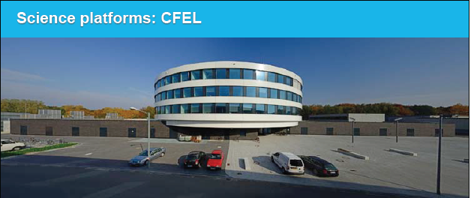
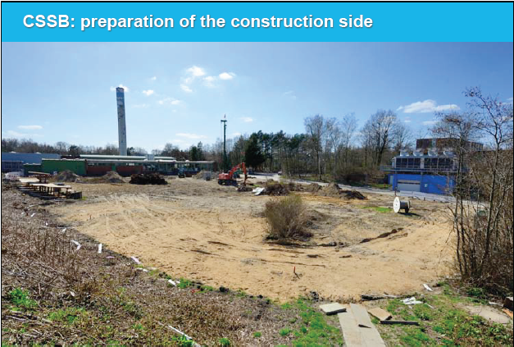
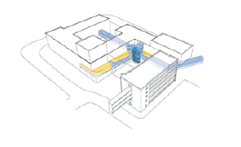
DESY Science Platforms
Center for Free Electron Laser Science
Site Prep: Center for Structural Systems Biology
Conceptual Design: NanoLab

Slide 18
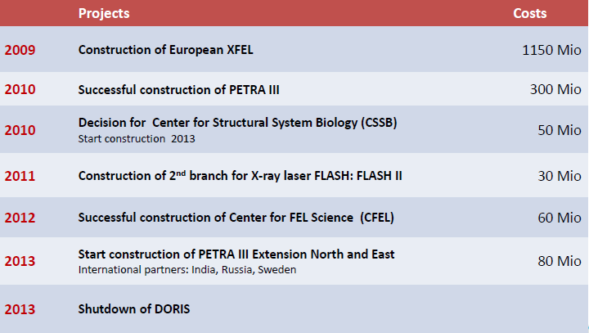
Investments at DESY Over 5 Years
1 Euro = $1.30

Slide 19
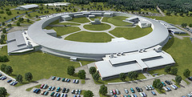
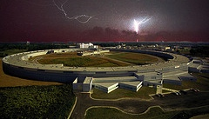
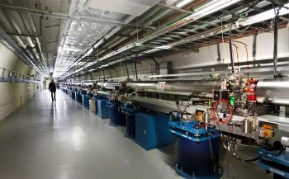
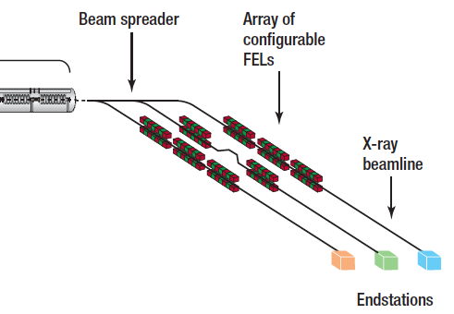
BES USA Strategy
Current State
  4 storage rings
    3 hard x-ray, 1 soft x-ray
  1 hard x-ray FEL: 120 Hz, one undulator, 6 endstations
Near Future
  NSLS II: 10⁴ boost in brightness, goal of 1 nm spatial & 0.1 meV energy resolution
  APS will be upgraded to APS-U, brightness boost and high rep rate 2 ps pulse capability
  LCLS II will extend capacity and capability with a new injector + 1km of linac, 2 undulators and 5-6 endstations.
Longer Future (past 2020)
  NGLS Proposal: MHz rep rates and ultimately10 undulators in soft x-ray FEL
2015
2018
2018
BES Strategy will be guided and informed by the BESAC Report we are about to discuss
>2020

Slide 20
Conclusions
Our charge: ‘The Charge to BESAC that we have been asked to address is to determine what is the most challenging and important science yet to be done that will require light sources and to determine the best sources, we can afford, that will allow us to explore those scientific frontiers’
The goal of this talk was to help set the stage:
  By 2020 Europe will have the most advanced suite of light source tools in the world
  There will be an extraordinarily high concentration of those tools in Hamburg, along with excellent supporting infrastructure to deliver science
  In addition to new FEL sources, both Europe and Japan propose to upgrade their hard x-ray rings to near diffraction limited
Existing US sources will still be very competitive into the 2020’s but the quality of the science performed at the US user facilities rather than the facilities specs alone will have to set the US apart from the pack
The work of this subcommittee is extremely important to ensure the US is well positioned past 2020

