Slide 1

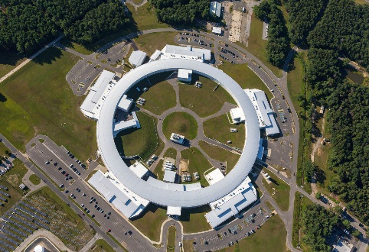
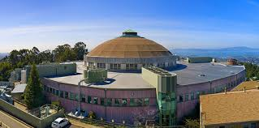
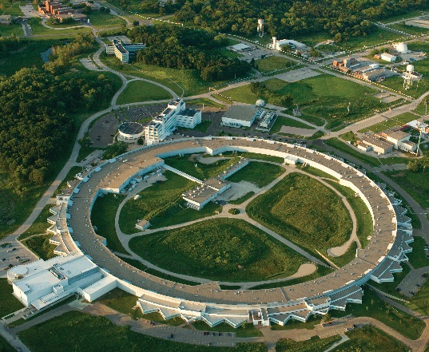
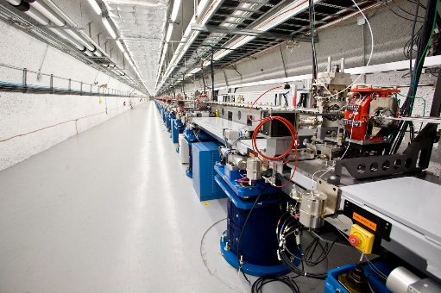
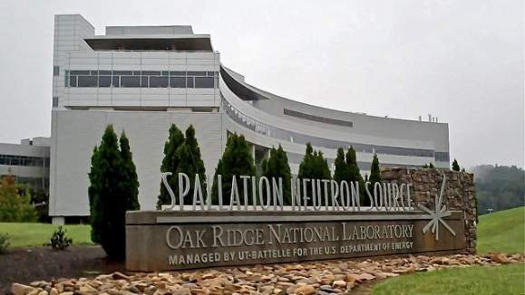
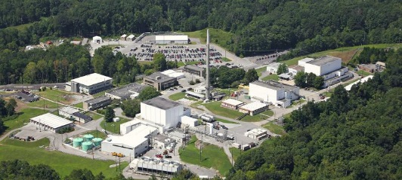


BES Light & Neutron Sources
ALS 1993
NSLS-II 2015
APS 1995
SPEAR3 2004
HFIR 2008
LCLS 2009
SNS 2007

Slide 2
December 21, 2015 Charge letter from Director Murray to BESAC
I am writing to present a new charge to BESAC, related to the prioritization of upgrades of existing user facilities and major construction projects for new user facilities. This charge is directed by the 2016 Omnibus appropriation for BES that stated:
“Since the February 2013 and the July 2013 Basic Energy Sciences Advisory Committee (BESAC) studies of BES facilities, the mix and status of ongoing and prospective BES major facility upgrades and construction projects have changed. Therefore the BESAC is directed to update its assessment of the proposed upgrades to x-ray scattering facilities (both free-electron laser-based sources and ring-based sources) and to the Spallation Neutron Source using the same criteria that were used in prior studies-the ability of a proposed upgrade or construction project to contribute to world leading science and the readiness of the upgrade or construction project to proceed to construction-and the same rating system. The assessment shall include a prioritization of the next three to five projects and be submitted to the Committees on Appropriations of both Houses of Congress not later than 180 days after the enactment of this Act.”

Slide 3
December 21, 2015 Charge letter from Director Murray to BESAC
The following are the two criteria to be considered in your evaluation:
1. The ability of a proposed facility or upgrade to contribute to world-leading science, noting in particular the relevance to the 2015 BESAC report "Challenges at the Frontiers of Matter and Energy: Transformative Opportunities for Discovery Science." Activities will be placed in one of three categories:( a) absolutely central; (b) important; and (c) don't know enough yet.
2. The readiness to proceed to construction, noting whether the concept has been thoroughly studied, the R&D performed to date is sufficient, the technical challenges can be met, and the extent to which the cost to build and operate the facility is understood. Concepts will be placed in one of three categories:
ready to initiate construction;
(b) significant scientific/engineering challenges to resolve before initiating construction;
( c) mission and technical requirements not yet fully defined.

Slide 4
BESAC Process
• BESAC meeting February 11-12, 2016
–presentations by laboratory and facility directors
Chi-Chang Kao
Mike Witherell, Roger Falcone
Peter Littlewood
Thom Mason, Paul Langan
–subcommittee formation (COI issues)
• BESAC subcommittee meeting April 14–16, 2016
–labs responded to multi-page request for information
–each lab team participated in half-day presentation/discussion
• Subcommittee report was prepared with unanimous committee agreement
Notes:
Discuss COI issues

Slide 5
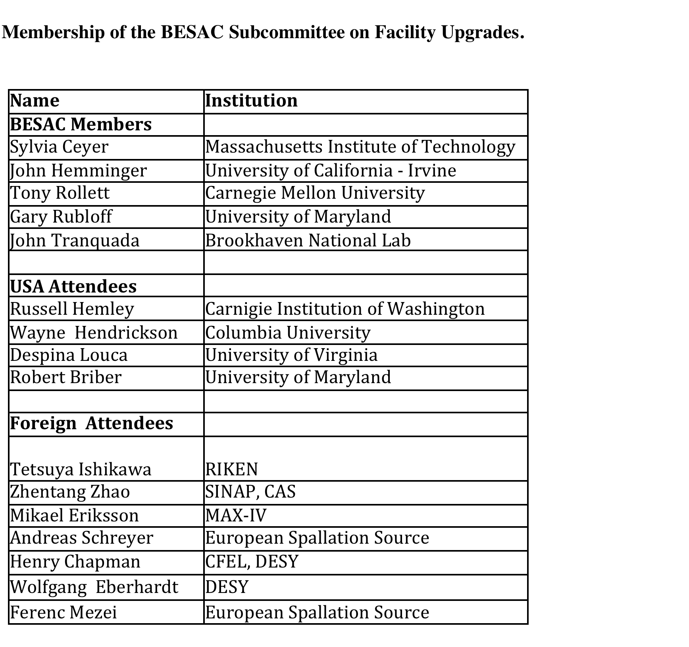

Slide 6
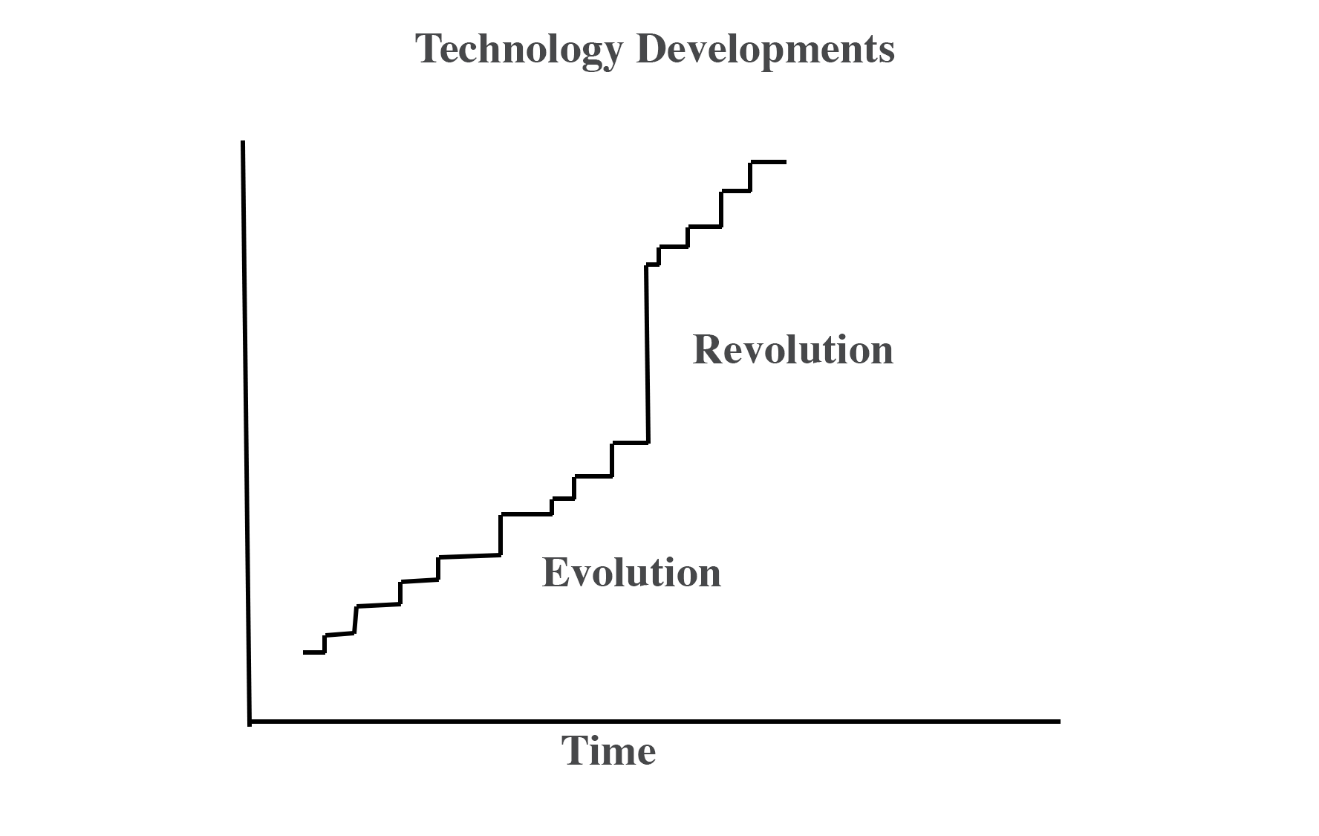
e.g.
• Multi-bend achromat lattice (MBA)
• large increase in neutron brightness
e.g.
• insertion devices
• top-off mode
• end-station developments
• robotics
• neutron guide designs
• enhanced methods for neutron polarization
• simultaneous simulations with measurements

Slide 7
X-ray Facility Upgrades
• Advanced Photon Source Upgrade (APS-U)
• Advanced Light Source Upgrade (ALS-U)
• Linac Coherent Light Source II High Energy Upgrade (LCLS II-HE)

Slide 8
Storage Ring X-ray Sources

Slide 9
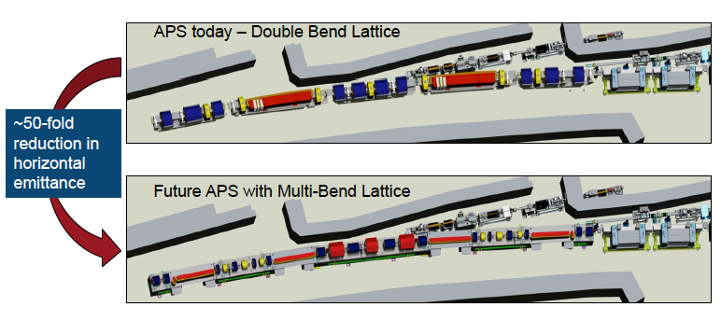
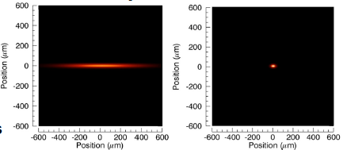
A Multibend Achromat Lattice has been implemented at MAX IV
Notes:
Discuss “swap out” injection----add a slide?

Slide 10
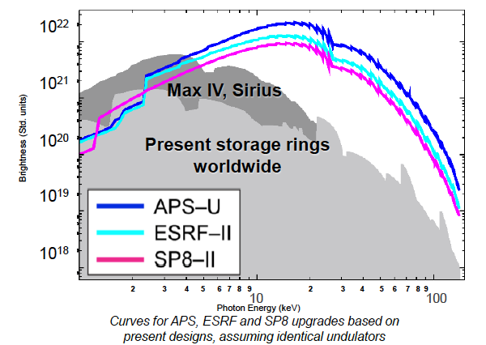
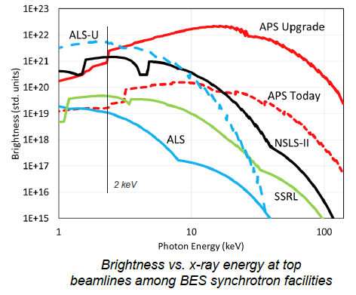
Brightness Curves With and Without Upgrades

Slide 11
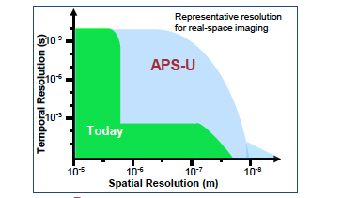
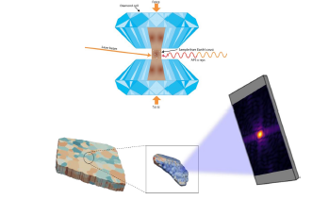
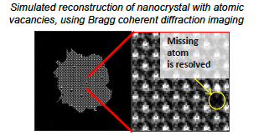
Opportunities Made Possible by APS-U
Resolution@Speed
Accessing Extreme Environments
Coherent Scattering and Imaging

Slide 12
APS-U Committee Findings
Criteria 1
APS-U is absolutely central to contribute to world-leading science
Criteria 2
APS-U is ready to initiate construction
The APS-U project is budgeted to deliver photons to the samples Necessary upgrades of APS beamlines are in the project
Dark time is estimated at one year.
APS should continue to enhance theory/simulation coupling to experiment

Slide 13
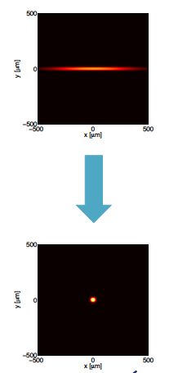
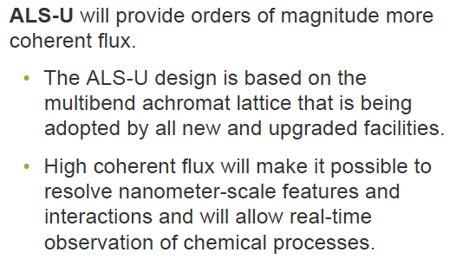
Advanced Light Source Upgrade
(Essentially fully coherent at 2 keV)
Notes:
Mention swap out here also

Slide 14
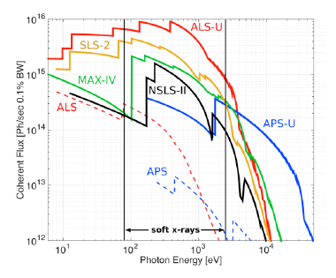
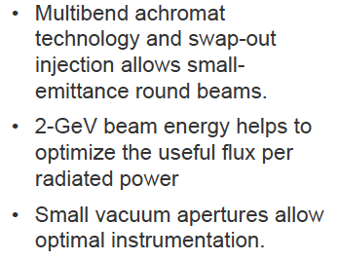
ALS with a Multibend Achromat Lattice

Slide 15
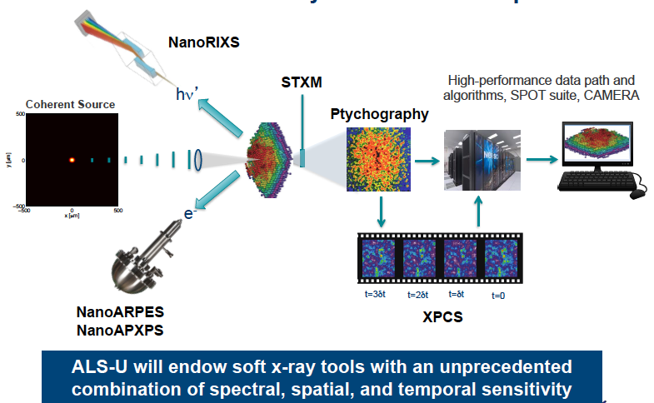
Opportunities with ALS-U

Slide 16
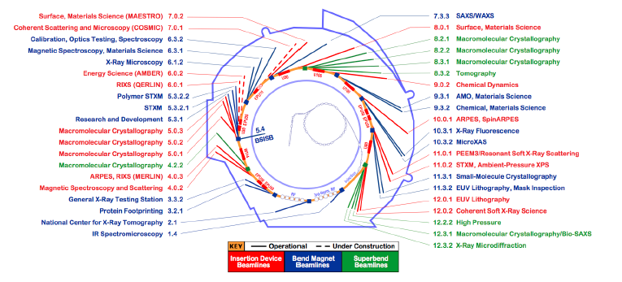
ALS Beamlines
The ALS is working to upgrade existing beamlines so that they are compatible with and deliver the capabilities of ALS-U

Slide 17
ALS-U Committee Findings
Criteria 1
ALS-U is absolutely central to contribute to world-leading science
Criteria 2
ALS-U is ready to initiate construction
The ALS is working to upgrade existing beamlines so that they are ALS-U capable. A more pro-active approach to involving the user community in the planning for necessary beamline and endstation updates is needed.
Dark time is estimated at 12 months.
A robust coupling between theory/simulation and experiment exists (e.g. CAMERA)
Notes:
Check dark time

Slide 18
X-ray Free Electron Lasers
LCLS II-HE

Slide 19
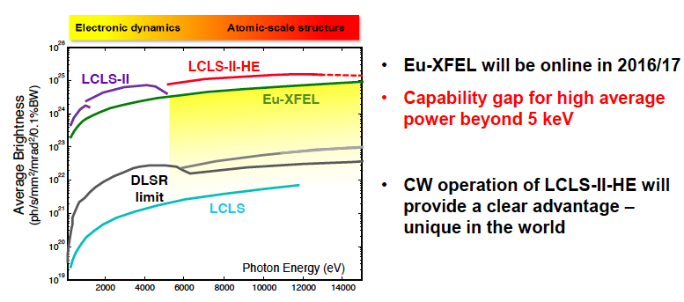

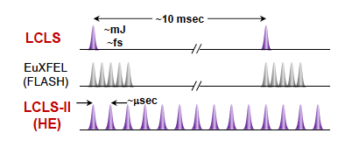


Slide 20
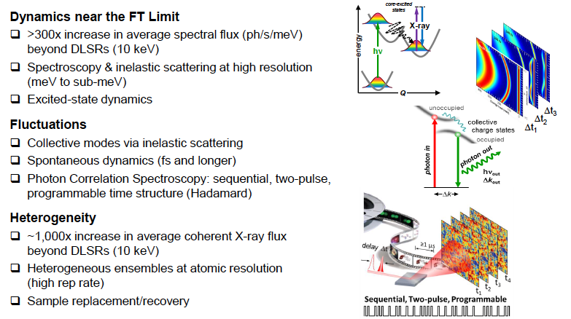

Slide 21
LCLS II-HE Committee Findings
Criteria 1
LCLS II-HE is absolutely central to contribute to world-leading science
Criteria 2
LCLS II-HE is ready to initiate construction
(anticipate limited down time beyond “normal” maintenance dark period)
The HE project could be accomplished during normal maintenance dark periods. So limited additional dark time is anticipated.

Slide 22
Neutron User Facilities
SNS-PPU and SNS-STS

Slide 23
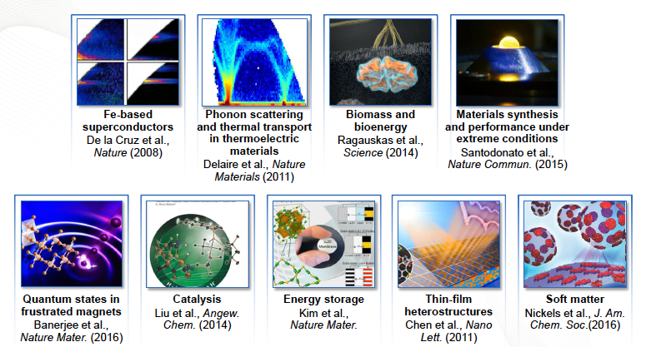
SNS --- A Major Science Success

Slide 24
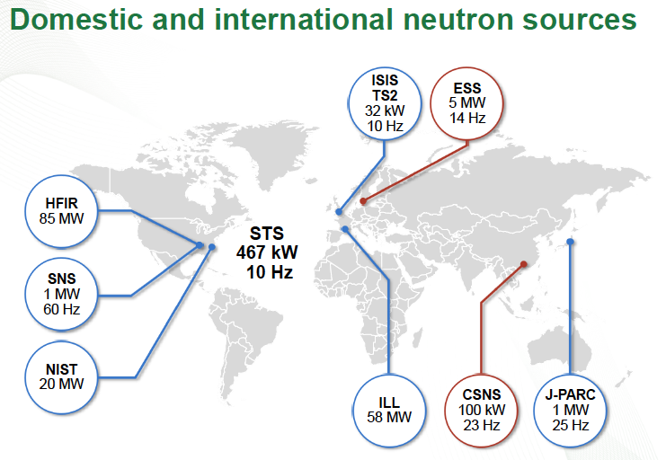
At Present the SNS (FTS) is the Most Powerful Pulsed Neutron Source
2019

Slide 25
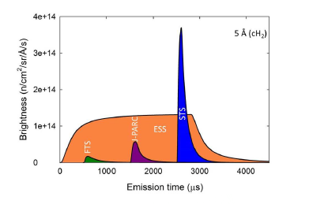
The European Spallation Source (ESS) will turn on in 2019

Slide 26
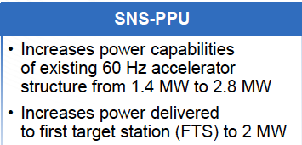
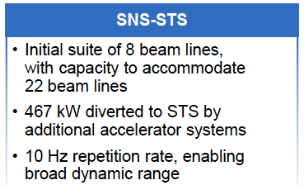
Rotating W target
1 of every 6 pulses to STS

Slide 27
SNS–PPU and SNS–STS Committee Findings
Criteria 1: SNS-PPU and SNS-STS are both absolutely central to contribute to world-leading science
Criteria 2: Significant scientific/engineering challenges to resolve before
initiating construction for SNS-PPU and SNS-STS
• Consideration of options for the repetition rate and the ways to increase the average brightness of the STS. A detailed study of the feasibility of running the STS at 20 Hz rather than 10 Hz is warranted. ORNL is encouraged to establish a review panel to make a detailed evaluation and recommendations on the proposed designs. Such a panel should be charged with detailed analysis of the technical issues such as those related to the STS repetition rate and pulse length.
•While progress has been made in the lifetime of the first target, the development of a robust first target is essential to fully utilize the PPU.
•The ORNL should make the build-out of the experimental stations for the first target station a priority.
• Continue to strengthen the coupling of theory/computation with experiments.

Slide 28
