Slide 1
Office of Workforce Development for Teachers and Scientists (WDTS) An Introduction and Overview
24 February 2017
Jim Glownia, Ph.D.
Director
Office of Workforce Development for Teachers and Scientists
https://science.energy.gov/wdts/
Office of Science U.S. Department of Energy
https:// www.science.energy.gov

Slide 2
Office of Science (SC)
Deputy Director for Science Programs
J. Steve Binkley
Office of Advanced Scientific Computing Research
Barbara Helland
Office of Basic Energy Sciences Harriet Kung
Office of Biological and Environmental Research Sharlene Weatherwax
Office of Fusion Energy Sciences Edmund Synakowski
Office of
High Energy Physics
Office of Nuclear Physics Timothy Hallman
Office of Project Assessment Stephen Meador
James Siegrist
Comp. Science Research and Partnerships Steven Lee (A)
Chemical Sciences, Geosciences, & Biosciences
Biological Systems Science
Robert Anderson
Facilities, Operations, and Projects Joseph May
Office of Workforce
Development
for Teachers and Scientists
James Glownia
Research & Technology Glen Crawford
Physics Research Timothy Hallman (A)
Bruce Garrett
Materials Sciences & Engineering Linda Horton
Climate and Environmental Sciences Gerald Geernaert
Facilities Michael Procario
Facilities & Project Management Jehanne Gillo
Facilities
Christine Chalk (A)
Research
James Van Dam
SBIR/STTR
Programs
Office
Manuel Oliver
Scientific User Facilities
James Murphy

Slide 3
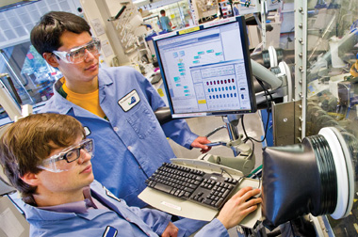
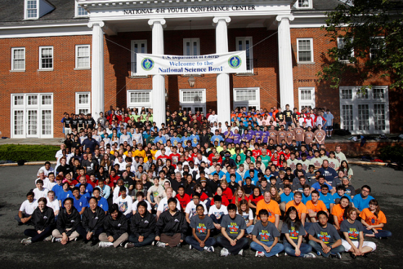
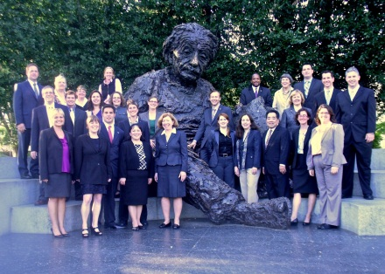
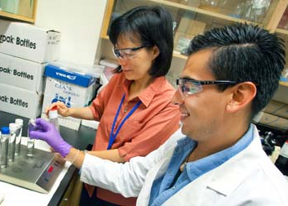
Workforce Development for Teachers and Scientists Program and Budget History ($s in Thousands)

Slide 4
FY 2017 WDTS Distribution of Funding
Technology Development
Evaluation Studies
Outreach
National Science Bowl®
Science Undergraduate Laboratory Internships
Albert Einstein Distinguished Educator Fellowship
Visiting Faculty Program
Activities at DOE Labs
Graduate Student Research Program
Community College Internships

Slide 5
SULI and CCI
Science Undergraduate Laboratory Internships (SULI) (~800 - 825 participants)
Students from 2- and 4-year undergraduate institutions are placed at DOE labs in paid internships in science and engineering research activities, working with laboratory staff scientists and engineers on projects related to ongoing research programs.
Experiences are intended to encourage undergraduates to pursue science, technology, engineering, and mathematics (STEM) careers.
Appointments are for 10 weeks during the summer term and 16 weeks during the fall and spring terms.
Community College Internships (CCI) (~100 - 105 participants)
Students from community colleges are placed at DOE labs in paid internships in technologies supporting laboratory work.
CCI experiences are designed to encourage community college students to enter technical careers relevant to the DOE mission.
Appointments are for 10 weeks during the summer, fall, and spring terms
Students work under the supervision of DOE laboratory staff who serve as mentors.
All students work on DOE mission projects with ~50% of these SC sponsored.

Slide 6
SULI Program Summary
Internship appointments
10 weeks during the Summer term (May-August)
16 weeks during the Fall term (August-December) or Spring (January-May)
Benefits
~$500 weekly stipend
Travel costs to/from laboratory
Possible housing allowance
Eligibility
Full-time undergraduates from 2- or 4-year colleges, sophomore through senior year or recent graduates
At least 18 years old at time of application
U.S. citizen or lawful permanent resident
Minimum cumulative GPA 3.0
Completed at least 1 year of coursework at time of application
May participate in SULI twice; may apply up to three times
Student deliverables
Research report
Oral or poster presentation
A peer review
General audience abstract
Pre- and post-participation surveys
WDTS manages applications, performs compliance and eligibility reviews, but host labs make placement decisions.

Slide 7
CCI Program Summary
Internship appointments
10 weeks during the Summer (May-Aug.), Fall (Aug.-Dec.) or Spring (Jan.-May)
Some labs offer flexible Fall and Spring schedules in which 400 work hours may be distributed over 16 weeks
Benefits
$500 weekly stipend
Travel costs to/from laboratory
Possible housing allowance
Student deliverables
A technical project report,
Oral or poster presentation,
Pre- and post-participation surveys
Eligibility
At least 18 years old at time of application
U.S. citizen or lawful permanent resident
Minimum cumulative GPA 3.0
Enrolled full-time, completed at least 1 semester at time of application, 6 credit hours in STEM, and at least 12 credit hours total
May participate in CCI twice and apply up to three times
WDTS manages applications, performs compliance and eligibility reviews, but host labs make placement decisions.

Slide 8
The SCGSR Program’s Key Elements
The goal of the Office of Science Graduate Student Research (SCGSR) program is to prepare graduate students for STEM careers critically important to the DOE Office of Science mission. (~ 100 - 120 participants)
Graduate students conduct a part of their graduate thesis research at a DOE lab with a collaborating principal investigator.
Award terms range from 3 months to 1 year and can begin any time between the earliest and latest start dates specified in the solicitation.
Graduate students pursuing Ph.D. degrees in areas of physics, chemistry, material sciences, biology (non-medical), mathematics, engineering, computer or computational sciences, or specific areas of environmental sciences that are aligned with the mission of the Office of Science are eligible to apply for the supplemental research awards provided by the SCGSR program.
SC Program Associate Directors (i.e., the ADs of ASCR, BER, BES, FES, HEP, and NP) determine specific areas of interest deemed to be of high program priority/workforce need. The areas may change slightly from year to year, depending on program determinations of workforce need.
Award Benefits:
A monthly stipend of up to $3,000/month for general living expenses
Reimbursement of inbound/outbound traveling expenses to/from the DOE laboratory of up to $2,000.
(Award payments are provided directly to the student.)
Eligibility:
U.S. Citizen or Lawful Permanent Resident
Qualified graduate program & Ph.D. Candidacy
Graduate research aligned with an SCGSR priority research area
Establishment of a collaborating DOE laboratory scientist at the time of application

Slide 9
SCGSR Program: Priority Research Areas (most recently completed solicitation - based on SC’s Assessment of Workforce Development Needs and evolving needs of SC programs)
Advanced Scientific Computing Research (ASCR)
(a) Applied Mathematics
(b) Computer Science
(c) Next Generation Networking for Science
(d) Research and Evaluation Prototypes
Basic Energy Sciences (BES)
(a) Accelerator and Detector R&D
(b) Heavy Element Radiochemistry
(c) Neutron Scattering Research and Instrumentation
(d) Predictive Materials Science and Chemistry
(e) Fundamental Electrochemistry related to Energy Transduction, Storage, and Corrosion
(f) Crystal Growth
(g) Ultrafast Materials and Chemical Sciences
(h) Electron and Scanning Probe Microscopy Research and Instrumentation
(i) Basic Geosciences
Gas Phase Chemical Physics
Biological and Environmental Research (BER)
(a) Computational Biology and Bioinformatics
(b) Biological Imaging - Mesoscale to Molecules
(c) Plant Science for Sustainable Bioenergy
(d) Environmental Systems Science
Biological and Environmental Research (BER) – cont’d
(e) Atmospheric Systems Research
(f) Earth System Modeling
(g) Regional and Global Climate Modeling
Fusion Energy Sciences (FES)
(a) Burning Plasma Science & Enabling Technologies
(b) Discovery Plasma Science
High Energy Physics (HEP)
(a) Theoretical and Computational Research in High Energy Physics
(b) Advanced Technology Research and Development in High Energy Physics
(c) Experimental Research in High Energy Physics
Nuclear Physics (NP)
(a) Medium Energy Nuclear Physics
(b) Heavy Ion Nuclear Physics
(c) Low Energy Nuclear Physics
(d) Nuclear Theory
(e) Nuclear Data and Nuclear Theory Computing
(f) Isotope Development and Production for Research and Applications
(g) Accelerator Research and Development for Current and Future Nuclear Physics Facilities

Slide 10
SCGSR Review and Selection Process
Completed Applications
Eligibility and Compliance Review
SCGSR Program Manager
Relevance Review
SC Research Office
Program Managers
Merit Based Peer Review
External Reviewers
WDTS AD Final Approval
(With recommendations from external reviewers and SC ADs)
Final Selection
Awards

Slide 11
Visiting Faculty Program
Visiting Faculty Program (VFP) (~ 70 faculty and 40 student participants)
The goal of the VFP is to increase the research competitiveness of faculty members and students at institutions of higher education historically underrepresented* in the research community in order to expand the workforce that addresses DOE mission areas.
University/college faculty members collaborate with DOE laboratory research staff on a research project of mutual interest. Faculty member participants may invite up to two students to participate in the research project.
WDTS manages applications, performs compliance and eligibility reviews, but host labs make placement decisions.
Joint research proposal is required - Faculty must, through their own efforts, establish a collaboration with a laboratory scientist to co-develop a 6-page research proposal prior to applying to VFP. Proposals are peer reviewed by host labs.
Appointments are in the summer term for 10 weeks.
Schools may not have Carnegie Classifications of Doctoral/Research Universities- Highest or Higher Research Activity, *here used to defined underrepresented in Federal research funding (exception – HBCUs are not excluded).

Slide 12
16/17 DOE Laboratories are WDTS Host Labs + DIII-D at General Atomics & Joint BioEnergy Institute (JBEI) at LBNL)
16/17 DOE Labs Have Participants in WDTS Sponsored Programs (all except NETL)
Project areas vary by stewardship and mission

Slide 13
Technology Development & On-Line Application Systems (WARS)
“TechDev” provides:
Efficient, best in class, systems for paperless management of WDTS programs;
Streamlined processes for applicant solicitation, review, and placement; and
Robust data collection and analyses of participant experiences.
The WDTS Application and Review System (WARS) is developed by a expert software team at the Oak Ridge Institute for Science and Education (ORISE) with WDTS providing technical requirements and project governance. The code base architecture is highly configurable, includes effective database management, is compliant (cyber and accessibility), with streamlined deployment into production environments, helping make multi-program development efficient, fast, and easily adaptable.
Currently under development:
Enhanced database management with embedded business intelligence data analysis and visualization toolsets for facile quantitative program evaluation and report dissemination.
Online real-time NSB finals score reporting.

Slide 14
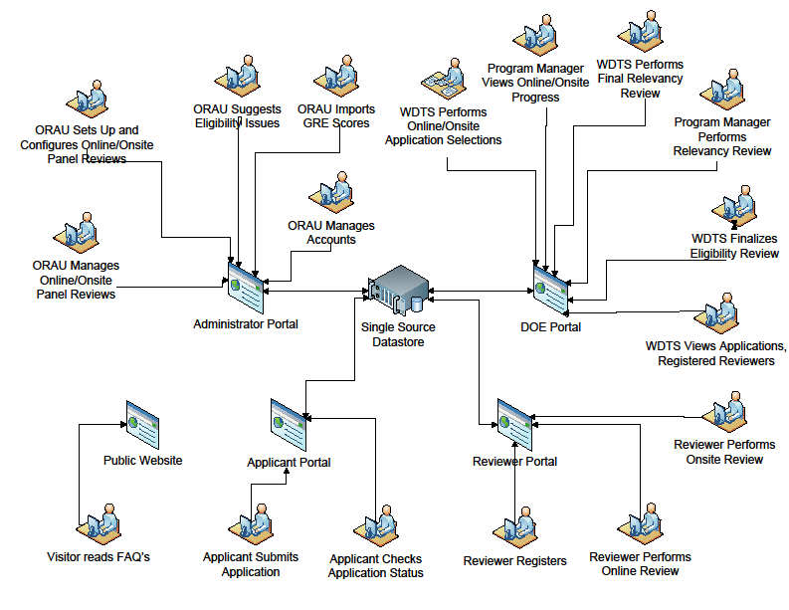
Sample Schematic – Science Undergraduate Laboratory Internship
Database for long-term tracking, assessment, evaluation
WDTS Queries of
Historical Data
WDTS Oversight of Placement Processes
ORAU Assists
with Data Archive
ggests Compliance issues
WDTS PMs monitor participant and Lab deliverables
ORAU Develops and Maintains
System
WDTS Approves Eligibility Review
ORAU Directs applications to first and second choice DOE Labs
3
WDTS Approves Compliance Review
ORAU…
Participant data & deliverables
Participant Interface
WDTS views applications and application status
Participant and Deliverables Portal
Scientist/Mentor
Interface
NSF interface with NSF funded applicants
DOE Lab Ed Portal
DOE Lab Ed Office Interface
DOE Lab Ed Office Placement Review and Sorting
DOE Lab Research Advisor Selects Applicants
1
1
4
5
Recommender submits letter
Application and selection process
2
14
DOE website

Slide 15
Evaluation
WDTS uses Office of Science standard peer review practices:
Lab Management: External peer review, including site and reverse-site visits, of DOE laboratory education program offices and other performers [ORISE] provide assessments of contractor program management. Additionally, a monthly tag-up teleconference call with host lab education directors, and an annual meeting in Washington, DC, are held.
Federal Management: Committee of Visitors (COV) reviews provide assessments of federal program management and the status of the WDTS programs relative to comparable programs supported by other agencies.
Program Impact: Application information, participant surveys, participant deliverables, and alumni surveys provide input on the impact of the program on the participants.
Derived from the logic models, each activity has a set of measureable outputs and outcomes.
Outputs and outcomes are obtained from the data collected for each term (Summer, Spring, Fall) and/or annually from application data; pre- and post-participant and contractor (Lab Education Director or advisor) surveys; participant deliverables; alumni surveys; and external peer review of programs.
Reverse Site Visit of Lab Programs resulted in Core Requirements, being implemented in 2014. Second program peer review completed in 2016.
2010 and 2016 COVs.
FY 2014 was first full year of application, participant surveys, and deliverables and outcomes (publications, patents, presentations) collected in WARS databases for SULI, CCI, and VFP. Data analysis will be performed using automated toolsets.
Longitudinal surveys planned, with legacy applicant and participant data being recovered and validated.

Slide 16
Outreach by WDTS is primarily via virtual engagement
Deliver webinar content that is:
Platform independent (smartphone, tablet, laptop, desktop, web TV, etc.)
Cyber-secure (no peer-to-peer connectivity)
Both live and archival delivery
Serve all WDTS programs:
Applicant/participant outreach for both broad and targeted audiences
Virtual training for online system users
Virtual training for NSB regional and national event volunteers
Partner to develop and deliver outreach content related to
Federal STEM programs (portal development at www.science.gov)
STEM professional societies and organizations
Participate in regional (DC-based) STEM outreach events
Developed and host a web-based access portal for DOE lab-based STEM related resources and opportunities targeting students and educators
Directed email campaigns to institutional Career Services/ Placement Offices announcing WDTS opportunities
Directed host labs and facilities to create/update their website content with current WDTS program information (including branding and identity), and especially showing these program’s attributes in the context of their institutional settings
Executed pilot outreach proposal solicitation to participating host labs promoting targeted outreach to grow the populations of underrepresented groups and communities in applicant pools

Slide 17
The National Science Bowl®
The U.S. Department of Energy (DOE) National Science Bowl® (NSB) seeks to encourage middle and high school students to expand their knowledge of math and science, expose students to careers relevant to DOE’s mission, and raise the visibility of academic achievement in the sciences through a nationally prestigious academic event.
Teams of four students each face off in a fast-paced question-and-answer format where contestants are quizzed on their knowledge of math and a range of science disciplines including biology, chemistry, Earth and space science, physics and energy (including DOE-related questions.)
Each year, the NSB attracts more than 14,000 students nationwide. At the high school level, the 2016 National Science Bowl involved more than 9,000 students and at the middle school level, more than 5,000 competitors. The NSB is the only science competition in the United States sponsored by a federal agency. Since being established in 1991, there have been more than 265,000 participants.
SC provides management and oversight for the NSB, and sponsors the finals competition.
Established branding and identity for SC’s roles.
Restructured Science Day and the middle school activity events to connect with priority DOE mission areas, with the DOE laboratory complex, and with the WDTS workforce mission.
The High School Science Day opens the National Finals, with a tradition of attracting prominent speakers, including Dr. Eric Brown, Director of Watson Technologies, two-time Academy Award winner Doug Roble (computer animation), MacArthur Fellow Carl Haber, and Nobel Laureates William Phillips and George Smoot. In 2017, Dr. Charles Bennett will be the plenary speaker.
In 2017, for the middle-school cohort, a Cyber Science Challenge is replacing the Electric Car Competition.

Slide 18
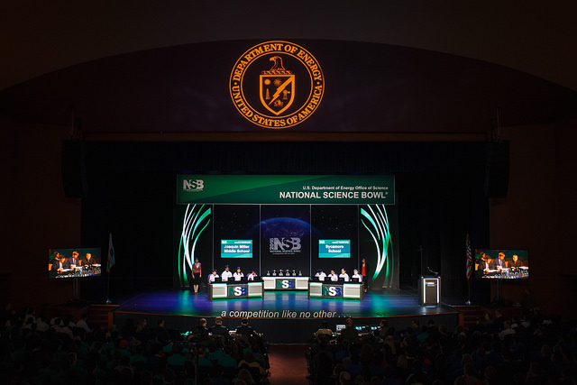
2016 Finals Competition at the Lisner Auditorium

Slide 19
The Albert Einstein Distinguished Educator Fellowship Program
The AEF Program places accomplished K-12 STEM Educators in a Federal agency or U.S. Congressional office in Washington, D.C., for an 11-month paid fellowship.
AEF Fellows bring their insights, extensive knowledge and experience in the classroom to national education program and/or education policy efforts.
Fellowship placements are currently available in the U.S. Department of Energy (DOE), the National Aeronautics and Space Administration (NASA), the National Science Foundation (NSF), the U.S. Senate, and the U.S. House of Representatives.
26 years of AEF; 351 fellowships; 81 Hill; 31 DOE; others @ NIH, NSF, NASA, NOAA, NIST, & DoEd
“Congress finds that -- …elementary and secondary school mathematics and science teachers can provide practical insight to the legislative and executive branches in establishing and operating education programs…” [The Albert Einstein Distinguished Educator Act; 1994]
Fellows bring valuable experiences, perspectives, and ideas to the offices in which they serve.
There are many parallels between STEM Educators (especially those from public schools) and civil servants who dedicate their lives to public service in a Federal agency or Congressional office.
19

Slide 20
Roles of DOE and AEF Federal Agency Program Partners
DOE
Has statutory responsibility for the AEF Program
Sets program policies/guidance
Establishes formal partnerships with participating agencies through interagency agreements
Manages the annual application process via WARS
Supports the application review and selection process in collaboration with ORISE and Partnering agencies
Contracts with ORISE to provide program support and administration
Sponsors and hosts Fellows
Sponsors Congressional Fellows
Leads Alumni Engagement efforts
NSF and NASA
Establishes a formal partnership with DOE for the AEF Program
Sponsors Fellows
Participates in candidate selection process
Hosts and mentors Fellows
Provides feedback to DOE on program policies and guidance
ORISE*
Administers the benefits for NSF, NASA, and DOE Fellows
Provides a 3-4 day orientation, professional development activities, and support for Einstein Fellows (2 PD events per month driven by Fellows’ Professional Development Plans)
Provides mentoring for Einstein Fellows based on formal and informal reports/meetings
Interfaces with the Congressional Offices for the Congressional Fellows
Partners with DOE on Alumni engagement
Partners with DOE on the application solicitation and review process
Partners with DOE on program outreach
Partners with DOE on program and process improvements

