Slide 1
Basic Energy Sciences Update
BES Advisory Committee Meeting
March 17, 2011
Harriet Kung
Director, Basic Energy Sciences
Office of Science

Slide 2
Outline
Strategic Planning Update
FY 2012 Budget Request
Materials by Design
Science for Energy Technology
21st Century Tools of Science & Technology
FY 2011 Appropriation Update
Program Highlights
BES Staffing
Upcoming Activities

Slide 3
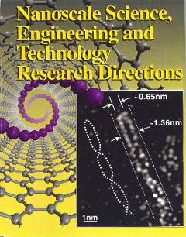
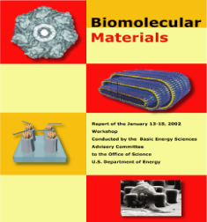
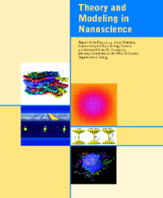
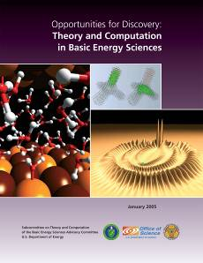
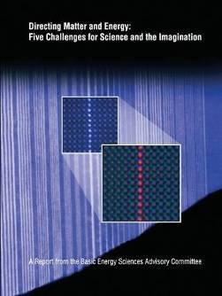
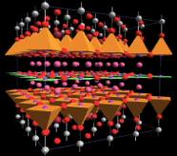
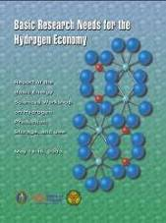
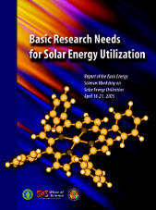
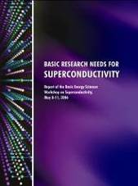
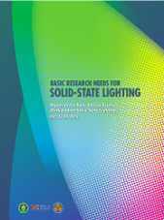
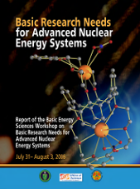
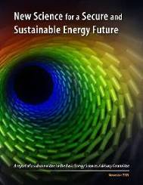
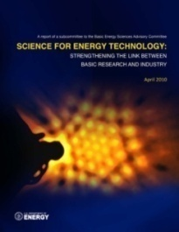
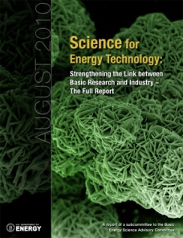
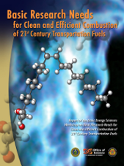
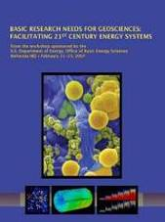
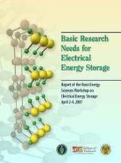
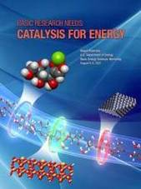
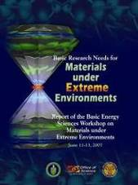
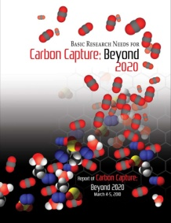
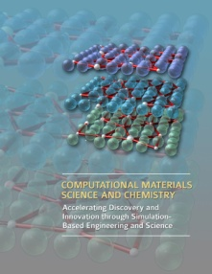
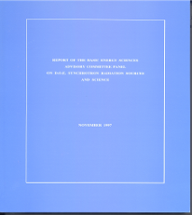
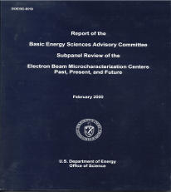
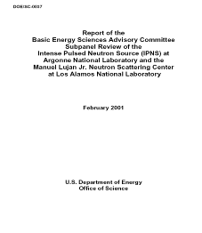
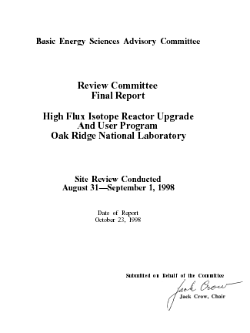
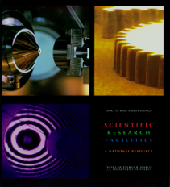
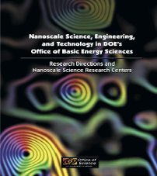
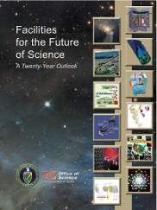
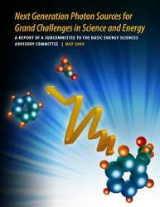
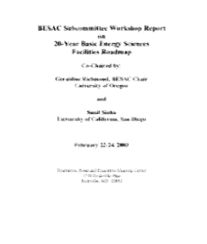
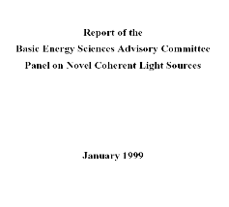
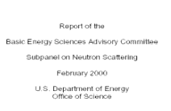
BES Strategic Planning Activities
Science for Discovery
Complex
Systems
Science for National Needs
National Scientific User Facilities, the 21st century Tools of Science & Technology
Notes:
3

Slide 4
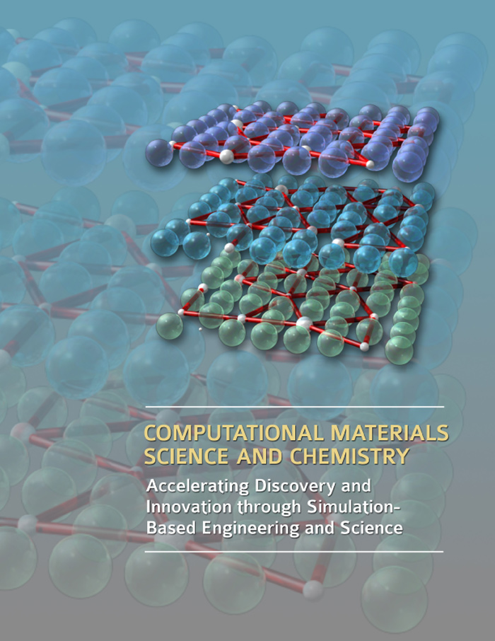
Computational Materials Science and Chemistry: Creating an Innovation Ecosystem
“We are at the threshold of a new era where predictive modeling will transform our ability to design new materials and chemical processes, thereby enabling rational discovery strategies for systems that were not tractable a few years ago.”
Integration of synthesis, processing, characterization, theory, and simulation and modeling.
Achieving/strengthening predictive capability in foundational challenge areas.
Developing validated computational approaches that span vast differences in time and length scales.
Experimental validation and quantification of uncertainty in simulation and modeling.
Robust and sustainable computational infrastructure, including software and applications.
Efficient transfer and incorporation of simulation-based engineering and science in industry.
http://www.science.doe.gov/bes/reports/list.html

Slide 5
Science for Energy Technology: Strengthening the Link Between Basic Research And Industry
9 Panels; 29 Priority Research Directions
Two kinds of science contributions:
1. “Supernovas” – breakthroughs that change technical landscape
High temperature superconductivity in 1986
2. Understanding and ultimately controlling existing phenomena
Complex materials and chemistry at the nanoscale
Mechanisms of “droop” in high current solid state lighting
Development of carbon sequestration plumes
Conversion among photons, electrons and chemical bonds
SciTech focused on near-term industry impact
Emphasize sustained building of scientific knowledge base underlying technology, like Moore’s Law: series of incremental breakthroughs changes the game

Slide 6
FY 2012 BES Budget Request
Research programs
Energy Innovation Hubs
Energy Frontier Research Centers
Core Research: increases in basic research for energy; materials by design; nanoelectronics; methane hydrates
Scientific user facilities operations
Synchrotron light sources
Neutron scattering facilities
Nanoscale Science Research Centers
Instrumentation for clean energy
FY 2012 Request:
$ 1,985M
SBIR & GPP
45.3
SUF Research
27.1
Construction
& OPC
Hub 58.3
MIE
97
NSRC 121.6
EFRC
100
159.1
Neutron Sources
276.9
Facilities
Ops
825.4
CSGB
Research
317.2
Light Sources
426.9
MSE
Research
355.6
Construction and instrumentation
National Synchrotron Light Source-II and instrumentation (NEXT)
Spallation Neutron Source instruments & power upgrade
Advanced Photon Source upgrade
Linac Coherent Light Source-II
TEAM-II

Slide 7
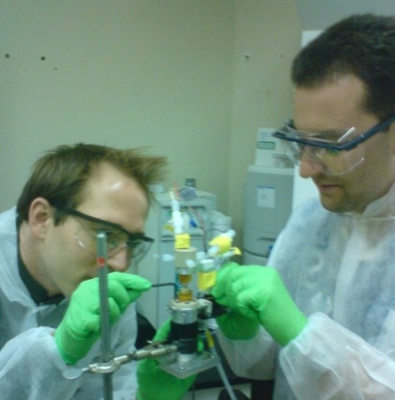
Materials by Design
Research to establish materials design rules to launch an era of predictive modeling, changing the paradigm of materials discovery from serendipity to rational design.
Discovery of new materials has been the engine driving science frontiers and fueling technology innovations. The U.S. has the world’s most powerful suite of tools for materials synthesis, characterization, and computation.
$40M request to support the following research focus:
Synthesis: Rational molecular-scale design guided by simulation.
Characterization and Testing: Verify & validate computational designs and software, including in situ measurements using x-ray, neutron, microscopy, and nanoscience facilities.
Theory/Simulation: New methods and algorithms for complex, multi-scale systems. Development of software and toolkits through a networked, broad community. Emphasis areas include: catalysis, light-weight materials, and materials for energy applications including radiation-resistant materials, carbon capture, batteries, liquid fuels, and photocatalysis.
Test
7

Slide 8
SciTech Priority Research Directions
Panel 1: Solar Electricity
Coordinator: Charles Gay, Applied Solar
Fundamentals of Materials and Interfaces in Photovoltaics
Advanced Photovoltaic Analysis and Computational Modeling for Up-scaling
Photovoltaic Lifetime and Degradation Science
Panel 2: Advanced Nuclear Energy
Coordinator: Kurt Edsinger, EPRI
Materials Degradation Mechanisms
Advanced Irradiation Effects Scaling
Back End of the Fuel Cycle
Panel 3: Carbon Sequestration
Coordinator: Richard Esposito, Southern Co.
Extraction of High Resolution Information from Subsurface Imaging and Modeling
Understanding Multi-scale Dynamics of Flow and Plume Migration
Understanding Millennium Timescale Processes from Short Timescale Experimentation
Panel 4: Electricity Storage
Coordinator: Bart Riley, A123 Systems
Identification and Development of New Materials
Invention of New Architectures for Energy Storage
Understanding and Controlling Heterogeneous Interfaces
Identification and Development of New Tools
Panel 5: Electric Power Grid Technologies
Coordinator: Thomas Schneider, NREL
Power Electronic Materials
High Power Superconductors
Electric Insulating and Dielectric Materials
Electrical Conductors
Panel 6: Advanced Solid State Lighting
Coordinator: Bernd Keller, Cree
White Light Emission Through Wavelength Conversion
High Efficiency Emission at High Current Density and Temperature
Organic Light Emitting Diode Materials and Structures
Panel 7: Biofuels
Coordinator: Gregory Powers, Verenium
Diversity of Biomass and Its Intermediates in the Manufacture of Biofuels
Mass Transport Phenomena in Conversion of Biomass to Biofuels
Biomass Catalyst Discovery, Characterization and Performance
Panel 8: Efficient Energy Generation and Use
Coordinator: Om Nalamasu, Applied Materials
Enabling Materials Technologies for Renewable Power
Fuel Cell Materials Understanding and Discovery
Dynamic Optical and Thermal Properties of Building Envelopes
Panel 9: Scientific User Facilities
Coordinator: Simon Bare, UOP
At-Scale Experiments on Commercial Materials/Devices
Development of New Materials
Study of Interfaces and Interfacial Phenomena
8

Slide 9
FY12 Budget Request: Science for Energy
Non-carbon Sources | (Dollars in thousands)
Solar Electricity from Photovoltaics | + 8,000
Advanced Nuclear Energy Systems | + 8,000
Materials under Extreme Environments | +15,000
Carbon Capture and Sequestration
Carbon Capture | + 8,000
Carbon Sequestration | + 8,000
Transportation and Fuel Switching
Energy Systems Simulation - Combustion | + 15,000
Batteries and Energy Storage Hub | + 34,020
Transmission and Energy Storage
Electric Power Grid–Enabling Materials Sciences | + 4,000
Power Electronics | + 3,500
Batteries and Energy Storage Hub | (same as above)
Efficiency
Advanced Solid-state Lighting | + 8,000
Energy Efficiency – Enabling Materials Sciences | + 4,000

Slide 10
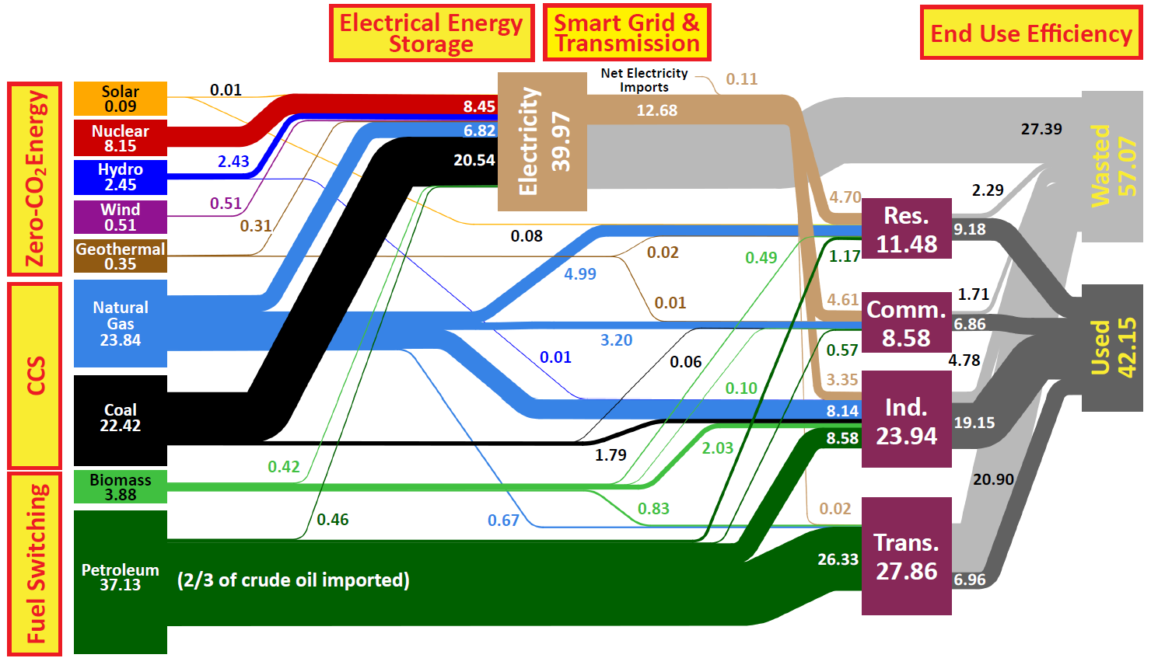
FY 12 Budget Request : A National Strategy for a New Energy Economy
Electric Power Grid
Power Electronics
Batteries and Energy Storage Hub
Solar Electricity from Photovoltaics
Advanced Nuclear Energy
Materials under Extreme Environments
Advanced Solid-state Lighting
Energy Efficiency – Enabling Materials Sciences
Carbon Capture
Carbon Sequestration
Energy Systems Simulation - Combustion
Batteries and Energy Storage Hub
Source: Lawrence Livermore National Laboratory and the Department of Energy, Energy Information Administration, 2009 (based on data from DOE/EIA-0384(2008), June 2009).

Slide 11
FY 12 Budget Request : 21st century Tools of Science & Technology
Light Source Construction, Upgrade & Expansion | (Dollars in thousands)
National Synchrotron Light Source-II (NSLS-II) | 151,400
Advanced Photon Source Upgrade | 20,000
Linac Coherent Light Source Expansion | 30,000
Instrumentation for NSLS-II (NEXT) | 12,000
Neutron Source Instrument & Upgrade
Spallation Neutron Source Instrument-II (SING-II) | 11,500
Spallation Neutron Source Power Upgrade (PUP) | 5,500
Electron Microscopy & Microcharacterization
Transmission Electron Aberration-Corrected Microscopy II (TEAM II) | 18,000
Facilities Instrumentation for Energy
Light Sources | 24,000
Neutron Sources | 8,000
Nanoscale Science Research Centers | 15,000

Slide 13
FY 2011 Appropriation Update

Slide 14
History of BES Request vs. Appropriation
FY 07 and FY08 appropriations were below the President’s Requests by $170M and $230M, respectively. Impacts included declination of 700 proposals for new research awards; premature termination of IPNS; delay of USB, LCLS, LUSI, and SING-II of one year or more; held core research program flat, and kept facilities at FY 2006 level of effort with only very small increases.

Slide 15
BES Budget: FY 2008 vs. FY 2010
 | FY 2008 | FY 2010 | FY 2010 vs. FY 2008
EFRCs | … | 100,000 | +100,000
Hubs* | … | … | ……
ALL Other BES Research | 451,517 | 563,428 | +111,911
SNS Power Upgrade Project ORNL | … | 2,000 | +2,000
NSLS -II (OPC + Construction) | 49,727 | 141,000 | +91,273
LCLS + Other Construction | 63,538 | 15,240 | -48,298
Other MIEs | 30,543 | 23,000 | -7,543
Facility Operations, including LCLS | 646,333 | 749,728 | +103,395
GPP/GPE | 11,098 | 4,572 | -6,526
SBIR/STTR | 30,646 | 37,532 | +6,886
Total, BES | 1,283,402 | 1,636,500 | +353,098
In addition to rigorously managing existing core research and user facilities, BES has made bold investments in key areas, as shown above, to ensure that the portfolios continue to serve DOE’s mission and maintain world leadership for decades to come.
* Hub was funded in EERE in FY 2010 and continued in FY 2011 under the CR.

Slide 16
FY 2011 Appropriation Status
1st Continuing Resolution, S. Amend. to H3081 (through December 3, 2010) P.L. 111-242; SC @ $4,903M
2nd Continuing Resolution, H.J.Res.101 (through December 18, 2010) P.L. 111-290; SC @ $4,903M
3rd Continuing Appropriations Act, 2011, H.J. Res. 105 (through December 21, 2010) P.L. 111-317; SC @ $4,903M
4th Continuing Appropriations Act, 2011, H. 3082 (through March 4, 2011) P.L. 111-322; SC @ $4,903M
*****************************************************************************************************
Further Continuing Appropriations Amendments, 2011, H.J. Res. 44 (through March 18, 2011) P.L. 112-4; SC @ $4,826 M
Additional Continuing Appropriations Amendments, 2011, H.J. Res. 48 (through April 8, 2011) Pending; SC @ $4,826 M

Slide 17
Program Update
EFRC highlights, upcoming Summit & Forum
JCAP
LCLS early science results
NSLS-II progress
FY 2010 Scientific User Facilities Statistics

Slide 18
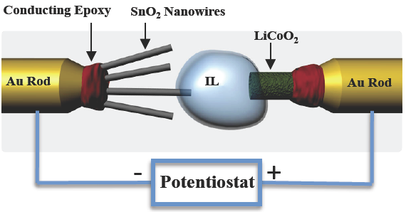
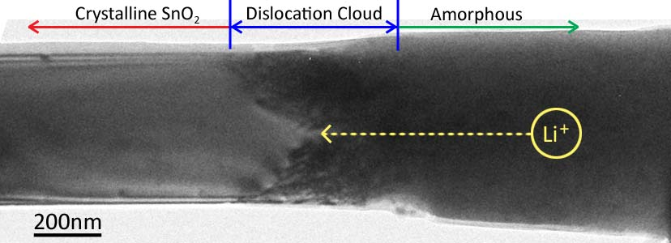
EFRC Research Reveals Unusual Nanowire Behavior in Battery
World’s smallest battery placed inside an electron microscope yields images of electrochemistry at atomic scales
New insight into electrochemical processes at the nanoscale:
Nanowires can sustain large stresses (>10 GPa) caused by Li⁺ transport without breaking—good candidate for battery
Elongation and twisting of nanowires during charging may lead to a short circuit and failure of the battery, a key factor to consider during design
Research at SNL supported by the Center for Science of Precision Multifunctional Nanostructures for Electrical Energy Storage (an EFRC led by University of Maryland) and in collaboration with PNNL and university contributors
Jian Yu Huang, et al., Science 330, 1515 (2010)

Slide 19
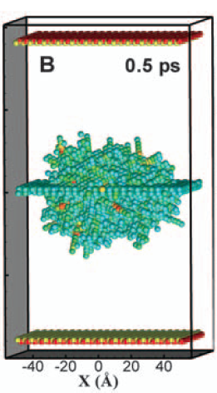
EFRC Research Predicts Radiation Damage Resistant Materials
Simulations reveal why nanostructured materials with a large number of grain boundaries exhibit increased tolerance to radiation damage
New interstitial emission and vacancy recombination mechanism critical to self-healing of radiation damaged material
At very short times, interstitial atoms are concentrated on the grain boundary, but at longer times they re-emit and annihilate trapped vacancies many atomic distances away
Grain boundaries loaded with interstitials reduce the barrier for vacancy diffusion and promote defect recombination
Designed nanostructured grain boundaries could slow down the accumulation of radiation damage
Research supported by the Center for Materials at Irradiation and Mechanical Extremes (an EFRC led by Los Alamos National Laboratory)
Radiation damage
Interstitials quickly move to grain boundary
Vacancies trapped in bulk material
interstitial emission
Interstitials
emit from grain boundary
Interstitials
and vacancies recombine
Diffusion of remaining vacancies very slow
Xian-Ming Bai et al. Science, 327, 1631 (2010)
19

Slide 20
May 25 – 27, 2011, Washington, D.C.
Science for Our Nation’s Energy Future will:
Explore the challenges and opportunities in applying America’s extraordinary scientific and technical resources to critical energy needs
Highlight early successes of the Office of Science Energy Frontier Research Centers
Promote collaboration across the national energy enterprise
Expected Participants include:
Leaders from science, industry and government from the US and abroad
Students, young researchers, and senior investigators
Members of the media and the general public

Slide 21
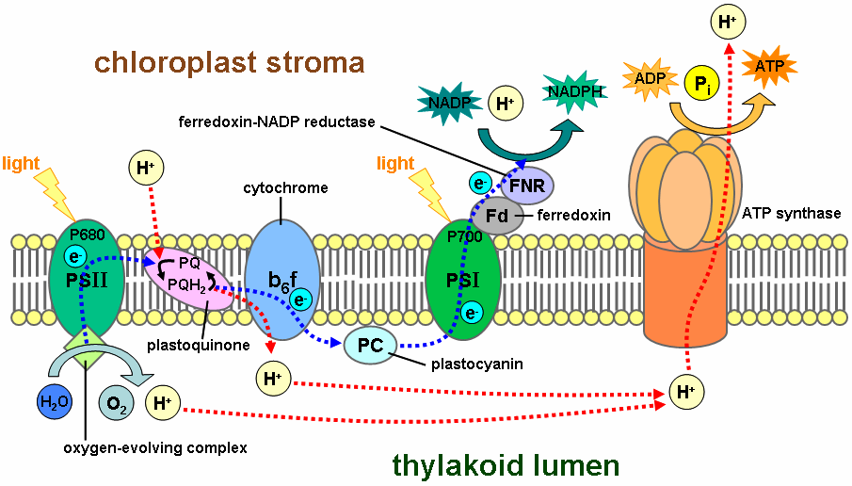
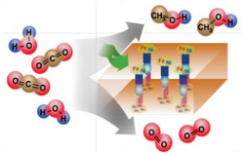
Fuels from Sunlight Energy Innovation Hub: Joint Center for Artificial Photosynthesis (JCAP)
The design of highly efficient, non‐biological, molecular‐level “machines” that generate fuels directly from sunlight, water, and carbon dioxide is the challenge.
Basic research has provided an understanding of the complex photochemistry of the natural photosynthetic system and the use of inorganic photo‐catalytic methods to split water or reduce carbon dioxide – key steps in photosynthesis.
JCAP Mission: To demonstrate a scalable, manufacturable solar-fuels generator using Earth-abundant elements, that, with no wires, robustly produces fuel from the sun 10 times more efficiently than (current) crops.
JCAP R&D focuses on:
Accelerating the rate of catalyst discovery for solar fuel reactions
Discovering earth-abundant, robust, inorganic light absorbers with optimal band gap
Providing system integration and scale-up
Begun in FY 2010, JCAP serves as an integrative focal point for the solar fuels R&D community – formal collaborations have been established with 20 Energy Frontier Research Centers.
21
Natural photosynthesis
Artificial photosynthesis

Slide 22
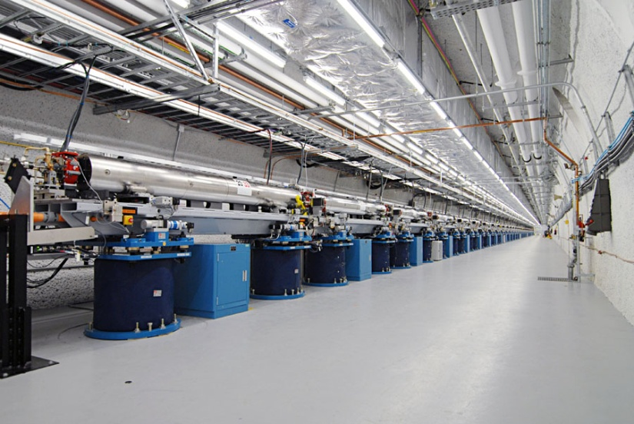
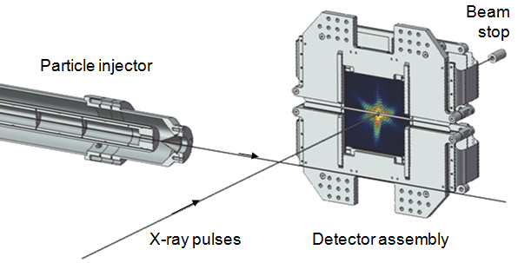
Research Highlights from LCLS The World’s First Hard X-ray Laser
Within 6 months of completion, LCLS is being used to study a wide array of science topics, including:
Hollow atoms
Magnetic materials
Structure of biomolecules in nano-crystals
Single shot images of viruses and whole cells
LCLS instruments provide new approach to x-ray bioimaging:
Liquid or aerosol injection
Very low noise, high-frame-rate CCD detectors
Integrated computing infrastructure to manage gigabytes of data per day
22

Slide 23
Femtosecond X-ray Protein Nanocrystallography
Photosystem I plays key role in photosynthesis.
Difficult to crystallize and use standard x-ray crystallography to obtain structure.
Single shot images from LCLS of nanocrystals used to build up full 3-D diffraction pattern.
Low resolution (~9 Å) shows structural details (e.g., helix density).
Single shot diffraction pattern
Combined 3D diffraction pattern
Reconstructed 3-D Structure
Chapman, H. N., et al. Nature, Feb 3rd, 2011.
23

Slide 24
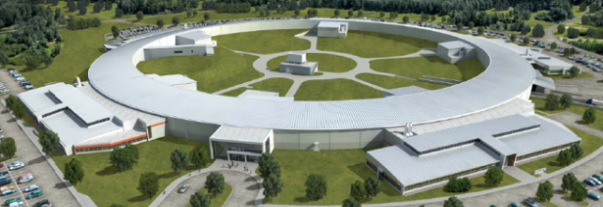
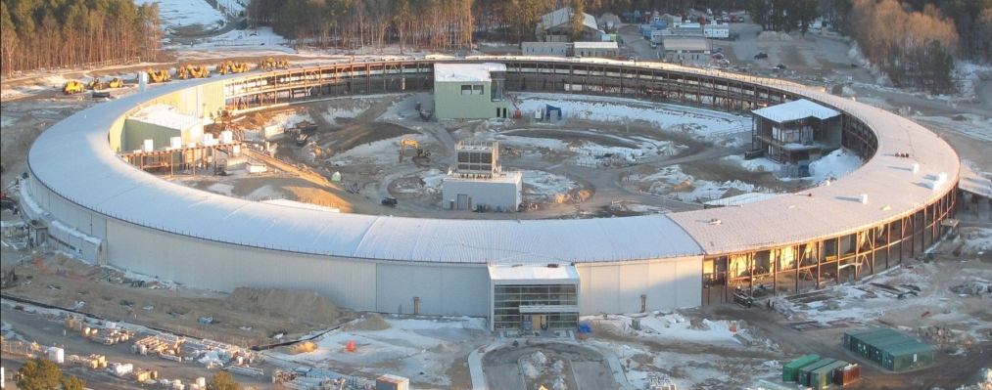
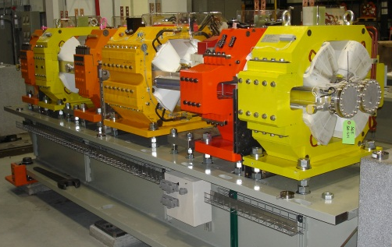
NSLS-II Project 50% Complete
Aug 2005 CD-0, Approve Mission Need (Complete)
Jul 2007 CD-1, Approve Alternative Selection and Cost Range (Complete)
Jan 2008 CD-2, Approve Performance Baseline (Complete)
Jan 2009 CD-3, Approve Start of Construction (Complete)
Feb 2009 Contract Award for Ring Building (Complete)
Aug 2009 Contract Award for Storage Ring Magnets (Complete)
May 2010 Contract Award for Booster System (Complete)
Mar 2011 1st Pentant Ring Building Beneficial Occ; Start Accelerator Installation (Complete)
Feb 2012 Beneficial Occupancy of Experimental Floor
Apr 2012 Start LINAC Commissioning
Oct 2012 Start Booster Commissioning
May 2013 Start Storage Ring Commissioning
Mar 2014 Projected Early Completion; Ring Available to Beamlines
Jun 2015 CD-4, Approve Start of Operations
Beneficial Occupancy & Accelerator Installation
Notes:
Image on right shows a real picture of the actual first girder, fully outfitted with magnets, vacuum chamber, and diagnostic components.

Slide 25
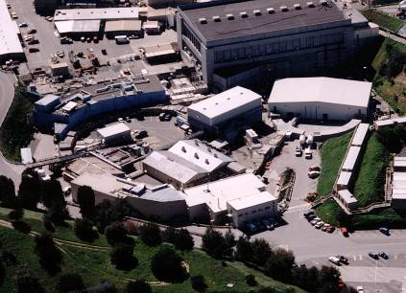
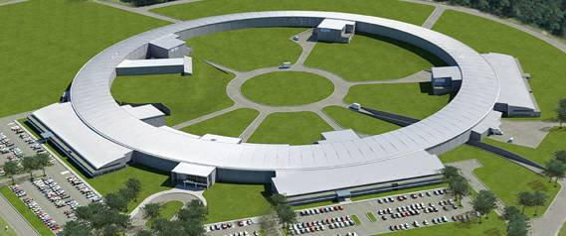
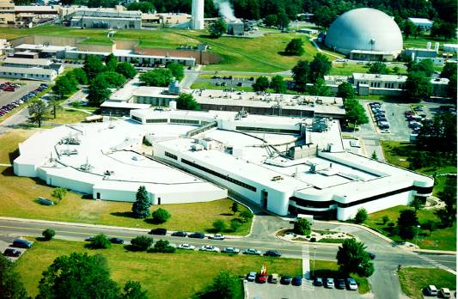
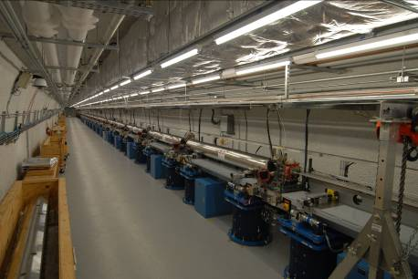
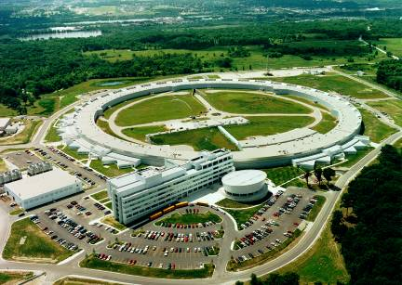
BES Synchrotron Light Sources
SSRL 1974 & 2004
NSLS-II 2015
NSLS 1982
APS 1996
LCLS 2009
ALS 1993
LCLS
APS
ALS
SSRL
NSLS

Slide 26
BES User Facilities Hosted Over 13,000 Users in FY 2010
More than 300 companies from various sectors of the manufacturing, chemical, and pharmaceutical industries conducted research at BES scientific user facilities. Over 30 companies were Fortune 500 companies.

Slide 27
Staffing Update

Slide 28
New
Vacancy

Slide 29
Upcoming Activities

Slide 30
BES Strategic Planning Activities
Science for Discovery
Mesoscale Science
Complex
Systems
Science for National Needs
National Scientific User Facilities, the 21st century tools of science
Notes:
30

Slide 31
BES Brochure Update
www.er.doe.gov/bes/brochures/files/SPSF_brochure.pdf
November 1, 1996
Overview of update plan: Dr. Linda Horton, March 18, 10:30 AM

