Slide 1
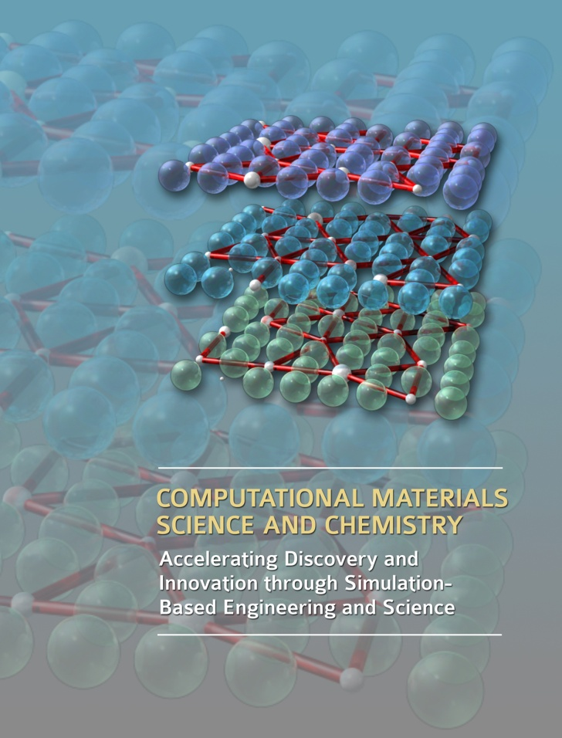
Computational Materials Science and Chemistry for Innovation
Report from the ASCR–BES Workshop
Presented to
Basic Energy Sciences Advisory Committee
Jim Roberto
Oak Ridge National Laboratory
Washington, DC
March 17, 2011

Slide 2
Outline
National context
The challenge of complexity
Simulation-based engineering and science
Workshop approach and themes
Materials and chemistry by design: Why now?
Creating an innovation ecosystem
Notes:
2

Slide 3

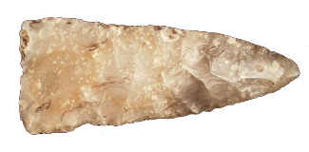


Advances in materials and chemistry enable technological revolutions
Materials lend their names to ages | Advances have shaped history
Stone Bronze Iron Nuclear Silicon | Iron and steel Gunpowder Antibiotics Ammonia synthesis Uranium and plutonium Silicon-based electronics
Materials and chemistry provide a pathway to innovation
Notes:
3

Slide 4

Energy technologies are limited by the availability of advanced materials and chemical processes
More than 100 years since the invention of the solar cell, electric car,
and rechargeable battery
Fossil plants operate at two-thirds optimum efficiency
No consensus on nuclear fuel cycles
or disposal of spent fuel
None of these technologies
are close to meeting their potential
Notes:
4

Slide 5

Transformational advances in materials and chemistry are needed
Materials that operate at greatly increased temperatures
in extreme environments of corrosion (and radiation)
Materials and chemical processes that efficiently
separate greenhouse gases from effluent streams
Materials and processes
  For separation and storage of radioactive materials
  To drive down the cost of solar cells while increasing efficiency
  For batteries with greatly increased energy densities and charging rates
High-strength, lightweight materials for transportation
New catalysts for efficient chemical processes
including direct conversion of sunlight to fuel
There are no known fundamental barriers
to these innovations
Notes:
5

Slide 6

Materials science and chemistry also underpin industrial competitiveness
Progress in virtually all technologies
depends on advances in materials
and chemistry
The company or nation with the best environment for discovering and deploying new materials and chemical processes
will be more competitive
Transformative advances in materials
and chemistry will be achieved:
The question is how quickly and by whom?
Notes:
6

Slide 7
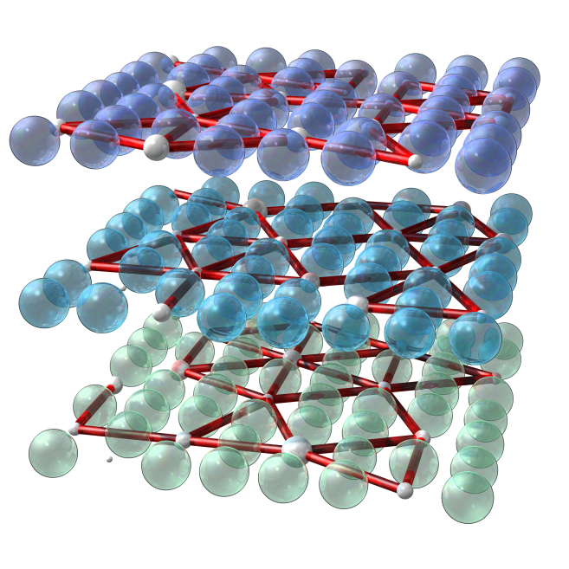
The challenge of complexity
Achieving performance gains requires exploiting many degrees of freedom in composition and structure
The parameter space for advanced steels
has increased a million-fold compared to early steels
There are billions of chemical combinations
and structures for new catalysts
New superconductors and high-field magnets
are much more complex than their predecessors
Intuitive, “trial and error” discovery is impractical
We do not have the time or resources to explore all the options experimentally
Notes:
7

Slide 8
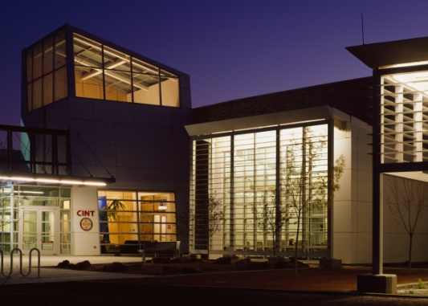
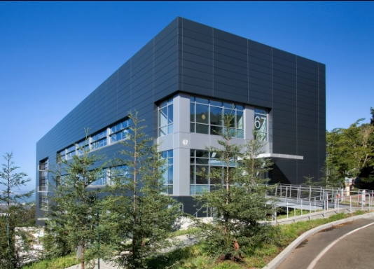

Transforming the discovery process
Over the past 2 decades, the U.S. has developed
and deployed the world’s most powerful collection
of tools for the synthesis, processing, characterization,
and simulation and modeling of materials
and chemical systems at the nanoscale
  World-leading x-ray and neutron sources
  Nanoscale science centers
  High-performance computers
For the first time in history, we are able to synthesize, characterize, and model materials and chemical behavior at the length scale where this behavior
is controlled
The scale and quality of U.S. scientific infrastructure currently convey a significant competitive advantage
Notes:
8

Slide 9

Harnessing predictive power through simulation–based engineering and science (SBES)
Over the past decade, computing power has increased by a factor of 1,000
  U.S. leads with 5 of the top 10 machines
In the same period, software advances have added another factor of 1,000
for many applications
This million-fold increase in effective capability provides access to length scales,
time scales, and numbers of particles that transform our ability to understand
and design new materials and chemistries with predictive power
This has profound implications for the pace of discovery and the creation
of new technologies
SBES impacts the entire innovation cycle, from scientific discovery to product development
Notes:
9

Slide 10
SBES: Early impacts
 | Innovation | Impact
Boeing | Predictive optimization of airfoil design | 7-fold decrease in testing
Cummins | New engine brought to market solely with modeling and analysis tools | Reduced development time and cost; improved engine performance
Goodyear | Predictive modeling for new tire design | 3-fold reduction in product development time
Ford | Virtual aluminum casting | Estimated 7:1 return on investment; $100M in savings
GE/P&W | SBES for accelerated insertion of materials in components | 50% reduction in development time, increased capability with reduced testing
SBES has demonstrated significant improvements in product development cycles across several industry sectors
Notes:
10

Slide 11

Workshop on Computational Science and Chemistry for Innovation
Bethesda, Maryland, July 26–28, 2010
Co-chairs | George Crabtree, Argonne National Laboratory Sharon Glotzer, University of Michigan Bill McCurdy, University of California–Davis Jim Roberto, Oak Ridge National Laboratory
Sponsors | Office of Advanced Scientific Computing Research Office of Basic Energy Sciences
Premise:
Advances in computing and computational science offer the potential for predictive capability in many areas of science and engineering
Experimentally validated simulations will accelerate discovery and innovation
This provides a competitive advantage for both science and technology
Notes:
11

Slide 12
Approach
Assemble experts in materials, chemistry, and computational science
Build on existing Basic Research Needs, Grand Scientific Challenges, Exascale, and FTAC reports
Assess the potential of experimentally validated simulations to accelerate discovery and innovation
Prepare a report
  Describing challenges
  and opportunities
  Focusing on potential impacts
  in science related to energy technologies
Arrange for a power
(and internet) blackout
to remove all distractions
160 invited participants
and observers
69 organizations
Notes:
12

Slide 13
Plenary session
Welcome and introductory remarks | Steve Koonin Michael Strayer Harriet Kung
Basic energy sciences context | Basic Research Needs workshops: Harriet Kung
Computational sciences context | Exascale, Grand Scientific Challenges, and FTAC workshops: Paul Messina (ANL), Thom Dunning (Illinois), Chuck Romine (NIST)
Industrial context | Integrated computational materials engineering: John Allison (Ford)
Computational design of materials | Materials Genome Project: Gerd Ceder (MIT)
Accelerating the innovation cycle | Designing a national research initiative: Tom Kalil (OSTP)
Notes:
13

Slide 14
Breakout sessions
Materials for extreme conditions | John Sarrao (LANL) Richard LeSar (Iowa State)
Chemical Reactions | Andy McIlroy (SNL) Alex Bell (UC Berkeley)
Thin films, surfaces, and interfaces | John Kieffer (U. Michigan) Ray Bair (ANL)
Self-assembly and soft matter | Clare McCabe (Vanderbilt) Igor Aronson (ANL)
Strongly correlated electron systems | Malcolm Stocks (ORNL) Warren Pickett (UC Davis)
Electron dynamics, excited states, and light-harvesting materials and processes | Gus Scuseria (Rice) Mark Hybertsen (BNL)
Separations and fluidic processes | Peter Cummings (Vanderbilt) Bruce Garrett (PNNL)
Notes:
14

Slide 15
Key questions addressed in the breakouts
What is the state of the art in each subfield of materials and chemistry?
What are the most significant research opportunities/barriers in science and technology, particularly related to energy?
How can experimentally validated computational models and simulations accelerate discovery and innovation in these areas?
What computational and experimental challenges must be overcome
to enable this acceleration?
Notes:
15

Slide 16
Materials and chemistry by design: Why now?
The experimental and computational facilities are in place and capable
The availability of new materials and chemistries is the pacing factor
in the development of many new technologies
Computational capability in design and manufacturing
has “left the materials field in the dust”
Predictive design of materials and chemical processes
is key to accelerating the discovery and innovation cycles
Advances are urgently needed for economic competitiveness
and energy technologies
We are at the threshold of a new era where predictive modeling will transform our ability to design new materials and chemical processes
Notes:
16

Slide 17
An average of 2 decades from discovery to commercialization
1930
1940
1950
1960
1970
1980
1990
2000
Teflon
Lithium-ion batteries
Velcro
Titanium production
Polycarbonate
Diamond-like thin films
GaAs
Predictive capability is key to accelerating the innovation cycle
Amorphous soft magnets
After Gerd Ceder (MIT); materials data from T. W. Eagar and M. King, Technology Review 98 (2), 42 (1995)
Notes:
17

Slide 18
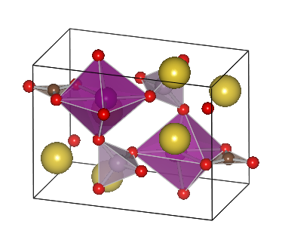
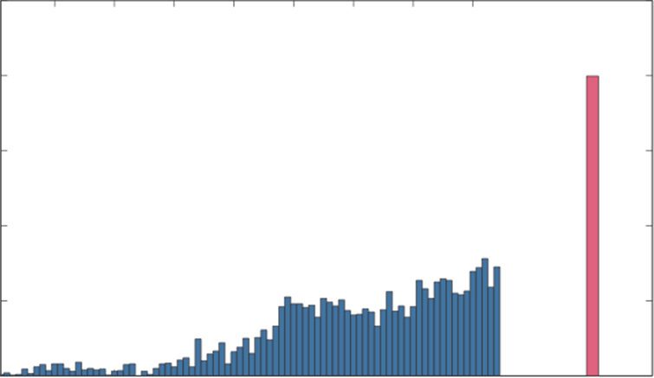
Materials Genome Project:
Accelerating the design of new materials
Many materials properties can be predicted
from first principles (more properties will become tractable with computational advances)
Compute these properties for all inorganic compounds (approximately 100,000)
Discover new structures and chemical classes
Synthesize and characterize
the most promising materials
Early results: 200 new ternary
compounds, new battery materials—
all hundreds of times faster
than conventional approaches
“Software equals infrastructure”
500
400
Materials Genome Project
300
Number of ternary oxides discovered
200
100
0
Gerd Ceder (MIT)
1930
1940
1950
1960
1970
1980
1990
2000
(Annualized)
Notes:
18

Slide 19
Foundational challenges in predictive materials science and chemistry
Predicting and optimizing structure | Materials for extreme conditions
Understanding and controlling self-assembly | Designing and engineering materials at the nanoscale
Light harvesting | Photons to energy
Controlling chemical reactions | Combustion and designer catalysts
Separations and carbon capture | Chemical engineering by design
Designer thin films and interfaces | From interfacial materials to advanced batteries
Predicting and controlling electronic structure | From spins to superconductivity
Notes:
19

Slide 20
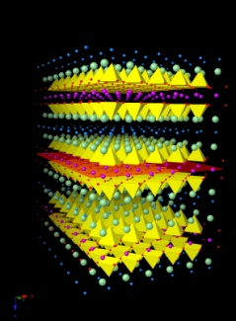
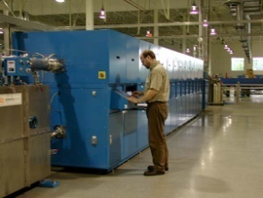
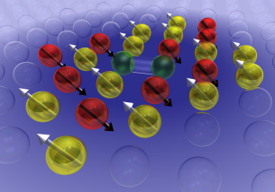
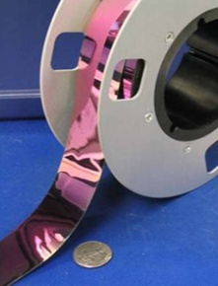
Creating an innovation ecosystem
Integration of synthesis, processing, characterization, and simulation and modeling
Achieving/strengthening predictive capability
in foundational challenge areas
Developing computational approaches that span
vast differences in time and length scales
Validation and quantification of uncertainty in simulation and modeling
Robust and sustainable computational infrastructure, including software and applications
Efficient transfer and incorporation of SBES in industry
Goal: Accelerate discovery and innovation through predictive materials science and chemistry
Seizing the opportunity requires integrating SBES across the discovery, development, and technology deployment enterprises
Notes:
20

