Slide 1
Basic Energy Sciences Update
BES Advisory Committee Meeting
August 5, 2010
Harriet Kung
Director, Office of Basic Energy Sciences
Office of Science, U.S. Department of Energy

Slide 2
What’s New
Strategic Planning
  SciTech Report
  Accelerator R&D Workshop
  Compact Light Source Workshop
Program Update
  EFRC Management Review
  JCAP
  LCLS CD-4
  NSLS-II
  APS-U, LCLS-II
Budget
  FY 2011 Appropriations
IV. Staffing

Slide 3
Strategic Planning

Slide 4
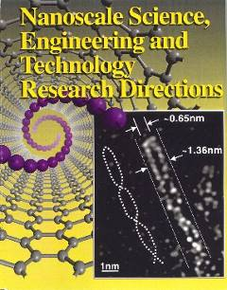
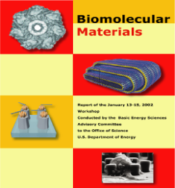
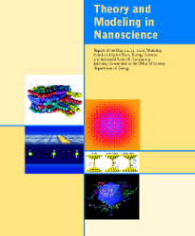
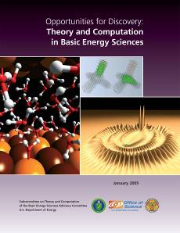
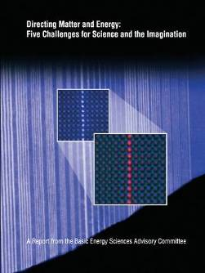
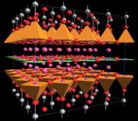
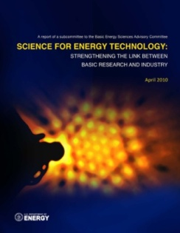
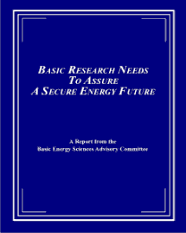
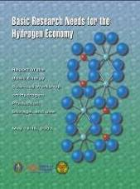

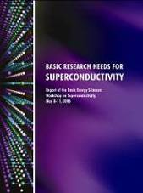
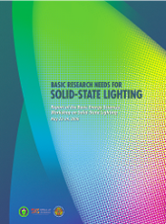
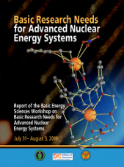

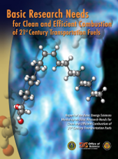
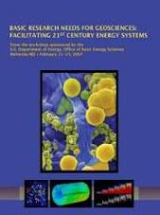
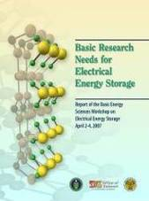
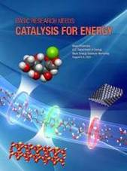
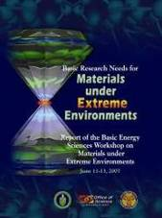
BESAC & BES Strategic Planning Activities
Science for Discovery
Complex
Systems
Computational Materials Science and Chemistry for Innovation
Science for National Needs
Charged by OSTP
Joint w/ ASCR
2010
Concept Report
April 2010
Notes:
4

Slide 5
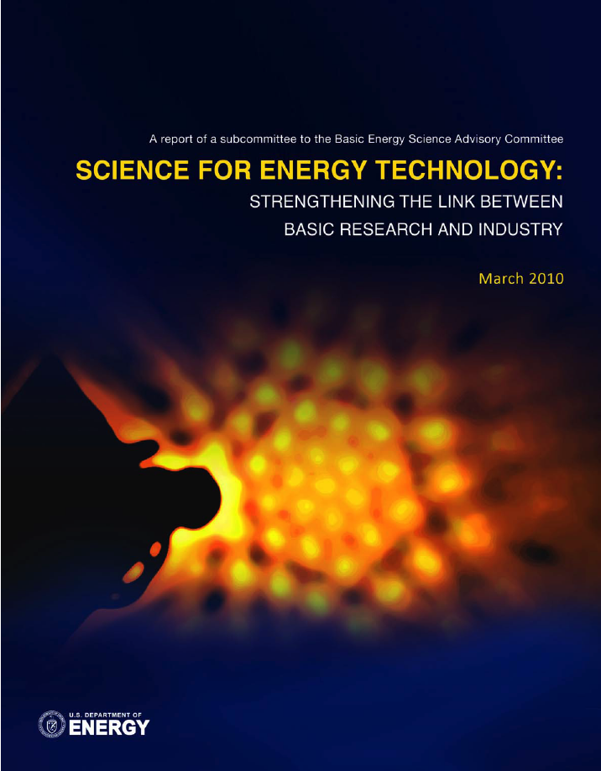
Science for Energy Technology:
Strengthening the Link Between Basic Research And Industry
9 Panels; 29 Priority Research Directions
Two kinds of science contributions:
  1. “Supernovas” – breakthroughs that change technical landscape
    High temperature superconductivity in 1986
  2. Understanding and ultimately controlling existing phenomena
    Complex materials and chemistry at the nanoscale
    Mechanisms of “droop” in high current solid state lighting
    Development of carbon sequestration plumes
    Conversion among photons, electrons and chemical bonds
SciTech focused on near-term industry impact
  Emphasize sustained building of scientific knowledge base underlying technology, like Moore’s Law: series of incremental breakthroughs changes the game

Slide 6


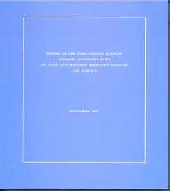
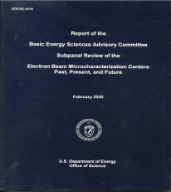
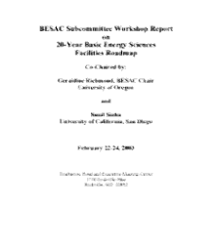
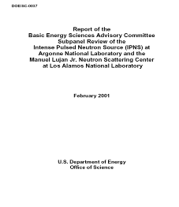
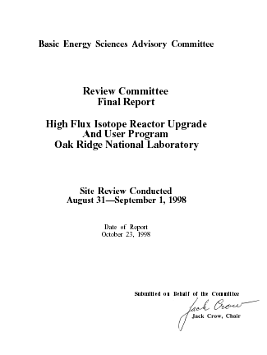
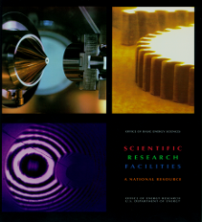
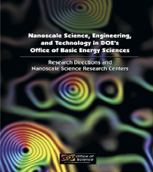
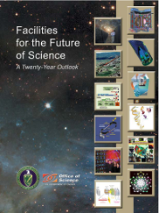
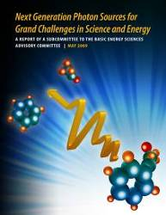
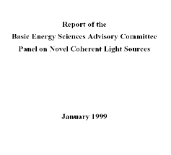
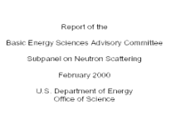
BESAC & BES Strategic Planning Activities
Science for Discovery
Complex
Systems
Science for National Needs
Compact Light Sources Report
National Scientific User Facilities, the 21st century tools of science
Notes:
6

Slide 7
BES Accelerator Physics of Future Light Sources Workshop
September 15-17, 2009
Co-Chairs: W.A. Barletta (MIT) & J.N. Corlett (LBNL)
Evaluate the state of readiness of machine architectures
to building the next major X-ray science user facility
  What will be ready in 5 years? In 10 years?
Provide peer-reviewable scientific manuscripts describing
  Potential of approach (not wavelength specific)
  Physics & technological challenges
  Technical readiness of light source architectures
Five reports will be published in Nuclear Instruments and Methods in Physics Research Section A:
Cathode R&D for Future Light Sources
Free Electron Lasers: Present Status & Future Challenges
New Source Technologies & the Impact on future Light Sources
The Potential of an Ultimate Storage Ring for Future Light Sources
X-ray Sources by Energy Recovered Linacs & Their Needed R&D
7

Slide 8
BES Compact Light Sources Workshop
May 11 &12, 2010
Co-Chairs: W.A. Barletta (MIT) & M. Borland (ANL)
Inverse Compton Sources
Working group: Cris Barnes, Ilan Ben-Zvi, Michael Borland, Anne-Sophie Chauchat, Jean Delayen, Eric E. Esarey, William S. Graves, Tso Yee Fan, Geoffrey Krafft, David Moncton, George R. Neil, Gerd Priebe, Ronald D. Ruth, Kazuyuki Sakaue, William White, Junji Urakawa
High Harmonic Generation
Working group: Margaret Murnane, Todd Ditmire, Franz Kaertner, Henry Kapteyn, Roger Falcone, Lou DiMauro, George Rodriguez
Plasma Sources
Working Group: Jorge Rocca, Christoph Rose-Petruck, Nathaniel Fisch, Howard Milchberg, Max Zolotorev
Plasma-based Accelerator Sources
Working group: Carl Schroeder, Mark Hogan, Wim Leemans, Victor Malka, Warren Mori
Compact Storage Ring Group Report
Working group: J. Bisognano, L. Emery, J. Murphy, C. Steier
8

Slide 9
Program Updates

Slide 10
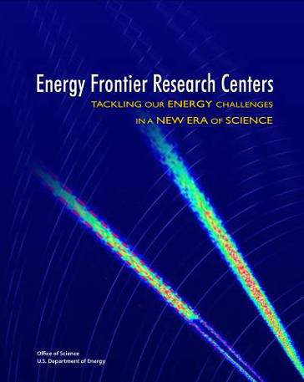
Energy Frontier Research Centers
Engaging the Talents of the Nation’s Researchers for the Broad Energy Sciences: BES announced the initiation of EFRCs to accelerate the scientific breakthroughs needed to create advanced energy technologies for the 21st century. The EFRCs will pursue the fundamental understanding necessary to meet the global need for abundant, clean, and economical energy.
2009
2010
2011
2012
2013
2014
FY09
FY10
FY11
FY12
FY13
FY14
FY15
  Initial Award Period
  Periodic Directors’ Meeting
  (tied to alternate BESAC meetings)
  Reverse Site Peer Reviews (Management/Operations focus)
On Site Peer Reviews
  EFRCs Science Forum
  Energy Frontiers Workshop
  BES Topical Contractors Meetings
  (as appropriate)
10

Slide 11
EFRC Initial Management / Operations Reviews
Initial evaluations (with external reviewers) have taken place for all 46 EFRCs
Focus: leadership, management, and operational practices of the centers
For each: two-hour presentations; one-hour reviewer-led discussion; one hour for executive session
Purpose: help each EFRC get the best start possible
    Identify best practices to enhance progress toward scientific goals
    Identify and address any operational issues which may impede progress
    These reviews are not associated with renewal of the center awards
Outcomes:
  Review results in letters to EFRC Directors
  A compilation of good practices will be assembled and distributed as a resource (not mandatory guidance) for the EFRCs
11

Slide 12
Energy Innovation Hub – Fuels from Sunlight
Modeled after the Office of Science Bioenergy Research Centers, the Energy Innovation Hubs focus on critical energy technology challenges by building creative, highly-integrated research teams that can accomplish more, faster, than researchers working separately.
The objective of the Fuels from Sunlight Hub is to develop an effective solar energy to chemical fuel conversion system. The system should operate at an overall efficiency and produce fuel of sufficient energy content to enable transition from bench-top discovery to proof-of-concept prototyping.
Timeline:
December 22, 2009: Funding Opportunity Announcement (FOA) issued
January 29, 2010: Letters of intent due (but not required)
March 29, 2010: Full applications due
May 24: First Round External Peer Review (Virtual Panel)
June 24-26 Second Round External Peer Review (Reverse Site Visit Panel)
July 22, 2010: Award announcement
September, 2010: Award initiation
Confidential Information – Procurement Sensitive

Slide 13

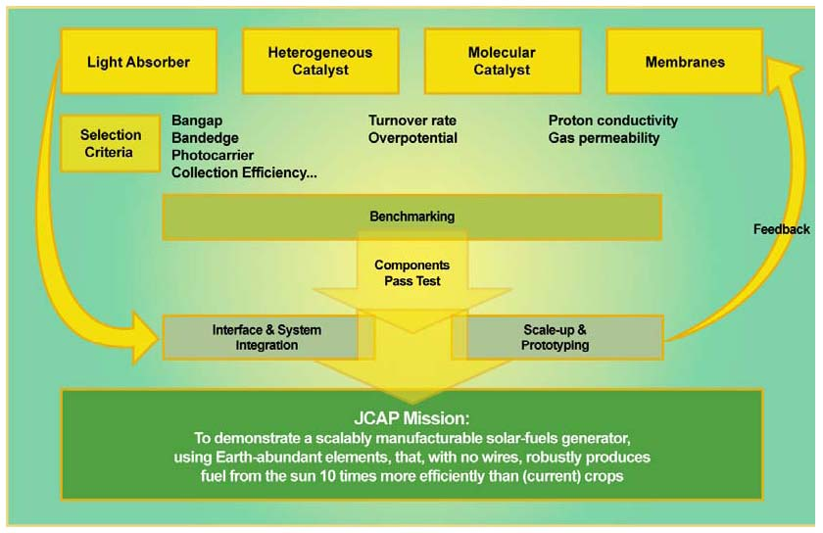
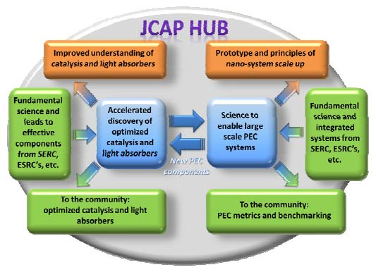
Energy Innovation Hub:
Fuels from Sunlight
JCAP R&D will focus on:
Robustness of components
Accelerating the rate of catalyst discovery for solar fuel reactions
Discovering earth-abundant, robust, inorganic light absorbers with optimal band gap
System integration, benchmarking, and scale-up
JCAP’s role as a solar fuels Hub:
Incorporating the latest discoveries from the community (EFRCs, single-PI or small-group research)
Providing metrics and benchmarking to the community
13

Slide 14
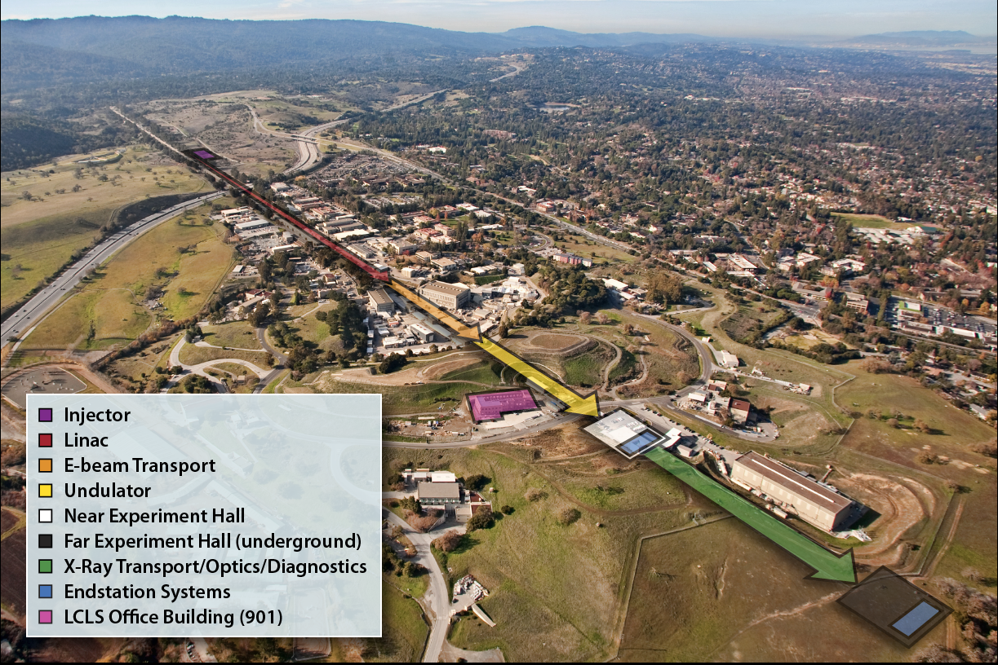
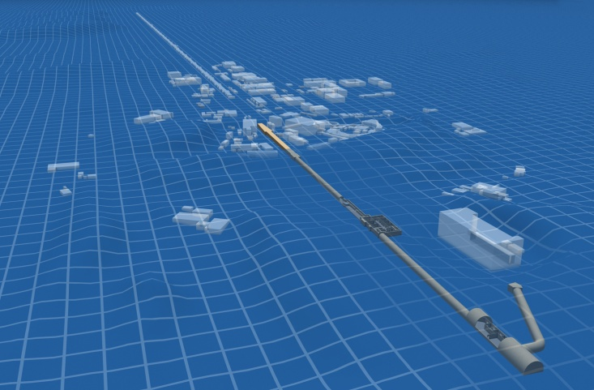
Linac Coherent Light Source
Injector
Beam Transfer Hall
Undulator Hall
Office Building
Office Building
Near Experimental Hall
Xray Transport
Far Experimental Hall
14

Slide 15
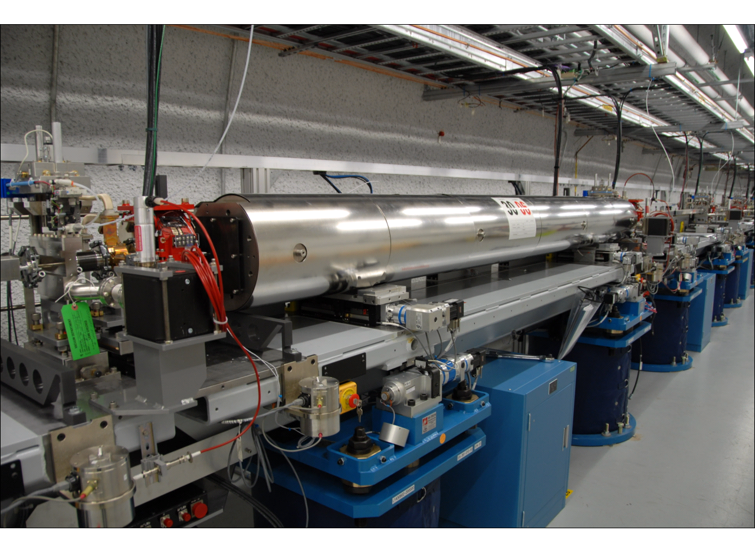
One of 33 undulators with controls
Beam Finder Wire (BFW)
Cavity BPM (<0.5 μm)
3.4-m
undulator
magnet
Quadrupole
magnet
beam
direction
X-translation (in/out)
Wire Position Monitor
cam-based 5-DOF motion control – 0.7 micron backlash
Hydraulic Level System

Slide 16
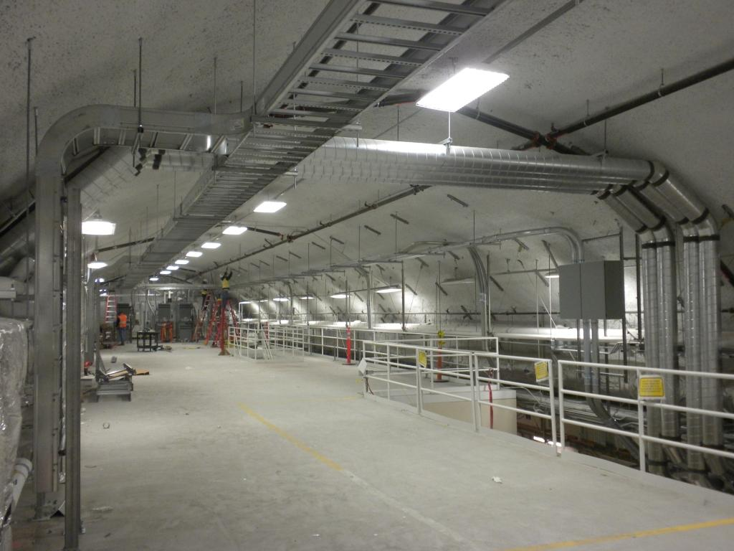
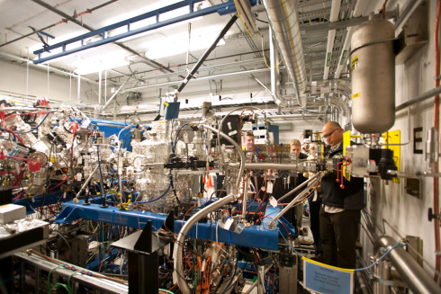
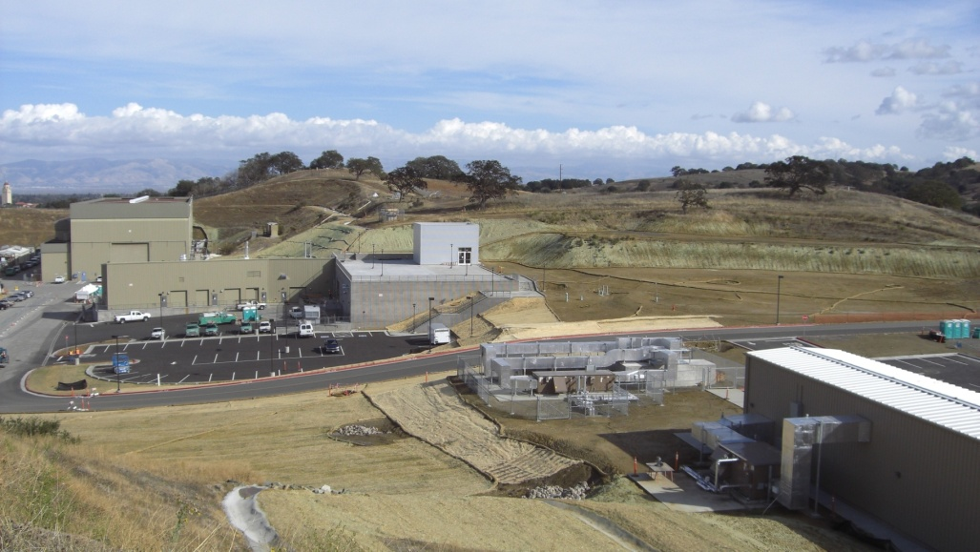
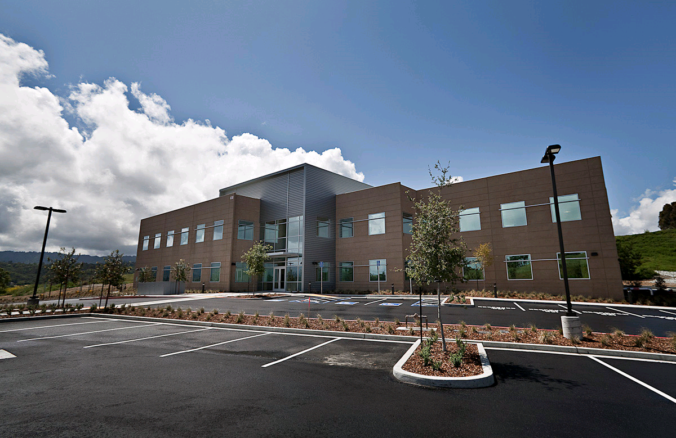
Linac Coherent Light Source
Near Experimental Hall
Far Experimental Hall
22,100 GSF
~ $9.7M
10 months construction
16

Slide 17
LCLS Project Baseline Schedule
Level 0 and I Baseline Milestones | Baseline Date | Completion Date
CD-0 Approve Need | June 2001 | June 2001
CD-1 Approve Preliminary Baseline Range | October 2002 | October 2002
CD-2a Approve Long-Lead Procurement Budget | May 2003 | July 2003
CD-3a Approve Start of Long-Lead Procurement | December 2004 | December 2004
CD-2b Approve Performance Baseline | April 2005 | April 2005
CD-3b Approve Start of Construction | February 2006 | March 2006
Level 0 Baseline Change Request (Deputy Secretary) |  | January 2008
CD-4 Project Complete - Start of Operations | July 2010 | June 2010
The Project was completed (CD-4) ahead of schedule, within budget, and with key performance capabilities meeting or exceeding technical specifications.
17

Slide 18
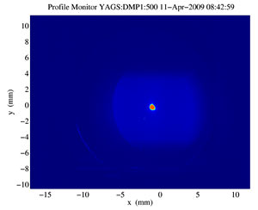
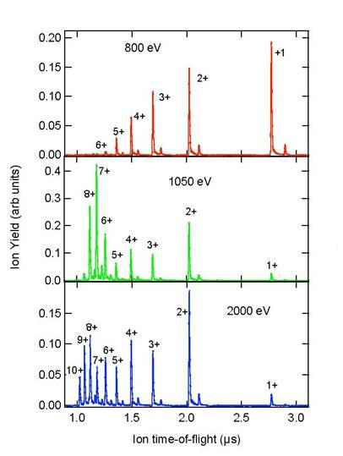
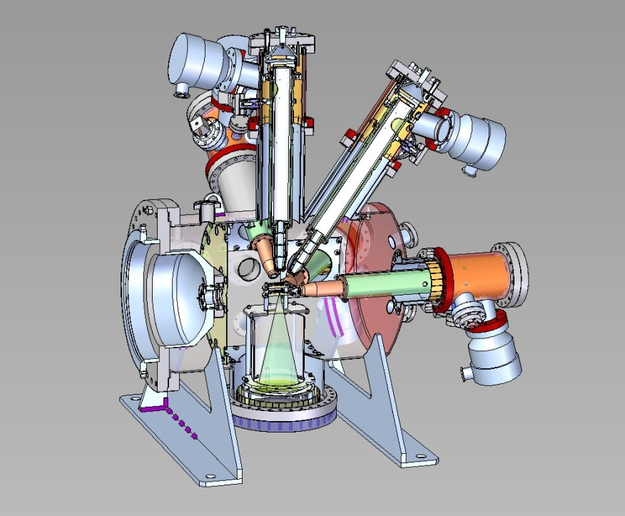
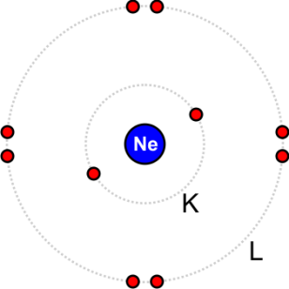
LCLS –First Light and First Experiments
Experiments led by Linda Young (ANL) at the LCLS involving a team of researchers at ANL, LLNL, OSU, WMU, LBNL, PULSE, and LCLS studied electronic damage by ultraintense x-rays irradiating neon atoms
First light, April 2009
First experiment, October, 2009: Neon atom stripped bare of all 10 electrons from the inside-out via inner shell photoionization. Data reveal mechanisms of radiation damage
AMOS Endstation
L. Young et al., Nature 466, 56-61 (1 July 2010)
18

Slide 19

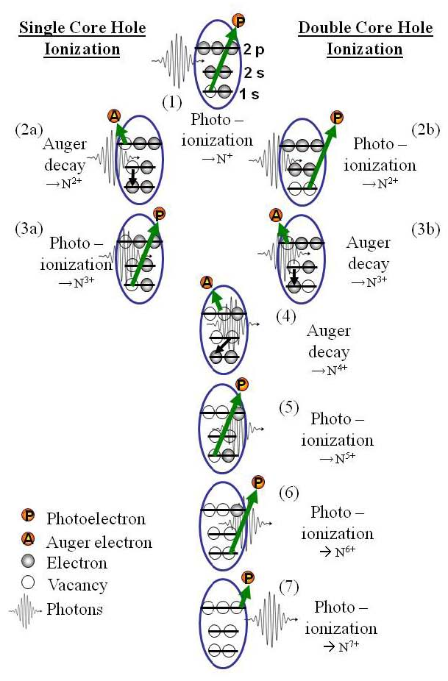
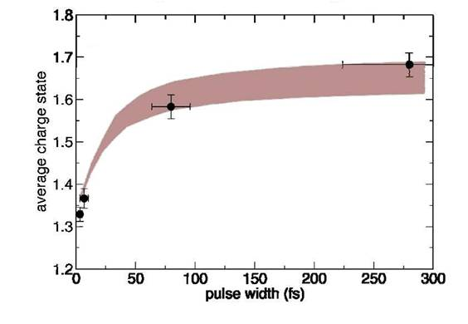
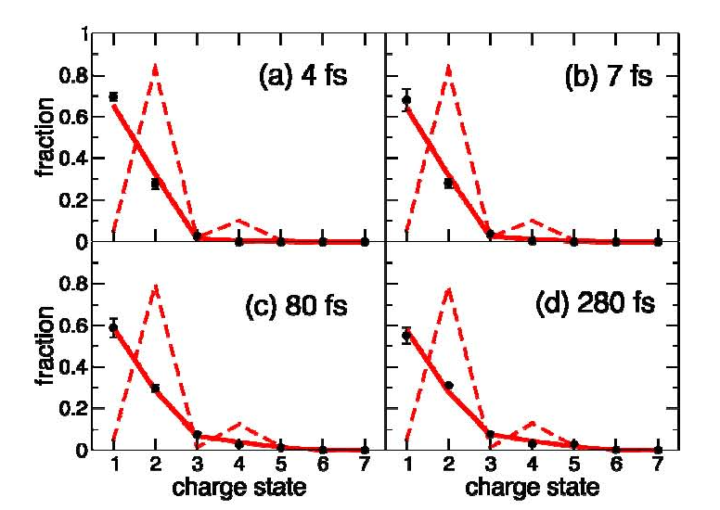
LCLS –Frustrated Absorption in N₂
Experiments led by Nora Berrah (WMU) involving a team of researchers at WMU, LBNL, ANL, PULSE, OSU, LSU, LLNL, UCB, Finland, and Hamburg studied x-ray induced ionization, dissociation, and frustrated absorption in molecular nitrogen.
The data show that short pulses produce much less highly charged products than short pulses, as the inner shell electrons are not replenished in time for subsequent interactions with x-rays.
The results for N₂ (solid lines) are much different than the theoretical results for a single N atom, indicating the importance of valence charge dynamics
Schematic illustration of K-shell ionization cycle in a single nitrogen atom
M. Hoener et al., Phys. Rev. Lett. 104, 253002 (2010)
19

Slide 20
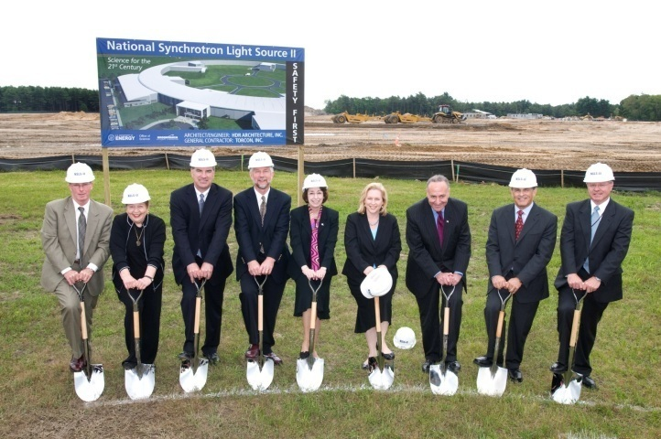
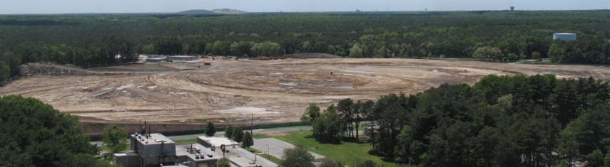
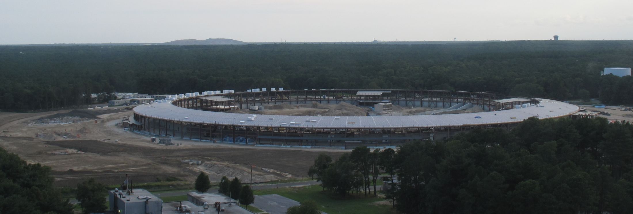
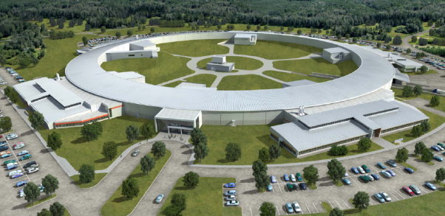
NSLS-II Construction
June 2009
August 2010

Slide 21
NSLS-II EXperimental Tools (NEXT)
The NSLS-II construction project scope provides an initial suite of six “best-in-class” beamlines. The NEXT project will design, build, install, test, and commission additional 5 – 6 best-in-class beamlines for studying the properties and functions of complex materials using state-of-the-art techniques in spectroscopy, scattering, and imaging applied over various time scales with enhanced resolution and sensitivity.
The state-of-the-art instrumentation of NEXT will increase user capacity by 300 – 400 users and enhance the scientific quality and productivity of NSLS-II .
The technical concepts for the additional beamlines will be developed by close consultation with the scientific community through a series of workshops, conferences, and focused review committees aimed at identifying and meeting the most compelling needs and highest priorities of the user community. They will be endorsed by the NSLS-II Science Advisory Committee.
Critical Decision-0 (Approval of Mission Need) for the NEXT project was approved on May 22, 2010.

Slide 22
Advanced Photon Science Upgrade
The project will design, build, install, test and commission an upgrade to the Advanced Photon Source.
Key Components:
  Accelerator and x-ray source upgrades
  New and upgraded beamlines
  Enabling technical capabilities
The Upgrade to the APS will:
  Provide an upgraded third-generation synchrotron light source facility that provides an unprecedented combination of high-energy, high-average-brilliance, and short-pulse x-rays together with state-of-the-art x-ray beamline instrumentation
  Provide for the studies of real materials under real conditions in real time by the for groundbreaking scientific tools that observe, understand, and ultimately control the functions of materials on the nanoscale to develop new technologies
Critical Decision-0 (Approval of Mission Need) for the APS-Upgrade was approved on April 22, 2010.

Slide 23
Linac Coherent Light Source Expansion (LCLS-II)
LCLS-II will enable BES to meet the scientific grand challenges by offering capabilities that currently do not exist:
  Extended spectral range and control of x-ray polarization for the study of charge and spin order
  Increased control of pulse intensity and length down to at least 1 femtosecond
  Temporally coherent beams with reduced band width and increased peak brightness
  Simultaneous operation of experimental stations to accommodate the fast growing number of users
Strategically, LCLS-II will present a cost-effective and timely plan for U.S. to remain at the international forefront, surpassing the FLASH-II upgrade of the Hamburg FEL, and favorably competing with X-FELs in Europe and Japan
Critical Decision-0 (Approval of Mission Need) for the LCLS-II was approved on April 22, 2010.

Slide 24






BES Stewardship of Synchrotron Light Sources
NSLS-II Today
SSRL 1974 & 2004
NSLS-II 2015
NSLS 1982
APS 1996
LCLS 2009
10,000
ALS 1993
9,000
8,000
7,000
6,000
APS
Numbers of Users
ALS
5,000
SSRL
NSLS
4,000
3,000
2,000
1,000
-
82
83
84
85
86
87
88
89
90
91
92
93
94
95
96
97
98
99
00
01
02
03
04
05
06
07
08
09
10
Est.

Slide 25
Budget Update

Slide 26

FY 2011 BES Budget Request
SBIR & GPP
40.2
FY 2011 Request:
$ 1,835M
Research programs
  Energy Innovation Hubs
  Energy Frontier Research Centers
  Core research increases for grand challenge science, use-inspired science, accelerator & detector research
Scientific user facilities operations
  Synchrotron light sources
  Neutron scattering facilities
  Nanoscale Science Research Centers
SUF Research
27.3
MIE 22.4
Hub 58.3
153.1
Construction
& OPC
NSRC 109.5
EFRC
140
Neutron Sources
262.7
Facilities
Ops
777.3
CSGB
Research
306
Light Sources
403.6
MSE
Research
309.4
Construction and instrumentation
  National Synchrotron Light Source-II
  Spallation Neutron Source instruments
  SNS Power Upgrade

Slide 27
BES FY 2011 Budget Highlights
The FY 2011 BES Budget Request supports President Obama’s goals for a clean energy economy, investments in science and technology—including exploratory and high-risk research.
Research:
  Two Energy Innovation Hubs in the topical areas of Fuels from Sunlight, (initiated in 2010) and Batteries and Energy Storage. Each hub will assemble a multidisciplinary team to address the basic science, technology, economic, and policy issues needed to achieve a secure and sustainable energy future.
  Energy Frontier Research Centers (EFRCs), initiated in FY 2009, requested expansion in FY 2011 (+$40M) to cover under-represented topical areas in carbon capture and advanced nuclear energy systems, and in discovery and development of new materials.
  Core research—primarily supporting single principal investigator and small group projects—will be continued and expanded to initiate promising new activities in grand challenge discovery science and use-inspired sciences, including: ultrafast science, materials synthesis, carbon capture, radiation resistant materials, separation sciences, advanced combustion modeling for engine design, geophysics and geochemistry on CO₂/minerals & rocks interactions, and gas hydrates.
Facilities:
  The National Synchrotron Light Source II at Brookhaven National Laboratory will continue its construction phase, including the largest component of the project—the building that will house the accelerator ring.
  Budget request for Scientific User Facility Operations will allow optimal operations in FY 2011. The BES user facilities are visited by more than 10,000 scientists and engineers from academia, national laboratories, and industry annually and provide unique capabilities to the scientific community that are critical to maintaining U.S. leadership in the physical sciences.
27

Slide 28
FY 2011 Senate E&WD Appropriations
“The Committee recommends $1,739,115,000 for Basic Energy Sciences. Of these funds, $151,600,000 is provided for construction activities as requested in the budget. The remaining $1,587,515,000 is for research. Within available funds, up to $100,000,000 shall be used to support the 46 Energy Frontier Research Centers. The Committee does not support the creation of new Energy Frontier Research Centers at this time. The Department must first demonstrate the benefits and results of this new research and development approach designed to address fundamental scientific energy challenges before the program is expanded further. A significant increase in funding for the core research program in materials and chemical sciences should be sufficient to advance scientific and engineering knowledge in areas of study where the Department feels there are gaps in addressing energy challenges.
Within the research funds provided, $16,000,000 shall be available for the Fuels from Sunlight energy innovation hub and $22,000,000 for a new Batteries and Energy Storage energy innovation hub.
The Committee recommends no funding for a research program in gas hydrates. A gas hydrates research program should continue in the Office of Fossil Energy, not the Office of Science. A recently issued, congressionally mandated report by the National Research Council [NRC] concluded that the Office of Fossil Energy's methane hydrate program had been "consistent and effective" in leading a broad-based science and technology development program to investigate naturally occurring gas hydrates. In addition, the NRC found the methane hydrate program had made advances in identification, drilling, and production of methane from hydrate for use as a possible energy source. The Office of Science is not the appropriate office to continue this work. The Committee also provides no funding for modeling of engine design at this time. Within the research funds provided, $35,000,000 is for the Experimental Program to Stimulate Competitive Research [EPSCoR]. The EPSCoR program is currently funding energy research that will help reduce our dependence on foreign oil.”

Slide 29
FY 2011 BES Appropriations
HEWD Mark
SEWD Mark
No funding for the proposed Batteries and Energy Storage Energy Innovation Hub.
$1,739,115,000 for BES, $95,885,000 below the request and $102,615,000 above FY 2010.
$151,600,000 for construction
$100,000,000 to support Energy Frontier Research Centers. The Committee does not support the creation of new Energy Frontier Research Centers at this time.
$16,000,000 shall be available for the Fuels from Sunlight energy innovation hub and $22,000,000 for a new Batteries and Energy Storage energy innovation hub.
$35,000,000 is for the Experimental Program to Stimulate Competitive Research (EPSCoR).
A gas hydrates research program should continue in the Office of Fossil Energy, not the Office of Science.
No funding for modeling of engine design at this time.

Slide 30
FY 2011 BES Appropriations
HEWD Mark
SEWD Full Committee Mark
No funding for the proposed Batteries and Energy Storage Energy Innovation Hub.
$1,739,115,000 for BES, $95,885,000 below the request and $102,615,000 above fiscal year 2010.
$151,600,000 for construction
$100,000,000 to support Energy Frontier Research Centers. The Committee does not support the creation of new Energy Frontier Research Centers at this time.
$16,000,000 shall be available for the Fuels from Sunlight energy innovation hub and $22,000,000 for a new Batteries and Energy Storage energy innovation hub.
$35,000,000 is for the Experimental Program to Stimulate Competitive Research (EPSCoR).
A gas hydrates research program should continue in the Office of Fossil Energy, not the Office of Science.
No funding for modeling of engine design at this time.
Both Marks provide full funding for construction activities & allow for near optimal operations of scientific user facilities. They differ significantly on EPSCoR and Hub, and leave very limited funding (SEWD) to no funding (HEWD) for the proposed new research activities.
Both Marks keep BES off the budget doubling track.

Slide 31
Staffing Update

Slide 32

New
Vacancy

