Slide 1
OFFICE OF SCIENCE
Office of Workforce Development
For Teachers & Scientists (WDTS)
Presentation for BESAC Meeting
November 2009
Bill Valdez
Director, WDTS
Office of Science, U.S. Department of Energy

Slide 2
WDTS Program Mission
Mission: Help ensure that DOE and the Nation have a sustained pipeline of highly trained science, technology, engineering and mathematics (STEM) workers.
Priorities:
Contribute to the development of STEM K-16 educators through experiential-based programs.
Provide mentored research experiences to undergraduate students and faculty through participation in the DOE research enterprise.
Increase opportunities for under-represented students and faculty to participate in STEM energy and environment education and careers leveraging the unique opportunities at DOE national laboratories.
Provide graduate fellowships for the pursuit of advanced degrees in scientific disciplines that prepare U.S. students for careers important to the DOE mission.

Slide 3
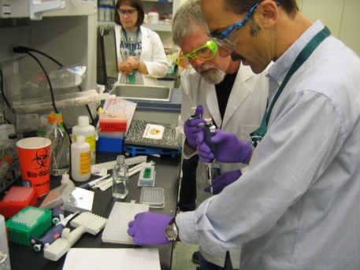
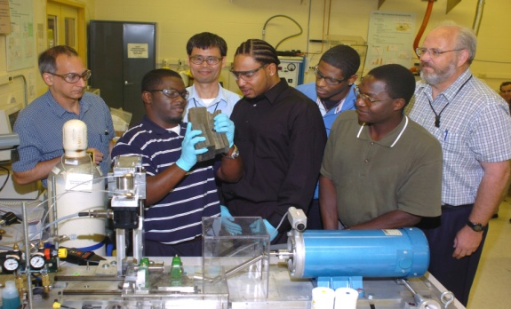
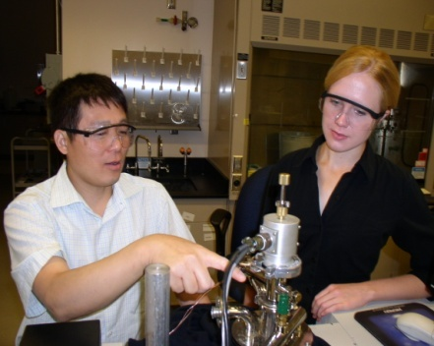
Our Core Strengths
The CORE of DOE’s Education & Workforce Development Programs:
National Laboratories
Partnerships with Universities
Why the National Laboratories & Universities?
Cutting-edge research & content
Unique facilities and immense infrastructure
World class mentors

Slide 4
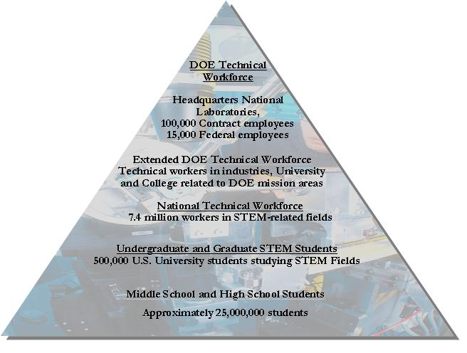
WDTS Portfolio is Aligned To Support the STEM Continuum
Capacity Building Programs
Public/Private Partnerships
Evaluation/Workforce Studies
Equipment Donation
Mentor Program
Outreach
Educator Programs
DOE ACTS (DOE Academies Creating Teacher Scientists)
FaST (Faculty and Student Teams)
Einstein Fellowship (Albert Einstein Distinguished Educator Fellowship)
CSU STAR
Graduate Programs
SCGF
(Office of Science Graduate Fellowship Program)
Undergraduate Programs
Undergraduate Research Internships
SULI (Science Undergraduate Laboratory Internship)
PST (Pre-Service Teachers)
FaST (Faculty and Student Teams)
CCI (Community College Institute of Science and Technology)
National Science Bowl
High School Engineering
High School & Middle School Programs

Slide 5
Student Programs
Student Programs: WDTS works with the DOE national laboratories to provide mentor-intensive research experiences to students and faculty. In addition, WDTS sponsors competitions designed to encourage and inspire students to participate in the STEM arena.
Student Undergraduate Research Internships (SULI) — increased funding in FY 2010 will support 570 student internships at the DOE national laboratories, up from 365 in FY 2009.
Community College Institute of Science and Technology (CCI) — program supports 115 students for mentored research internships at the DOE laboratories, up from 48 students in FY 2009.
Pre-service Teachers (PST) — support in FY 2010 will double the number of undergraduate students participating in research internships at the DOE laboratories to 60. Participating students are preparing for careers as K-12 STEM educators.
The National Science Bowl (NSB) — continues the annual regional and national competitions for middle school and high school students. 22,000 students compete in the regionals, representing 1,500 school districts.
Office of Science Graduate Fellowships — a new fellowship program for the 2010/11 academic year that will support 160 Fellows in the first year and up to 400 in subsequent years.

Slide 6
Educator Programs
Educator Programs: Working to improve the ability of educators at the K-16 level to teach STEM content and methods is a key to improving student achievement and developing a long-term STEM pipeline.
DOE Academies Creating Teacher Scientists (ACTS) —supports 220 middle school and high school educators for intensive mentored research experiences at the DOE national laboratories.
Albert Einstein Distinguished Educator Fellowship—WDTS will support 6 Fellows in FY 2010, two in WDTS and four on the Hill. The Fellowship program has produced almost 200 Fellows since 1995. WDTS cooperates with NSF, NIH, NOAA, and NASA to place Fellows outside DOE (16 non-DOE Fellows in 2009). In addition, EERE accepted a Fellow for the first time in 2009.
Faculty and Student Teams (FaST)—supports more than 60 faculty from Minority Serving Institutions in FY 2010. This is the premier WDTS program to increase the representation of minority and women faculty and students in SC programs.

Slide 7
WDTS R&D Internship Participants By Discipline
Discipline Area | Number of participants |  |  |  | 2009 % by Discipline
 | 2006 | 2007 | 2008 | 2009
Biology | 92 | 68 | 86 | 86 | 14.3%
Chemistry | 65 | 75 | 76 | 100 | 10.1%
Computer Science | 76 | 58 | 66 | 57 | 11.8%
Engineering | 88 | 107 | 100 | 111 | 13.7%
Environmental Science | 70 | 67 | 68 | 72 | 10.9%
Materials Science | 71 | 53 | 48 | 70 | 11.1%
Medical & Health Sciences | 7 | 25 | 24 | 17 | 1.1%
Nuclear Science | 36 | 25 | 20 | 28 | 5.6%
Physics | 108 | 122 | 98 | 134 | 16.8%
Other Sciences** | 29 | 13 | 22 | 17 | 4.5%
Total participants | 642 | 613 | 608 | 692

Slide 8
Program Administration & Evaluation
Program Administration and Evaluation is designed to provide the resources for effective program management and delivery. Those resources take two forms: analytical/evaluation studies that will be used by the program managers to make efficient use of resources that are informed by results and lessons learned; and, non-financial resources that enable WDTS performers and participants to more effectively participate in WDTS programs.
Evaluation Studies. WDTS has implemented a rigorous, comprehensive, and sustained evaluation of all its experiential education programs consistent with the requirements specified by the Academic Competitiveness Council. (FY2008=$0.150M; FY2009=$0.300M; FY2010=$0.200M)
Workforce Studies. These will focus on the critical skill gaps, by scientific discipline, which may exist within the DOE/SC Federal and national laboratory workforces. (FY2008=$0.020M; FY2009=$0.500M; FY2010=$0.300M)
Laboratory Equipment Donation Program. This provides excess laboratory equipment to faculty at institutions of higher education -- $17 million of equipment donated in FY 2008. (FY2008=$0.075M; FY2009=$0.075M; FY2010=$0.240M)
Technology Development and On-Line Applications. An entirely new on-line system is being developed, including the creation (in cooperation with OSTI) of a ScienceEducation.gov portal for students, faculty and the general public. (FY2008=$0.175M; FY2009=$0.400M; FY2010=$0.400M)
Outreach. The focus is on outreach to under-represented groups and institutions. (FY2008=$0.200M; FY2009=$0.732M; FY2010=$0.610M)

Slide 9
Partnerships & Leveraging
We have engaged in successful partnerships with other agencies and organizations to leverage our assets:
National Science Foundation MOU
Funding provided by NSF to sponsor undergraduate research internships through SULI
Funding provided for FaST Teams
Emerging cooperation on MSI STEM Training Programs
California State University System
STAR program, NSF Noyce, NASA Centers
National Science Bowl
5,000 volunteers from industry and academia
Shell, Areva, Honda, and other private sector sponsors
Einstein Fellowship
NSF, NIH, NASA, NOAA, etc.
NSTC Education Subcommittee
Very useful coordinating and info sharing of best practices, partnerships

Slide 10
Strategic Planning
Major activities in FY 2010 include:
Interagency coordination through the NSTC Education Subcommittee (DOE is a co-lead to develop a strategy), with an emphasis on the Obama Administration’s STEM education activities at Department of Education.
Committee of Visitors review to be conducted in May 2010.
Annual evaluation cycle which will include laboratory self-appraisals, participant surveys, and a new workforce study/analysis.
Updated Strategic Plan to be released in early 2010.
Potential National Academy of Engineering workshop and study of engineering education in the U.S.

Slide 11
Benefits to Society
WDTS provides 3 major benefits to society:
Students who otherwise might not have selected a STEM education/career are provided opportunities to make an informed choice about pursuing a STEM career in areas of high importance to DOE/SC’s missions.
Students and faculty with an aptitude and desire to pursue STEM careers and education are introduced through WDTS programs to authentic research environments and mentors as a way to increase the retention of students and faculty in STEM fields.
WDTS provides students and faculty with a pathway to STEM careers at DOE, its National Laboratories, and other institutions that support scientific disciplines consistent with DOE’s missions.

Slide 12
Office of Workforce Development Funding Levels 1990-2011

Slide 13
Questions or Comments
Bill Valdez
Director
Office of Workforce Development for Teachers and Scientists
U.S. Department of Energy
Washington, DC
Bill.Valdez@science.doe.gov
13

