Slide 1
Portfolio Analysis and Management System (PAMS)
Briefing for the
Fusion Energy Sciences Advisory Committee
Linda G. Blevins, Office of the Deputy Director for Science Programs
Keith A. Tucker, Office of Business Policy and Operations
March 8, 2011

Slide 2
Agenda
Grants Management Process
PAMS Overview
PAMS Design Philosophy
Project Methodology
Project Status and Next Steps
Planned Iterations

Slide 3
Universities (Financial Assistance)
Future PAMS Contributions
Pre-Award
Issue solicitation
Receive pre-proposals; send encourage / discourage decisions
Receive proposals
Log and assign proposals to program
managers
Perform administrative review
Execute peer review (mail, panel, site visit,
or combination)
Make selections
Award
Negotiate scope and budget
Receive revised budget and scope
Document award decision
Place money in monthly financial plan
Create requisition and route for review and
concurrence
Approve award recommendation
Route requisition to CH budget & contracting officers
Negotiate final award
Issue award
Return reviews to PI
Document decline decision
Obtain approvals for decline
recommendation
Issue declination letter
Return reviews
Post-Award
Release continuation or supplemental funding
All IT systems listed above are used to release funds during the post-award period (e.g., non-review years).
One program uses RIMS to manage progress reports, continuations, and renewal due dates.
IT SYSTEM - CURRENT |  | IT SYSTEM - PROPOSED
 |  | PAMS
Website
Email |  | Email
STRIPES |  | STRIPES
FedConnect |  | FedConnect
IMSC
FMIS/FDS |  | FMIS/FDS
PeerNet
Grants.gov |  | Grants.gov
Selection Statement Software
E-Link
Closeout
Receive and approve final technical reports
Close out award
PARTICIPANTS LEGEND
Program
Grants & Contracts
Budget
Chicago
OSTI
Crosscutting Activities During Above:
Document decisions manually in IMSC
Send correspondence by paper or email or RIMS

Slide 4
DOE National Laboratories
Future PAMS Contributions
Pre-Award
Issue solicitation
Receive pre-proposals; send encourage / discourage decisions
Receive proposals
Log and assign proposals to program
managers
Execute peer review (mail, panel, site visit,
or combination)
Make selections
Award
Negotiate scope and budget
Receive revised Field Work Proposal (FWP)
Document award decision
Obtain approvals for award
recommendations
Complete Work Authorization and Program
Guidance Letter
Place money in monthly financial plan
Negotiate M&O contract modification
Modify M&O Contract to issue award
Return reviews or summary report and
communicate review results to lab
management in writing
Document decline decision
Obtain approvals for decline
recommendation
Issue declination letter
Return reviews
Post-Award
Release continuation or supplemental funding
All IT systems listed above are used to release funds during the post-award period (e.g., non-review years).
Closeout
Receive final technical reports
IT SYSTEM - CURRENT |  | IT SYSTEM - PROPOSED
 |  | PAMS
Website |  | Website
Email |  | Email
IMSC
FMIS |  | FMIS
PeerNet
Searchable FWP |  | Searchable FWP
PARTICIPANTS LEGEND
Program
Budget
Grants & Contracts
Site Office
Crosscutting Activities During Above:
Document decisions manually in IMSC
Send correspondence by paper or email

Slide 5
Application Overview
Portfolio Analysis and Management System
Based on Government Off-The-Shelf (GOTS) software in use at several Federal agencies including
Grants Management Support for DHS/FEMA, HHS/HRSA, Department of Justice, Treasury
Contracts and Loans Support for NASA and Overseas Private Investment Corporation
SBIR/STTR Support for NASA and DHS Science & Technology Directorate
Supports the grants management process from end to end.
Employs a service-oriented design, already integrated with Grants.gov and Financial Management systems at other Federal Agencies, and will be able to integrate with DOE and other Federal systems (Grants.gov, STRIPES, etc.).

Slide 6
PAMS Design Philosophy
Support the complete research funding process
Fill processing gaps
Seamlessly manage grants from solicitation through award to publishing the final results
Consolidate or integrate with existing information systems, as appropriate
Replace outdated information systems
Don’t duplicate functionality of externally managed information systems, exchange data with them
Improve data management
Associations between people and research proposals or projects
Grant proposal demographics
Standardize data exchanges
Enable flexibility in process implementation

Slide 7
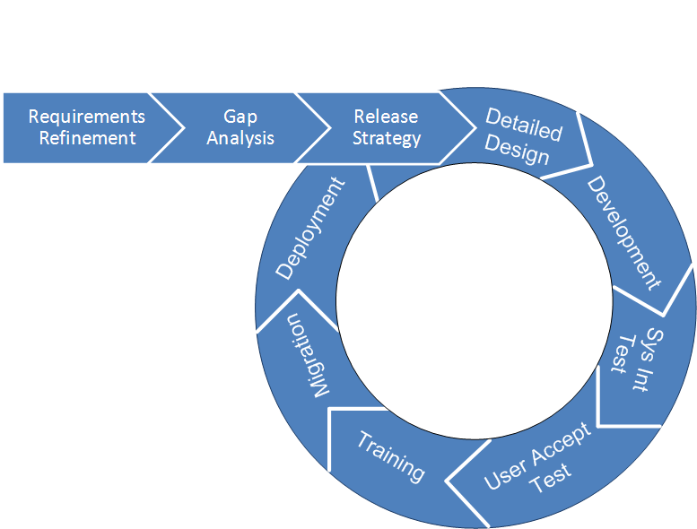
Project Methodology
PAMS will be implemented in multiple iterations

Slide 8
Project Status and Next Steps
Requirements Refinement in final steps
Draft Requirements Definition Document, describing what PAMS must do, was written and reviewed
Final Requirements Definition Document, incorporating reviewer comments, is expected to be delivered this week
Gap analysis estimate completed, estimating how much work is needed to modify the baseline GOTS software to meet the Office of Science’s requirements
Requirements prioritized and partitioned into 7 iterations
Project schedule for PAMS iterations is in-progress

