Slide 1
Fusion Energy Sciences Program Update and Perspectives on the New Charges
July 28, 2011
Edmund J. Synakowski Associate Director, Office of Science
for Fusion Energy Sciences Office of Science, U.S. DOE

Slide 2
Welcome and thank you
In this discussion
Developments within the office
Snapshot of ITER
The Office of Science has issued a new set of charges for you to consider

Slide 3
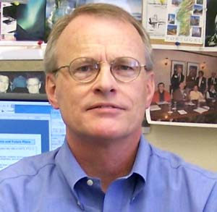
Please help me welcome the soon-to-be Research Division Director…
Dr. James Van Dam
- Calvin College, B.A., Physics and Mathematics, 1970
- University of California, Berkeley (1970-71) and Nagoya University (1972-73), graduate studies, Physics
- University of California, Los Angeles, M.S., Physics, 1974; Ph.D., Physics, 1979
- Institute for Advanced Studies (Princeton) and then The University of Texas at Austin when the Institute for Fusion Studies was established in 1980.
Associate Director of the IFS since 1986 and Director since 2003.
Director, US Burning Plasma Organization, Chief Scientist to U.S. ITER project office since 2007
Various national and international advisory committees.
Co-chair, US-Japan Joint Institute for Fusion Theory

Slide 4
The new FES organizational structure reflects what we need to do as a community
Operating principles:
Two Divisions: (1) Research
(2): Facilities, Operations, and Projects
In the Research Division
Now, program managers will constitute Teams that will interface with the community to establish goals, metrics, and to monitor progress where targeted goals are appropriate.
The Teams we develop will reflect our science and the goals we need to pursue over the next several years
In the Facilities, Operations, and Projects Division
Develop consistent approach in major facility operations and project management
One aim of the new proposed organization is to better reflect the work we need to do, and support the work and functions required of a national program
Another is to create a flexible template for working that promotes cross-fertilization of ideas and expertise within the office

Slide 5
On FES office (con’t)
We hope to be able to post for the SES leadership position of Facilities, Operations and Projects Division in the coming months.
The formal reorganization has to be completed to formally create this division first.
We have been working hard to increase staffing to where we need it to be.
Other new hires:
Ed Stevens (Project Manager from NASA);
Ann Satsangi (General Plasma Science);
Sean Finnegan (GPS and HEDLP);
Pete Pappano (Materials scientist);
Pam Miller (Program analyst, budget formulation, personnel).

Slide 6
Update regarding solicitations
The 41 proposals submitted in response to our theory solicitation (“Theoretical Research in Magnetic Fusion Energy Science”) are being reviewed. Award decisions should be made before September 30, 2011
The joint FES / ASCR SciDAC solicitation entitled “Scientific Computation Application Partnerships in Fusion Energy Science” should be published around the first week of August. It will also include the computational materials part. Tentative due dates: September 9 for Preapplications and October 26 for full proposals. (FES POC: John Mandrekas)
The NSTX Diagnostics Collaboration solicitation should be published in early August. Tentative due dates: mid-September for pre-apps and October 18 for full proposals. (FES POC: Steve Eckstrand)
The joint FES / NNSA High Energy Density Laboratory Plasmas solicitation should be published by August 15. Due date for Letters-of-Intent: October 1; Due date for full proposals: October 15. (FES POC: Ann Satsangi)
A materials solicitation is planned for later this FY. The solicitation will be published in September and the proposals will be due late fall or early winter (FES POC: Gene Nardella & Pete Pappano)

Slide 7
Snapshot of ITER
ITER Council Meeting last June
Construction proceeding at a good pace
Leading questions include how ITER gets paid for in the EU budgetary system, and the impact of the Japanese disasters on the JA ability to deliver
The latter point is being worked aggressively
Director General Motojima stated publically after the last Council meeting that he would like to strive to keep the delays from the disaster to a year maximum (first plasma 2020)
Ned Sauthoff (Director, U.S. ITER Organization) and I are part of a scheduling task group formed by Motojima that aims to develop a modified schedule by this fall
Tom Vanek will speak about this in more detail later at this meeting

Slide 8
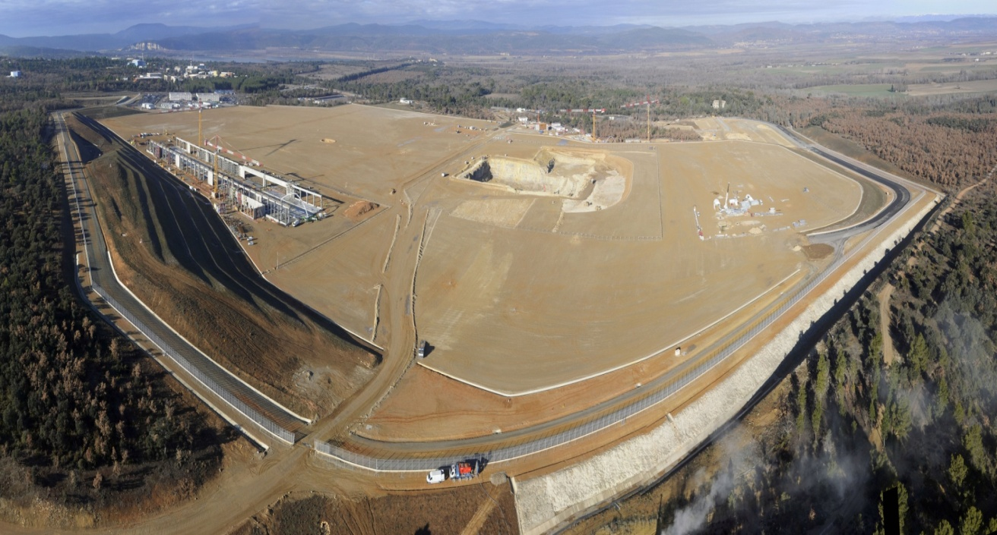
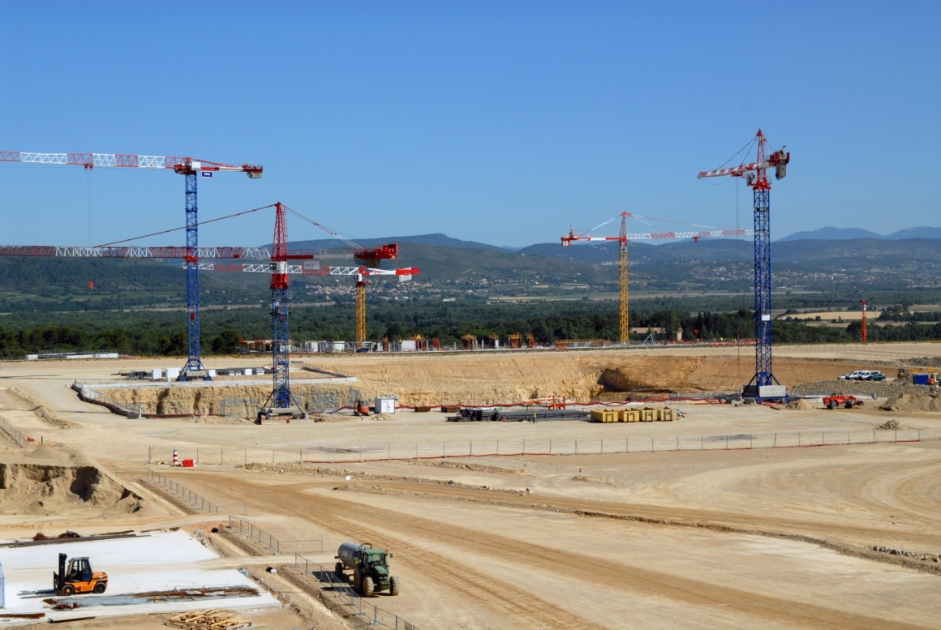
The excavation site for the Tokamak Complex in June 2011
The excavation site for the Tokamak Complex in June 2011

Slide 9
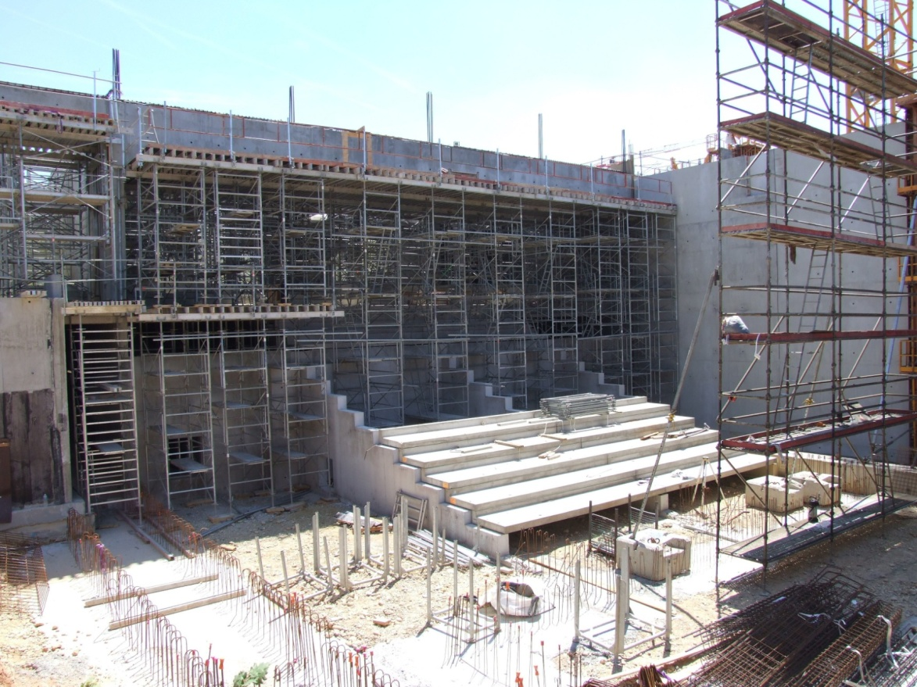
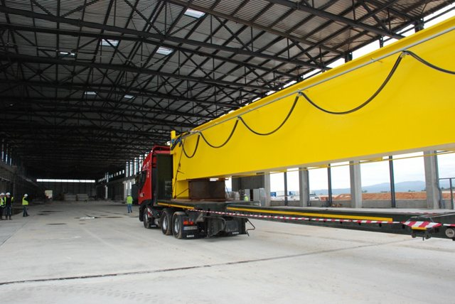
The 500 seat amphitheatre of the future ITER Headquarters building takes shape. (May 2011)
One of two 38.3 meter-long steel beams destined for the Poloidal Field Coil Winding Facility's 25 ton travelling crane. (June 2011)

Slide 10
Regarding the charge(s)

Slide 11
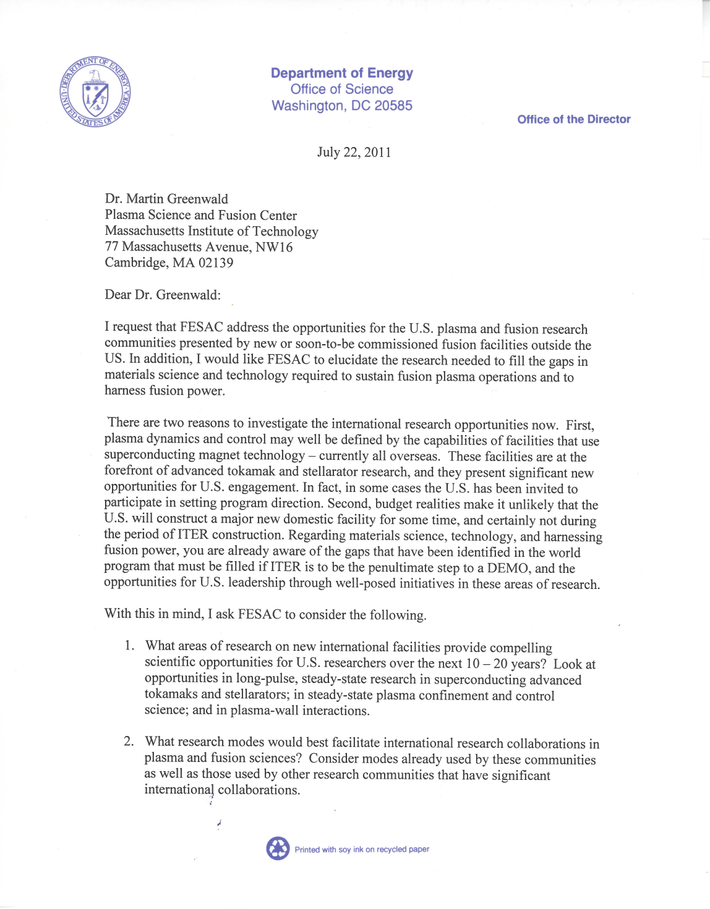
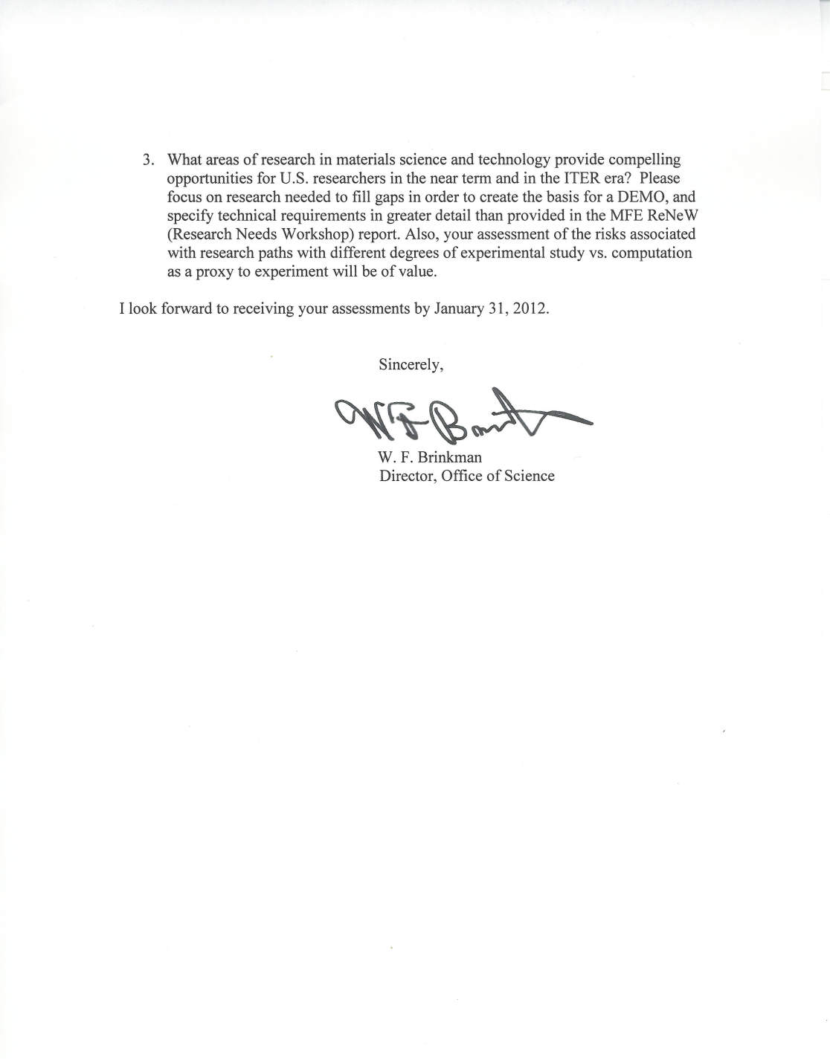

Slide 12
About the charges (1)
“What areas of research on new international facilities provide compelling scientific opportunities for U.S. researchers over the next 10 – 20 years? Look at opportunities in long-pulse, steady-state research in superconducting advanced tokamaks and stellarators; in steady-state plasma confinement and control science; and in plasma-wall interactions.”
The explicit aim is to focus on the superconducting facilities in Asia and Europe, both existing and emergent
The programs of EAST, KSTAR, JT-60SA, W7-X, and LHD are less well known to us
A narrower scope, rather than a broader one, has been issued. Other international opportunities can be studied at a later date
Mike Zarnstoff will describe an assessment he led and recently completed. The FESAC charge will be discussed in more detail this afternoon

Slide 13
About the charges (2)
“What research modes would best facilitate international research collaborations in plasma and fusion sciences? Consider modes already used by these communities as well as those used by other research communities that have significant international collaborations.”
What lessons can we learn from other scientific fields, e.g. high energy physics, nuclear physics, others, that have had to undergo a transition and take on off-shore research significantly or nearly entirely
You are encouraged to engage members of those fields and representatives from universities where international research efforts are successful, as well as where transitions to an off-shore emphasis have failed
Your observations about national lab/university partnerships in new international collaborations will be highly valued. Again, what can other fields teach us?
There will be discussion this afternoon

Slide 14
About the charges (3)
“What areas of research in materials science and technology provide compelling opportunities for U.S. researchers in the near term and in the ITER era? Please focus on research needed to fill gaps in order to create the basis for a DEMO, and specify technical requirements in greater detail than provided in the MFE ReNeW (Research Needs Workshop) report. Also, your assessment of the risks associated with research paths with different degrees of experimental study vs. computation as a proxy to experiment will be of value.”
Consider near- and long-term (~0-5; 5-15; 15+ years); what can be done with existing facilities, new facilities, and emergent international facilities
Experiment & the role of computation: Identify 2-3 paths with varying emphases on massively parallel computing – what are the risks associated with each path?
Materials = nuclear (dpa’s); non-nuclear (pmi); differential and integrated; harnessing fusion power
Chuck Kessel will give an update on the FNS-PA and there will be discussion this afternoon.

Slide 15
Thank you

