Slide 1
HEP Directed Accelerator R&D and Accelerator Projects
June 2017
Mike Procario
Facilities Director for High Energy Physics
Office of Science, U.S. Department of Energy

Slide 2
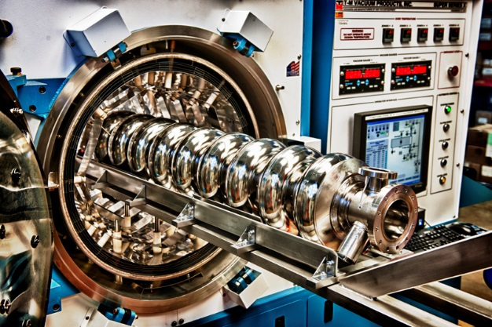
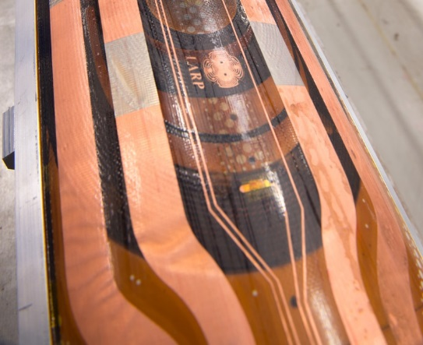
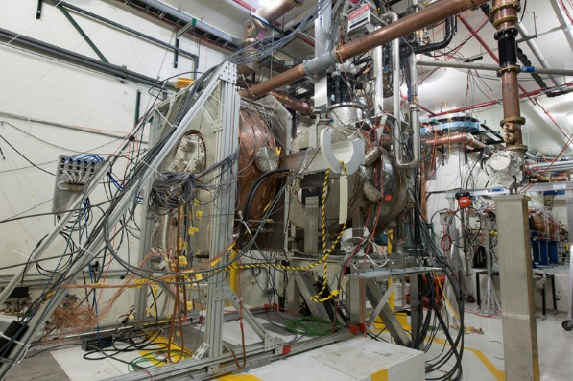
Directed Accelerator R&D
At times it is desirable to conduct R&D on specific concepts in order to determine their feasibility. HEP has had a number of these programs.
ILC (2003-2012)
  Significant amount was learned about SRF cavities that is still being used today for other projects.
LARP (2006-2018)
  LARP has succeeded and we will be looking to see if a new effort is needed in this area.
MAP (2010-2017)
  The MICE effort predated MAP by many years.
Directed R&D can turn into a project like LARP → HL-LHC Accelerator Upgrade or simply end if there is no viable path forward.

Slide 3
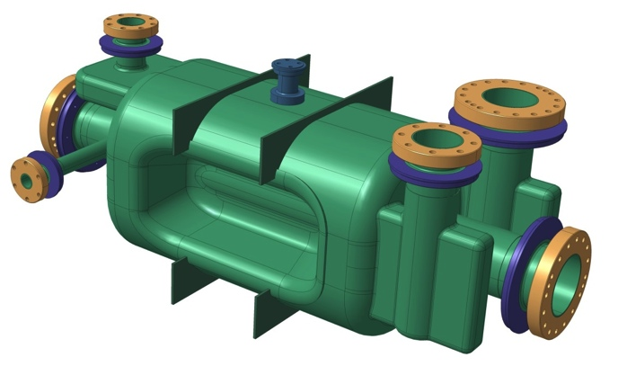
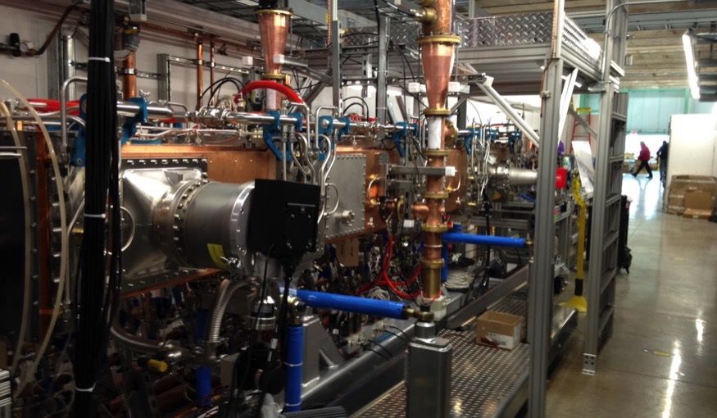
Accelerator Projects
HL-LHC Accelerator Upgrade Project
  High priority P5 Project
  Major contribution that forestalls pay operating costs.
  CD-0 was approved 4/13/2016.
PIP-II
  Also endorsed by P5
  Needed to increase the power at Fermilab for neutrinos.
  CD-0 was approved 10/20/2015.
FACET-II
  Office of Science priority
  CD-1 approved 12/21/2015.

Slide 4
Moun Accelerator Program
P5 recommended that MAP being brought to an end.
HEP proposed a ramp down budget of
  FY 2015: $9 million
  FY 2016: $6 million
  FY 2017: $3 million
MAP management proposed a plan and HEP reviewed in September 2015.
  Completion of the Muon Ionization Cooling Experiment (MICE) was the primary remaining scope.
  The MICE downstream spectrometer solenoid failed in autumn 2015. Repair was too expensive but a workaround was found.
  STFC informed us in June 2016 that they would only support MICE through mid 2017.
HEP redirected $2M of 2017 MAP funding to LARP.

Slide 5
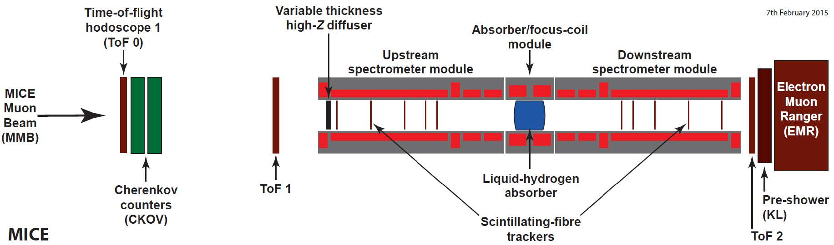
MICE Results
Step IV Physics Program – Measurements of:
  Multiple Coulomb Scattering
  Energy Loss
  Emittance Evolution
Absorber Materials
  LiH data in hand and being analyzed
  LH₂ setup underway (measurements to
  begin in September)
    Some scattering measurements with LNe
    in the absorber module
    Empty absorber module characterization
Energy Loss in LiH (Preliminary)

Slide 6
MICE results
LiH results
Beam Cooling
MICE Step IV data-taking to continue through October 2017.
FNAL MuCool Test Area prototype operation demonstrated
  >14 MV/m gradients in B-field
    75% above original design spec
US MAP effort now completing its ramp-down

Slide 7
LHC Accelerator Research Program (LARP)
LARP began as the original US LHC Accelerator Project was ramping down.
Early activities included help commissioning the LHC with a long term visitor program.
The Toohig Fellowship program is a competitive program to support postdocs interested in LHC related accelerator R&D.
The program evolved towards doing research on LHC upgrade topics.
LARP proposed topics for study and LARP management consulted CERN on what topics they were interested in.

Slide 8
CERN-LARP Agreements
In 2012 Rolf Heuer wrote to DOE to express CERN’s priorities for LARP
Nb₃Sn low-beta focusing magnets (triplets)
High Bandwidth Feedback System for SPS
Crab Cavities
11 Tesla Dipole (cold mass, no cryostat)
Hollow Electron lenses
In 2016 CERN took up the 11 Tesla effort and determined that the SPS feedback system were not needed.
There has been good progress on Nb₃Sn and crab cavities

Slide 9
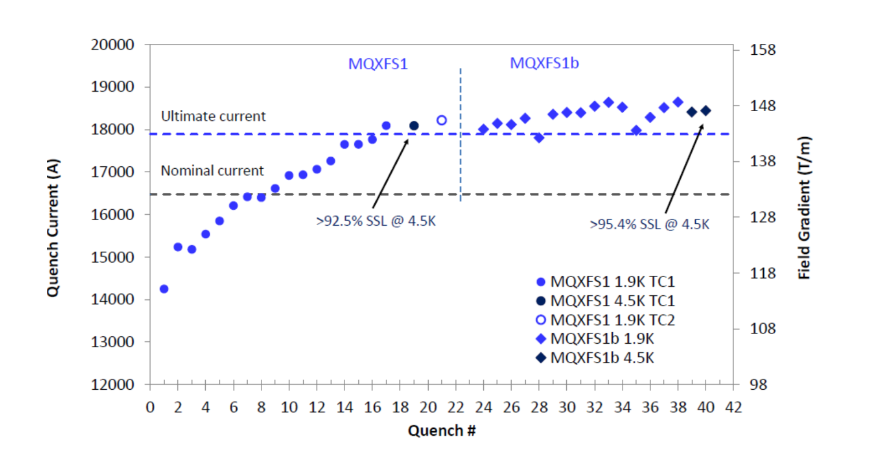
Quad Prototype Testing
MQXFS1b Quench Training
Highest quench current @1.9 K is 18649 A = 0.867 SSL
Highest quench current @4.5 K is 18447 A = 0.958 SSL (actual T=4.66 K)

Slide 10
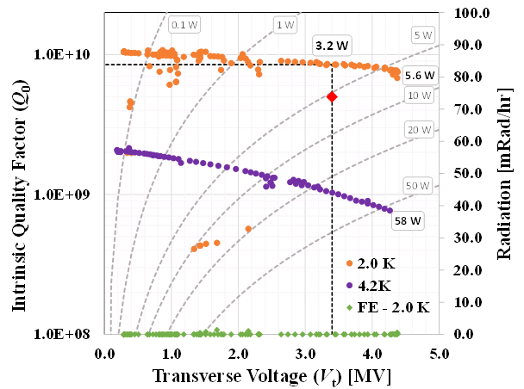
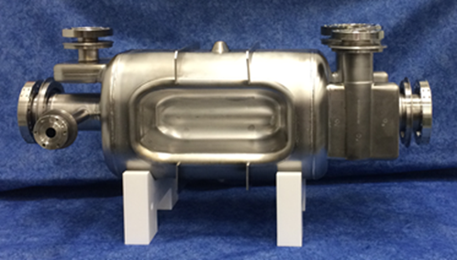
Crab Cavity Prototypes
SPS Prototype
Exceeded Threshold Requirements for performance:
Deflecting voltage 4.4 MV
  (> 4.1 MV)
Dissipated power 5 W
  (< 10 W)
: Nominal : Threshold

Slide 11
HL-LHC Accelerator Upgrade Project
CD-0 was approved 4/13/2016.
The CD-0 coast range was $200-250 million.
Scope will be Nb₃Sn low-beta quadrupoles and crab cavities
  U.S. will deliver half of the Nb₃Sn low-beta quadrupoles.
  CERN will produce the rest.
  LARP developed to crab cavities designs
    Radio Frequency Dipole (RFD)
    Double Quarter Wave (DQW)
  HL-LHC AUP will build the RFD and CERN will build the DQW.
This estimated cost of this scope is above $200 million and evolving.
The CD-1 review is scheduled for August 2017.

Slide 12
HL-LHC Accelerator Upgrade Project
The addendum to the US-CERN agreement for HL-LHC AUP has been signed by DOE and CERN.
The CD-0 showed $15 million funding for FY 2018.
  The need for long-lead procurement of Nb₃Sn conductor led HEP to increase the funding to $27 million in FY 2018.
  The tooling and the testing infrastructure sets the pace for the production and CERN has set the need by date on mid 2024.
All prototyping will move from LARP to the projects as soon as is sensible.
  LARP will complete its prototypes in FY 2018.
  All work will be in the project in FY 2019.
Project planning so far has been quite good.

Slide 13
Schedule

Slide 14
PIP-II
CD-0 was approved 10/20/2015.
  Two pronged mission need.
    Replace the linac that includes parts from the original Fermilab construction.
    Support 1.2 MW of power for the neutrino program.
The scope is a superconducting linac to replace the current Fermilab linac and upgrades to the rest of the complex to allow 1.2 MW of power to LBNF.
The energy of PIP-II will 800 MeV instead of the 400 MeV of the current linac.
  This allows the injection of more charge into the booster.
There is significant international interest in this project.

Slide 15
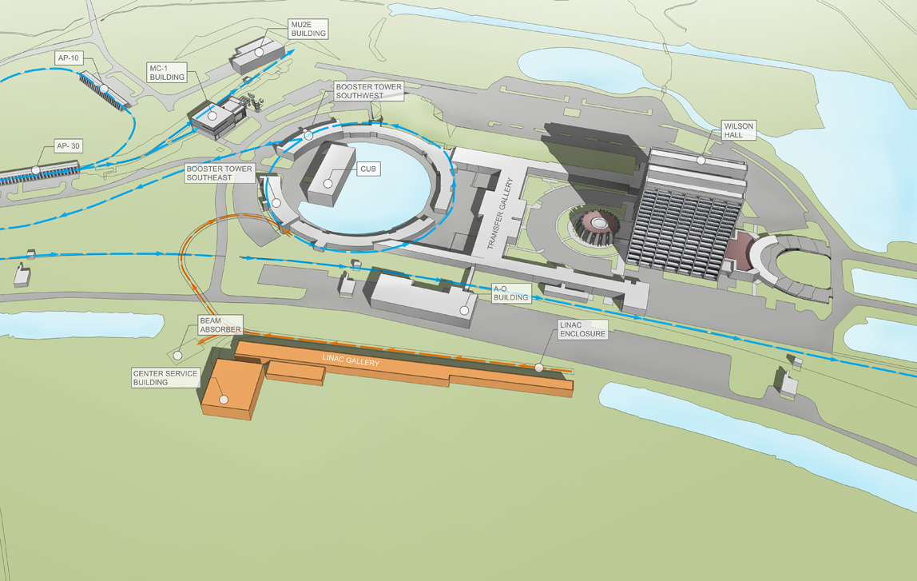

Slide 16
International
India has strong interest in the SRF technology.
We have an international agreement in place to participate in the R&D phase of PIP-II
  Indian contributions to the PIP2IT have started to arrive.
  Indian engineers are making extended stays at Fermilab.
  Still have some culture clashes
    India won’t use TeamCenter for example.
Italy is interested in building cyromodules and could contribute the 650 MHz low beta cavities.
The UK is also 650 MHz high-beta cavities.

Slide 17
Project Reviews
OPA conducted a status review of PIP-II in November 2016.
The short summary is:
HEP, OPA, and Fermilab are discussing when to do the CD-1 review.
Overall, the Committee judged that the project team made good progress with the technical aspects of the project since receiving CD-0. However, the project team now has to transform from a research and development effort to align with more focused “project like” activities, in order to support CD-1.

Slide 18
FACET II
FACET has had a very successful program.
LCLS-II displaced half of the linac used by FACET, so a new solution was needed to continue the physics program.
SLAC proposed FACET-II, which uses the part of the linac not displaced by LCLS-II.
CD-0 was approved 9/18/2015.
CD-1 was approved 12/21/2015.
CD-2 review was held 9/13-15/2016.
FACET-II was a new start in the FY 2017 budget.
  HEP was reluctant to approve CD-2 until CR ended.

