Slide 1
Roadmapping Basic Science Needed for Our Energy Future:
Part I – Energy Facts Leading to an Energy Strategy
Ceramic Leadership Summit
The American Ceramic Society
21June 2010
Dr. Patricia M. Dehmer
Deputy Director for Science Programs
Office of Science, U.S. Department of Energy
http://www.science.doe.gov/SC-2/Deputy_Director-speeches-presentations.htm

Slide 2
The Department of Energy

Slide 3
DOE Quick Facts
Mission:
Advance national, economic, and energy security;
Promote scientific and technological innovation; and
Ensure environmental cleanup of the nuclear weapons complex.
$26.4B FY 2010 budget request
$36.7B in Recovery Act funds
14,000 Federal employees
93,000 contractor employees
17 National Laboratories
4 Power Marketing Administrations
89 Nobel Laureates

Slide 4
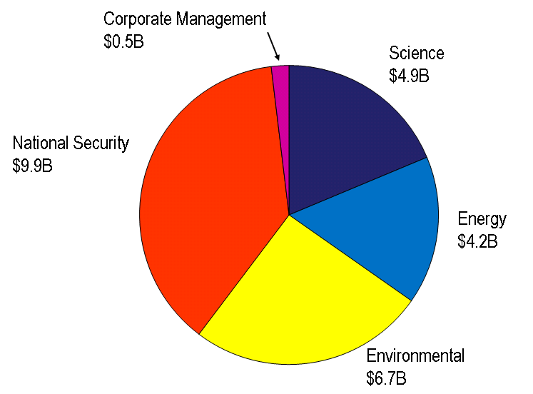
FY 2010 DOE Budget

Slide 5
DOE’s Office of Science

Slide 6
Office of Science Quick Facts
$4.9B FY 2010 appropriation
$1.6B in Recovery Act funds
10 National Laboratories
1,000 Federal employees
Support for:
  Disciplines of condensed matter and materials physics, chemistry, biology, climate and environmental sciences, applied mathematics, computational science, high energy physics, nuclear physics, plasma physics, and fusion energy sciences
  300 academic institutions and all 17 DOE laboratories
  25,000 Ph.D.s, graduate students, undergraduates, engineers, and technicians
  25,000 users at the scientific user facilities

Slide 7
The Energy Challenge

Slide 8
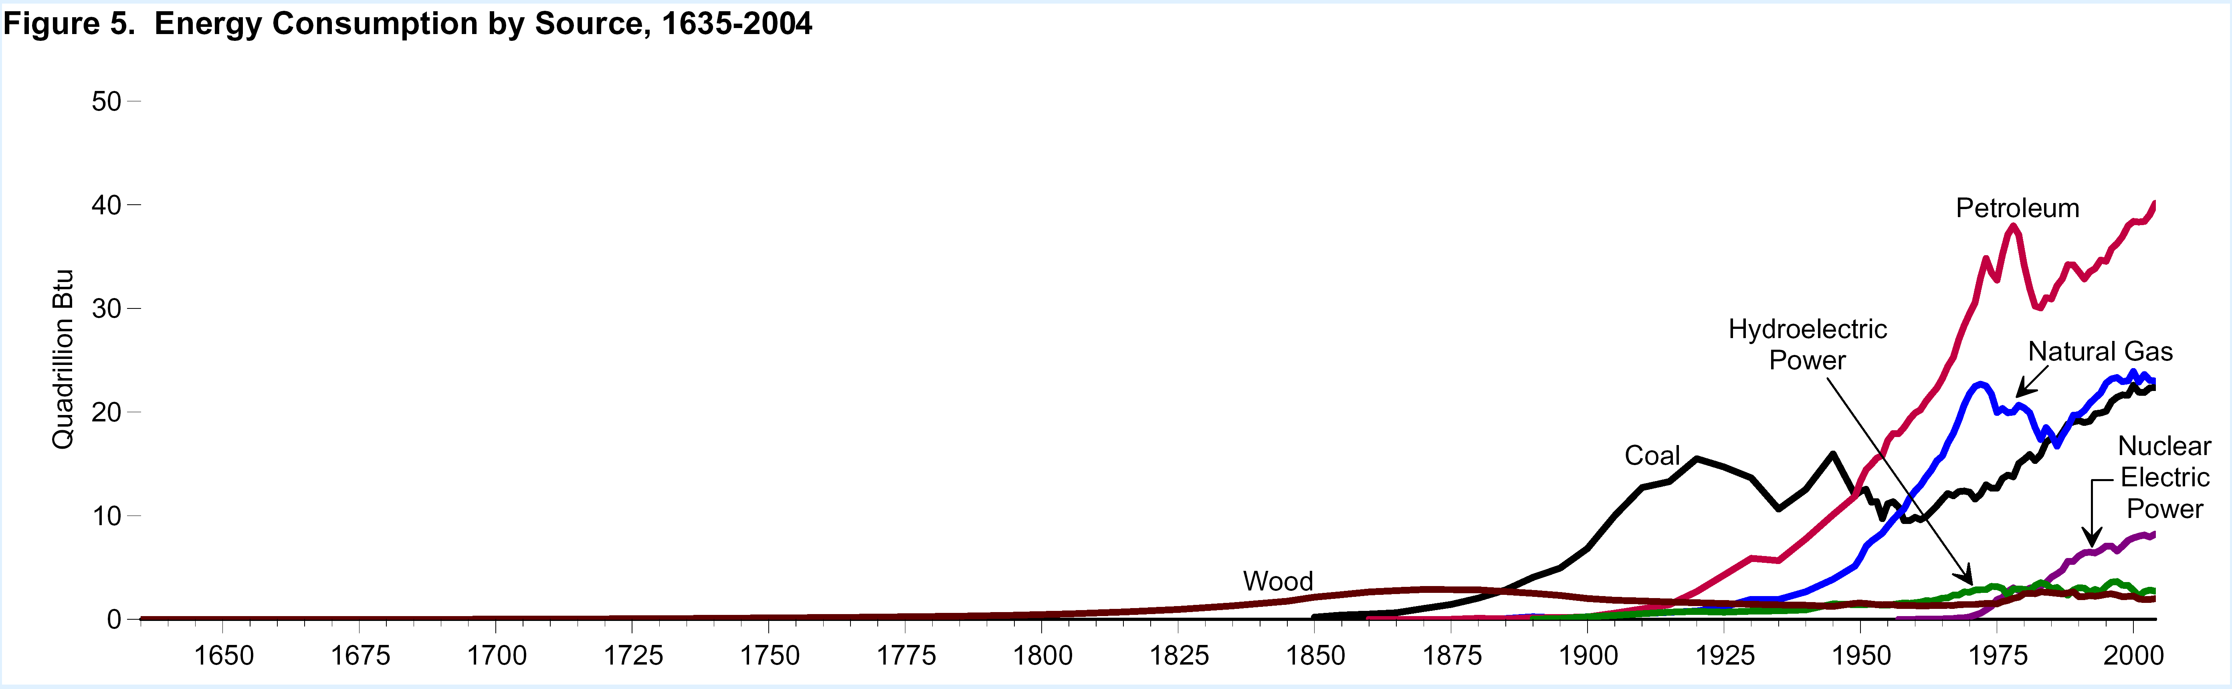
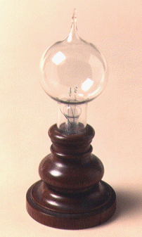
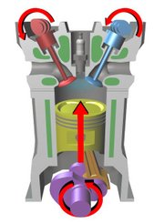
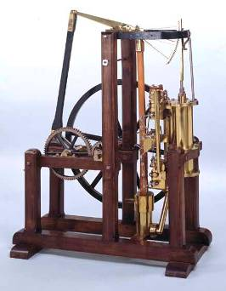
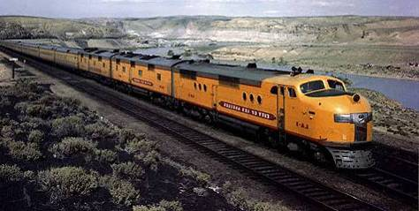
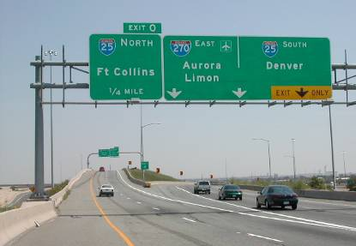


400 Years of Energy Use in the U.S.
19th C discoveries and 20th C technologies are very much part of today’s infrastructure
40
Petroleum
40
U.S. Energy Consumption by Source
30
30
Hydroelectric
Power
Natural Gas
Quadrillion Btu
Quadrillion Btu
20
20
Coal
Nuclear Electric Power
Incandescent lamp,
1870s
Four-stroke combustion engine, 1870s
10
10
Wood
Watt Steam Engine, 1782
0
0
1650
1700
1750
1800
1850
1900
1950
2000
Rural Electrification Act,
1935
Intercontinental Rail System, mid 1800s
Eisenhower Highway System, 1956
8

Slide 9
Energy consumption today
~100 Quads
Quad = 10¹⁵ BTU

Slide 10
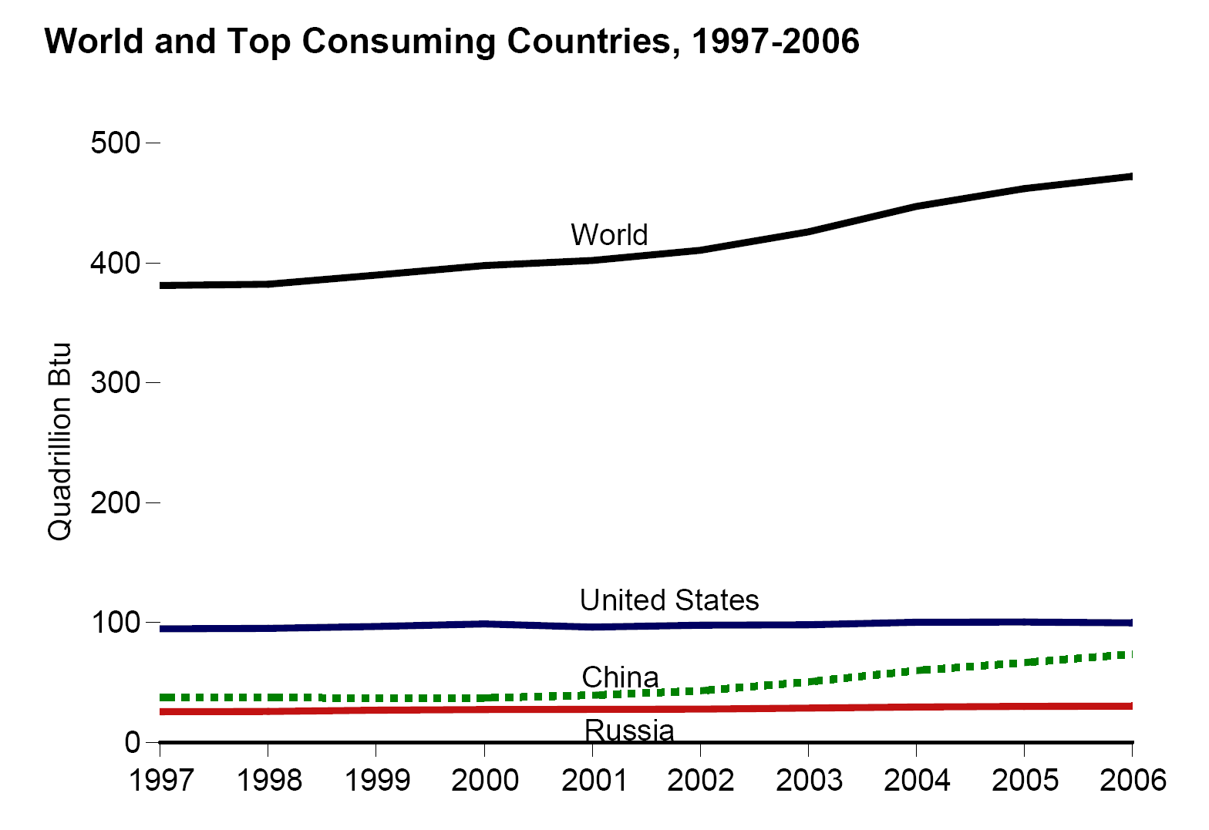
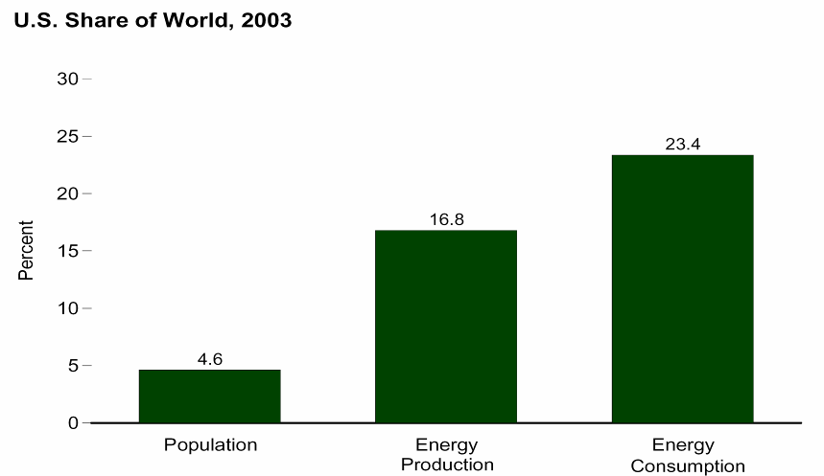
U.S. and World Energy Consumption Today
With <5% of the world’s population, the U.S. consumes 21% of all primary energy
472 Quads
World
U.S. Share of World, 2006
21.1%
15.1%
4.6%
United States
Population
Energy
Production
Energy
Consumption
100 Quads
China
Russia
Some equivalent ways of referring to the energy used by the U.S. in 1 year (approx. 100 Quads)
100.0 quadrillion British Thermal Units (Quads) U.S. & British unit of energy
105.5 exa Joules (EJ) Metric unit of energy
3.346 terawatt-years (TW-yr) Metric unit of power (energy/sec)x(#seconds in a year)

Slide 11
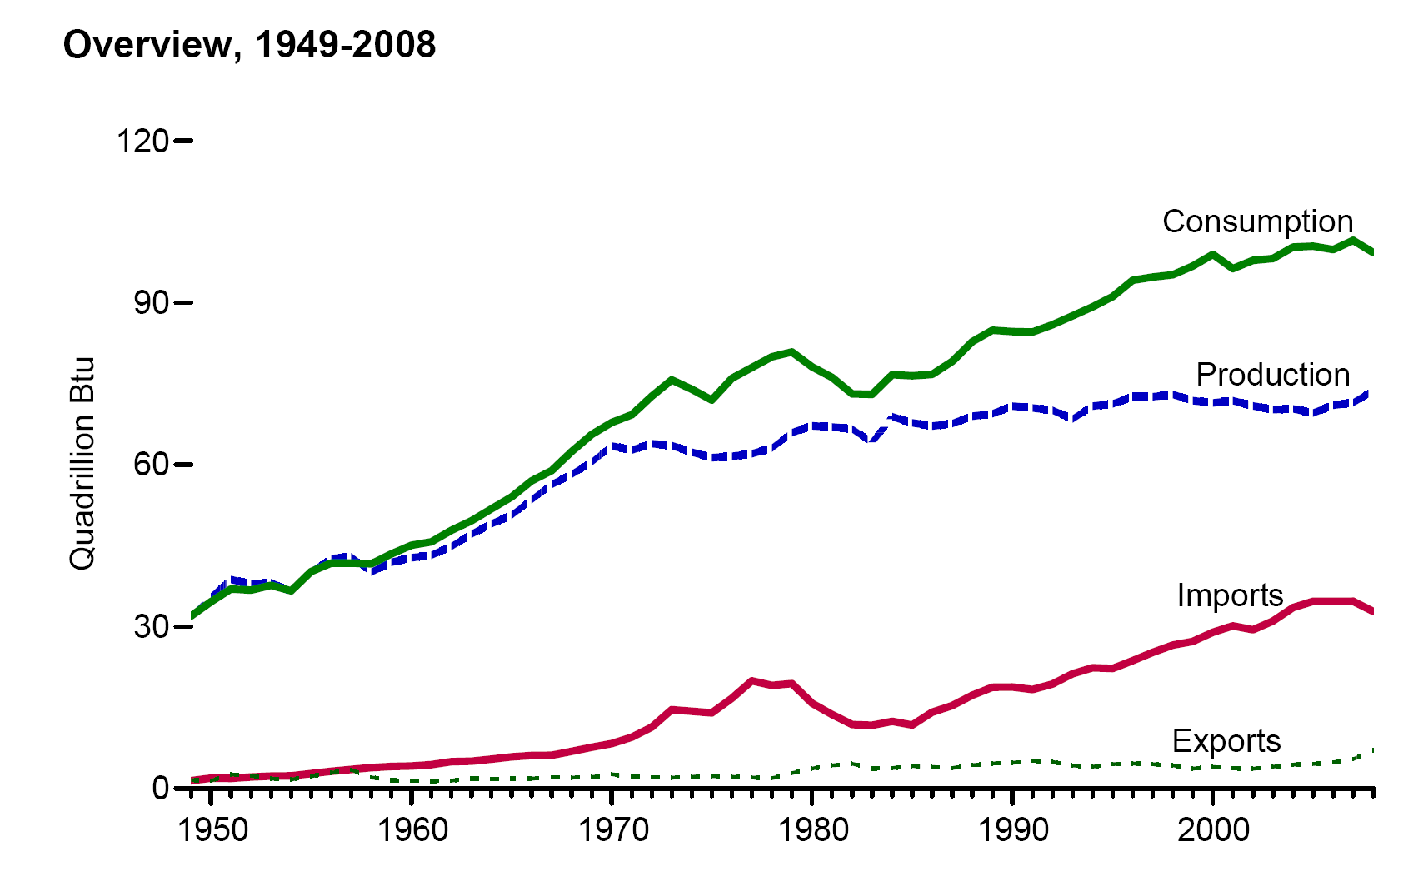
U.S. Energy Production & Consumption Since 1950
The U.S. was self sufficient in energy until the 1950s

Slide 12
Energy needs in the 21st century
?
U.S.
~100 Quads
?
World
472 Quads

Slide 13
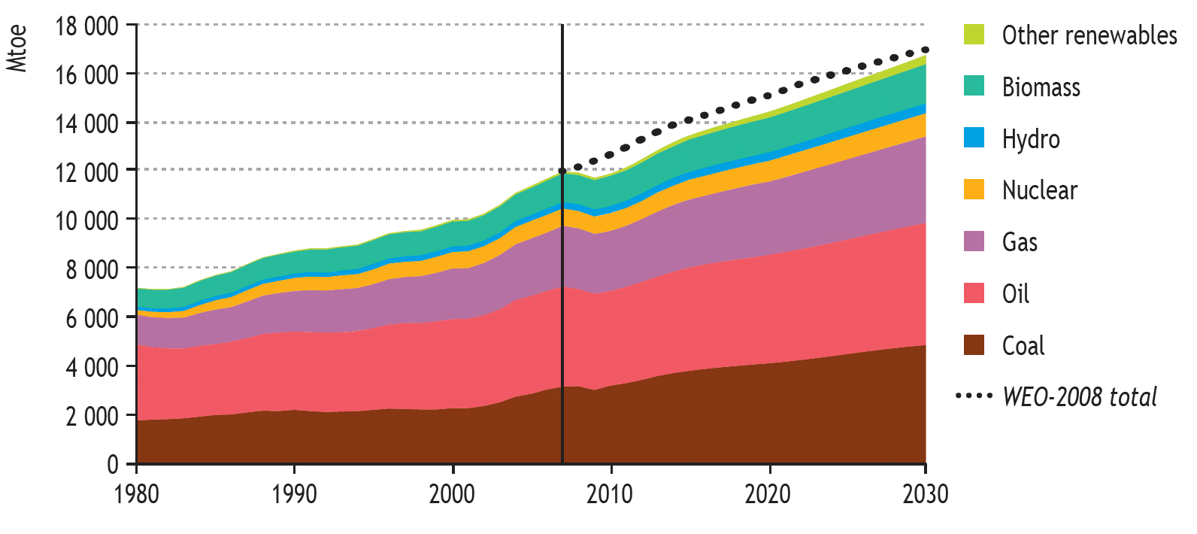
Fossil Fuels Will Continue to Dominate World Energy Supply Under Business as Usual
IEA World Energy Outlook 2009 Reference Case
Millions of tons of oil equivalent
Over 90% of the increase in world primary energy demand between 2007 and 2030 is projected to come from non-OECD countries, driven largely by China and India
Source: International Energy Agency World Energy Outlook, 2009.

Slide 14
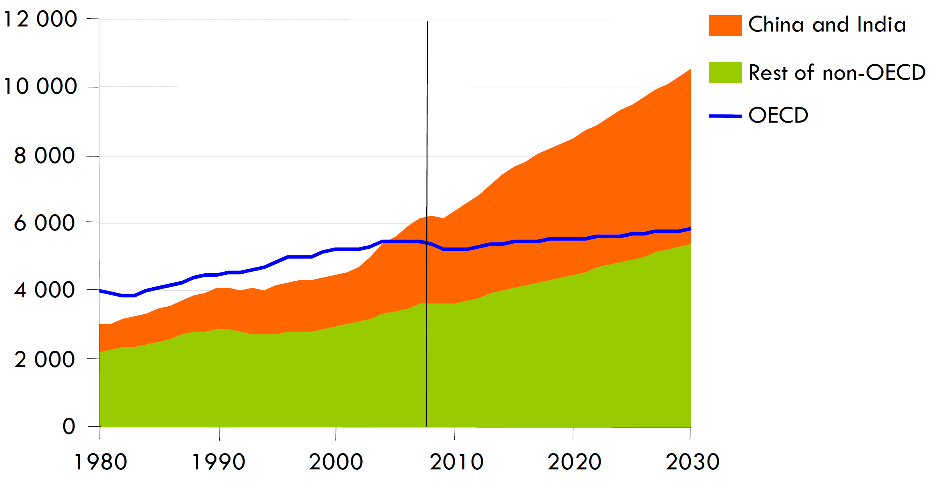
Fossil Fuels Will Continue to Dominate World Energy Supply Under Business as Usual
IEA World Energy Outlook 2009 Reference Case
Millions of tons of oil equivalent
Source: International Energy Agency World Energy Outlook, 2009.

Slide 15
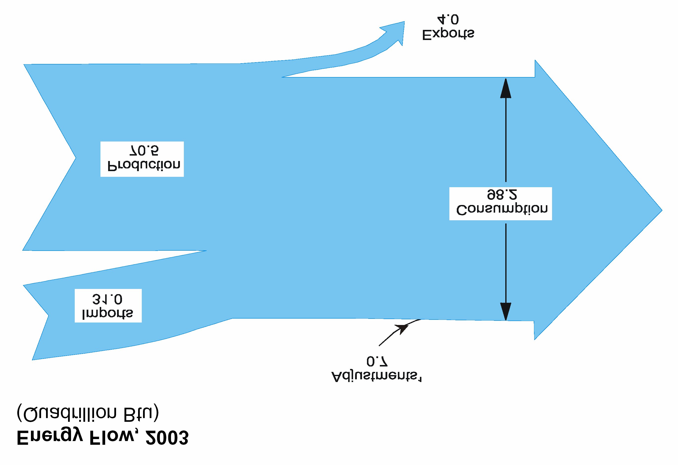

Energy sources and consumption sectors in the U.S.

Slide 16
U.S. Energy Flow, 2008
About 1/3 of U.S. primary energy is imported
Exports
7 Quads
Domestic
Production:
74 Quads
Consumption:
99 Quads
Energy Supply (Quads)
Energy Consumption
Imports:
33 Quads
Adjustments ~1

Slide 17
U.S. Energy Flow, 2007 (Quads)
85% of primary energy is from fossil fuels
Residential
Commercial
Domestic
67%
Supply
107
Quads
Consume
102
Quads
Fossil
85%
Industrial
Imports
33%
Nuclear 8%
Transportation
Renewable 7%

Slide 18
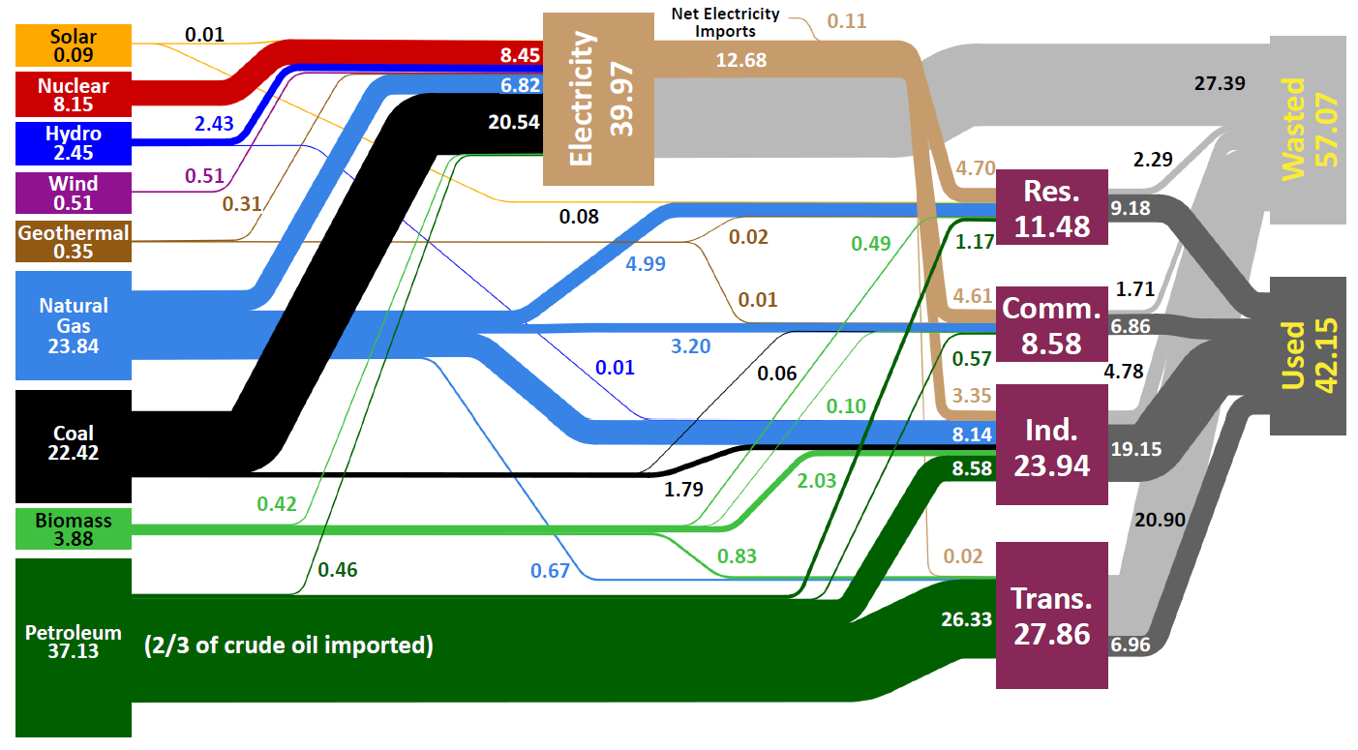
U.S. Energy Production and Usage in 2008
Units in Quadrillion BTUs (Quads)
Source: Lawrence Livermore National Laboratory and the Department of Energy, Energy Information Administration, 2009 (based on data from DOE/EIA-0384(2008), June 2009).
Notes:
Delete yellow things

Slide 19
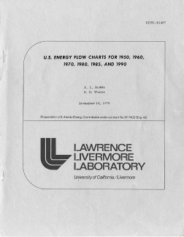
U.S. Energy Flow, 1950 (Quads)
At midcentury, the U.S. used 1/3 of the primary energy used today and with greater overall efficiency
19

Slide 20
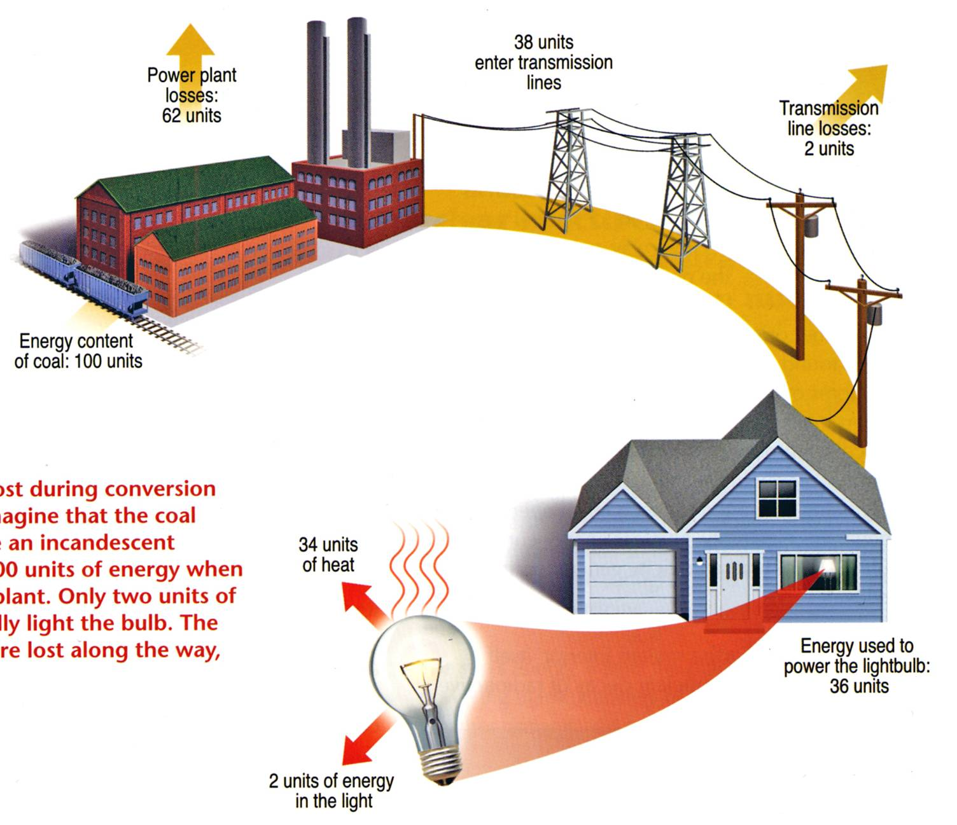

Overall Efficiency of an Incandescent Bulb ≅ 2%
Lighting accounts for 22% of all electricity usage in the U.S.
Energy content of coal: 100 units
Example of energy lost during conversion and transmission. Imagine that the coal needed to illuminate an incandescent light bulb contains 100 units of energy when it enters the power plant. Only two units of energy eventually light the bulb. The remaining 98 units are lost along the way, primarily as heat.
2 units of energy
in light output

Slide 21
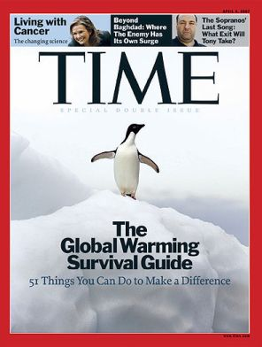
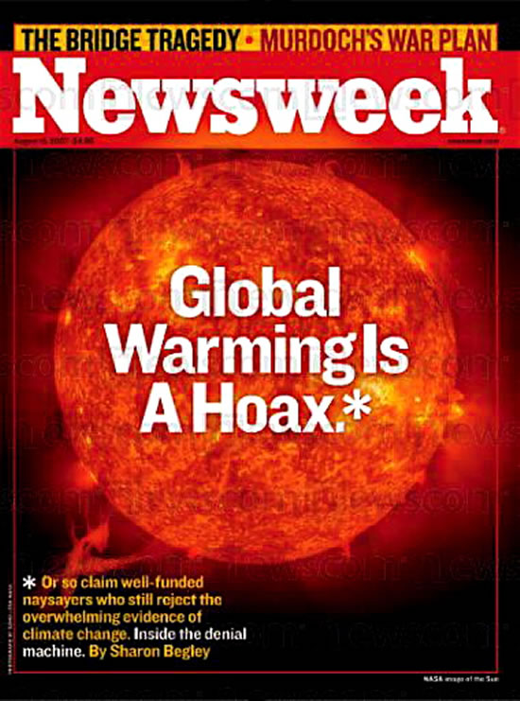
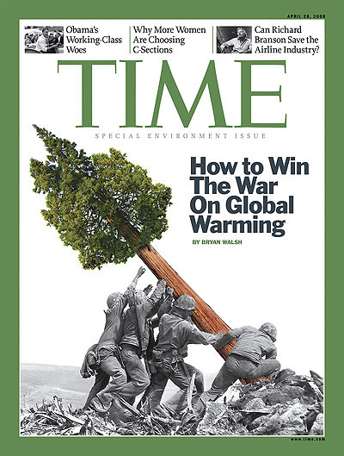
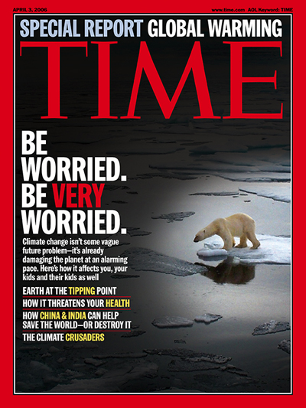
Energy and the environment

Slide 22

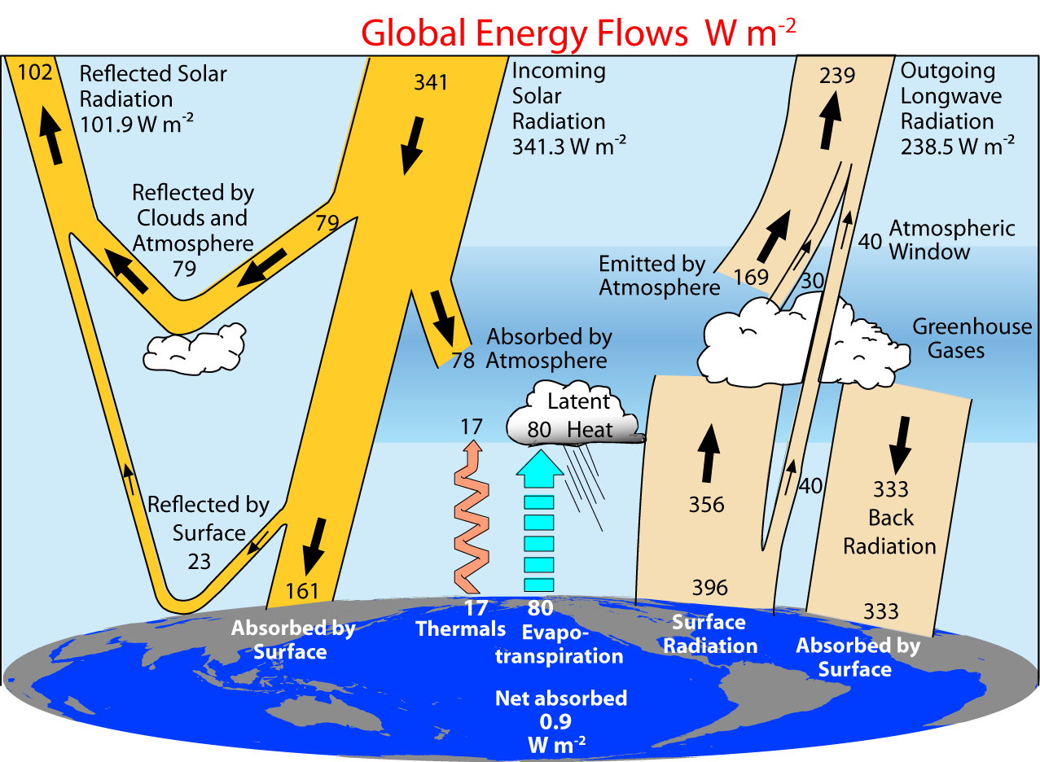
Greenhouse Effect
Naturally occurring greenhouse gases include water vapor, carbon dioxide, methane, nitrous oxide, and ozone. Greenhouse gases that are not naturally occurring include hydro-fluorocarbons (HFCs), perfluorocarbons (PFCs), and sulfur hexafluoride (SF₆), which are generated in a variety of industrial processes.
22
Notes:
THE FLOW OF ENERGY THROUGH THE CLIMATE SYSTEM
A suite of papers has provided updated estimates of trends, variability, mean and annual cycle of energy flowing through the climate system, and energy storage, release, and transport in the atmosphere, ocean, and land surface. The estimates are obtained from recent observations using the latest datasets ([1]-[5]). The results indicate that the global energy budget can now be estimated reasonably well, with the largest continuing sources of uncertainty being the ocean heat budget south of about 35°S. The current imbalance in radiation at the top-of-atmosphere owing to human-induced increases in greenhouse gases means that the atmosphere, land and ocean are warming up, and ice is melting, leading to a rise in sea level. A holistic integrated approach that brings all information to bear provides constraints on what is happening and where the main weaknesses are in the current observing system. These analyses also provide insights into both top-of-atmosphere and surface balances and model problems. For instance, the results indicate that climate models typically have too much downward longwave radiation, which is compensated by too much evaporation and precipitation.
Figure: From Trenberth et al (2008) shows the estimated global mean energy flows for the 2000 to 2004 time frame.
Fasullo, J. T., and K. E. Trenberth, 2008: The annual cycle of the energy budget. Part I: Global mean and land-ocean exchanges. J. Climate, 21, 2297-2312.
Fasullo, J. T., and K. E. Trenberth, 2008: The annual cycle of the energy budget. Part II: Meridional structures and poleward transports. J. Climate, 21, 2313-2325.
Trenberth, K. E., and L. Smith, 2008: The three dimensional structure of the atmospheric energy budget: methodology and evaluation. Climate Dynamics, in press. doi:10.1007/s00382-008-0389-3.
Trenberth, K. E., and L. Smith, 2008: Atmospheric energy budgets in the Japanese Reanalysis: Evaluation and variability. J. Meteor. Soc. Japan, in press.
Trenberth, K. E., J. T. Fasullo, and J. Kiehl, 2008: Earth's global energy budget. Bull. Amer. Meteor. Soc., in press.
Several recent presentations by Trenberth may be found at http://www.cgd.ucar.edu/cas/Trenberth/trenberth_presentations.html

Slide 23
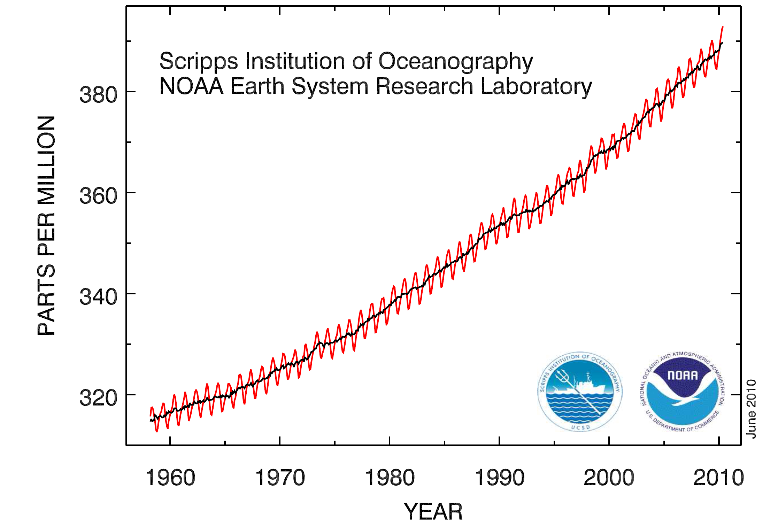
Modern CO₂ Concentrations are Increasing
The current concentration is the highest in 800,000 years, as determined by ice core data
Concentration now ~390 ppm
Concentration prior to 1800 was ~280 ppm

Slide 24
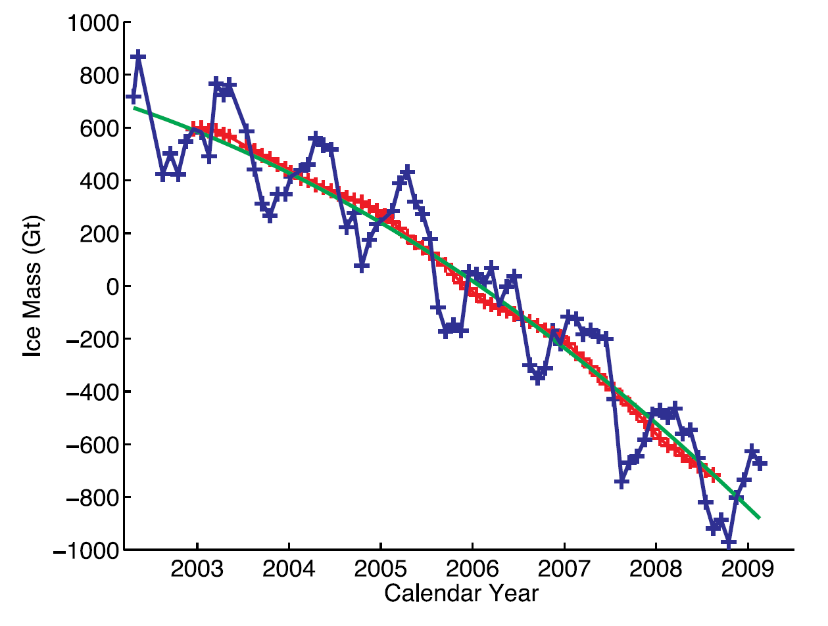
Greenland Ice Mass Loss – 2002 to 2009
Increasing rates of ice mass loss from the Greenland and Antarctic ice sheets revealed by GRACE (Gravity Recovery and Climate Experiment) satellite
In Greenland, the mass loss increased from 137 Gt/yr in 2002–2003 to 286 Gt/yr in 2007–2009
In Antarctica, the mass loss increased from 104 Gt/yr in 2002–2006 to 246 Gt/yr in 2006–2009
Time series of ice mass changes for the Greenland ice sheet estimated from GRACE monthly mass solutions for the period from April 2002 to February 2009. Unfiltered data are blue crosses. Data filtered for the seasonal dependence using a 13-month window are shown as red crosses. The best-fitting quadratic trend is shown (green line). The GRACE data have been corrected for leakage and GIA.
I. Velicogna, GEOPHYSICAL RESEARCH LETTERS, VOL. 36, L19503, doi:10.1029/2009GL040222, 2009

Slide 25
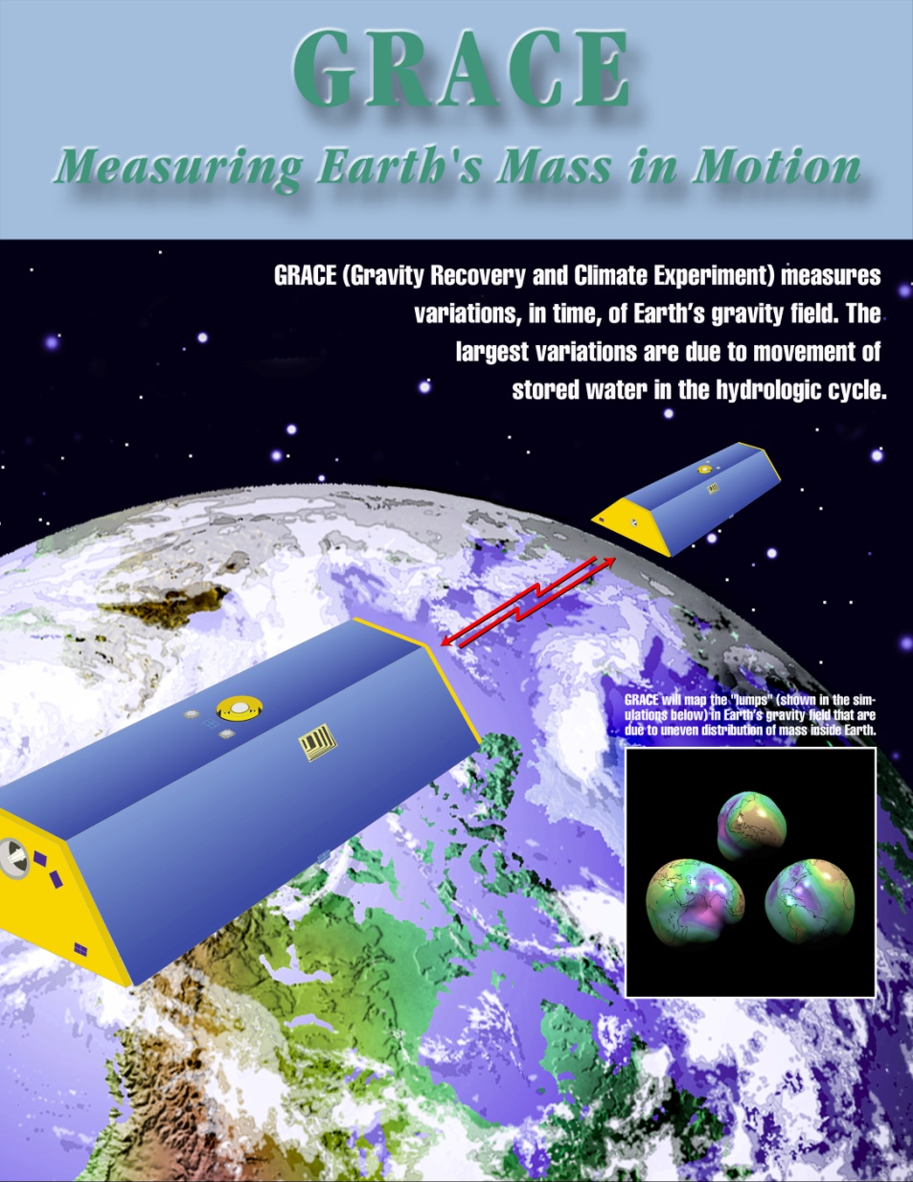
Gravity Recovery and Climate Experiment (GRACE)
GRACE uses a microwave ranging system to measure changes in the speed and distance between two identical spacecraft flying about 220 kilometers apart, 500 kilometers above Earth. Separation changes as small as 10 microns—about one-tenth the width of a human hair—can be detected.
GRACE satellites can sense minute variations in Earth's gravitational pull. When the first satellite passes over a region of slightly stronger gravity, it is pulled ahead of the trailing satellite, causing the distance between the satellites to increase.
By measuring the changing distance between the two satellites and combining that data with positioning measurements from GPS instruments, a gravity map can be constructed.

Slide 26
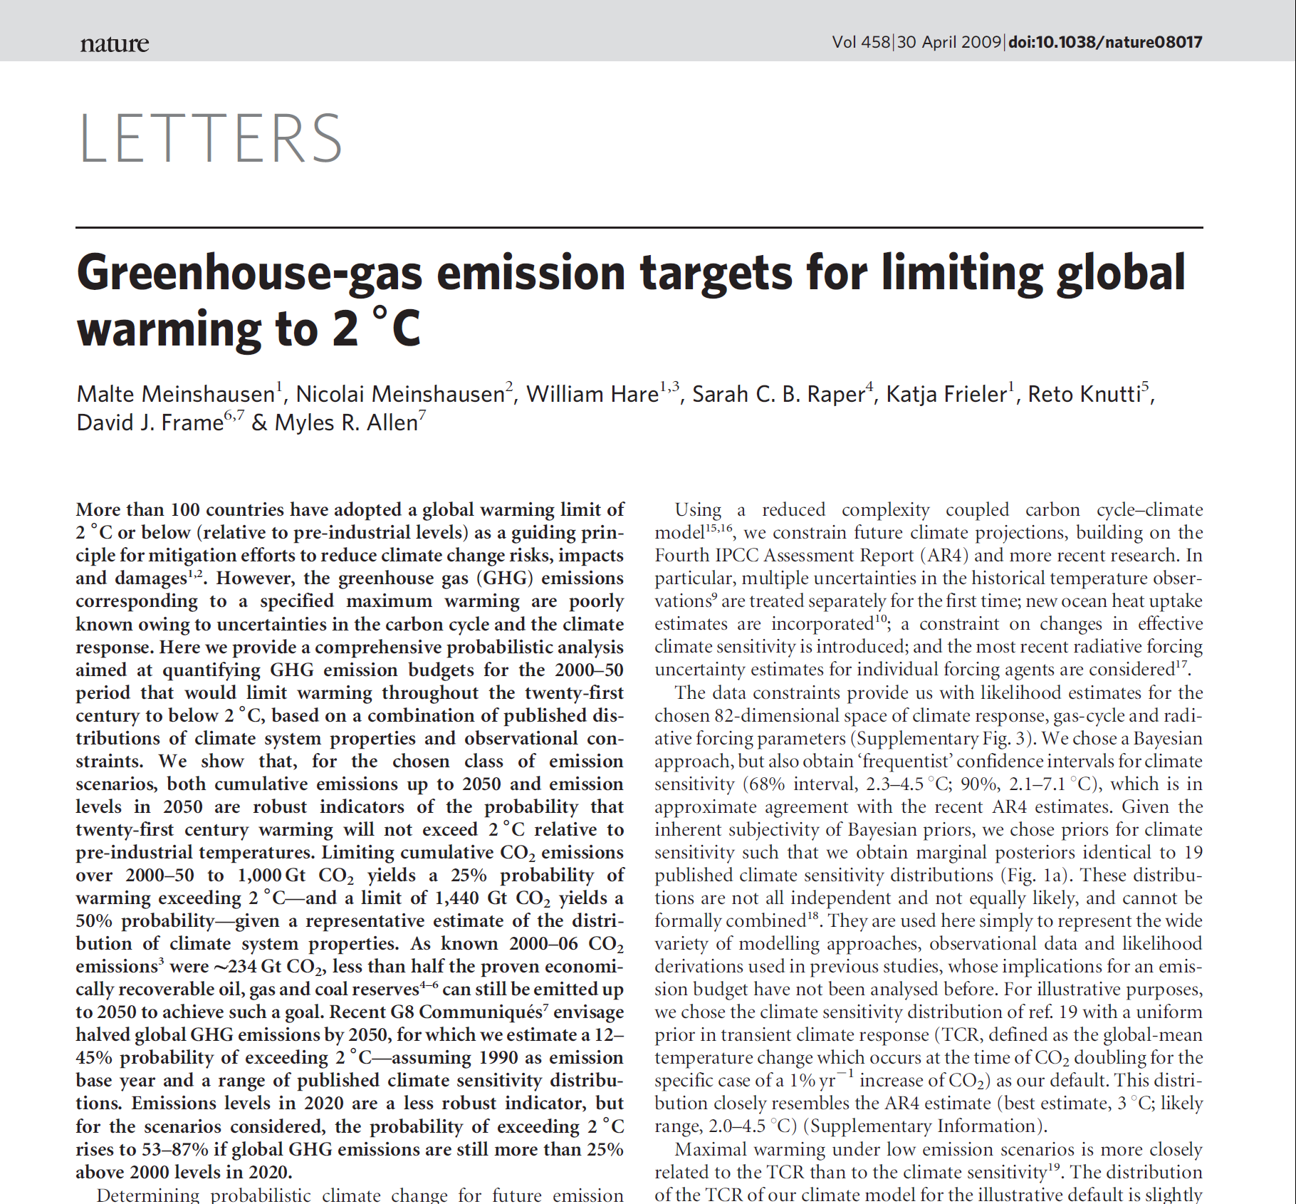
Major Changes are Required to
Reduce Greenhouse Gas Concentrations

Slide 27
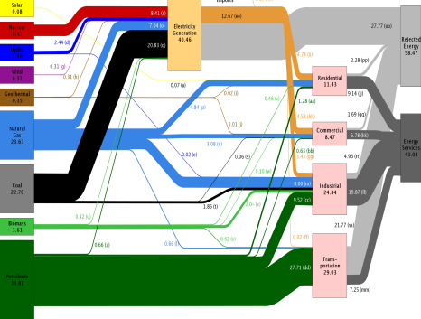
Recap
and the components of energy strategies

Slide 28
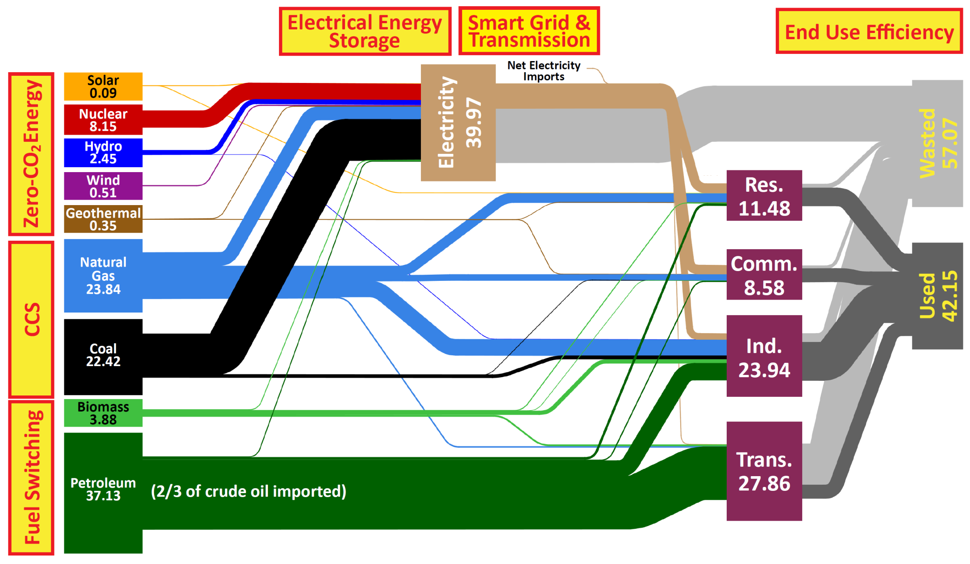
A National Strategy for a New Energy Economy
Climate Science
Notes:
“Zero Carbon Energy”

Slide 29

Tranformational change –
the role of basic research and innovation

Slide 30


Strategic Planning:
10 “Basic Research Needs …” Workshops
Basic Research Needs to Assure a Secure Energy Future (BESAC)
  Basic Research Needs for the Hydrogen Economy
  Basic Research Needs for Solar Energy Utilization
  Basic Research Needs for Superconductivity
  Basic Research Needs for Solid State Lighting
  Basic Research Needs for Advanced Nuclear Energy Systems
  Basic Research Needs for the Clean and Efficient Combustion of 21st Century Transportation Fuels
  Basic Research Needs for Geosciences: Facilitating 21st Century Energy Systems
  Basic Research Needs for Electrical Energy Storage
  Basic Research Needs for Catalysis for Energy Applications
  Basic Research Needs for Materials under Extreme Environments
10 workshops; 5 years; more than 1,500 participants from academia, industry, and DOE labs
www.science.doe.gov/bes/reports/list.html
Notes:
Since the start of the 20th century, it has been clear that the microscopic world in which atoms interact through the movement of electrons is not subject to the same classical laws of physics that govern the macroscopic world we encounter in our daily lives. The activities of electrons, atoms, and their molecular assemblies follow the counter-intuitive and often paradoxical rules of quantum mechanics, where, for example, a beam of light can function either as particles traveling in a straight line (photons) or as a wave propagating through empty space. During the twentieth century, scientists developed increasingly sophisticated technologies and instrumentation for the study of quantum effects. Our understanding of these phenomena has reached the point where we are ready to move beyond simple observation and take the steps that will enable us to direct and control matter and energy at the quantum level.
During the twentieth century, chemical synthesis and materials preparation began to be based more on control than on serendipity, resulting in advances ranging from new polymers to nanostructures. Now, scientists are positioned to begin directing and controlling the outcomes on a molecule-by-molecule and atom-by-atom basis, or even at the level of electrons. Long the staple of science- fiction novels and films, the ability to direct and control matter at the quantum, atomic, and molecular levels creates enormous opportunities across a wide spectrum of critical technologies.
One of the most spectacular technological advances in the 20th century took place in the field of information, as computers and microchips became ubiquitous in our society. Vacuum tubes were replaced with transistors and, in accordance with Moore’s Law (named for Intel co-founder Gordon Moore), the number of transistors on a microchip has doubled approximately every two years for the past two decades. However, if the time comes when integrated circuits can be fabricated at the molecular or nanoscale level, the limits of Moore’s Law will be far surpassed. A supercomputer based on nanochips would comfortably fit in the palm of your hand and use less electricity than a cottage. All the information stored in the Library of Congress could be contained in a memory the size of a sugar cube. Ultimately, if computations can be carried out at the atomic or sub-nanoscale levels, today’s most powerful microtechnology will seem antiquated.

Slide 31
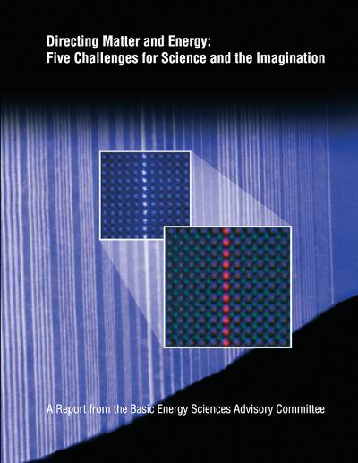
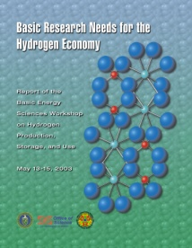
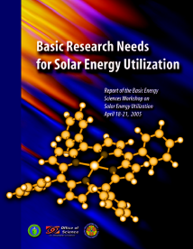
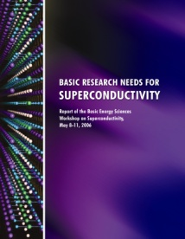

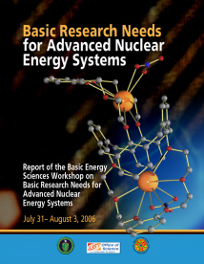
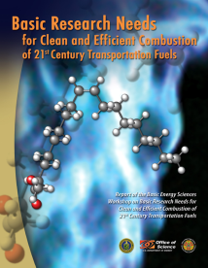
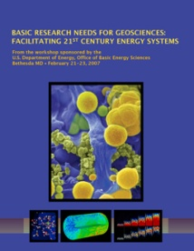
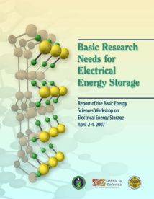
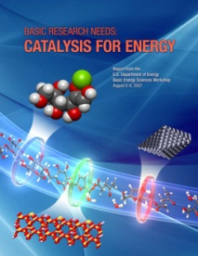
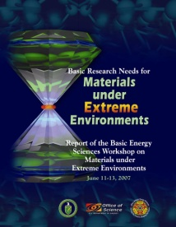
Directing Matter and Energy:
Five Challenges for Science and the Imagination
Control the quantum behavior of electrons in materials
Synthesize, atom by atom, new forms of matter with tailored properties
Control emergent properties that arise from the complex correlations of atomic and electronic constituents
Synthesize man-made nanoscale objects with capabilities rivaling those of living things
Control matter very far away from equilibrium
Notes:
Since the start of the 20th century, it has been clear that the microscopic world in which atoms interact through the movement of electrons is not subject to the same classical laws of physics that govern the macroscopic world we encounter in our daily lives. The activities of electrons, atoms, and their molecular assemblies follow the counter-intuitive and often paradoxical rules of quantum mechanics, where, for example, a beam of light can function either as particles traveling in a straight line (photons) or as a wave propagating through empty space. During the twentieth century, scientists developed increasingly sophisticated technologies and instrumentation for the study of quantum effects. Our understanding of these phenomena has reached the point where we are ready to move beyond simple observation and take the steps that will enable us to direct and control matter and energy at the quantum level.
During the twentieth century, chemical synthesis and materials preparation began to be based more on control than on serendipity, resulting in advances ranging from new polymers to nanostructures. Now, scientists are positioned to begin directing and controlling the outcomes on a molecule-by-molecule and atom-by-atom basis, or even at the level of electrons. Long the staple of science- fiction novels and films, the ability to direct and control matter at the quantum, atomic, and molecular levels creates enormous opportunities across a wide spectrum of critical technologies.
One of the most spectacular technological advances in the 20th century took place in the field of information, as computers and microchips became ubiquitous in our society. Vacuum tubes were replaced with transistors and, in accordance with Moore’s Law (named for Intel co-founder Gordon Moore), the number of transistors on a microchip has doubled approximately every two years for the past two decades. However, if the time comes when integrated circuits can be fabricated at the molecular or nanoscale level, the limits of Moore’s Law will be far surpassed. A supercomputer based on nanochips would comfortably fit in the palm of your hand and use less electricity than a cottage. All the information stored in the Library of Congress could be contained in a memory the size of a sugar cube. Ultimately, if computations can be carried out at the atomic or sub-nanoscale levels, today’s most powerful microtechnology will seem antiquated.

Slide 32
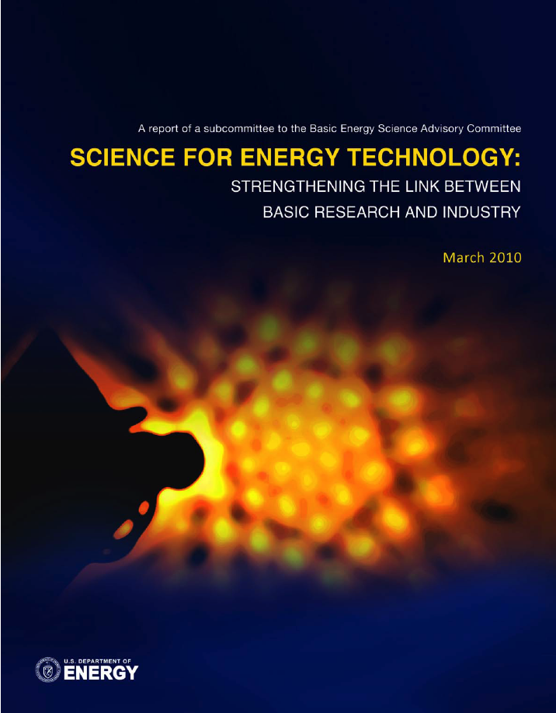
Science for Energy Technology:
Strengthening the Link Between Basic Research And Industry
Two kinds of science contributions:
  1. “Supernovas” – breakthroughs that change technical landscape
    High temperature superconductivity in 1986
  2. Understanding and ultimately controlling existing phenomena
    Complex materials and chemistry at the nanoscale
    Mechanisms of “droop” in high current solid state lighting
    Development of carbon sequestration plumes
    Conversion among photons, electrons and chemical bonds
SciTech focused on near-term industry impact
  Emphasize sustained building of scientific knowledge base underlying technology, like Moore’s Law: series of incremental breakthroughs changes the game
Notes:
Each workshop had three common goals: (1) to summarize, prior to the workshop, the current state of technology and the associated R&D challenges in a Technology Perspectives Factual Document, which was used as a resource document for the basic research community at the workshop and well into the future; (2) to define a set of proposed research directions that address the technology R&D challenges, the so-called technology show stoppers; and (3) to define a set of grand challenges that, if solved, might result in transformational changes in energy technologies. The DOE technology offices participated in the plenary sessions of these workshops to provide perspectives of their programs along with their current targets, goals, and milestones; and often assisted in preparing the technology perspective factual documents prior to the workshops.

Slide 33
END

