Slide 1

Energy Facts:
Energy challenges in a new era of science
University of Chicago
5 November 2013
Patricia M. Dehmer
Acting Director, Office of Science, U.S. Department of Energy
http://science.energy.gov/sc-2/presentations-and-testimony/

Slide 2
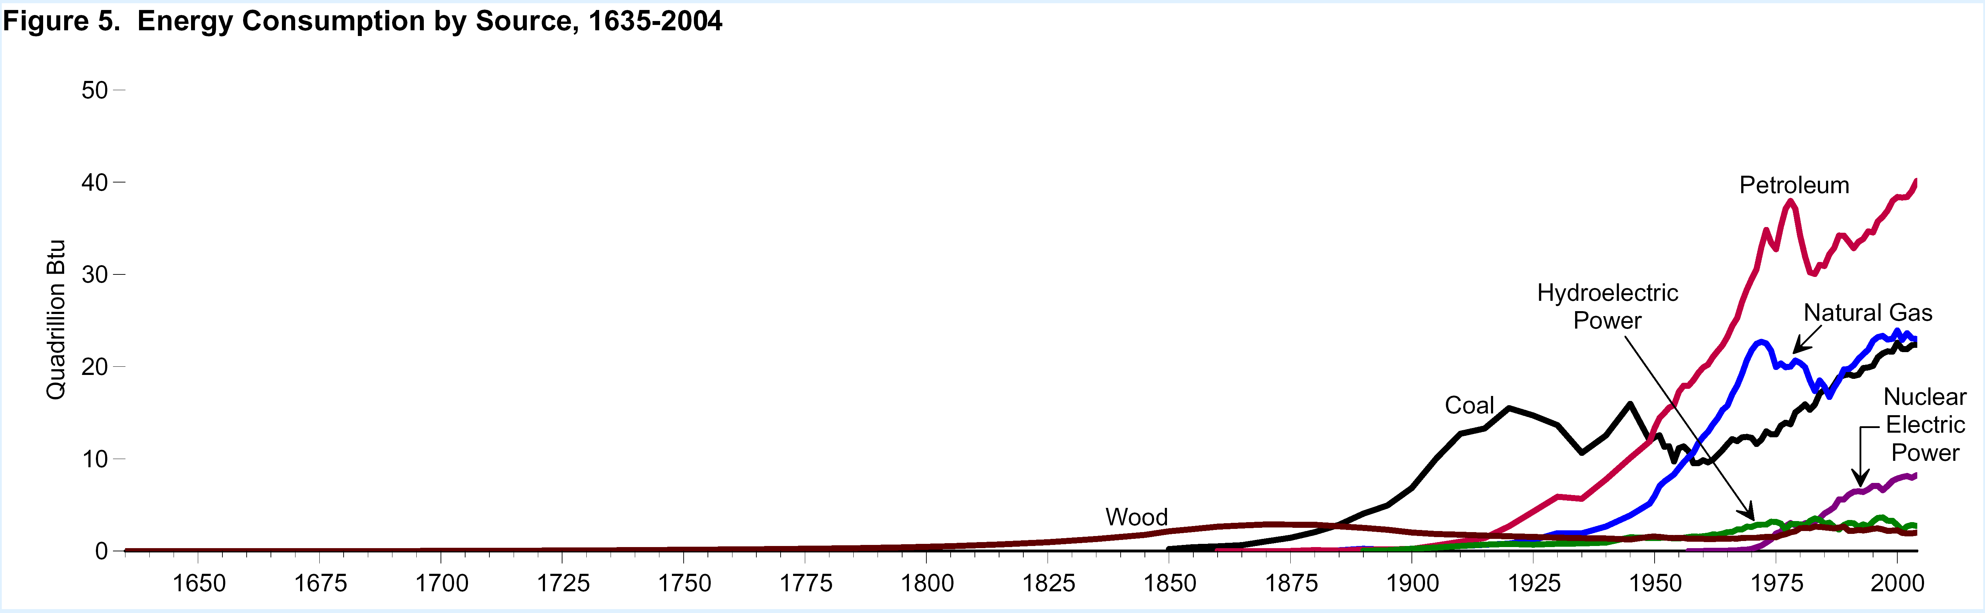
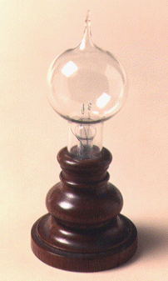
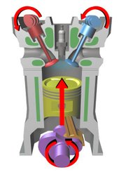
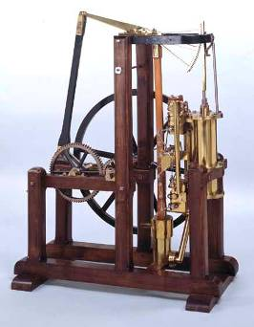
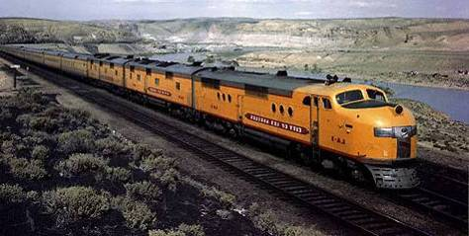
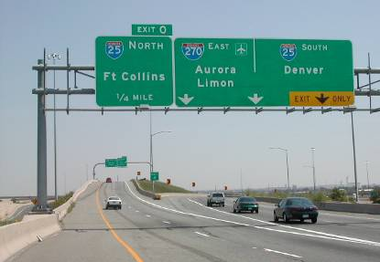
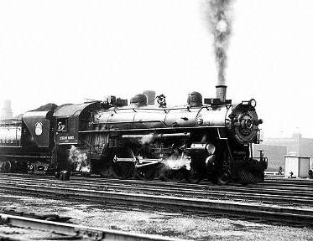
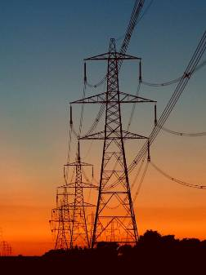
400 Years of Energy Use in the U.S.
19th C discoveries and 20th C technologies are very much part of today’s infrastructure
Still >80% reliant on fossil fuels
40
Petroleum
40
U.S. Energy Consumption by Source
30
30
Hydroelectric
Power
Natural Gas
Quadrillion Btu
Quadrillion Btu
20
20
Coal
Nuclear Electric Power
Incandescent lamp,
1870s
Four-stroke combustion engine, 1870s
10
10
Wood
Watt Steam Engine, 1782
0
0
1650
1700
1750
1800
1850
1900
1950
2000
Rural Electrification Act,
1935
Intercontinental Rail System, mid 1800s
Eisenhower Highway System, 1956

Slide 3
Sustainable Energy = High Tech Materials
Materials, Chemical Transformations, & Biology by (Computer-Aided) Design
Today
Gas CH₄
Oil CH₂
Coal CH_{0.8}
useful work
combustion
heat
Disposable fuels
Commodity materials
Future
direct conversion
Sunlight
Wind
Water
Geothermal
Biomass
+
Storage
Transmission
CCS
Efficiency
Electricity
and
fuels
useful work
High-tech materials, chemistry, biology, e.g., for photovoltaics, electrodes and electrolytes, smart membranes, separators, superconductors, catalysts, fuels, sensors, and novel piezoelectrics
3

Slide 4
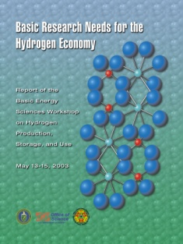
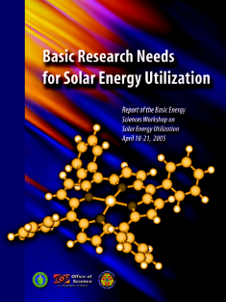
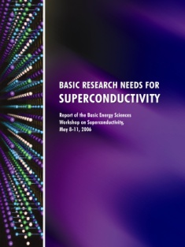
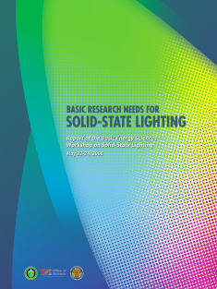
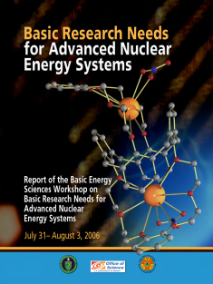
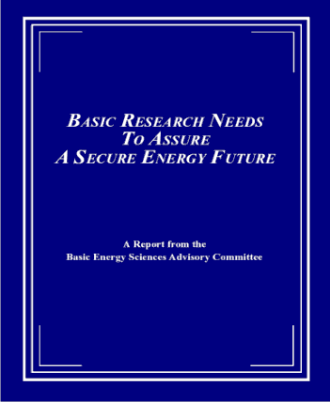
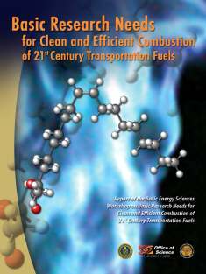
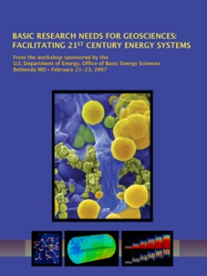
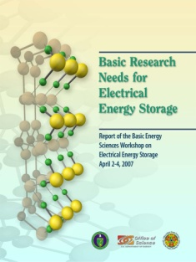
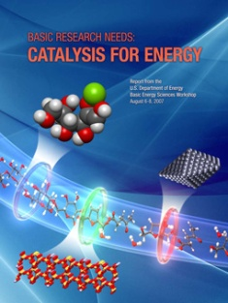
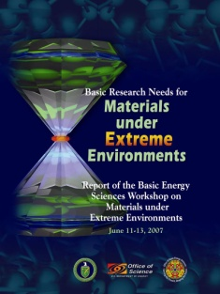
The “Basic Research Needs” Series
10 workshops; 5 years; more than 1,500 participants from academia, industry, and DOE labs
Control of materials properties and functionalities through atomic design: Science at the nanoscale
Designer catalysts, interfaces, membranes, bio-materials, …
Engineered microbes
Discovery, design, and synthesis of new materials, especially those that perform well under extreme conditions
New tools for atomic-level characterization and for computational modeling
Notes:
CHARACTERISTICS OF A BASIC RESEARCH NEEDS WORKSHOP
Each workshop has three goals: (1) to summarize, prior to the workshop, the current state of technology and the associated R&D challenges in a Technology Perspectives Factual Document, which is used as a resource document for the basic research community at the workshop and well into the future; (2) to define a set of Proposed Research Directions that address the technology R&D challenges, the so-called technology show stoppers; and (3) to define a set of Science Grand Challenges that, if solved, might result in transformational changes in energy technologies.
The Basic Research Needs workshops must accomplish a great deal in a short time and their output must be authoritative, influential, and enduring. To accomplish the goals, the workshop planning, execution, and output stages are defined and structured. Ideally, each workshop report should serve as a reference document with a long shelf life. Additionally, the reports should be readily accessible. All reports are available on the BES website (http://www.sc.doe.gov/bes), usually within 60-75 days of the workshop.
The workshops are structured so that the participants learn about the status and challenges of a particular energy technology, generate proposed basic research directions to address short-term technology showstoppers, and articulate basic research grand challenges that might lead to transformational changes in energy technologies for the 21st century and beyond. The workshop reports that result from this process can help define the basic research agenda for a “decades-to-century” national energy agenda.
Workshop planning begins many months in advance and is performed by the workshop executive group, which is led by strong scientist chairs and co-chairs from academia and/or national laboratories. The executive group is made up of the workshop chair, co-chair(s), and panel leads. Participants come primarily from the scientific community and include the workshop chair(s), plenary speakers, panel leads, panelists, and writers. Each role is assigned tasks to complete before, during, and after the workshop. Technology experts serve as plenary speakers to provide applied perspectives to the scientific community.
A hallmark of the Basic Research Needs workshops is the production of the Technology Perspectives Factual Document. This feature describes the current status of technology development and is prepared prior to the workshop. It provides a common context and language for workshop discussions, it is used to educate workshop participants, and it becomes part of the workshop report. The Technology Perspectives Factual Document is written by technology experts from inside and outside DOE. If existing material is available (for example, technology roadmaps), it is included either explicitly or by reference. The Technology Perspectives Factual Document is not meant to provide the perspectives of the science community. Instead, science perspectives are garnered as an outcome of the workshop.
The outputs of the workshop are organized as (1) Panel Surveys describing the current state of science for each panel theme, (2) Priority Research Directions and Cross-Cutting Research Directions listed by each panel, (3) Science Grand Challenges outlined by all participants, and (4) Science and Technology Relationships Charts completed by the participants.
The result is a prioritization of the discovery-class and use-inspired basic research pertinent to energy technologies, obtained through a documented process. Often after the workshop, the chair and co-chair(s) and BES federal staff members participate in outreach activities to communicate the results of the workshop to the scientific community. Additionally, BES federal staff members brief other interested parties in the federal system, both inside and outside of DOE.

Slide 5
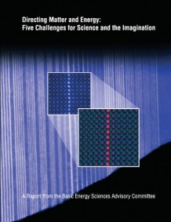
Grand Challenge Questions in Materials and Chemistry
Synthesize, atom by atom, new forms of matter with tailored properties
Synthesize nanoscale objects with capabilities rivaling those of living things
Control the quantum behavior of electrons in materials
Control emergent properties that arise from the complex correlations of atomic and electronic constituents
Control matter far from equilibrium

Slide 6
Banishing fear of
energy discussions

Slide 7
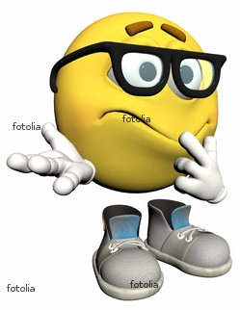
Fear of Too Many Energy Units
BTU .. quad .. boe .. bboe .. toe .. tce .. Joule .. therm .. thermie .. calorie ..
“toe”
“quads”
7

Slide 8
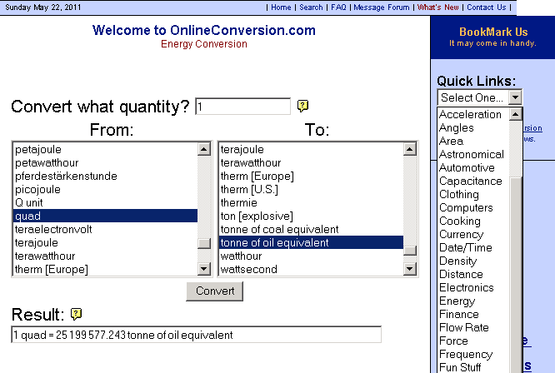
On-Line Energy Conversion Calculators Banish Fear of Units
8

Slide 9
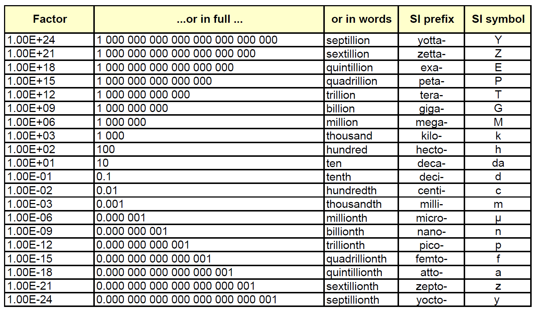
Prefixes and Names for Large and Small Numbers

Slide 10
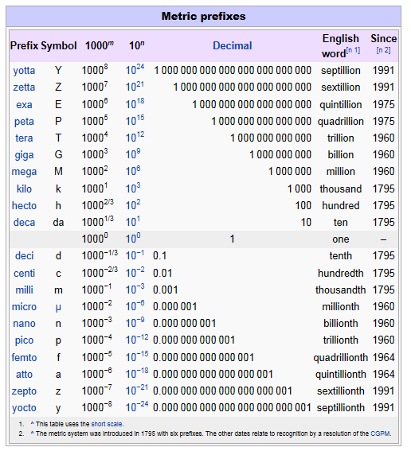
Metric Prefixes
10

Slide 11
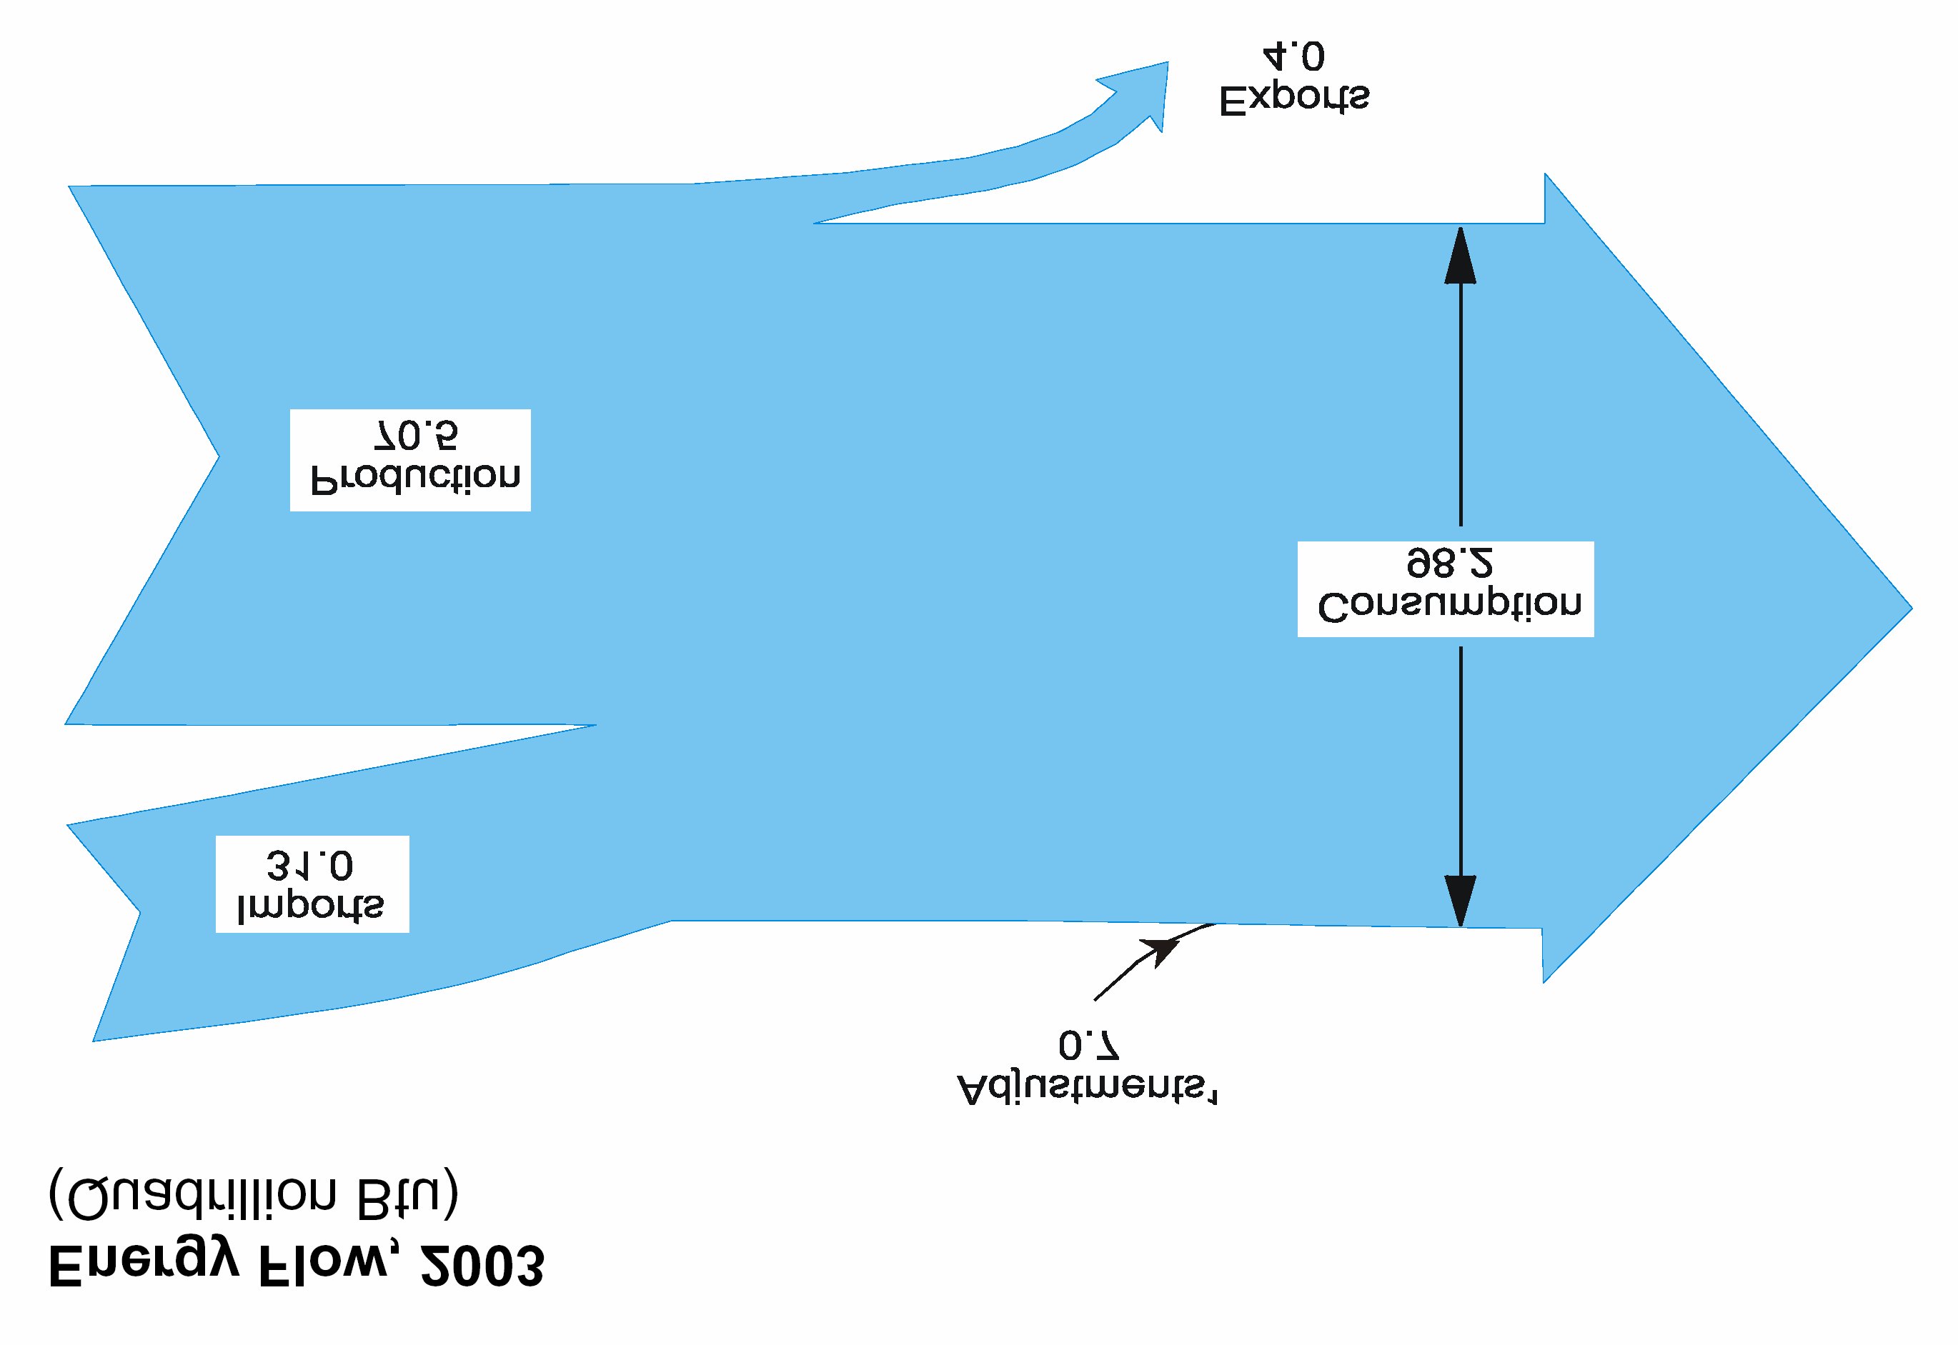

Energy sources and consumption sectors in the U.S.
Sankey Diagrams

Slide 12
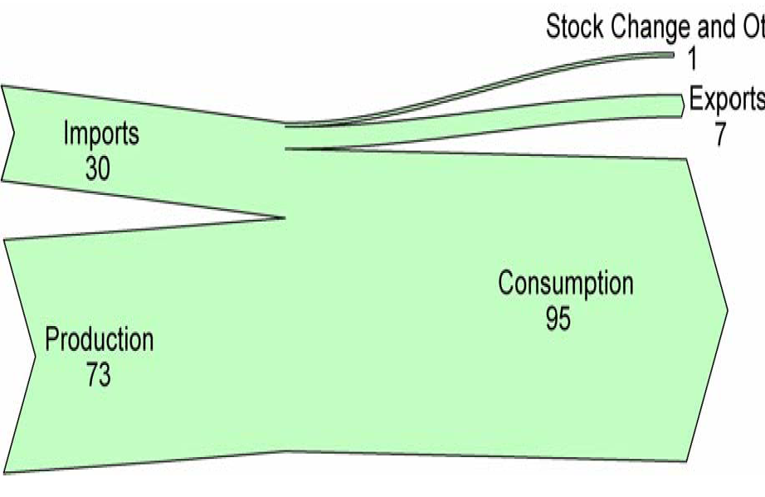
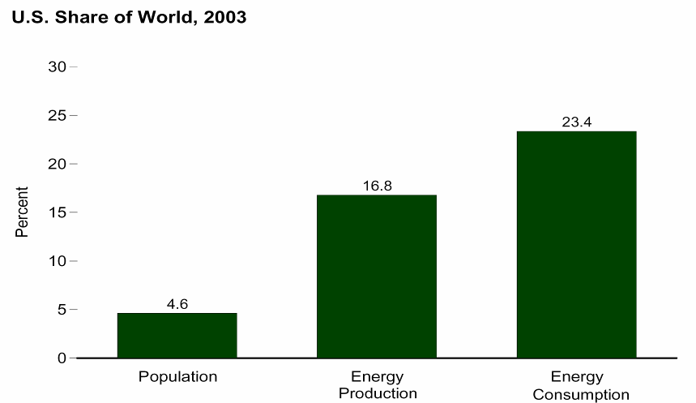
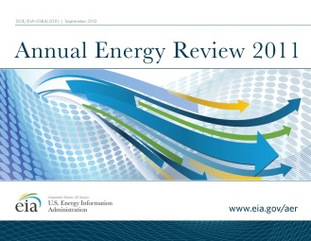
U.S. Energy Flow, 2012
About 30% of U.S. primary energy is imported
Adjustments: -1
Exports:
10.4 Quads
Imports:
28.6 Quads
Consumption:
97.3 Quads
Energy Supply (Quads)
Energy Consumption
Domestic
Production:
78.1 Quads
U.S. Share of World, 2007
21.0%
15.0%
4.6%
12
Population
Energy
Production
Energy
Consumption

Slide 13
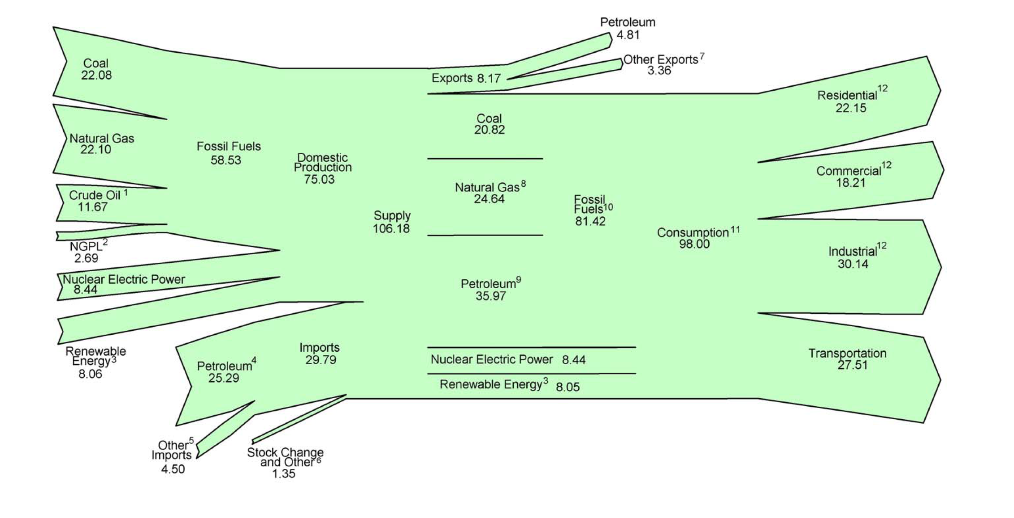
U.S. Energy Flow, 2011 (Quads)
>80% of primary energy is from fossil fuels
Coal
Exports
Residential
Coal
Natural Gas
Domestic
73%
Commercial
Supply
108
Quads
Natural Gas
Fossil
82%
Consume
98
Quads
Crude Oil
NGPL
Industrial
Nuclear Electric Power
Petroleum
Renewable Energy
Imports
27%
Nuclear 9%
Transportation
Petroleum
Nuclear Electric Power
Renewable Energy
Renewable 9%
13

Slide 14
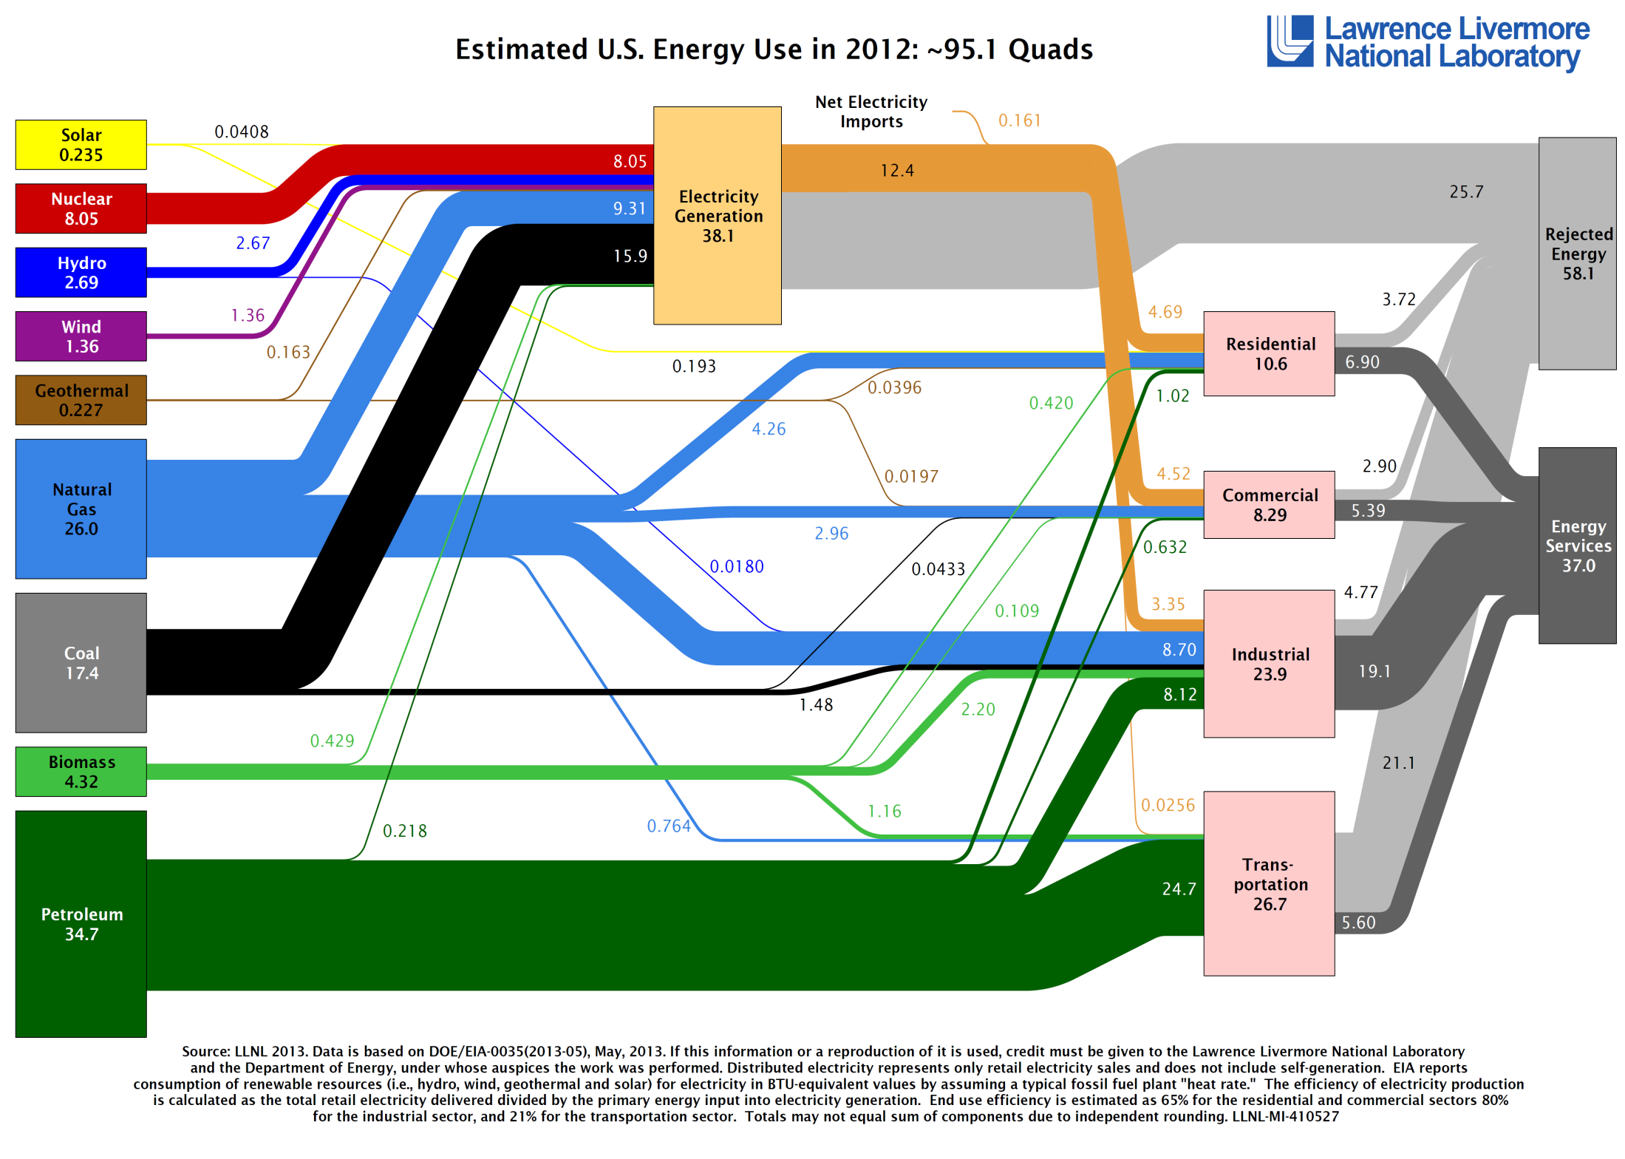
U.S. Energy Production and Use in 2012
Estimated Energy Use: ~95.1 Quads
14
Notes:
“Zero Carbon Energy”

Slide 15
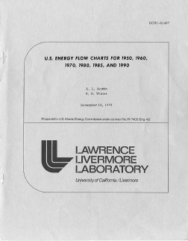
U.S. Energy Flow, 1950 (Quads)
At midcentury, the U.S. used 1/3 of the primary energy used today and with greater overall efficiency
Today compared to 1950:
U.S. population ~2x that in 1950
Total primary energy ~3x that in 1950
Primary energy (petroleum) for transportation ~4x that in 1950
Primary energy for electricity generation ~10x that in 1950
Little or no imported petroleum in 1950
“Used” and “Wasted” energy were about equal in 1950
(Today: “Wasted” energy = 1.5x “Used” energy)
15

Slide 16
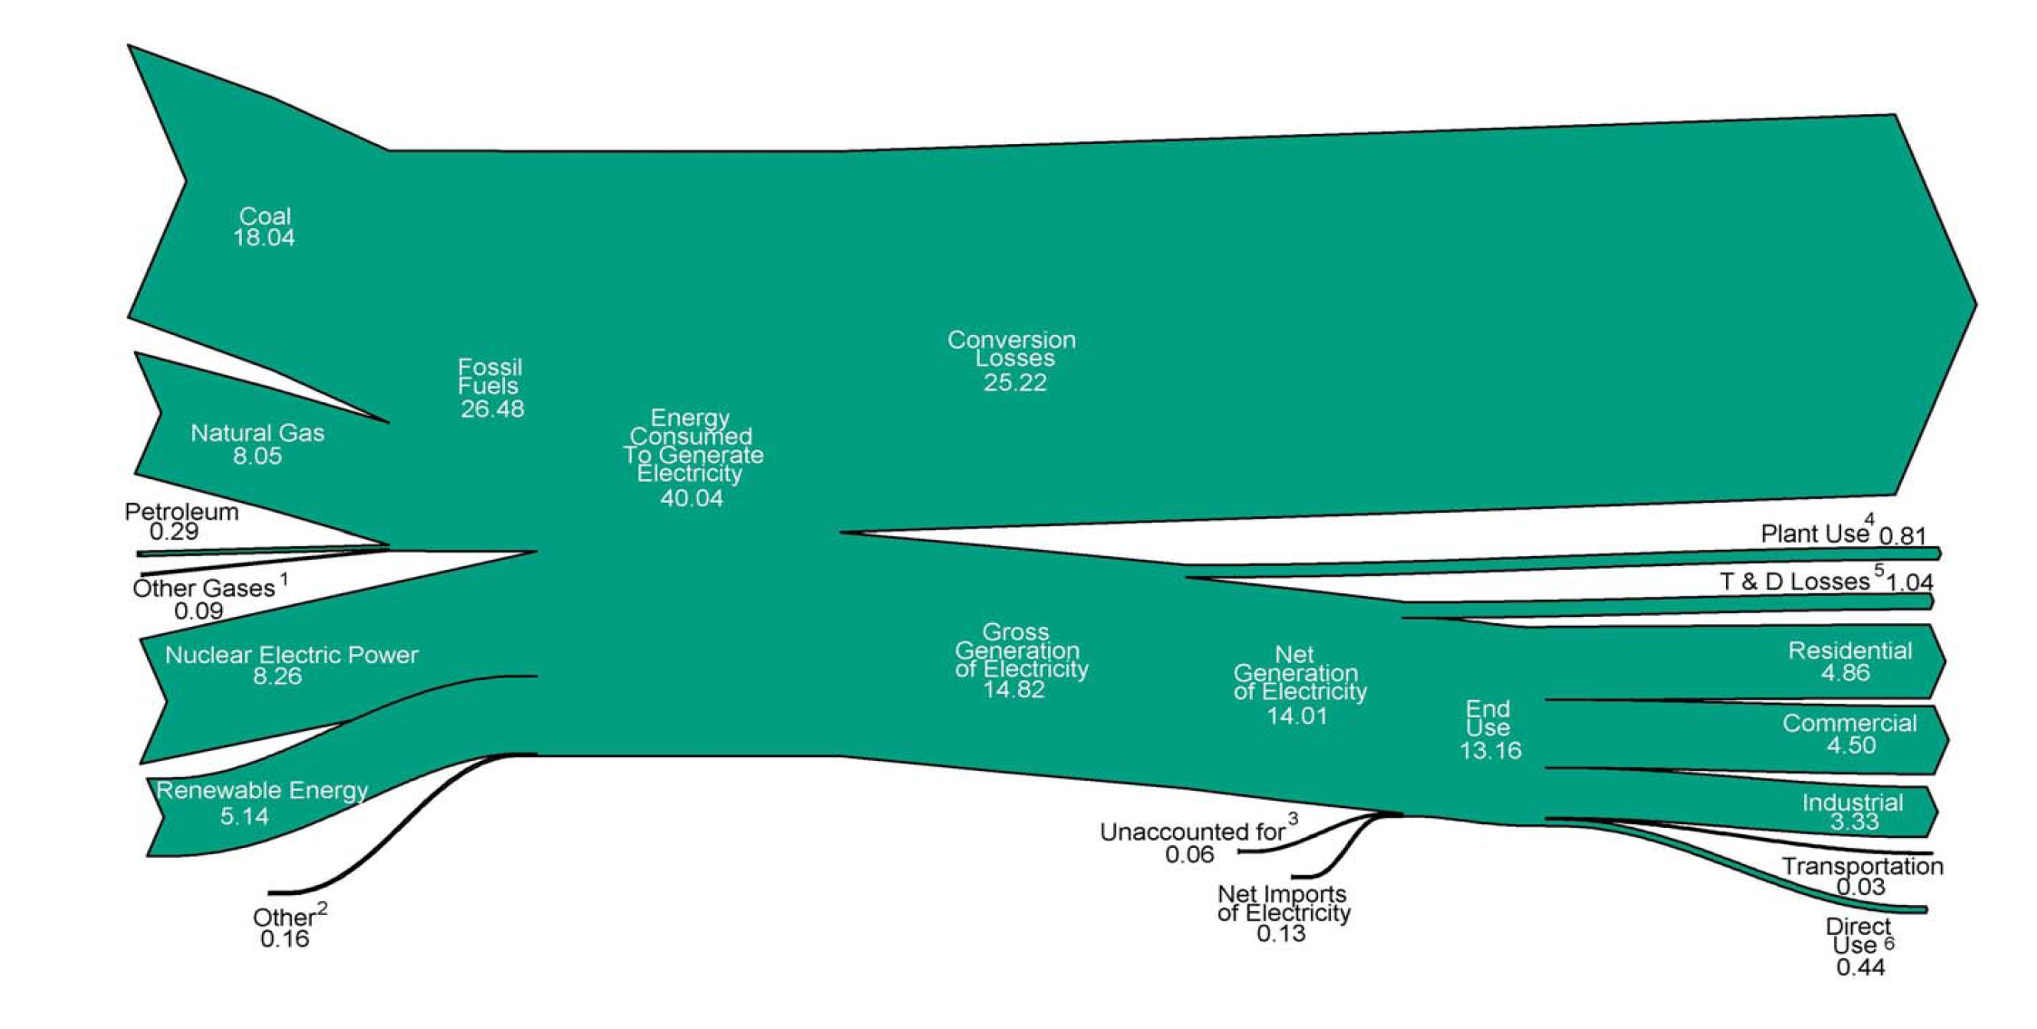

Electricity Sources and End Uses
Energy Consumed to
Generate Electricity
40 Quads
Conversion Losses
25 Quads
Gross Generation
15 Quads
Residential
Commercial
Industrial
16

Slide 17
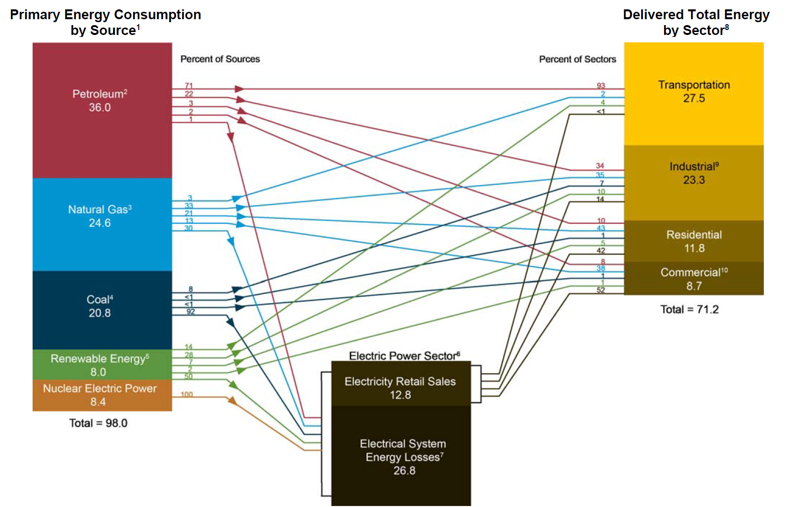

Summary of Sources and Consumption Sectors (Quads)
17

Slide 18
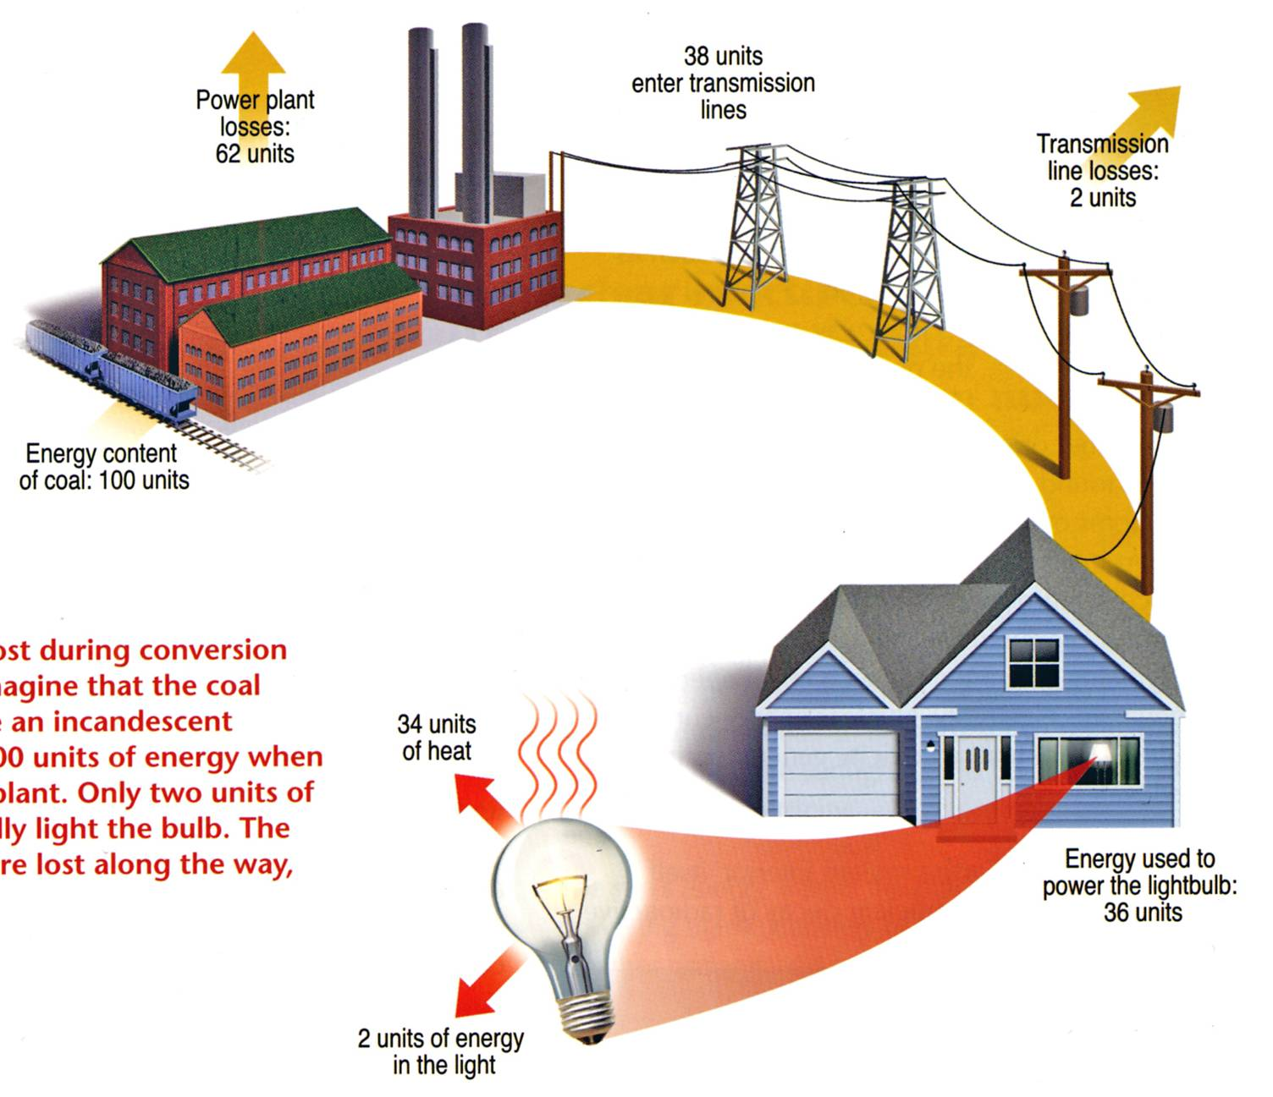
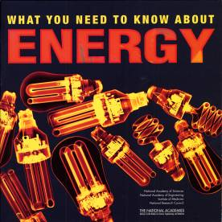
Overall Efficiency of an Incandescent Bulb ≅ 2%
Lighting accounts for 22% of all electricity usage in the U.S.
Energy content of coal: 100 units
The Energy Independence and Security Act of 2007 requires light bulbs be 30% more energy efficient (similar to current halogen lamps) than current incandescent bulbs by 2012 to 2014. The efficiency standards start with 100-watt bulbs in January 2012 and end with 40-watt bulbs in January 2014. By 2020, all general-purpose bulbs must produce at least 45 lumens per watt (similar to current CFLs).
Example of energy lost during conversion and transmission. Imagine that the coal needed to illuminate an incandescent light bulb contains 100 units of energy when it enters the power plant. Only two units of energy eventually light the bulb. The remaining 98 units are lost along the way, primarily as heat.
Question: Do you know how many light bulbs are in your house?
2 units of energy
in light output
18

Slide 19
World energy consumption

Slide 20
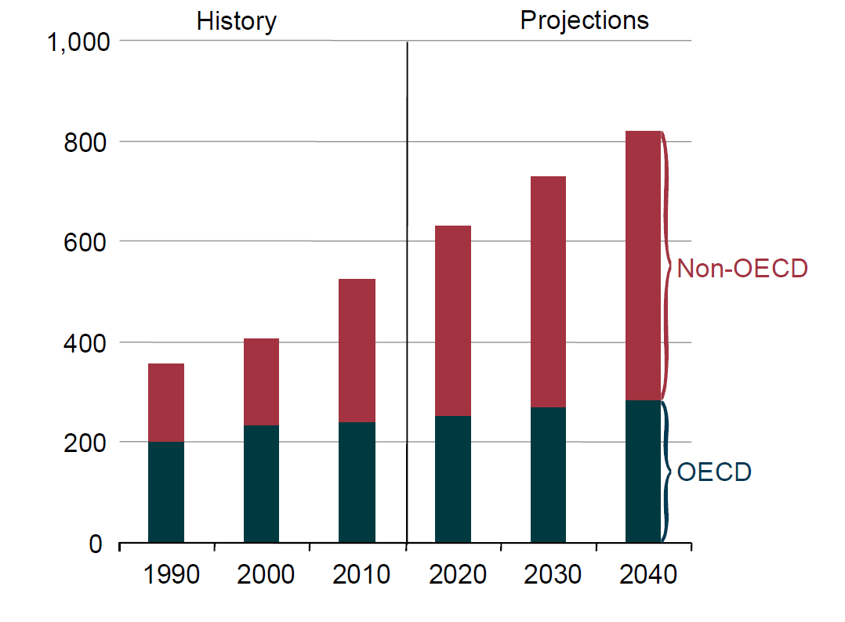

World Energy Consumption 1990-2040 (Quads)
Some equivalent ways of referring to the energy used by the U.S. in 1 year (approx. 100 Quads)
100.0 quadrillion British Thermal Units (Quads) U.S. & British unit of energy
105.5 exa Joules (EJ) Metric unit of energy
3.346 terawatt-years (TW-yr) Metric unit of power (energy/sec)x(#seconds in a year)
Energy Facts 2013
20

Slide 21
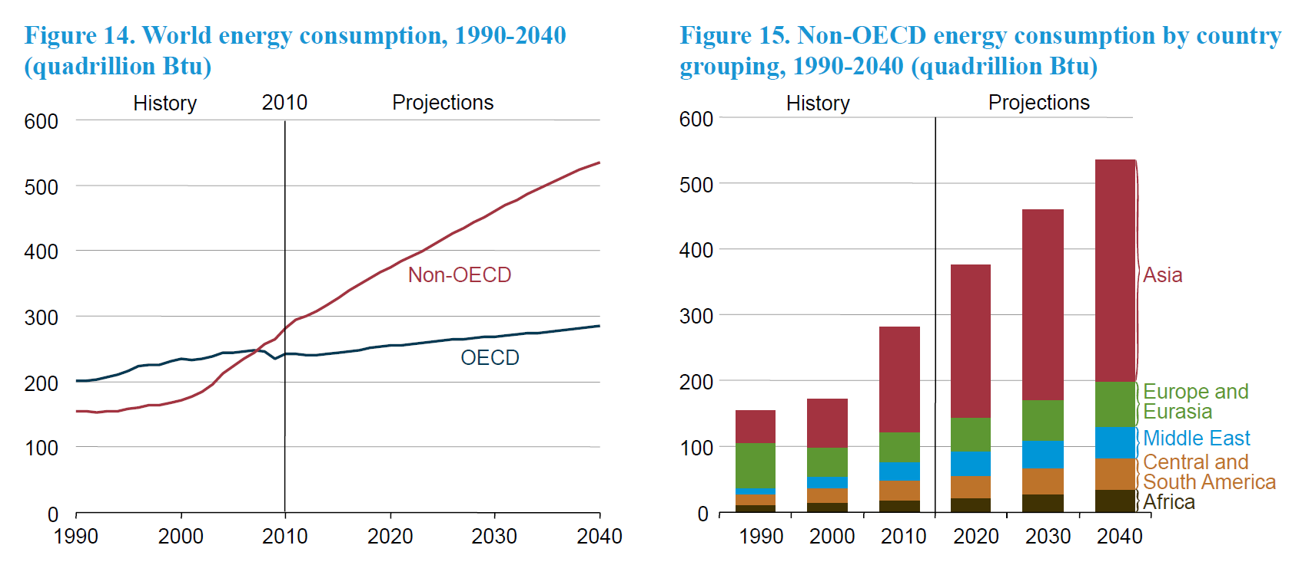
Growth in Global Energy Consumption Occurs
Almost Exclusively in non-OECD Countries
World energy consumption, 1990-2040 (Quads)
Non-OECD energy consumption by country grouping, 1990-2040 (Quads)
Some equivalent ways of referring to the energy used by the U.S. in 1 year (approx. 100 Quads)
100.0 quadrillion British Thermal Units (Quads) U.S. & British unit of energy
105.5 exa Joules (EJ) Metric unit of energy
3.346 terawatt-years (TW-yr) Metric unit of power (energy/sec)x(#seconds in a year)
21

Slide 22
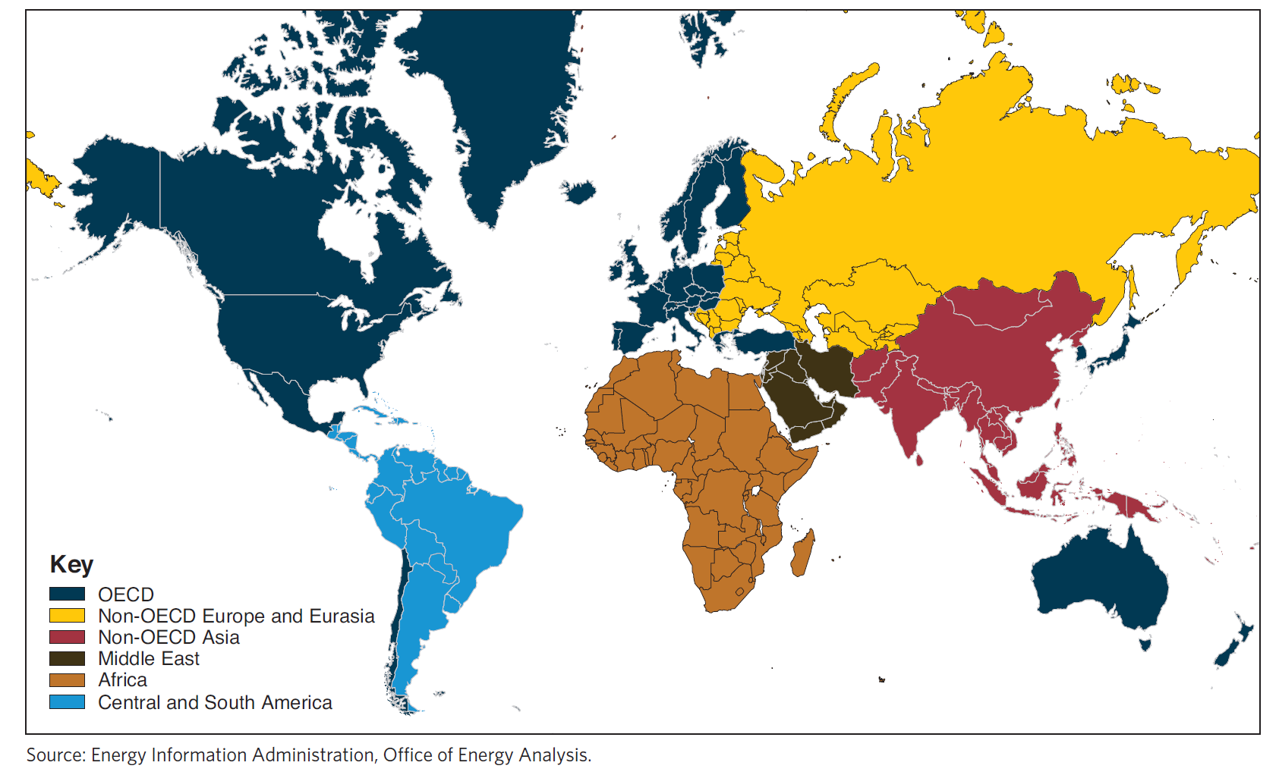

World Regions and OECD Member Countries
The OECD is a forum of countries committed to democracy and the market economy, providing a setting to compare policy experiences, seek answers to common problems, identify good practices, and co-ordinate domestic and international policies. Twenty countries signed the Convention on the OECD on 14 December 1960; twelve additional countries have joined since.
22

Slide 23
OECD Member Countries
AUSTRALIA: 7 June 1971
AUSTRIA: 29 September 1961
BELGIUM: 13 September 1961
CANADA: 10 April 1961
CHILE: 7 May 2010
CZECH REPUBLIC: 21 December 1995
DENMARK: 30 May 1961
FINLAND: 28 January 1969
FRANCE: 7 August 1961
GERMANY: 27 September 1961
GREECE: 27 September 1961
HUNGARY: 7 May 1996
ICELAND: 5 June 1961
IRELAND: 17 August 1961
ITALY: 29 March 1962
JAPAN: 28 April 1964
KOREA: 12 December 1996
LUXEMBOURG: 7 December 1961
MEXICO: 18 May 1994
NETHERLANDS: 13 November 1961
NEW ZEALAND: 29 May 1973
NORWAY: 4 July 1961
POLAND: 22 November 1996
PORTUGAL: 4 August 1961
SLOVAK REPUBLIC: 14 December 2000
SLOVENIA: 21 July 2010
SPAIN: 3 August 1961
SWEDEN: 28 September 1961
SWITZERLAND: 28 September 1961
TURKEY: 2 August 1961
UNITED KINGDOM: 2 May 1961
UNITED STATES: 12 April 1961
OECD MEMBER COUNTRIES
Twenty countries originally signed the Convention on the Organisation for Economic Co-operation and Development on 14 December 1960. Since then twelve countries have become members of the Organisation. The Member countries of the Organisation and the dates on which they deposited their instruments of ratification are:
23

Slide 24
Energy needs in the 21st century
U.S.
?
~100 Quads
World
?
~500 Quads

Slide 25
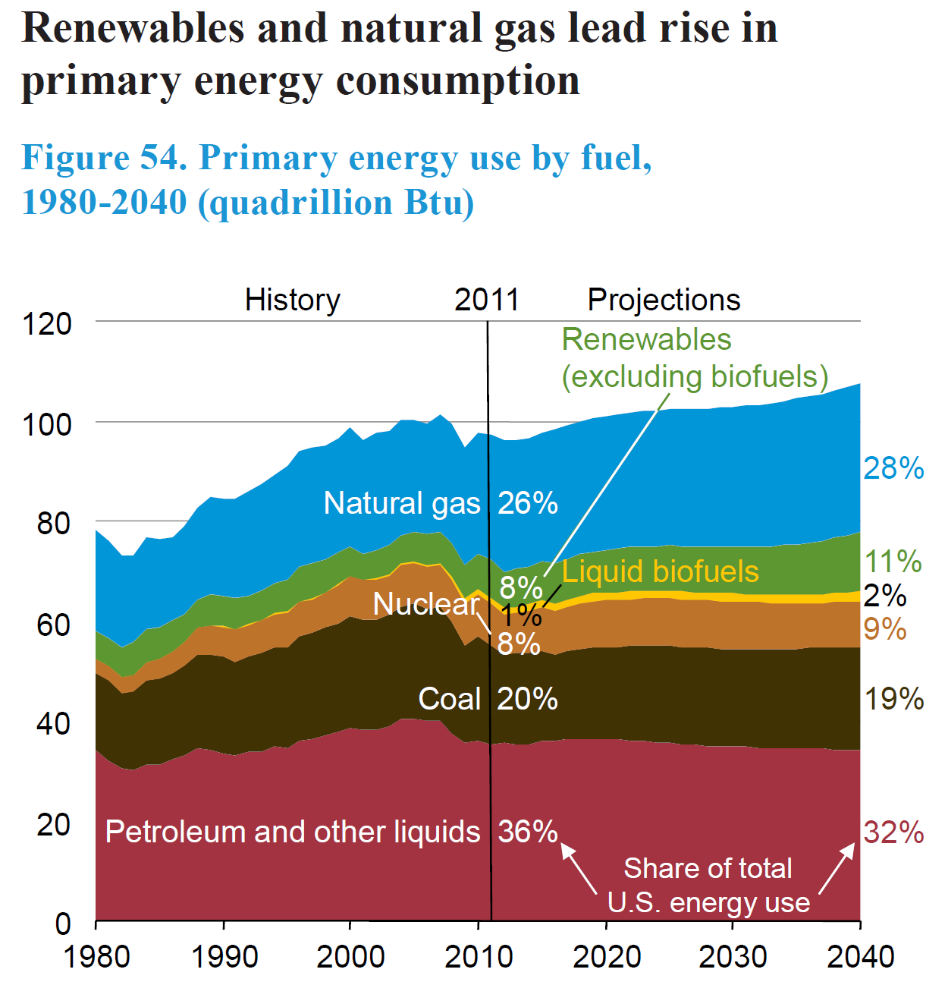
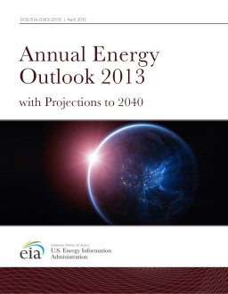
U.S. Primary Energy Use by Fuel 1980-2040
Renewables and natural gas lead rise in primary energy consumption
Quads
25

Slide 26
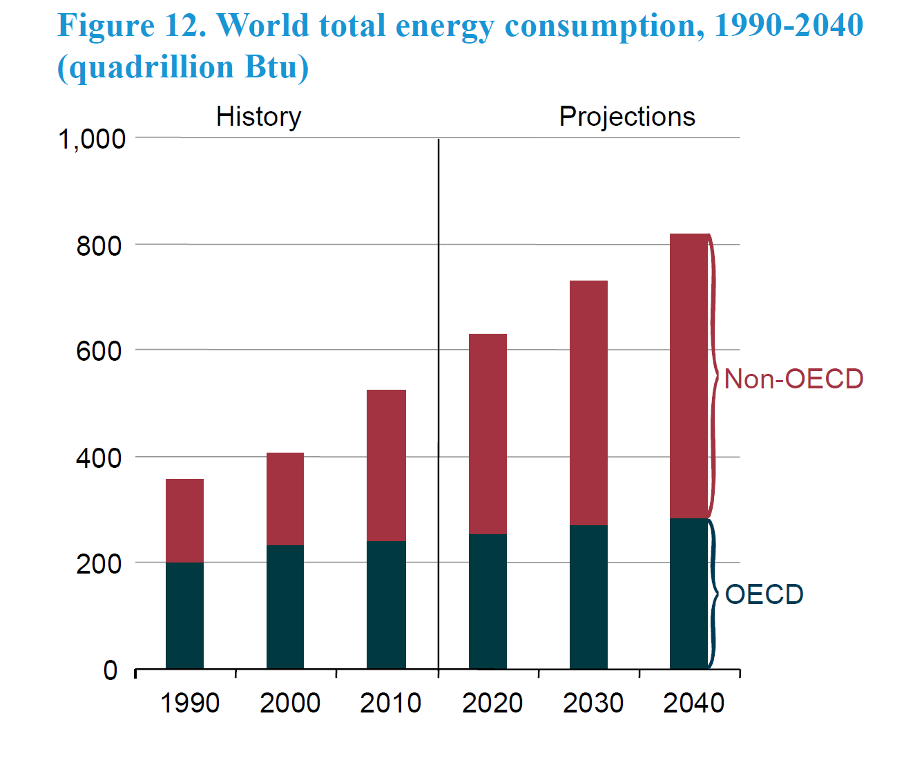
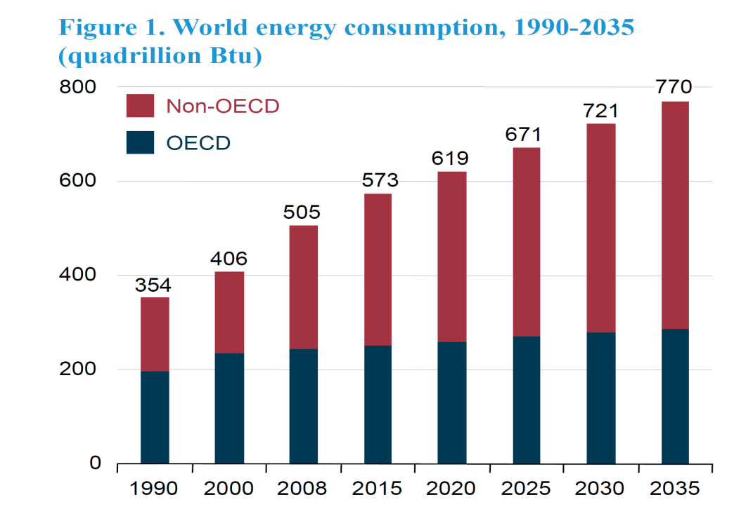

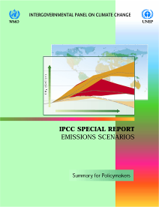
World Energy Needs will Grow in the 21st Century
World energy consumption (Quads)
1,286
Projections to 2035 are from the Energy Information Administration, International Energy Outlook, 2010.
Projections for 2050 and 2100 are based on a scenario from the Intergovern-mental Panel on Climate Change (IPCC), an organization jointly established in 1988 by the World Meteorological Organization and the United Nations Environment Programme. The IPCC provides comprehensive assessments of information relevant to human-induced climate change. The scenario chosen is based on “moderate” assumptions (Scenario B2) for population and economic growth and hence is neither overly conservative nor overly aggressive.
826
2050
2100
26

Slide 27
Fossil fuels
Coal 21%
Nuclear 9%
Petroleum 37%
Renewables 8%
Natural Gas 25%

Slide 28
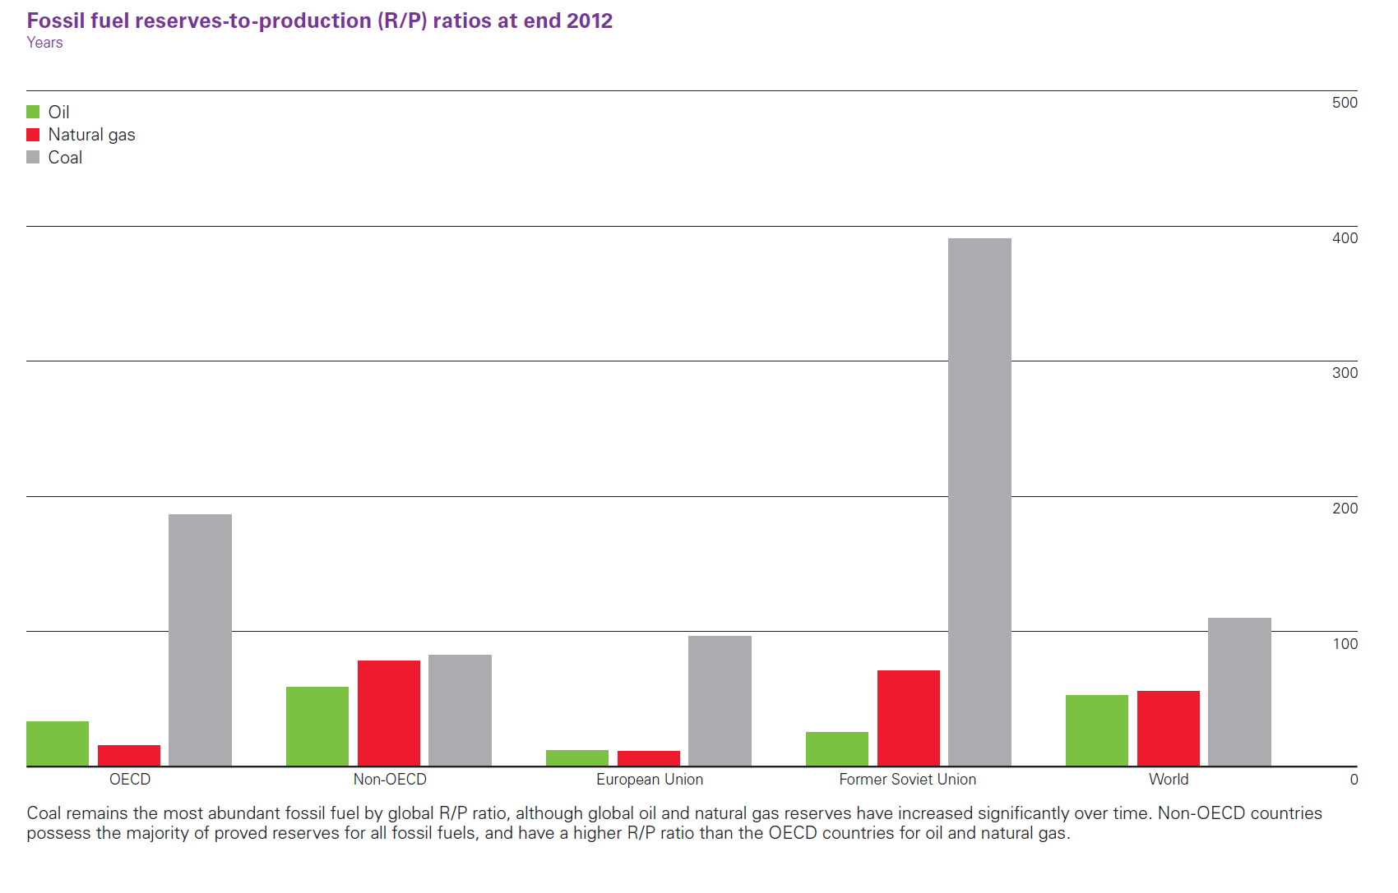
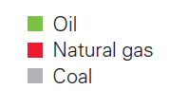

Fossil Fuel Supplies are Estimated using
Reserves-to-Production (R/P) Ratios
500
The R/P ratio is the number of years that proved reserves would last at current production rates.
400
300
Proven World Reserves-to-Production Ratio at End 2012 (Years)
200
100
OECD
Non-OECD
European Union
Former Soviet Union
World
28
Notes:
“BP Statistical Review of World Energy 2005,” http://www.bp.com/liveassets/bp_internet/globalbp/globalbp_uk_english/publications/energy_reviews_2005/STAGING/local_assets/downloads/pdf/statistical_review_of_world_energy_full_report_2005.pdf
Slide Courtesy: Steven E. Koonin, Chief Scientist, BP, plc

Slide 29
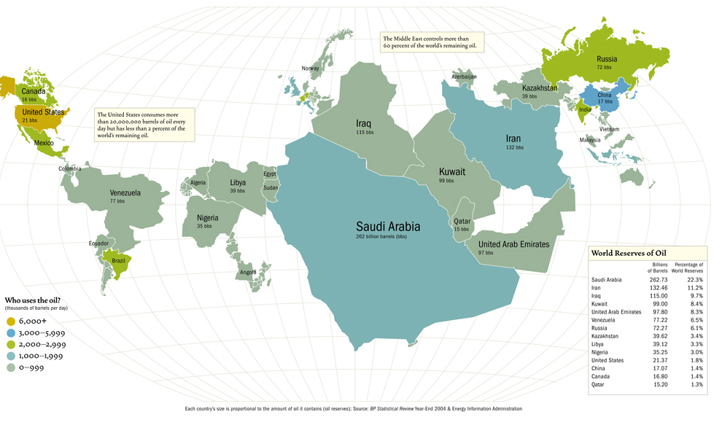
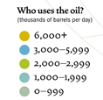
World Reserves of Oil
There is a significant dislocation between fossil fuel supply and demand
Who uses the oil?
(thousands of barrels per day)
(http://www.energybulletin.net/37329.html)
29
Notes:
“BP Statistical Review of World Energy 2005,” http://www.bp.com/liveassets/bp_internet/globalbp/globalbp_uk_english/publications/energy_reviews_2005/STAGING/local_assets/downloads/pdf/statistical_review_of_world_energy_full_report_2005.pdf
Slide Courtesy: Steven E. Koonin, Chief Scientist, BP, plc

Slide 30
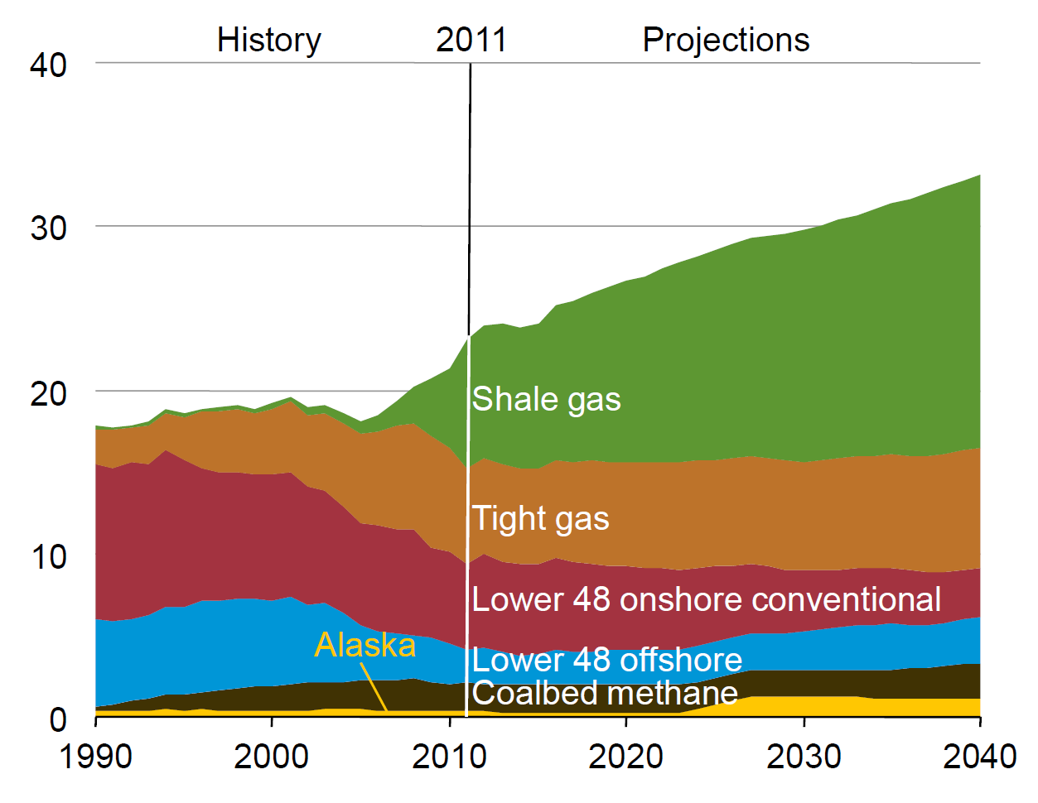
U.S. Natural Gas Production Showing Increase in Shale Gas
Trillion cubic feet per year
30

Slide 31
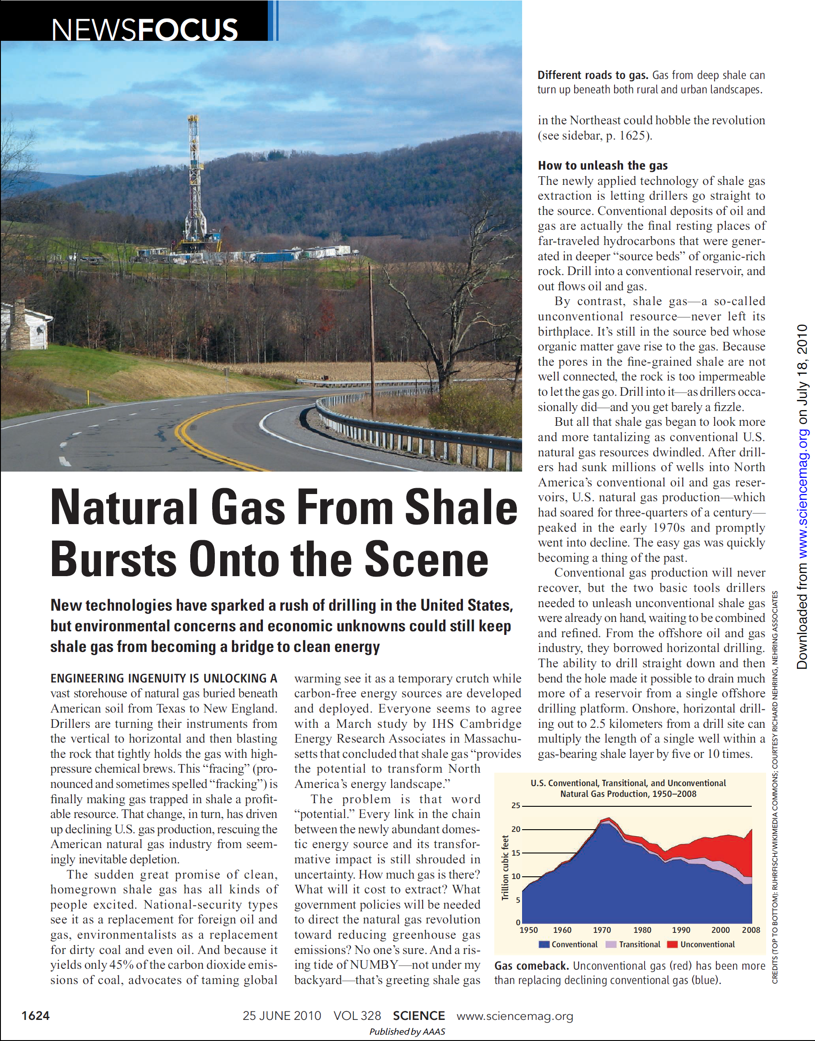
Unconventional Gas: Shale Gas

Slide 32
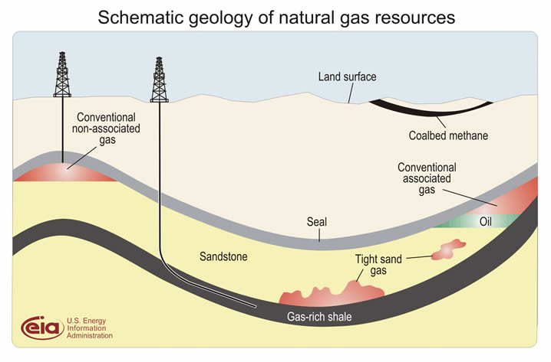
Tight Gas vs. Shale Gas
32

Slide 33
Nuclear energy
Coal 21%
Nuclear 9%
Petroleum 37%
Renewables 8%
Natural Gas 25%

Slide 34




Permits for U.S. Reactors Issued Only Until 1979
8.4 quads of nuclear energy produced by 104 operable nuclear power plants
300
Units Ordered
250
200
Construction Permits Issued
Number of Units
150
Full-power Operating Licenses
100
Operable Units
50
Shutdowns
0
1955
1960
1965
1970
1975
1980
1985
1990
1995
2000
Year
34

Slide 35




Nuclear Energy Provides 20% of U.S. Electricity
Europe and Japan rely much more heavily on nuclear energy for electricity generation
35

Slide 36
Renewables
Coal
20%
Nuclear 8%
Petroleum 36%
Renewables 9%
Natural Gas 26%

Slide 37







Nuclear and Renewable are ~17% of Energy Supply
Hydroelectric and wood still dominate the renewable energies
Coal
20%
Nuclear 8%
Petroleum 36%
Renewables 9%
Natural Gas 26%
37

Slide 38

Renewable Energy Consumption and Major Sources
38

Slide 39

Generation and Use of Wind and Solar Energy
Separation between renewable sources and demand centers requires new long distance transmission lines.
Demand
Wind
Demand
Sun
Wind
39
http://visibleearth.nasa.gov/view_rec.php?id=1438l
Chart adapted from the American Physical Society report, Integrating Renewable Energy on the Grid

Slide 40





Energy and the environment

Slide 41

How do the Earth's land, water, air, and life interact to affect the environment?
41

Slide 42

Modern CO₂ Concentrations are Increasing
The current concentration is the highest in 800,000 years, as determined by ice core data
Concentration now ~395 ppm. Under a “business-as-usual” scenario, concentration could rise to 1,000 ppm
Concentration prior to 1800 was ~280 ppm
Monthly mean atmospheric carbon dioxide at Mauna Loa Observatory, Hawaii. The carbon dioxide data (red curve) are the longest record of direct measurements of CO₂ in the atmosphere. Begun by C. David Keeling of the Scripps Institution of Oceanography in March of 1958, they have been continued by NOAA since May of 1974. The black curve is the seasonally corrected data.
42

Slide 43

Bubbles – 800,000 Years of CO₂ Concentrations
Nature, 15 May 2008 The air bubbles trapped in the Antarctic Vostok and EPICA Dome C ice cores provide composite records of levels of atmospheric carbon dioxide and methane for the past 800,000 years.
The fundamental conclusion is that today's concentrations of these greenhouse gases have no past analogue in the ice-core record. Concentrations do not rise above pre-industrial revolution values.
The general long-term behavior of methane and carbon dioxide, following patterns driven by slow changes in Earth's orbit, continues throughout the older sections of the records.
43

Slide 44
CO₂ Concentrations and Temperature
The correlation extends throughout the 800,000-year time span of the ice core data
a The 800,000-year records of atmospheric carbon dioxide (red; parts per million, p.p.m.) and methane (green; parts per billion, p.p.b.) from the EPICA Dome C ice core together with a temperature reconstruction (relative to the average of the past millennium) based on the deuterium–hydrogen ratio of the ice, reinforce the tight coupling between greenhouse-gas concentrations and climate observed in previous, shorter records. Concentrations of greenhouse gases in the modern atmosphere are highly anomalous with respect to natural greenhouse-gas variations (present-day concentrations are around 380 p.p.m. for carbon dioxide and 1,800 p.p.b. for methane).
b The carbon dioxide and methane trends from the past 2,000 years.
E.J. Brook, Nature 453, 291 (2008).
44

Slide 45

Past and Future CO₂ Concentrations
IPCC Fifth Assessment Report, WG 1, Climate Change 2013: The Physical Science Basis
45

Slide 46


Past and Future CO₂ Concentrations
CO₂ concentrations are predicted to increase by a factor of two to three
395
46

Slide 47



Natural Variations in the Earth’s Orbit Affect Climate
and Greenhouse Gas Concentrations
W. F. Ruddiman, Scientific American, March 2005, p. 46
There are three orbital perturbations with five periods: eccentricity (at 400 and 100 ky); obliquity (41 ky); and precession (23 and 19 ky). (A) Eccentricity refers to the shape of Earth’s orbit around the sun, varying from near circular to elliptical. (B) Obliquity refers to the tilt of Earth’s axis relative to the plane of the ecliptic, varying between 22.1º and 24.5º. A high angle of tilt increases the seasonal contrast, most effectively at high latitudes. (C) Precession refers to the wobble of the axis of rotation describing a circle in space with a period of 26 ky. Modulated by orbital eccentricity, precession determines where on the orbit around the sun seasons occur, thereby increasing the seasonal contrast in one hemisphere and decreasing it in the other. The periods of the precessional signal modulated by eccentricity are 23 and 19 ky.
James Zachos, Mark Pagani, Lisa Sloan, Ellen Thomas, and Katharina Billups, Science 292, 4 (2001).

Slide 48

Planets, Atmospheres, and Climate
A planet's climate is determined by its mass, its distance from the sun, and the composition of its atmosphere. Earth's atmosphere is 78% nitrogen, 21% oxygen, and 1% other gases. Carbon dioxide accounts for 0.03 - 0.04%. Water vapor, carbon dioxide, and other minor gases absorb thermal radiation leaving the surface. These greenhouse gases act as a partial blanket for the thermal radiation from the surface and enable it to be substantially warmer than it would otherwise be. Without the greenhouse gases, Earth's average temperature would be roughly -20°C = -4 °F.
= -58ºF
= 59ºF
= 788 ºF
Sun
48
Notes:
A planet's climate is decided by its mass, its distance from the sun and the composition of its atmosphere. Mars is too small to keep a thick atmosphere. Its atmosphere consists mainly of carbon dioxide, but the atmosphere is very thin. The atmosphere of the Earth is a hundred times thicker. Most of Mars' carbon dioxide is frozen in the ground. Mars' average surface temperature is about -50°C. Venus has almost the same mass as Earth but a thicker atmosphere, composed of 96% carbon dioxide. The surface temperature on Venus is +460°C. Earth's atmosphere is 78% nitrogen, 21% oxygen, and 1% other gases. Carbon dioxide accounts for just 0.03 - 0.04%. Water vapour, varying in amount from 0 to 2%, carbon dioxide and some other minor gases present in the atmosphere absorb some of the thermal radiation leaving the surface and emit radiation from much higher and colder levels out to space. These radiatively active gases are known as greenhouse gases because they act as a partial blanket for the thermal radiation from the surface and enable it to be substantially warmer than it would otherwise be, analogous to the effect of a greenhouse. This blanketing is known as the natural greenhous effect. Without the greenhouse gases, Earth's average temperature would be roughly -20°C. The climates on Mars and Venus are very different, but very stable and highly predictable. The Earth's climate is unstable and rather unpredictable as compared with that of the other two planets.
Planets and atmospheres. (2000). In UNEP/GRID-Arendal Maps and Graphics Library. Retrieved from http://maps.grida.no/go/graphic/planets_and_atmospheres.

Slide 49


Solar Energy Cycle
And the Greenhouse Effect
Notes:
THE FLOW OF ENERGY THROUGH THE CLIMATE SYSTEM
A suite of papers has provided updated estimates of trends, variability, mean and annual cycle of energy flowing through the climate system, and energy storage, release, and transport in the atmosphere, ocean, and land surface. The estimates are obtained from recent observations using the latest datasets ([1]-[5]). The results indicate that the global energy budget can now be estimated reasonably well, with the largest continuing sources of uncertainty being the ocean heat budget south of about 35°S. The current imbalance in radiation at the top-of-atmosphere owing to human-induced increases in greenhouse gases means that the atmosphere, land and ocean are warming up, and ice is melting, leading to a rise in sea level. A holistic integrated approach that brings all information to bear provides constraints on what is happening and where the main weaknesses are in the current observing system. These analyses also provide insights into both top-of-atmosphere and surface balances and model problems. For instance, the results indicate that climate models typically have too much downward longwave radiation, which is compensated by too much evaporation and precipitation.
Figure: From Trenberth et al (2008) shows the estimated global mean energy flows for the 2000 to 2004 time frame.
Fasullo, J. T., and K. E. Trenberth, 2008: The annual cycle of the energy budget. Part I: Global mean and land-ocean exchanges. J. Climate, 21, 2297-2312.
Fasullo, J. T., and K. E. Trenberth, 2008: The annual cycle of the energy budget. Part II: Meridional structures and poleward transports. J. Climate, 21, 2313-2325.
Trenberth, K. E., and L. Smith, 2008: The three dimensional structure of the atmospheric energy budget: methodology and evaluation. Climate Dynamics, in press. doi:10.1007/s00382-008-0389-3.
Trenberth, K. E., and L. Smith, 2008: Atmospheric energy budgets in the Japanese Reanalysis: Evaluation and variability. J. Meteor. Soc. Japan, in press.
Trenberth, K. E., J. T. Fasullo, and J. Kiehl, 2008: Earth's global energy budget. Bull. Amer. Meteor. Soc., in press.
Several recent presentations by Trenberth may be found at http://www.cgd.ucar.edu/cas/Trenberth/trenberth_presentations.html

Slide 50

Radiation Transmitted by the Atmosphere
Atmospheric Window
50

Slide 51

Carbon Cycle
Atmosphere = 800 GtC
51

Slide 52

52

Slide 53


Simplified Schematic of the Global Carbon Cycle
IPCC Fifth Assessment Report, WG 1, Climate Change 2013: The Physical Science Basis
53

Slide 54
Proxies for Climate Change

Slide 55




Proxies for Climate Change
Preserved physical characteristics of the past that enable reconstruction of past climatic conditions. The deposition or growth rates of the proxies' material is influenced by the climatic conditions of the time in which they were laid down or grew. Examples of proxies include ice cores, tree rings, boreholes, corals, land & sea ice, and lake and ocean sediments.
55

Slide 56


56
56
Notes:
Time Magazine, Special Report on Global Warming, April 3, 2006.

Slide 57

Greenland Ice Mass Loss – 2002 to 2009
Increasing rates of ice mass loss from the Greenland and Antarctic ice sheets revealed by GRACE (Gravity Recovery and Climate Experiment) satellite
In Greenland, the mass loss increased from 137 Gt/yr in 2002–2003 to 286 Gt/yr in 2007–2009
In Antarctica, the mass loss increased from 104 Gt/yr in 2002–2006 to 246 Gt/yr in 2006–2009
Time series of ice mass changes for the Greenland ice sheet estimated from GRACE monthly mass solutions for the period from April 2002 to February 2009. Unfiltered data are blue crosses. Data filtered for the seasonal dependence using a 13-month window are shown as red crosses. The best-fitting quadratic trend is shown (green line). The GRACE data have been corrected for leakage and GIA.
I. Velicogna, GEOPHYSICAL RESEARCH LETTERS, VOL. 36, L19503, doi:10.1029/2009GL040222, 2009
57

Slide 58

Gravity Recovery and Climate Experiment (GRACE)
GRACE uses a microwave ranging system to measure changes in the speed and distance between two identical spacecraft flying about 220 kilometers apart, 500 kilometers above Earth. Separation changes as small as 10 microns—about one-tenth the width of a human hair—can be detected.
GRACE satellites can sense minute variations in Earth's gravitational pull. When the first satellite passes over a region of slightly stronger gravity, it is pulled ahead of the trailing satellite, causing the distance between the satellites to increase.
By measuring the changing distance between the two satellites and combining that data with positioning measurements from GPS instruments, a gravity map can be constructed.
58

Slide 59
How GRACE Works
GRACE uses a microwave ranging system to measure changes in the speed and distance between two identical spacecraft flying in a polar orbit about 220 kilometers apart, 500 kilometers above Earth. The ranging system can detect separation changes as small as 10 microns over a distance of 220 kilometers.
As the GRACE satellites circle the globe 16 times a day, they sense minute variations in Earth's gravitational pull. When the first satellite passes over a region of slightly stronger gravity, a gravity anomaly, it is pulled slightly ahead of the trailing satellite. This causes the distance between the satellites to increase. The first spacecraft then passes the anomaly, and slows down again; meanwhile the following spacecraft accelerates, then decelerates over the same point.
By measuring the constantly changing distance between the two satellites and combining that data with precise positioning measurements from Global Positioning System (GPS) instruments, scientists can construct a detailed map of Earth's gravity.
The two satellites (nicknamed "Tom" and "Jerry") constantly maintain a two-way microwave-ranging link between them. Fine distance measurements are made by comparing frequency shifts of the link. As a cross-check, the vehicles measure their own movements using accelerometers. All of this information is then downloaded to ground stations. To establish baseline positions and fulfill housekeeping functions, the satellites also use star cameras, magnetometers, and GPS receivers. The GRACE vehicles also have optical corner reflectors to enable laser ranging from ground stations, bridging the range between spacecraft positions and Doppler ranges.
59
Notes:
Sec. Chu has pic of two satellites; missing estimate of sea level rise; consider 14C/12C story

Slide 60
Climate Modeling

Slide 61


Types of Climate Models
Global Climate Models: Based on general circulation models (GCMS) driven by physical forcing in the atmosphere and oceans Earth System Models: Couple individual process models (e.g., atmosphere, land, ocean, sea ice, carbon, and sulfur cycles) | Integrated Assessment Models: Understand and model the complex interactions of human and natural systems Regional Models: Models at scales that are useful for regional and local planners
10km
IPCC AR5
2010
61

Slide 62
Global Climate Models
First type of climate model, pioneered by DOE supported scientists in the 1980s
Based on general circulation models (GCMs) that describe physics of atmospheric and ocean circulation
More recently, land surface and sea ice have been included in GCMs
Spatial resolution is currently 10–100 km
62

Slide 63
Earth System Models
Highly coupled models that incorporate information from GCMs as well as
  Biogeochemical cycles (carbon and sulfur)
  Atmospheric chemistry (a variety of active species)
  Land models include dynamic vegetation
  Spatial resolution is currently similar to GCMs
63

Slide 64
Integrated Assessment Models
Assessing human interactions with nature and the role of human decision-making
Scenarios involve changes in energy sources, energy policy, and economics
Current conditions
  Continental or country scales
  Strongly assumption driven
Beginning to address emerging interest in impacts, adaptation, and vulnerabilities
64

Slide 65
Regional Climate Models
Typically at scale 1–50 km
May be derived in 2 different ways:
  “Bottom up” approach incorporating regional and local scale data—adapted from regional forecast models
  “Top down” approach, downscaling from Global or Earth System model
In demand by regional and local planners
65

Slide 66

Evolution of Climate Models
✔
✔
Global Climate Models
✔
✔
✔
✔
Earth System Models
✔
✔
DOE contributions
66

Slide 67

CO₂ Concentration, Temperature, and Sea Level
Rise Long after Emissions are Reduced
Sea-level rise due to ice melting
Assume anthropogenic CO₂ emissions peak in 0-100 years, then drop off to near zero
Sea-level rise due to thermal expansion
Temp stabilization
CO₂ stabilization
CO₂ emissions
Now
100 yrs
1,000 yrs
67

Slide 68


Recent Predictions of Climate Models
68

Slide 69

IPCC Socioeconomic Scenarios for Climate Modeling
69

Slide 70


Scenarios from the U.S. Climate Change Science Program Report
“Scenarios of Greenhouse Gas Emissions and Atmospheric Concentrations”
Integrated Assessment Models – include both physical and social science models that consider demographic, political, and economic variables that affect greenhouse gas emission scenarios in addition to the physical climate system (atmosphere, oceans, and terrestrial biosphere).
The Integrated Global Systems Model (IGSM) [MIT]
Model for Evaluating the Regional and Global Effects (MERGE) of GHG Reduction Policies [Stanford University and EPRI]
The MiniCAM Model of the Joint Global Change Research Institute [PNNL and the University of Maryland]
70

Slide 71

U.S Primary Energy Consumption by Fuels Across Scenarios
IGSM
MERGE
MiniCAM
Reference Scenarios
450 ppmv CO₂
71

Slide 72

Components of Research

Slide 73










A Research Strategy
Nanostructured thin-film organic photovoltaic devices
High-Tc and high current superconductors for grid and other electrical applications
Artificial
Photosynthesis
Capture or separation of CO₂ from gas mixtures
Lightweight structural materials
for transportation
Sequestration of CO₂ underland
Radiation-resistant Materials
Structure of lignocellulose at the nanoscale and the rules by which plants create this material
Conversion of electricity to light using new designs, such as luminescent nanowires, quantum dots, and hybrid architectures;
73
Notes:
“Zero Carbon Energy”

Slide 74
How to Buy a Light Bulb

Slide 75

Lighting Tutorial

Slide 76

Decisions when purchasing a light bulb
Shape of glass bulb/size of base
Type: Incandescent, halogen, fluorescent, LED
Brightness (lumens)
Color (K)
Color rendition index
Energy (watts)
Efficacy (lumens/watt) … and …
Efficiency (%)
Cost
Life expectancy (hours or years, sometimes assuming 1,000 hours/year)
Life cycle cost: Initial purchase price and price of energy to operate
Health/Safety
Instant on/Buzz/Dimmable/3-Way

Slide 77


Slide 78

Brightness (lumens)
The lumen (symbol: lm) is the SI derived unit of luminous flux, a measure of the total "amount" of visible light emitted by a source. Luminous flux depends on nominal response of the human eye to different wavelengths as represented by the luminosity function.
The lumen is defined in relation
to the candela as
  1 lm = 1 cd · sr
The candela is the luminous intensity, in a given direction, of a source that emits monochromatic radiation of frequency 540 x 10¹² hertz (555 nm) and that has a radiant intensity in that direction of 1/683 watt per steradian.

Slide 79


Slide 80


Slide 81


Slide 82

100 watt
soft white incandescent
2700K CFL
3500K CFL
4100K CFL
5500K CFL
6500K CFL
All CFLs are 100 watt replacements, ranging from 23 to 26 watt

Slide 83
Color Rendering Index (CRI)
The CRI measures the ability of a light source to reproduce the colors of objects faithfully in comparison with an ideal (blackbody) light source or natural light source.
Blackbody radiation has a CRI of 100; incandescent lamps have that rating, because they are almost blackbody radiators.
An ideal light source for color rendering will have both a color temperature similar to daylight and a high CRI value.
Notes:
Lighting technologies are substitutes for sunlight in the 425-675 nm spectral region where sunlight is most concentrated and to which the human eye has evolved to be most sensitive. The history of lighting can be viewed as the development of increasingly efficient technologies for creating visible light inside, but not wasted light outside, of that spectral region.
A 200-year perspective on that history is shown in the figure. The left axis indicates luminous efficacy, in units of lumens (a measure of light which factors in the human visual response to various wavelengths) per watt. The right axis indicates the corresponding power-conversion efficiency for a tri-LED tri-color white light source with moderate color rendering (CRI=80) and relatively warm color temperature (CCT=3900K). For such a source, 400lm/W would correspond to 100% power-conversion efficiency.
The three traditional technologies are fire; incandescence; and fluorescence and high-intensity discharges (HID). These three traditional technologies have all made significant progress over the past 200 years, but appear to be saturating at efficiencies in the 1-25% range.
A new, fourth technology is solid-state lighting. In principle, the technology is simple: electrons and holes are injected into a forward-biased semiconductor p-n junction; they recombine creating photons; the resulting photons are extracted from the chip; then the photons are either mixed with different-color photons from other LEDs, or are energy down-converted into a distribution of colors using phosphors or other down-conversion materials, with the colors chosen so as to create the appearance of white.
In practice, there are losses at every step of the way, and efficiently creating white light from semiconductor materials with band-gaps that span the visible spectrum is extremely challenging. Nevertheless, great strides are being made, and SSL-LED technology is currently on a very rapid improvement curve, particularly the red, green and blue monochrome lamps necessary for white light.

Slide 84
Color Rendering Index (CRI) made easier
Two different light spectra that have the same effect on the three color receptors in the human eye will be perceived as the same color.
Daylight, which has a continuous spectrum
White light emitted by fluorescent lamps, which has a spectrum of a few bands
The human eye cannot tell the difference between such light spectra by looking into the light source, but reflected colors from objects can look different.
Notes:
Lighting technologies are substitutes for sunlight in the 425-675 nm spectral region where sunlight is most concentrated and to which the human eye has evolved to be most sensitive. The history of lighting can be viewed as the development of increasingly efficient technologies for creating visible light inside, but not wasted light outside, of that spectral region.
A 200-year perspective on that history is shown in the figure. The left axis indicates luminous efficacy, in units of lumens (a measure of light which factors in the human visual response to various wavelengths) per watt. The right axis indicates the corresponding power-conversion efficiency for a tri-LED tri-color white light source with moderate color rendering (CRI=80) and relatively warm color temperature (CCT=3900K). For such a source, 400lm/W would correspond to 100% power-conversion efficiency.
The three traditional technologies are fire; incandescence; and fluorescence and high-intensity discharges (HID). These three traditional technologies have all made significant progress over the past 200 years, but appear to be saturating at efficiencies in the 1-25% range.
A new, fourth technology is solid-state lighting. In principle, the technology is simple: electrons and holes are injected into a forward-biased semiconductor p-n junction; they recombine creating photons; the resulting photons are extracted from the chip; then the photons are either mixed with different-color photons from other LEDs, or are energy down-converted into a distribution of colors using phosphors or other down-conversion materials, with the colors chosen so as to create the appearance of white.
In practice, there are losses at every step of the way, and efficiently creating white light from semiconductor materials with band-gaps that span the visible spectrum is extremely challenging. Nevertheless, great strides are being made, and SSL-LED technology is currently on a very rapid improvement curve, particularly the red, green and blue monochrome lamps necessary for white light.

Slide 85

Color Rendering Index
Notes:
Lighting technologies are substitutes for sunlight in the 425-675 nm spectral region where sunlight is most concentrated and to which the human eye has evolved to be most sensitive. The history of lighting can be viewed as the development of increasingly efficient technologies for creating visible light inside, but not wasted light outside, of that spectral region.
A 200-year perspective on that history is shown in the figure. The left axis indicates luminous efficacy, in units of lumens (a measure of light which factors in the human visual response to various wavelengths) per watt. The right axis indicates the corresponding power-conversion efficiency for a tri-LED tri-color white light source with moderate color rendering (CRI=80) and relatively warm color temperature (CCT=3900K). For such a source, 400lm/W would correspond to 100% power-conversion efficiency.
The three traditional technologies are fire; incandescence; and fluorescence and high-intensity discharges (HID). These three traditional technologies have all made significant progress over the past 200 years, but appear to be saturating at efficiencies in the 1-25% range.
A new, fourth technology is solid-state lighting. In principle, the technology is simple: electrons and holes are injected into a forward-biased semiconductor p-n junction; they recombine creating photons; the resulting photons are extracted from the chip; then the photons are either mixed with different-color photons from other LEDs, or are energy down-converted into a distribution of colors using phosphors or other down-conversion materials, with the colors chosen so as to create the appearance of white.
In practice, there are losses at every step of the way, and efficiently creating white light from semiconductor materials with band-gaps that span the visible spectrum is extremely challenging. Nevertheless, great strides are being made, and SSL-LED technology is currently on a very rapid improvement curve, particularly the red, green and blue monochrome lamps necessary for white light.

Slide 86
Luminous efficacy vs. efficiency for a light source
Luminous efficacy is the ratio of the luminous flux emitted (lumens) to the input power (watts).
But, remember, luminous flux depends on response of the human eye to different wavelengths as represented by the luminosity function.
When expressed as a fraction of the maximum possible luminous efficacy (i.e., uncorrected for the response of the eye), this is called lighting efficiency.

Slide 87

Luminous efficacy (lumens/watt) for various light sources

Slide 88








Luminous efficacy (lumens/watt) for various light sources
3
Jeff Y. Tsao, “Solid-State Lighting: Lamps, Chips and Materials for Tomorrow,” IEEE Circuits & Devices 20(3), 28-37 (2004).
88
Notes:
Lighting technologies are substitutes for sunlight in the 425-675 nm spectral region where sunlight is most concentrated and to which the human eye has evolved to be most sensitive. The history of lighting can be viewed as the development of increasingly efficient technologies for creating visible light inside, but not wasted light outside, of that spectral region.
A 200-year perspective on that history is shown in the figure. The left axis indicates luminous efficacy, in units of lumens (a measure of light which factors in the human visual response to various wavelengths) per watt. The right axis indicates the corresponding power-conversion efficiency for a tri-LED tri-color white light source with moderate color rendering (CRI=80) and relatively warm color temperature (CCT=3900K). For such a source, 400lm/W would correspond to 100% power-conversion efficiency.
The three traditional technologies are fire; incandescence; and fluorescence and high-intensity discharges (HID). These three traditional technologies have all made significant progress over the past 200 years, but appear to be saturating at efficiencies in the 1-25% range.
A new, fourth technology is solid-state lighting. In principle, the technology is simple: electrons and holes are injected into a forward-biased semiconductor p-n junction; they recombine creating photons; the resulting photons are extracted from the chip; then the photons are either mixed with different-color photons from other LEDs, or are energy down-converted into a distribution of colors using phosphors or other down-conversion materials, with the colors chosen so as to create the appearance of white.
In practice, there are losses at every step of the way, and efficiently creating white light from semiconductor materials with band-gaps that span the visible spectrum is extremely challenging. Nevertheless, great strides are being made, and SSL-LED technology is currently on a very rapid improvement curve, particularly the red, green and blue monochrome lamps necessary for white light.

Slide 89

Luminous efficacy vs. efficiency for light sources

Slide 90

Traditional
incandescent
Halogen
incandescent
Compact
fluorescent (CFL)
Light-emitting
diode (LED)
Approximate wattage to produce 1,600 lumens
100
watts
77
watts
23
watts
20
watts
1,600
lumens
1,600
lumens
1,600
lumens
1,600
lumens

Slide 91

For LEDs: Packaging Labels Provide the Facts
91
Notes:
“Zero Carbon Energy”

Slide 92

For CFLs: Packaging Labels Provide Similar Facts

Slide 93

The End

