Slide 1
Science for Energy
Department of Physics
University of Missouri
February 18, 2011
Dr. William F. Brinkman
Director, Office of Science
U.S. Department of Energy

Slide 2
The Office of Science
The Office of Science (SC), within DOE focuses on basic science for discovery, innovation, and national need.
Research programs span physics, chemistry, materials science, biology, climate and environmental sciences, applied mathematics, computer science, high energy physics, nuclear physics, plasma physics, fusion energy and more.
The Office of Science provides state-of-the-art open-access R&D user facilities—used by more than 18,000 researchers from universities, other government agencies, and private industry each year.
SC stewards 10 of the 17 DOE national laboratories.
Notes:
Thank you for inviting me to deliver the Whitfield Lecture in Physics. It is a pleasure to be here and I would like to start with some introductions about the Office of Science and some of our connections to your prestigious University

Slide 3
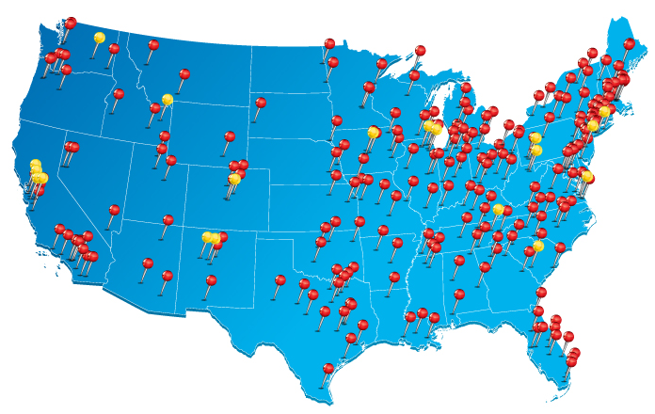
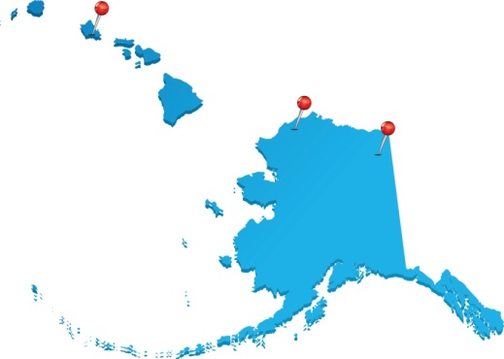
SC Supports Research at More than 300 Institutions Across the U.S.
Universities
DOE laboratories
The Office of Science supports:
27,000 Ph.D.s, graduate students, undergraduates, engineers, and technicians
26,000 users of open-access user facilities
300 academic institutions
17 DOE laboratories

Slide 4
Connections to University of Missouri
Approximately $10.3 million in FY 2010 via awards from the Offices of Biological and Environmental Research, Basic Energy Sciences, and Nuclear Physics (radioisotopes)
Biological and Environmental Sciences:
  Systems biology research on nutrient uptake in soybean root hairs
  Development of new dual-mode radionuclide and fluorescent peptide probes for in vivo analysis of carbohydrate-lectin interactions.
  Development of radionuclide and fluorescent imaging technologies to track the in vivo fate of nanoparticle constructs targeting tumor gene expression
  Study of metabolic branch points and flux limitations in fermentative hydrogen production in sulfate-reducing bacteria
  Research on microbial physiology to determine factors which regulate metal reduction and immobilization
Basic Energy Sciences:
  New pathways and metrics for enhanced, reversible hydrogen storage in boron-doped carbon nanospaces
  Time-dependent current density-functional theory of charge, energy and spin transport in nanoscale conductors
  Charge and spin dynamics in bulk and heterostructured dilute magnetic semiconductors
  Fundamental studies of complex oxides and their Interfaces
  Platinum oxo complex reactivity and dioxygen activation
Notes:
This is an ongoing process…

Slide 5
Office of Science Early Career Research Program
Proposed investment in FY 2011 would bring 60 new scientists into the program
New in
2010!
To support individual research programs of outstanding scientists early in their careers and to stimulate research careers in the disciplines supported by the Office of Science
Eligibility: Within 10 years of receiving a Ph.D., either untenured academic assistant professors on the tenure track or full-time DOE national lab employees
Award Size:
    University grants $150,000 per year for 5 years to cover summer salary and expenses
FY 2010 Results:
    69 awards funded via the American Recovery and Reinvestment Act
    47 university grants and 22 DOE national laboratory awards
  FY 2011 Application Process:
    Funding Opportunity Announcement issued in Spring 2010
    Awards made in the Second Quarter of 2011
http://www.science.doe.gov/SC-2/early_career.htm

Slide 6
Office of Science Graduate Fellowship Program
The FY 2011 request would double the number of graduate fellowships
New in
2010!
The Administration has requested $10 million in FY 2011 to fund about 170 additional fellowships.
Purpose: To educate and train a skilled scientific and technical workforce in order to stay at the forefront of science and innovation and to meet our energy and environmental challenges
Eligibility:
    Candidates must be U.S. citizens and a senior undergraduate or first or second year graduate student to apply
  Candidates must be pursuing advanced degrees in areas of physics, chemistry, mathematics, biology, computational sciences, areas of climate and environmental sciences important to the Office of Science and DOE mission
Award Size:
  The three-year fellowship award, totaling $50,500 annually, provides support towards tuition, a stipend for living expenses, and support for expenses such as travel to conferences and to DOE user facilities.
FY 2010 Results:
    ~150 awards will be made this Spring with FY 2010 and American Recovery and Reinvestment Act funds.
  FY 2011 Application Process:
    Funding Opportunity Announcement issued in Fall 2010
    Awards made in March 2011
http://www.scied.science.doe.gov/SCGF.html

Slide 7
The Global Climate Crisis
7

Slide 8
Modern CO₂ Concentrations are Increasing
The current concentration is the highest in 800,000 years, as determined by ice core data
Atmospheric CO₂ at Mauna Loa Observatory
Concentration now ~388 ppm
Concentration prior to 1800 was ~280 ppm

Slide 9
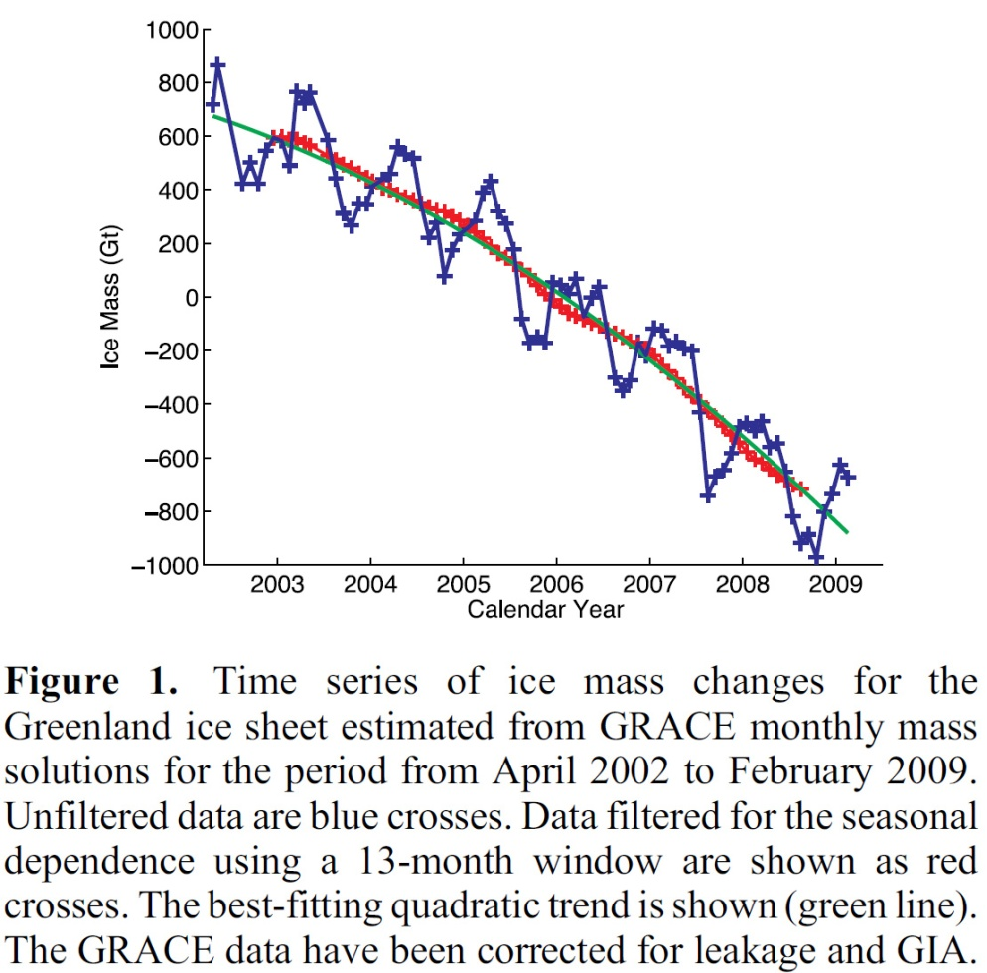
Greenland Ice Mass Loss – 2002 to 2009
Increasing rates of ice mass loss from the Greenland and Antarctic ice sheets revealed by GRACE (Gravity Recovery and Climate Experiment) satellite:
In Greenland, the mass loss increased from
137 Gt/yr in 2002–2003 to 286 Gt/yr in 2007–2009
In Antarctica, the mass loss increased from
104 Gt/yr in 2002–2006 to 246 Gt/yr in 2006–2009
I. Velicogna, Geophysical Research Letters, VOL. 36, L19503, 2009
Notes:
Sec. Chu has pic of two satellites; missing estimate of sea level rise; consider 14C/12C story

Slide 10
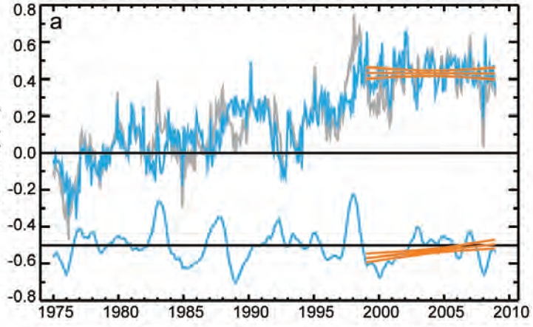
Accounting for Stagnation of Global Average Temperature:
The Role of Climate Model Variability
Temperature change (° C)
J. Knight et al., Bull. Amer. Met. Soc., “State of the Climate” Supplement, August 2009
10
Notes:
Global mean temperature changes over the last decade in context. Monthly global mean temperature anomalies (with respect to 1961–90 climatology) since 1975, derived from the combined land and ocean temperature dataset HadCRUT3 (gray curve). (top blue curve) The global mean after the effect of ENSO that has been subtracted is also shown, along with (bottom blue curve, offset by 0.5°C) the ENSO contribution itself. Least squares linear trends in the ENSO and ENSO-removed components for 1999–2008 and their two std dev uncertainties are shown in orange.
Old notes:
(a) Monthly global mean temperature anomalies (with respect to 1961–90 climatology) since 1975, derived from the combined land and ocean temperature dataset HadCRUT3 (gray curve). (top blue curve) The global mean after the effect of ENSOthat has been subtracted is also shown, along with (bottom blue curve, offset by 0.5°C) the contribution itself. Least squares linear trends in the and ENSO-removed components for 1999–2008 and their two std dev uncertainties are shown in orange.
(b) adjusted global mean temperature changes to 2008 as a function of starting year for HadCRUT3, GISS dataset (Hansen et al. 2001) and the NCDC dataset (Smith et al. 2008) (dots). Mean changes over all similar-length periods in the twenty-first century climate model simulations are shown in black, bracketed by the 70%, 90%, and 95% intervals of the range of trends (gray curves).
“Near-zero and even negative trends are common for intervals of a decade or less in the simulations, due to the model’s internal climate variability. The simulations rule out (at the 95% level) zero trends for intervals of 15 yr or more, suggesting that an observed absence of warming of this duration is needed to create a discrepancy with the expected present-day warming rate.”
10

Slide 11
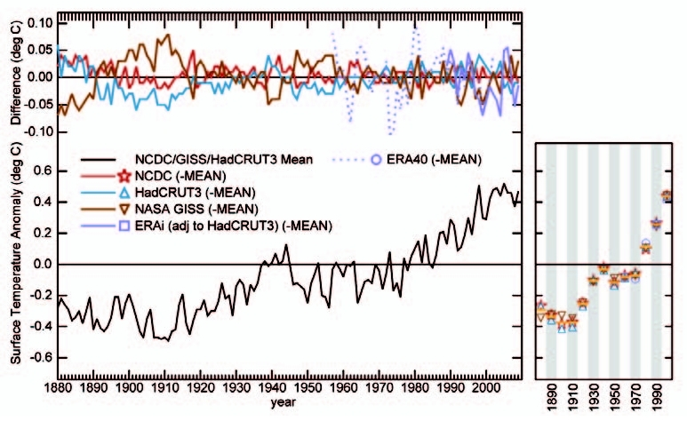
Accounting for Stagnation of Global Average Temperature:
The Role of Climate Model Variability
J. Knight et al., Bull. Amer. Met. Soc., “State of the Climate” Supplement, August 2010
11
Notes:
Fig. 2.2. Global surface temperature anomalies with respect to the 1961 to 1990 average: (bottom) mean of the NASA/GISS, HadCRUT3 and NOAA/NCDC analyses; (top) difference between NASA/GISS, HadCRUT3, NOAA/NCDC, ERA-interim, ERA-40 and the mean. Decadally averaged anomalies are shown on the right-hand side where 66% of months are present along with the multi-dataset mean. ERA-interim anomalies are with respect to a 1989–2008 climatology and so have been adjusted by the difference between the ERA-interim and HadCRUT3 mean over the 1989–1998 period for consistency. Documented issues exist with ERA-40 pre-1979, especially in the Southern Hemisphere and Antarctic (e.g., Simmons et al. 2004). ECMWF always tell users to use caution when mixing pre-1979 data from ERA-40 into a climate analysis.
Old notes:
(a) Monthly global mean temperature anomalies (with respect to 1961–90 climatology) since 1975, derived from the combined land and ocean temperature dataset HadCRUT3 (gray curve). (top blue curve) The global mean after the effect of ENSOthat has been subtracted is also shown, along with (bottom blue curve, offset by 0.5°C) the contribution itself. Least squares linear trends in the and ENSO-removed components for 1999–2008 and their two std dev uncertainties are shown in orange.
(b) adjusted global mean temperature changes to 2008 as a function of starting year for HadCRUT3, GISS dataset (Hansen et al. 2001) and the NCDC dataset (Smith et al. 2008) (dots). Mean changes over all similar-length periods in the twenty-first century climate model simulations are shown in black, bracketed by the 70%, 90%, and 95% intervals of the range of trends (gray curves).
“Near-zero and even negative trends are common for intervals of a decade or less in the simulations, due to the model’s internal climate variability. The simulations rule out (at the 95% level) zero trends for intervals of 15 yr or more, suggesting that an observed absence of warming of this duration is needed to create a discrepancy with the expected present-day warming rate.”
11

Slide 12
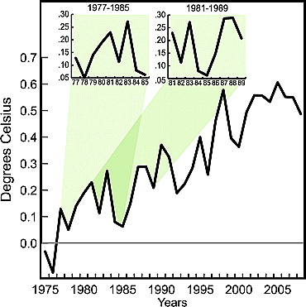
Global Surface Temperature Does Not Always Rise
Observations of Global Surface Temperature
Easterling, D. R., and M. F. Wehner, Geophys. Res. Lett., 36, L08706 (2009).
Notes:
The decadal variability in the observed global temperature trend.
Fig 1 from Easterling and Wehner, 2009 - Globally averaged surface air temperature for land and ocean based on the data set by Smith et al. [2005]
Easterling, David R., and Michael F. Wehner. “Is the climate warming or cooling?.” Geophysical Research Letters 36, no. 8 (4, 2009). http://www.agu.org/pubs/crossref/2009/2009GL037810.shtml.
Smith, T. M., T. C. Peterson, J. H. Lawrimore, and R. W. Reynolds (2005), New surface temperature analyses for climate monitoring, Geophys. Res. Lett., 32, L14712, doi:10.1029/2005GL023402.

Slide 13
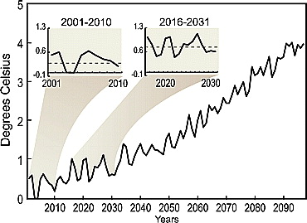
Models Predict Flat Periods
Model of Global Surface Temperature
Easterling, D. R., and M. F. Wehner, Geophys. Res. Lett., 36, L08706 (2009).
Notes:
a similar plot from the most strongly forced 21st Century scenario simulation by the German modeling group, which is consistent with those from other major modeling centers. Even in the presence of strong forcing, there are decadal periods of little surface warming and even cooling.
One realization of the globally averaged surface air temperature from the ECHAM5 coupled climate model forced with the SRES A2 greenhouse gas increase scenario for the 21st century.

Slide 14
Global and U.S. Energy Outlook
14

Slide 15
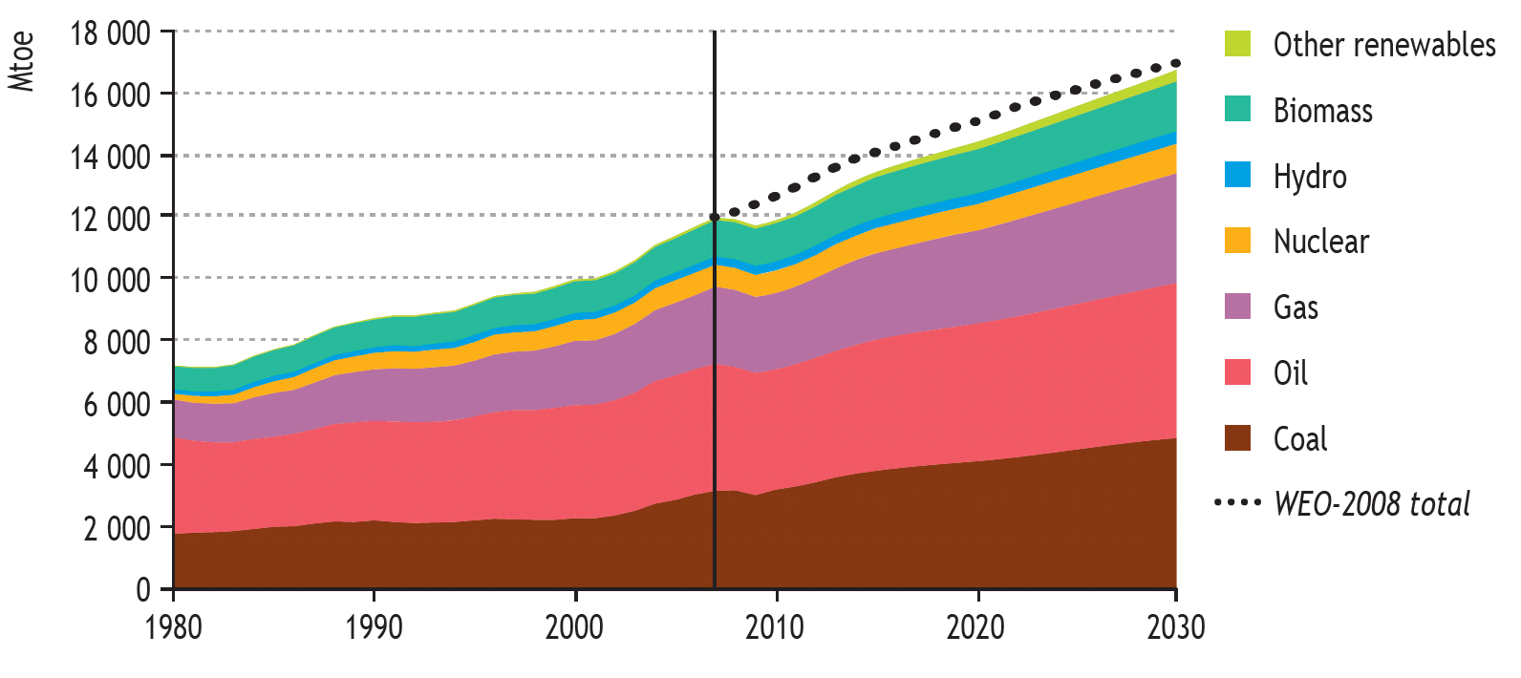
Fossil Fuels Will Continue to Dominate World Energy Supply Under Business as Usual
IEA World Energy Outlook 2009 Reference Case
Millions of tons of oil equivalent
Over 90% of the increase in world primary energy demand between
2007 and 2030 is projected to come from non-OECD countries
Source: International Energy Agency World Energy Outlook, 2009.

Slide 16
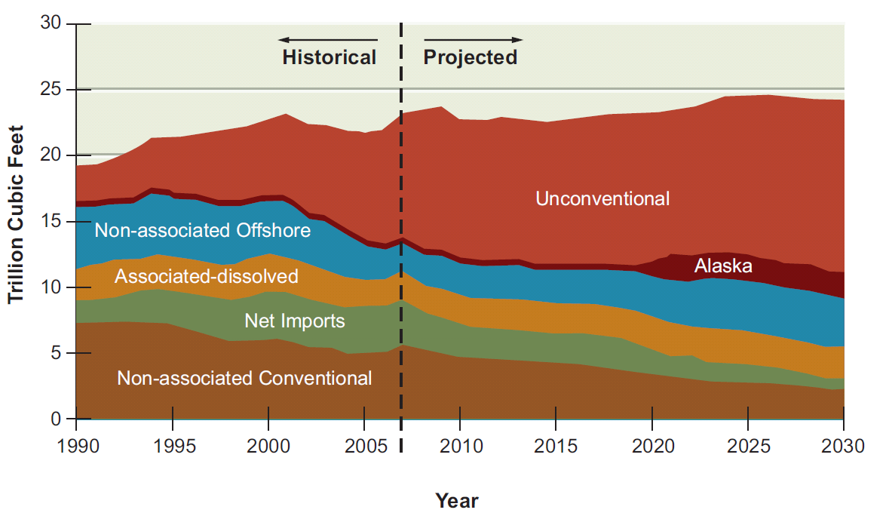
The Market Favors Expanded Use of
Unconventional Natural Gas
Today, perhaps the biggest change to the energy system is not expanded use of nuclear or renewable energy, but the development of shale gas formations through horizontal drilling and hydraulic fracturing.
Proved natural gas reserves at the end of last year were 244.7 trillion cubic feet (tcf), the highest level since reports commenced in 1977.
Proved reserves of shale gas grew by 8.9 tcf to 32.8 tcf.
Source: Department of Energy, Energy Information Administration Annual Energy Outlook 2009, Reference Case.
Notes:
Figure 7.2 Energy Information Administration reference case for U.S. natural gas production,
showing the projected increase in the proportion of gas from unconventional
sources along with the decline in gas from conventional sources. “Associated” refers to
gas produced as a result of oil production.

Slide 17
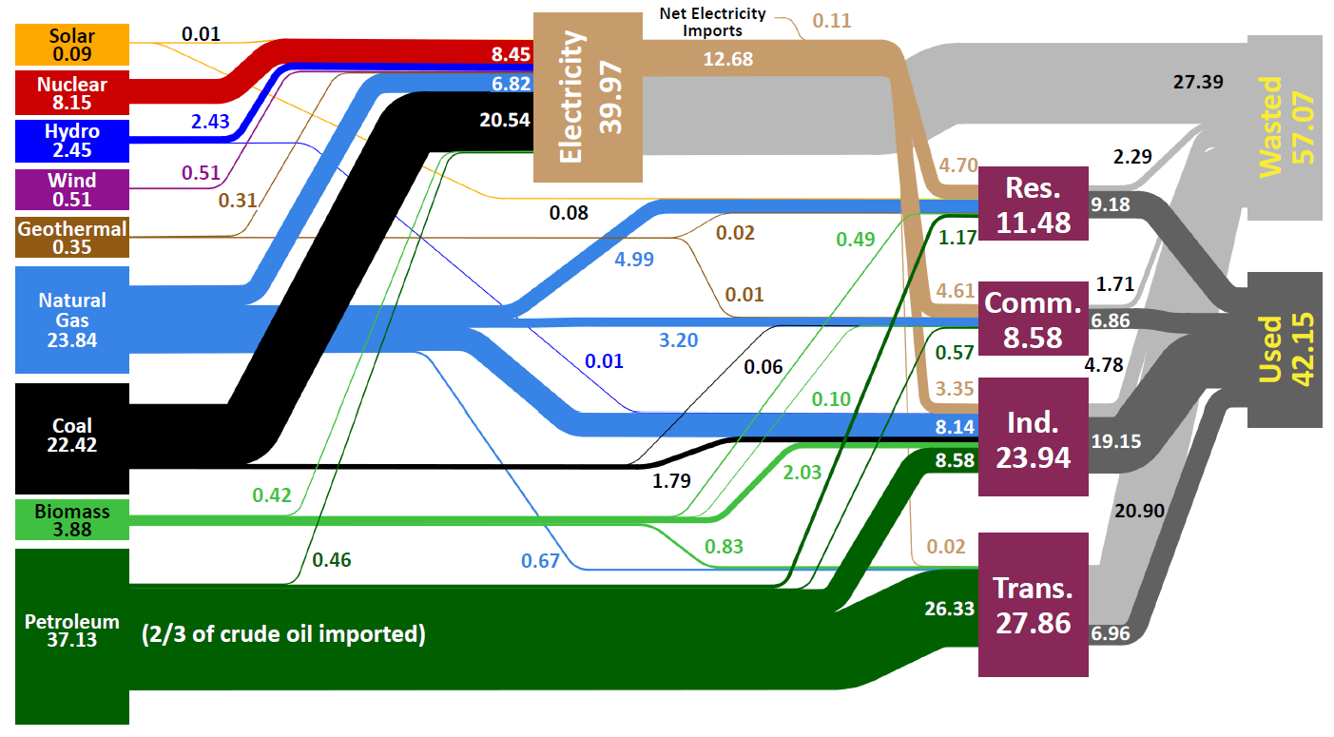
U.S. Energy Production and Usage in 2008
Units in Quadrillion BTUs (Quads)
Source: Lawrence Livermore National Laboratory and the Department of Energy, Energy Information Administration, 2009 (based on data from DOE/EIA-0384(2008), June 2009).
Notes:
Delete yellow things

Slide 18
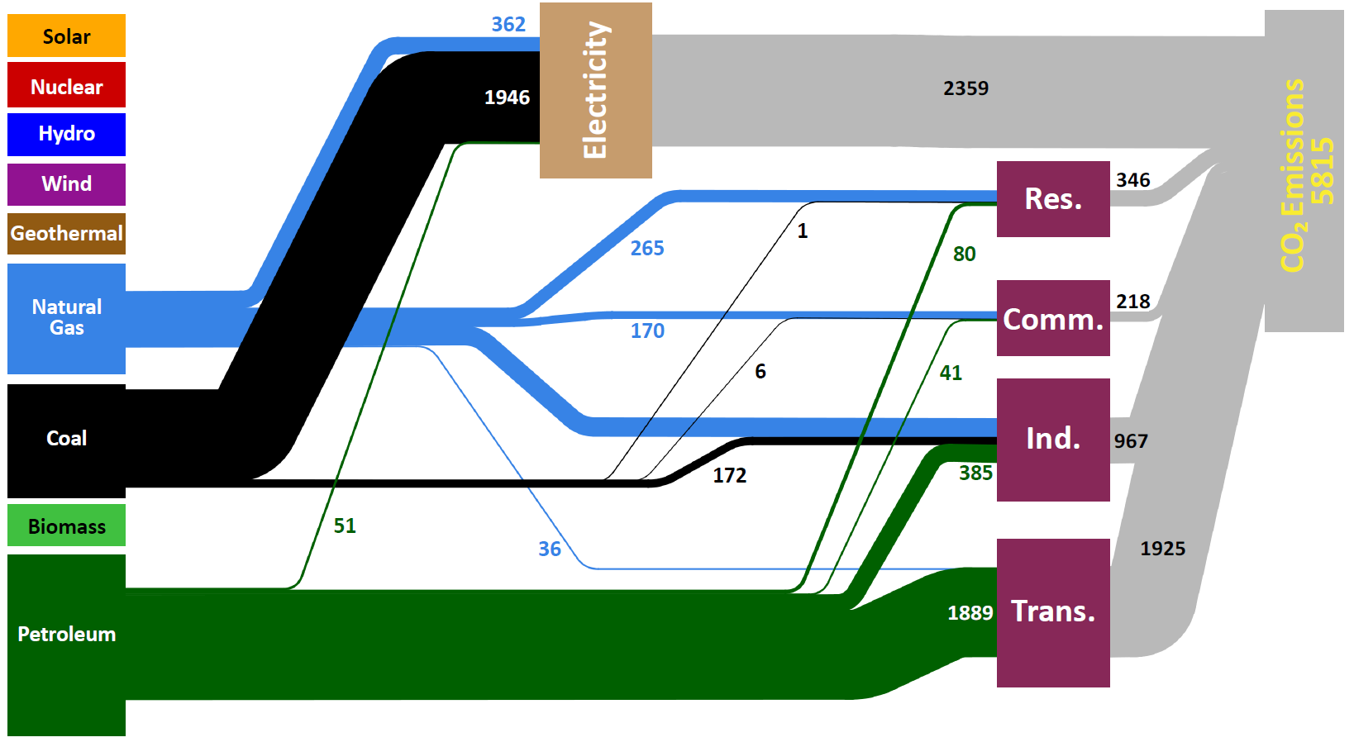
U.S. Carbon Dioxide Emissions in 2008
Units in Millions of Metric Tons
Source: Lawrence Livermore National Laboratory and the Department of Energy, Energy Information Administration, 2010 (based on data from DOE/EIA-0573(2008), December 2009).

Slide 19
We must drive toward Clean Energy
To prevent global average surface temperature from rising more than 2.5° C by 2050 . . .
. . . we must emit less than 1000 GT of CO₂ between 2000–2050 . . .
. . . but our emissions rate from 2000–2010 was 33 GT per year . . .
. . . so we must reduce our emissions by a factor of 8 between 2010-2050.

Slide 20
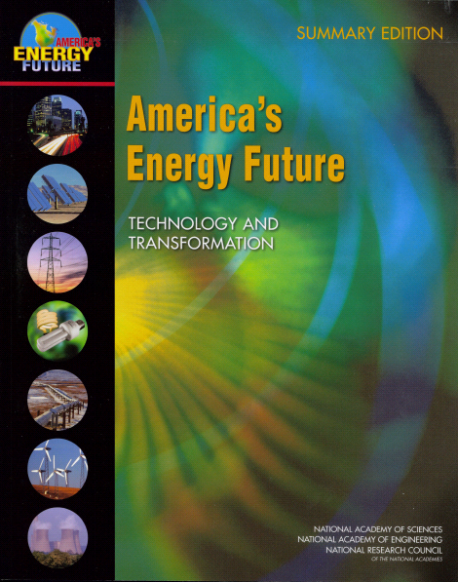

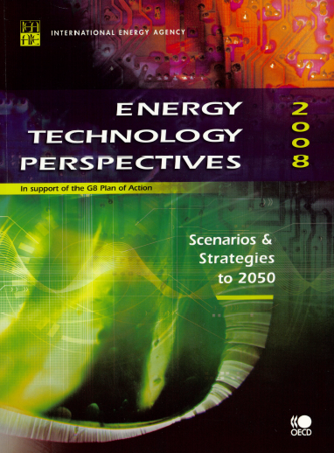
Broad Expert Consensus on the Need for New Technologies
Scientific and technological advances will be required to make major changes to the energy system a “no brainer” for consumers and industry.

Slide 21
New in FY 2012: Science for Clean Energy
  Applications of 21st century science to long-standing barriers in energy technologies: employing nanotechnology, biotechnology, and modeling and simulation
  Examples:
    Materials by design using nanoscale structures and syntheses for: carbon capture; radiation-resistant and self-healing materials for the nuclear reactor industry; highly efficient photovoltaics; and white-light emitting LEDs.
    Biosystems by design combining the development of new molecular toolkits with testbeds for the design and construction of improved biological components or new biohybrid systems and processes for improved biofuels and bioproducts.
    Modeling and simulation to facilitate materials and chemistry by design and to address technology challenges such as the optimization of internal combustion engines using advanced transportation fuels (biofuels).

Slide 22
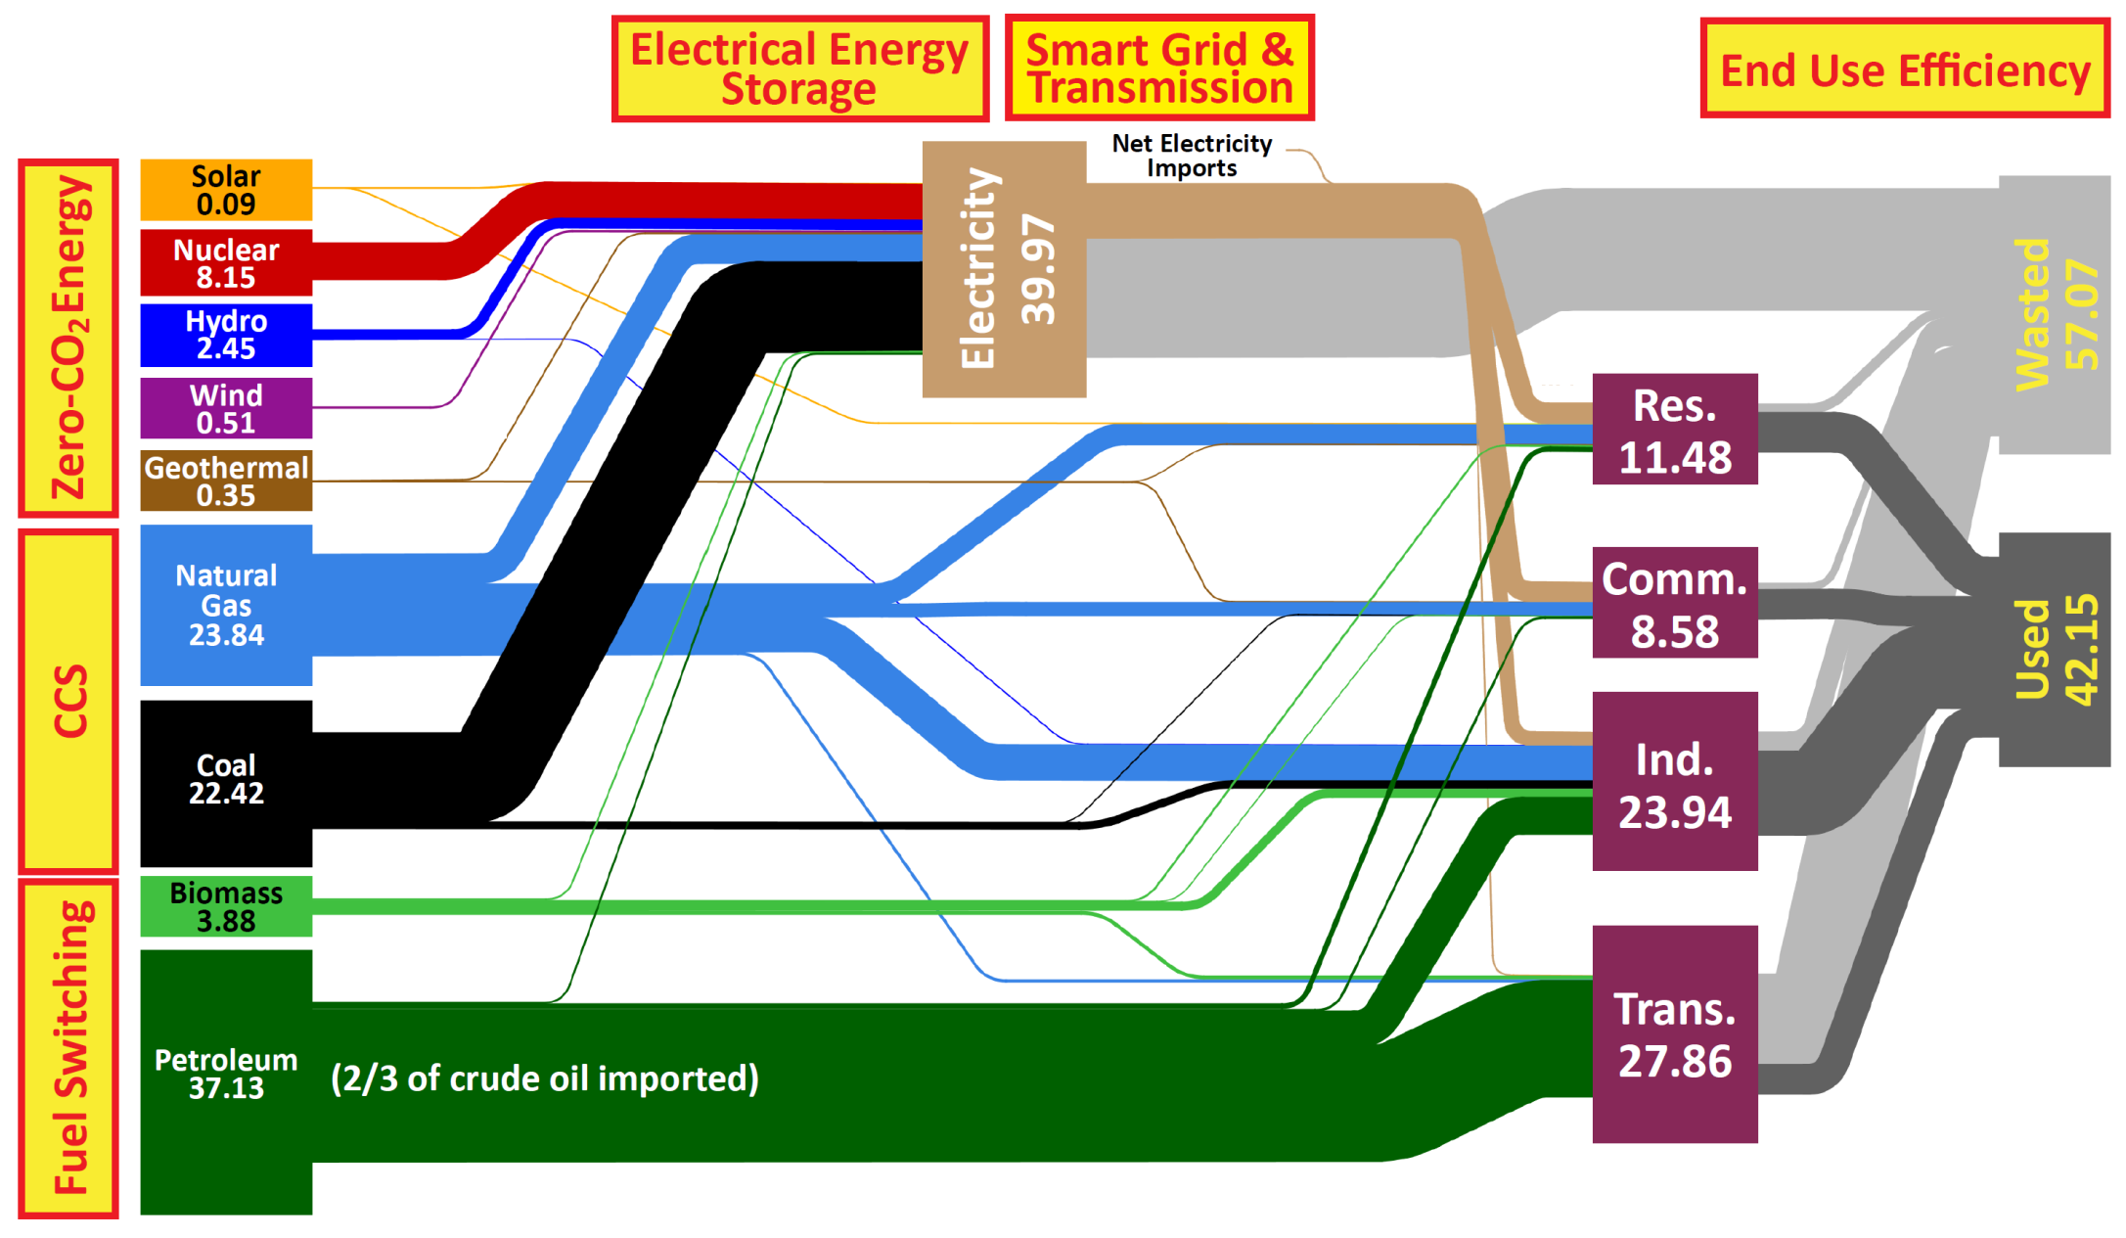
A National Strategy for a New Energy Economy
Notes:
“Zero Carbon Energy”

Slide 23
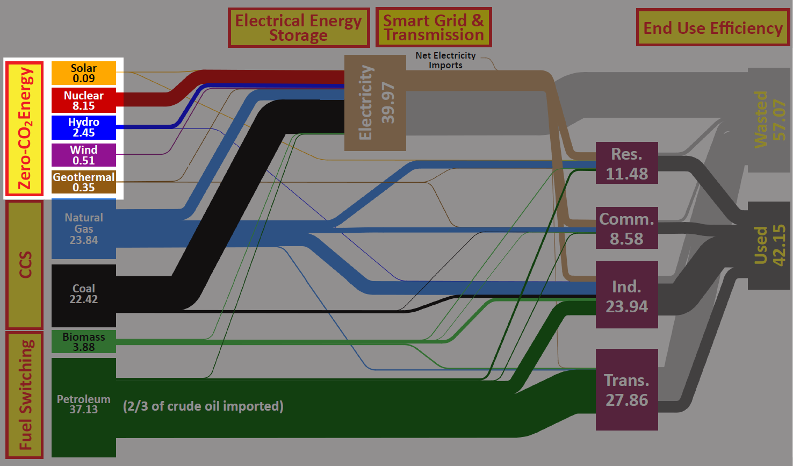
Science for Zero Carbon Energy
Notes:
“Zero Carbon Energy”

Slide 24
Solar Photovoltaics
24

Slide 25
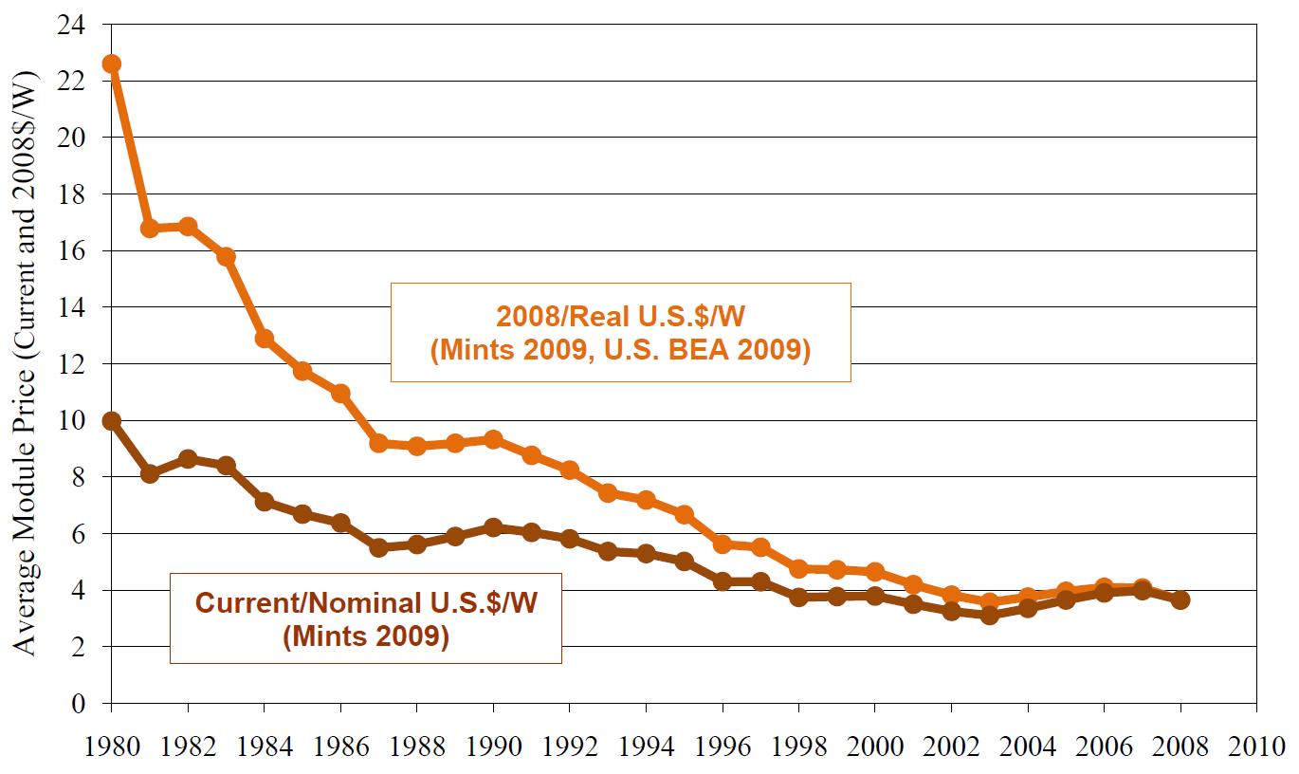
Cost Competitiveness of Solar Energy is Improving
Source: Mints, P.; Tomlinson, D. (2008). Photovoltaic Manufacturer Shipments & Competitive Analysis 2007/2008. Report # NPS-Supply3. Palo Alto, CA: Navigant Consulting Photovoltaic Service Program and Mints, P. (2009). Photovoltaic Manufacturer Shipments, Capacity, & Competitive Analysis 2008/2009. Report # NPS-Supply4. Palo Alto, CA: Navigant Consulting Photovoltaic Service Program. .
Notes:
http://www1.eere.energy.gov/solar/pdfs/46025.pdf
Figure 3.8 shows average global PV module selling prices at the factory gate (i.e., prices do not include charges such as delivery and subsequent taxes), as obtained from sample market transactions. As stated earlier, these prices are averages over all PV module technologies including thin film, for PV power modules greater than 75 W in size and purchased in relatively small quantities. Excluded from this category are smaller PV modules, consumer indoor PV (e.g., for calculators and watches), and large (e.g., greater than 150 W) standard modules sold in large quantities (e.g., 500–1,000-unit minimums) in the unrestricted international commodity market. The large-module/large-quantity category has been increasing in market share in recent years and constituted more than half of module sales in 2008. In 2008, the average price per watt for the large-module/large-quantity category was 11% lower than for the power module category shown in Figure 3.8. The current/nominal prices shown in the figure are actual prices paid in the year stated. The 2008/real prices are adjusted for inflation (indexed to 2008 U.S. dollars).

Slide 26
Solar Photovoltaics: We Can Still Do Better
  Technology Challenge: Reduce costs and increase capacity for converting sunlight into electricity – $1/watt program
  Silicon: Top commercial solar cells (single crystal silicon) have conversion efficiencies of ~18%; triple-junction cells with Fresnel lens concentrator technology are ~40%.
  Science Challenges: Cost-effective improvements in efficiency depend on understanding and controlling phenomena at the nanoscale.

Slide 27
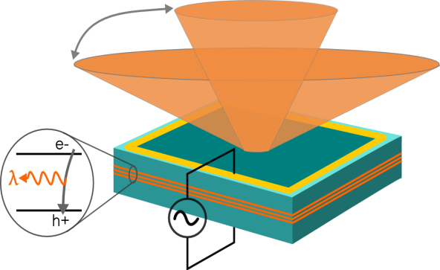
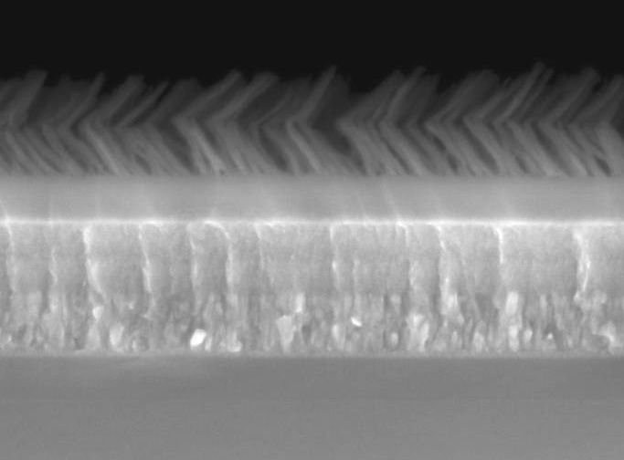
New Techniques for Improvement of PV Cell Efficiency
solar
AR coating
Solar cell
Silicon
λ/4 coating
Quintic AR coating
Molding the flow of light: a novel photonic design for antireflection coatings for multiple wavelengths and light incident angles
Basic science breakthrough:
A new architectural design for antireflection coating that solves, for the first time, both the multiple wavelength and incident light angles critical for efficient solar collection.
The multi-layer nanostructure can produce a >20% solar efficiency enhancement and is universally applicable to many type of solar cells, including Si, III-V and organic cells.
n=1.00
SiO₂
slanted rods
1.09
1.22
TiO₂/SiO₂
1.53
1.86
2.24
TiO₂
2.52
n
2.60
200nm
Substrate
SEM Image of a 7-layer graded anti-reflection coating structure
Kuo and Lin et. al. Optics Letters, Nov. 2008
27
Notes:
27
Top Left: To achieve a significant improvement in solar conversion, innovative “photon management” is as important as electronic material study.
This diagram illustrates the need of a novel photonic structure to improve solar collection at all angles and all solar-spectrum.
Bottom left: SEM image of the first successful realization of a 7-layer antireflection (AR) coating structure at RPI.
The top two layers have a super low refractive-index of 1.09 and 1.22, achieved by using a “Glancing-angle growth” method.
The layer index follows a “smooth” mathematical function that enables a maximum solar transmission and a minimum reflection.
Top right: Total reflectance spectra, showing the superior optical property of our “Quintic AR coating” (~4% reflection).
For comparison, a quarter-wave AR-coating reflects an average of 21% and a silicon wafer reflects 36%.
The solar spectrum is shown as a reference.

Slide 28

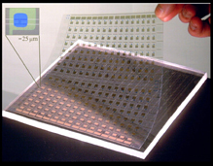


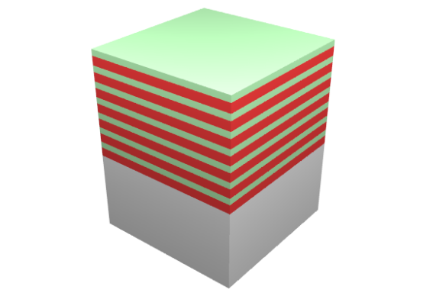





Low Cost Solar Cells:
From Fundamental Research to Commercialization
Basic Science
Applied R&D
Manufacturing/
Commercialization
EERE Solar America Initiative: Established new materials strategies & manufacturing methods for low-cost, high performance photovoltaic modules
John Rogers, Ralph Nuzzo (co-founders)
Micro-Contact Printed Solar Cells
Industrial collaborations
GaAs epi-stacks for
solar microcells
Basic research focused on materials-centric aspects of a micro-transfer printing process for single crystalline silicon and other semiconductors, dielectrics and metals.
release; transfer print
AlAs release
layers
GaAs wafer
etch in HF
regrow
28
Notes:
John Rogers and Raplh Nuzzo University of Illinois
BES-supported materials research at UIUC has resulted in an extensive intellectual property (IP) portfolio related to printable, flexible electronics.
The basic research knowledge base includes key materials-centric aspects of a micro-transfer printing process for single crystalline silicon and other semiconductors, dielectrics and metals.
BES-supported materials research at UIUC has resulted in an extensive intellectual property (IP) portfolio related to printable, flexible electronics.
The basic research knowledge base includes key materials-centric aspects of a micro-transfer printing process for single crystalline silicon and other semiconductors, dielectrics and metals.
Key Technology Outcomes/Benefits:
Efficiencies of ~12% at thicknesses of 15 microns (> 10x thinner than conventional monocrystalline silicon photovoltaic devices)
Integration with flexible substrates (e.g., plastic)
Integration with optical over-layers for directing/focusing light
Controllable transparency
The goal of the EERE program was to establish new materials strategies & manufacturing methods for low-cost, high performance photovoltaic modules
Semprius has 25 full-time employees; 2 researchers received PhD’s at UIUC under DOE BES support
Large joint development programs: Siemens (solar), Cambridge Display Technology, Sumitomo, X-FAB
First purchase order for 1 kW concentrator PV system from Tucson Electric Power
Attracted over $10 M in venture capital funding from: Applied Materials, Arch, GVC, In-Q-Tel and Intersouth Partners,

Slide 29
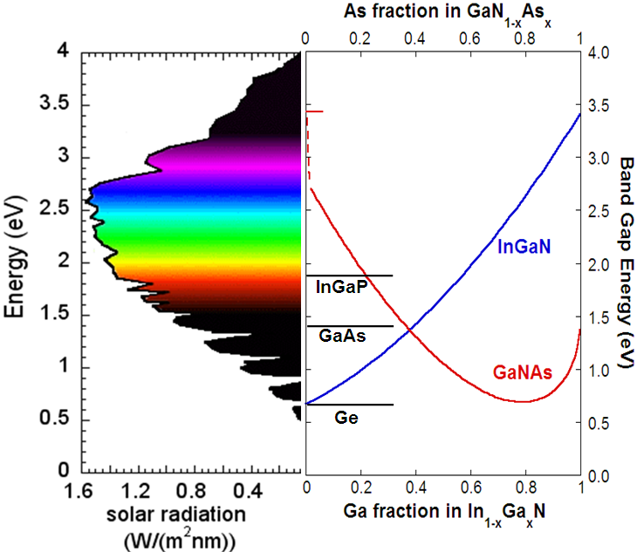
Ultra High–Efficiency Solar Cells
In_{x}Ga_{1-x}N (x~0.45)
junction
Basic science breakthrough:
Discovery of single alloy systems with wide band gap range: InGaN and GaNAs
Low cost alternatives to conventional multi-junction cells
Notes:
Single alloy systems, InGaN and GaNAs, capable of broad band absorption of solar spectrum were developed previously at LBNL. Tandem cells that utilize these ally semiconductor system with Si offer the prospect of higher photocurrents and higher efficiencies (See bottom right figure). While this is yet to be demonstrated, proof of principle is shown in the top right figure with GaN-Si tandem cell. GaN absorbs only in the UV, and thus either concentrator (20X sun) or sun+324nm laser are needed to obtain higher photocurrents. In InGaN-Si tandem cell, laser is not needed and the expectation is that higher photocurrents will be obtained with regular or concentrated solar power.

Slide 30
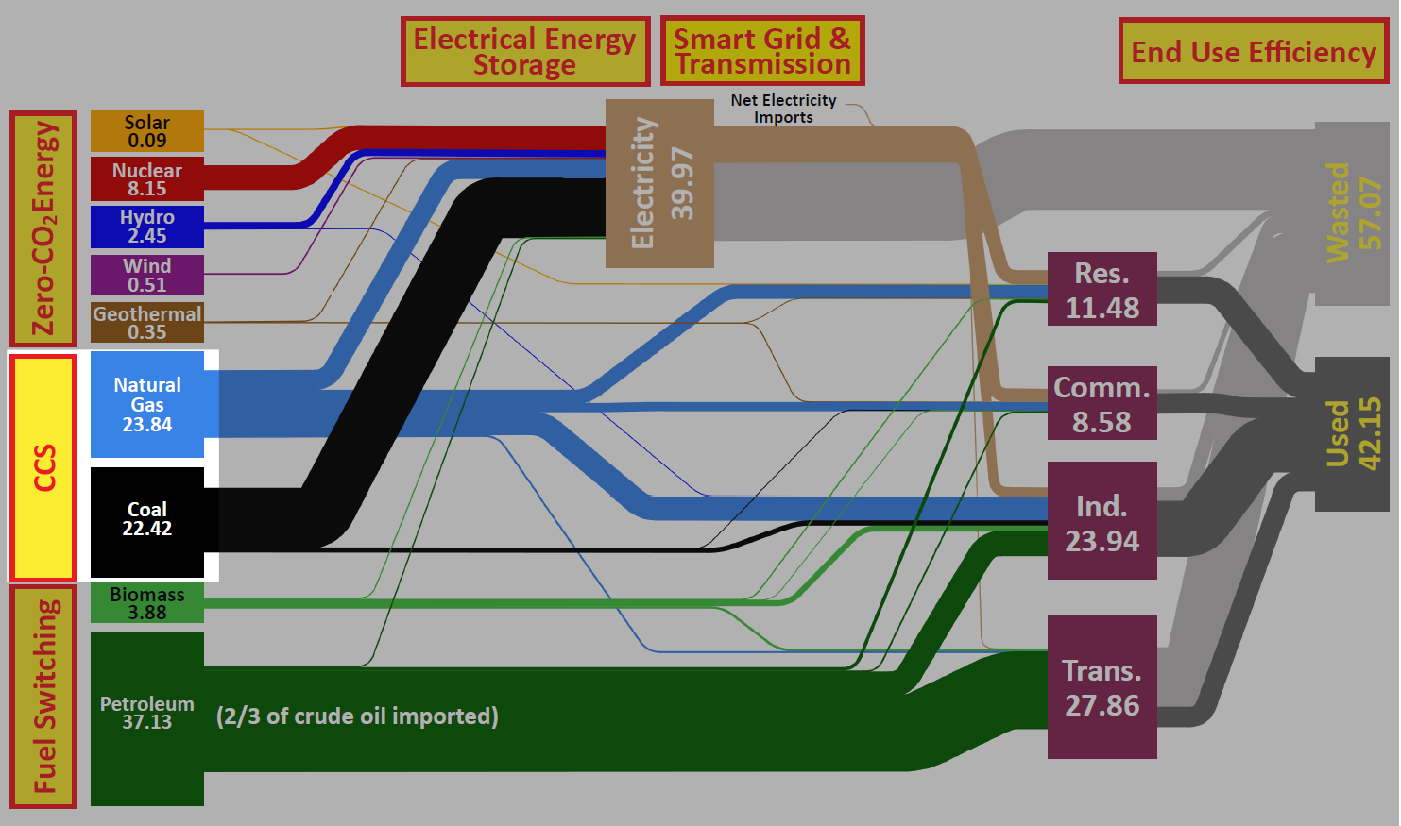
Science for Carbon Capture and Sequestration

Slide 31
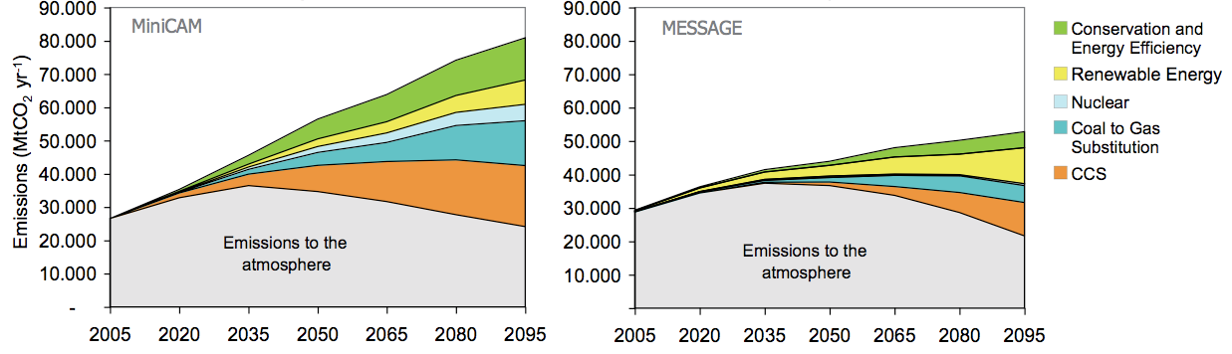
Carbon Capture and Sequestration
Two scenarios for reducing carbon dioxide emissions to keep atmospheric concentrations at 450-750 ppmv. Left: high-emission scenario, where nuclear plays an important role. Right low-emission scenario. In both cases, carbon capture and storage (CCS) – the orange wedge - plays a critical role. (IPCC report, 2007)
Continued use of fossil fuel while capping the atmospheric concentration of carbon dioxide to about double the pre-industrial level requires the sequestration of ~10 GT of CO₂ per year.
Current technologies for the post-combustion capture of CO₂ are too expensive.
“Underground” as a long-term storage container
  Advantages: Enormous volume; distance from subsurface environment; pre-made container
  Disadvantages: Designed by nature, only approximately fits the design criteria for containment; complex materials and processes; difficult to see and monitor; uncertainty about long-term performance
Notes:
Imagine: (1) Underground sequestration of CO₂ that is safe and environmentally benign for the amount of time required – at least 200 years, given the lifetime of CO₂ in the Earth’s atmosphere. (2) Same thing but for spent nuclear fuel and with a much longer time scale – licensing for Yucca Mt. is talking about 1 million years.
No better way to motivate this than to look at the IPCC scenarios for CO₂ emissions. Left – high emission scenario in which nuclear plays a large role. This would require at least a 10 fold increase in nuclear power. Right – low emission case with much less nuclear power. In both cases, CCS plays a vital role.
That translates into about 10 GT of CO₂ per year that needs to be sequestered. And if we expand nuclear tenfold using current technology, the amount of SNF created would fill one Yucca Mt each year.
So, how good is the “underground” as a container for CO₂ or Spent Nuclear Fuel (SNF)? On the plus side, it has the volume and there is a nice, safe separation between underground and the subsurface environment. Also, it is a pre-made container. On the negative side, it was designed by nature and it only approximately fits the bill for what we want. Storage of CO₂ or SNF creates a complex set of materials and chemical processes underground that we do not fully understand. It’s difficult to see and monitor what’s going on underground. Finally, there is significant uncertainty regarding our ability to model and predict long-term performance, where long term means at least 100 years for CO₂ and perhaps 1 million years for SNF.

Slide 32
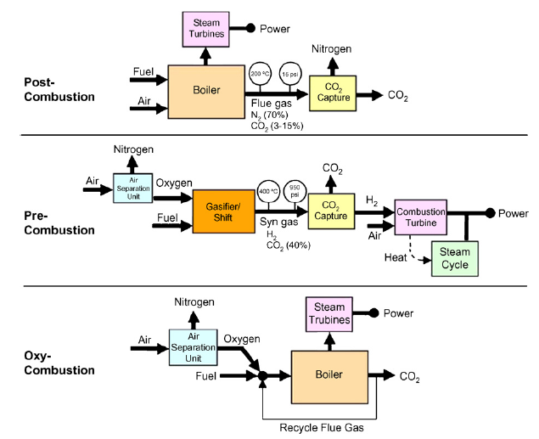
Today’s Carbon Capture Options
Challenges
Low CO₂ Concentration
High energy for regeneration
Mostly new plants
Oxygen production – Air Separation Units (ASUs) have high electricity cost (chemical looping, ITMs)
ASUs consume considerable energy
Expense - corrosion resistant materials
IGCC
Notes:
Today’s Carbon Capture Approaches –
A Brief Review
Pre-Combustion Capture
Applicable to plants where coal gasification is first processing step
Few existing plants – will apply mostly to new plants
CO₂ capture should be easier
Oxy-Combustion
Generally involves cryogenic oxygen separation plant
Novel concepts involving oxygen transport membranes and chemical looping – lab/pilot scale development
Post-Combustion Capture
Existing coal fired power plants
Commercial amine-based processes available from Fluor, Mitsubishi Heavy Industries,& others
Parasitic power requirements and cost -major challenges
Pilot and demonstration projects - “advanced amines,” chilled ammonia, ionic liquid solvents
New approaches, “Breakthrough Concepts,” - metal organic frameworks (MOFs), zeolite imidazole frameworks (ZIFs), membranes, and other sorbents - smaller scales

Slide 33
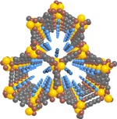
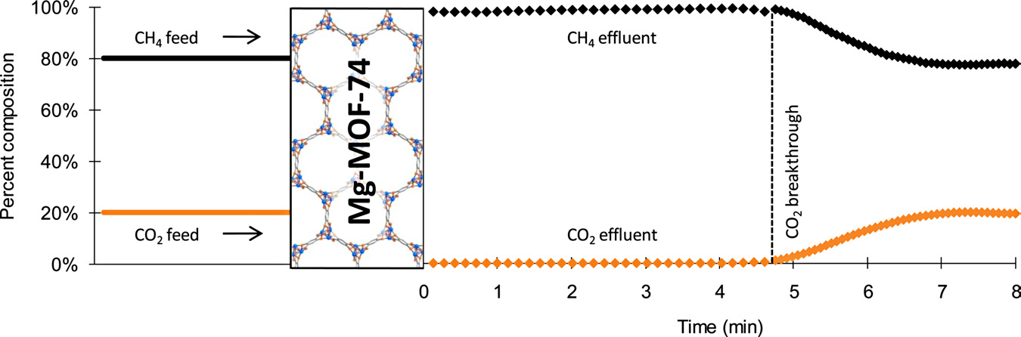
New Materials May Aid in Capturing Carbon Dioxide
Metal-organic frameworks (MOFs) act as “crystalline sponges” and show promise at reducing the energy penalty for CO₂ capture.
A new magnesium-based MOF is selective in capturing CO₂ in the presence of CH₄ and releases the stored CO₂ at temperatures much lower than current capture media.
Schematic structure of Mg-MOF-74
D. Britt, H. Furukawa, B. Wang, and O. M. Yaghi, PNAS 106, 20637 (2009); also see N.Y. Times on Dec. 8, 2009.

Slide 34

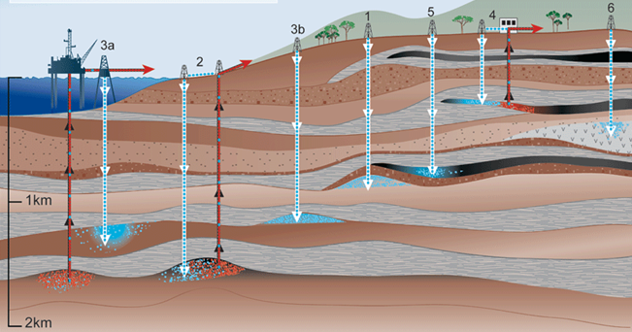
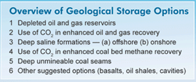
Geological CO₂ Sequestration
Prediction of CO₂ Sequestration effectiveness depends on understanding:
Reactive fluid flow properties of multiphase fluids under reservoir conditions in porous and fractured media
Geochemical stability of mineral phases within deep formations
Improved geophysical imaging of reservoir-scale properties to track changing reservoir dynamics over long periods of time

Slide 35
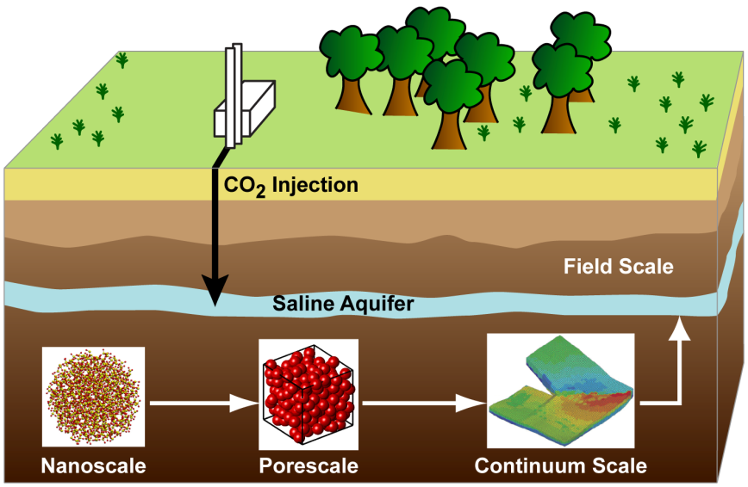


Energy Frontier Research Center:
Center for Frontiers of Subsurface Energy Security
RESEARCH OBJECTIVES:
Development of scientific understanding of subsurface physical, chemical and biological processes from very small to very large scale so that we can predict the behavior of CO₂ and other byproducts of energy production stored in the subsurface.

Slide 36
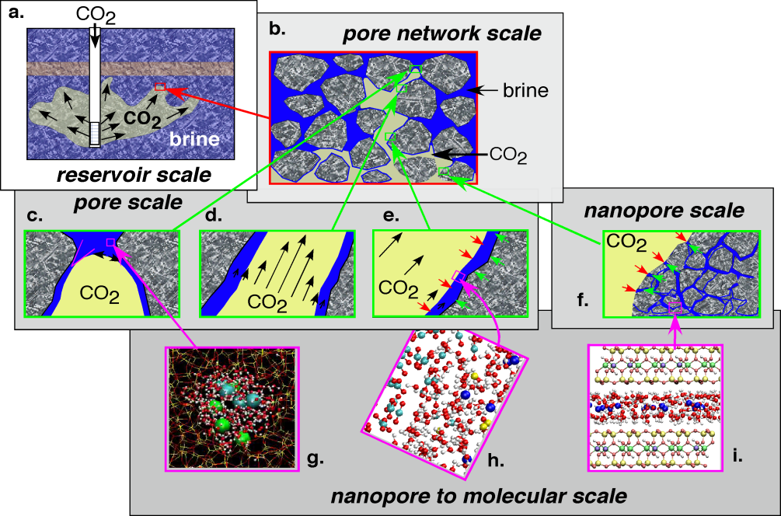





Energy Frontier Research Center:
Nanoscale Controls on Geologic CO₂
RESEARCH OBJECTIVES:
Development of molecular, nano-scale, and pore network scale approaches for controlling flow, dissolution, and precipitation in subsurface rock formations during emplacement of supercritical CO₂; and
Achievement of a new level of prediction of long-term performance
36

Slide 37
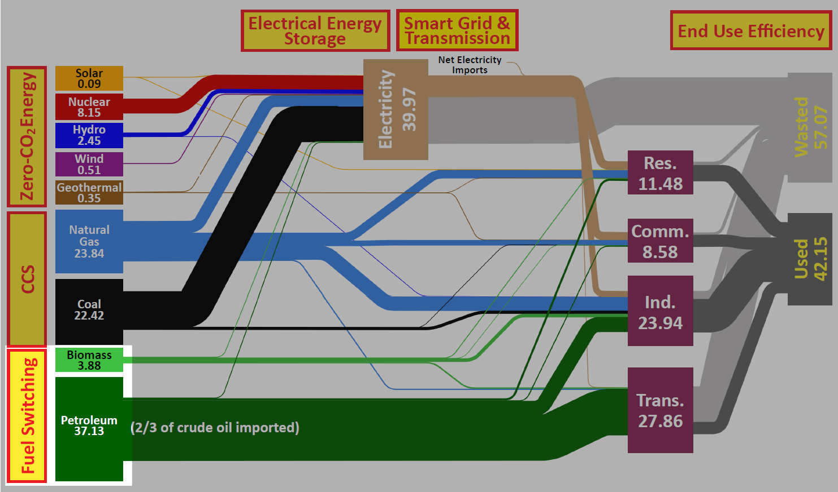
Science for Transportation Fuel Switching
Transportation Fuel Switching:
Advanced Biofuels
37

Slide 38


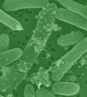



Advancing Energy Technologies through Bioenergy Research Centers
In the first three years of operations, the BRCs together had 66 inventions in various stages of the patent process, from disclosure to formal patent application, and over 400 peer-reviewed publications.
Developed new strains of ethanol-producing microbes with enhanced tolerance to stresses associated with industrial biofuels production.
Used synthetic biology toolkit to construct the first microbes to produce an advanced biofuel (biodiesel) directly from biomass.
Characterized impacts of
biomass crop agriculture on marginal lands, studying shifts
in microbial community and
potential for changes in
greenhouse gas emissions.
Notes:
The lignin part of plant cell walls makes plants difficult to breakdown and convert to biofuels. BESC researchers identified a key gene involved in lignin biosynthesis in switchgrass, a major perennial feedstock for lignocellulosic ethanol production. Their results provide a potential target for modification in the development of switchgrass as a bioenergy crop. Photo shows transgenic switchgrass in lab culture.
Reference: Escamilla-Treviño et al 2010. Switchgrass (Panicum virgatum) possesses a divergent family of cinnamoyl CoA reductases with distinct biochemical properties. New Phytologist 185: 143-155.
JBEI researchers (in collaboration with LS9) engineered several key changes into E. coli to take up hemicellulose, break it down and convert into biodiesel.
overproduce fatty acids that could then be metabolically converted into structurally tailored fatty esters (biodiesel), alcohols and waxes
produce hemicellulases.
Photo shows microbes producing oil droplets
Reference : Microbial production of fatty-acid-derived fuels and chemicals from plant biomass; Steen et al, Nature, Vol 463|28 January 2010
GLBRC uses high-capacity sequencing technology to characterize microbial rhizosphere communities of biofuel crops grown on agricultural vs. marginal lands. Found that soil environment and land management were key factors influencing community structure. Although more limited in plant diversity, greater bacterial diversity was observed in the biofuel crop samples than in the forest samples. Photo shows agricultural row cropland tested.
Reference: Jesus, E. C., et al., 2010, “Bacterial Communities in the Rhizosphere of Biofuel Crops Grown on Marginal Lands as Evaluated by 16S rRNA Gene Pyrosequences,” Bioenergy Research, 3: 20–27.

Slide 39
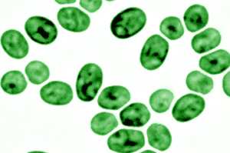
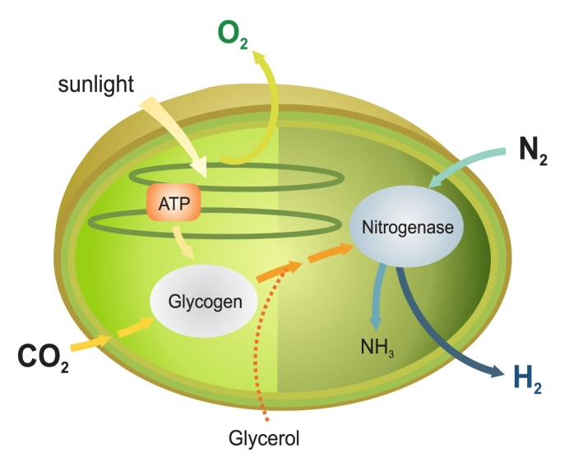
Systems Biology for Bioenergy Production
Systems biology techniques were used to dissect how the common microbe Cyanothece balances photosynthesis with carbon, nitrogen, and hydrogen metabolism.
Although oxygen is toxic to the enzymes involved in ammonia and hydrogen production, Cyanothece is unique in generating both in the presence of air and while producing O₂ as a byproduct of photosynthesis.
These results suggest metabolic engineering this microbe for enhanced production of hydrogen, biodiesel, or other biofuels using only water and sunlight and without the need for added fertilizers.
Bandyopadhyay, A., J. Stockel, H. Min, L. Sherman, & H. Pakrasi. 2010. “High Rates of Photobiological Hydrogen Production Under Aerobic Conditions “ Nature Communications DOI:10.1038/ncomms1139
Notes:
High rates of photobiological H₂ production by a cyanobacterium under aerobic conditions
Anindita Bandyopadhyay1, Jana Stöckel1, Hongtao Min2, Louis A. Sherman2 & Himadri B. Pakrasi1
Among the emerging renewable and green energy sources, biohydrogen stands out as an appealing choice. Hydrogen can be produced by certain groups of microorganisms that possess functional nitrogenase and/or bidirectional hydrogenases. In particular, the potential of photobiological hydrogen production by oxygenic photosynthetic microbes has attracted significant interest. However, nitrogenase and hydrogenase are generally oxygen sensitive, and require protective mechanisms to function in an aerobic extracellular environment. Here, we describe Cyanothece sp. ATCC 51142, a unicellular, diazotrophic cyanobacterium with the capacity to generate high levels of hydrogen under aerobic conditions. Wild-type Cyanothece 51142 can produce hydrogen at rates as high as 465 μmol per mg of chlorophyll per hour in the presence of glycerol. Hydrogen production in this strain is mediated by an efficient nitrogenase system, which can be manipulated to convert solar energy into hydrogen at rates that are several fold higher, compared with any previously described wild-type hydrogen-producing photosynthetic microbe.
In the present report, we describe Cyanothece sp. ATCC 51142, a cyanobacterial strain with the ability to produce remarkably high amounts of H2 under aerobic conditions. Cyanothece strains thrive in marine environments limited in dissolved inorganic bioavailable nitrogenous compounds, and have been recognized for their role in maintaining the marine nitrogen cycle. Cyanothece 51142 can derive the majority of its nutritional requirements from sunlight, atmospheric carbon dioxide and nitrogen gases. During the day, it performs photosynthesis and fixes carbon, which is stored as large reserves of glycogen. At the onset of the dark period, high rates of respiration rapidly create a suboxic intracellular environment. This, in turn, facilitates oxygen-sensitive and energy-intensive processes such as N2 fixation and H2 production to occur at night at the expense of the accumulated glycogen. The orchestrated diurnal cycling patterns of the central metabolic processes in this organism have recently been described using a global transcriptomic approach. These unique attributes of Cyanothece 51142, which make it an ideal organism for H2 production, are possibly the remnants of the metabolic and regulatory processes that aided in the acclimatization of ancient cyanobacteria during their transition from an anaerobic to an aerobic environment. Retention of ancient metabolic traits that originated in the Archaean oceans has been reported in other cyanobacterial strains.

Slide 40



The DOE Bioenergy Research Centers
Revolutionizing discovery of biofuels solutions
New paradigm for research—single focus, multi-disciplinary, highly integrated science
Building on DOE’s investments in user facilities and fundamental research programs
Focus on
  Feedstock characterization & development
  Feedstock deconstruction
  Feedstock conversion to liquid fuels
40
Notes:
Replace GLBRC logo
DOE’s investments in bioenergy research span the spectrum from the fundamental research supported in the Office of Science to the applied research supported by the Office of Energy Efficiency and Renewable Energy’s (known as EERE) Biomass Program. Our fundamental research on the characterization and development of biomass feedstocks, some of which is done in partnership with the USDA, is trying to understand, for the first time, the complexity of the almost indestructible lignocellulose complex that gives plants their rigidity. Our basic research on the conversion of biomass material to next generation liquid fuels supports EERE’s efforts to demonstrate the scalability and commercialization of various bioenergy concepts.
The bottom line is that each of these centers is taking a strong fundamental science approach, looking for transformational, game-changing breakthroughs in the science of bioenergy --- from the fundamental structure of plant cell walls to the redesign and re-engineering of biosynthetic pathways in microbes.
40

Slide 41
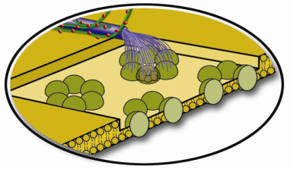
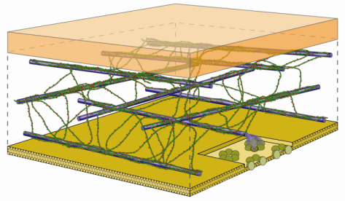





Energy Frontier Research Center:
Center for Lignocellulose Structure and Formation (PSU)
Cellulose synthesis
50 nm
Cell wall assembly
Plant material properties
RESEARCH OBJECTIVES:
Develop a detailed understanding of the nano-scale structure of lignocellulose and the physichemical principles of its formation through:
Use a nano-engineered platform to facilitate biophysical spectroscopic studies
Characterize the dynamics and energetics of specific cellulose-polysaccharide-protein-enzyme-lignin binding interactions
Develop and validate a multiscale model that will bridge the nano and molecular scale to real-world applications including drying and chemical/enzymatic degradation

Slide 42
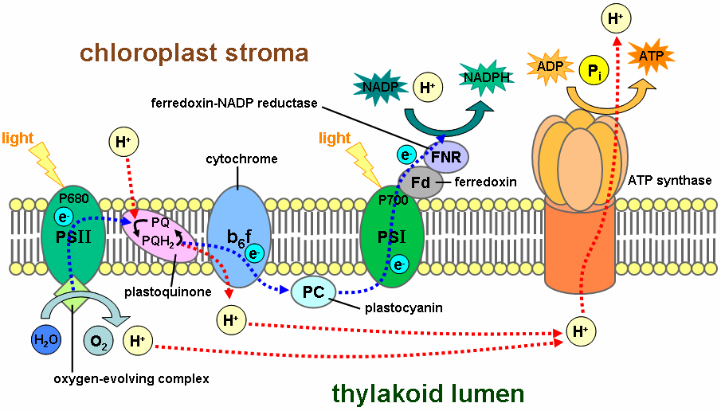
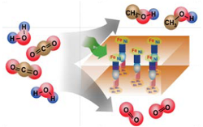
Innovation Hub
Joint Center for Artificial Photosynthesis (JCAP)
The design of highly efficient, non‐biological, molecular‐level “machines” that generate fuels directly from sunlight, water, and carbon dioxide is the challenge.
Basic research has provided an understanding of the complex photochemistry of the natural photosynthetic system and the use of inorganic photo‐catalytic methods to split water or reduce carbon dioxide – key steps in photosynthesis.
JCAP Mission: To demonstrate a scalable, manufacturable solar-fuels generator using Earth-abundant elements, that, with no wires, robustly produces fuel from the sun 10 times more efficiently than (current) crops.
JCAP R&D focuses on:
      Accelerating the rate of catalyst discovery for solar fuel reactions
      Discovering earth-abundant, robust, inorganic light absorbers with optimal band gap
      Providing system integration and scale-up
Begun in FY 2010, JCAP serves as an integrative focal point for the solar fuels R&D community – formal collaborations have been established with 20 Energy Frontier Research Centers.
Natural photosynthesis
Artificial photosynthesis

Slide 43
Prospects for Solar Fuels Production
What We Can Do Today
Two Limits
Ultimate Goal
solar microcatalytic energy conversion
$12/kg H₂ @ $3/pW PV
(BRN on SEU 2005)
PV cell
High capital costs
Low capital costs
balance of system
current
liquid
electrolyzer
fuel storage
gas
We do not know how to produce solar fuels in a cost effective manner.
Chemists do not yet know how to photoproduce O₂, H₂, reduce CO₂, or oxidize H₂O on the scale we need.
gas
fuel storage
fuel storage
H₂ compression
compression
Notes:
Given that we now have an active FOA out on the Fuels from Sunlight topic, we have decided not to follow the other module example by giving specific research highlight examples. This is to avoid the “perception” of endorsing any specific groups’ efforts. Therefore, the solar fuels slides are essentially laying the case for why we would need a Hub and ending with a Hub FOA slide. Please let me know if you would like us to do something different for this module.

Slide 44
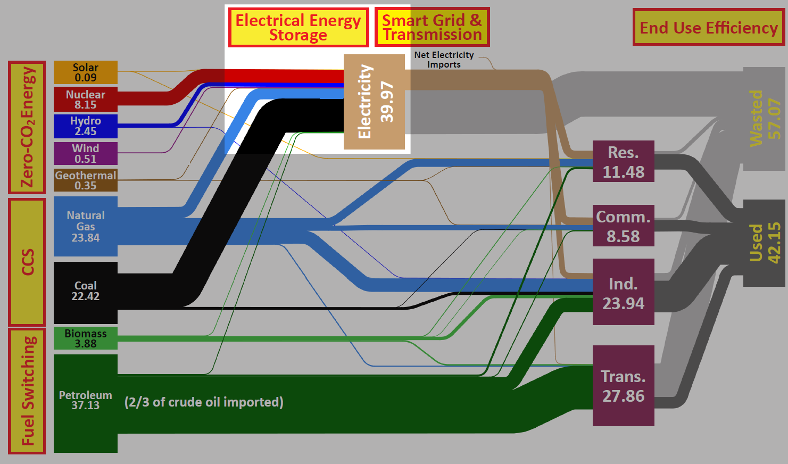
Science for Electrical Energy Storage
Electrical Energy Storage
44

Slide 45
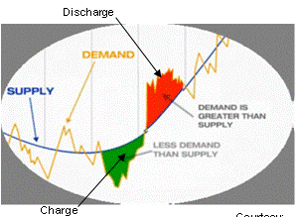
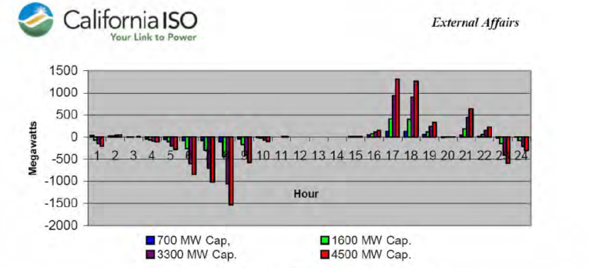
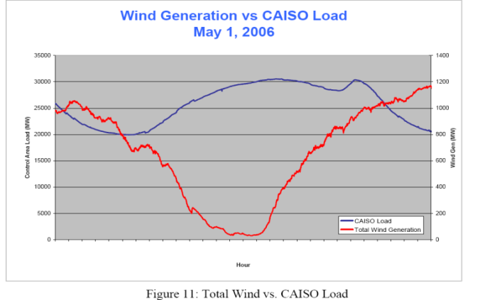
Basics: Energy Storage Time Scales
Seconds to Minutes
Minutes - One Hour
Several Hours - One Day
Regulation
Ramping
Peak shaving, load leveling
Transformer Load
Peak load [MVA]
With Battery (Measured)
Without Battery (Calculated)
While different time regimes will require
different storage solutions, there are
many common science questions.
Total Wind Generation
CAISO Load
Notes:
Make visible captions and intelligible graph labels

Slide 46
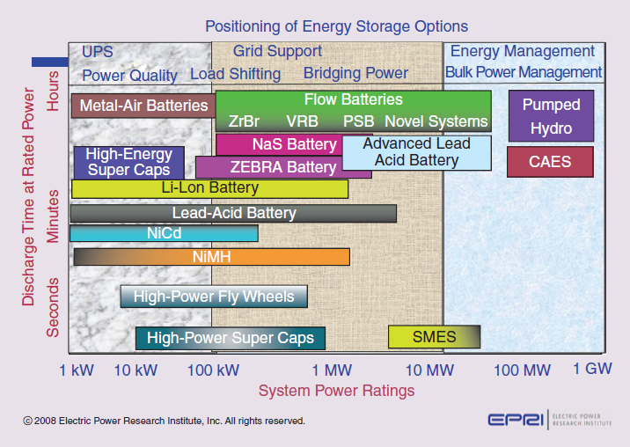
Current Battery and Energy Storage Technologies
Consumer Transportation Grid Management
46
Notes:
Make a new version of this one

Slide 47

From Bench to Marketplace:
The Story of A123 Systems
The Office of Science sponsored basic research at MIT over a decade ago that led to the discovery of a new nanostructured cathode material for battery applications.
Based on this discovery, the faculty member started a company, A123 Systems in Watertown, MA, to commercialize this new battery technology.
Development was further supported by a DOE Small Business Innovation Research grant starting in 2002 and by a grant from the DOE Office of Energy Efficiency and Renewable Energy starting in 2006.
Today A123 Systems’ batteries have reached the commercial marketplace in power tools, hybrid and plug-in hybrid electric vehicles, and grid-related applications.
Transportation
Transportation
Electric Grid
Electric Grid
Portable Power
Portable Power
Notes:
Perhaps keep this slide as an example of how this process can work (science to new technology to production) but note the long time to market even after the fundamental science was known.

Slide 48
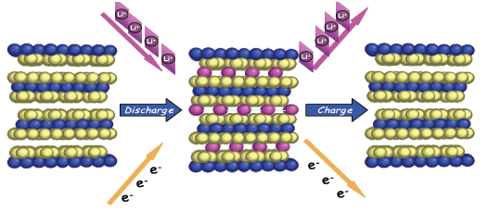
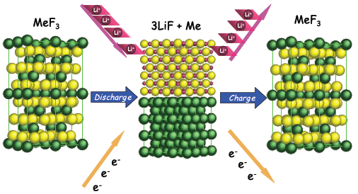




Energy Frontier Research Center:
Northeastern Center for Chemical Energy Storage
Intercalation Chemistries
Conversion Chemistries
RESEARCH OBJECTIVES:
Develop a fundamental understanding of how key electrode reactions occur, and how they can be controlled through the development of new diagnostic tools;
Identify critical structural and physical properties that are vital to improving battery performance;
Use this information to optimize and design new electrode materials
48
Notes:
48

Slide 49
Advanced Fission & Fusion Energy Systems
49

Slide 50
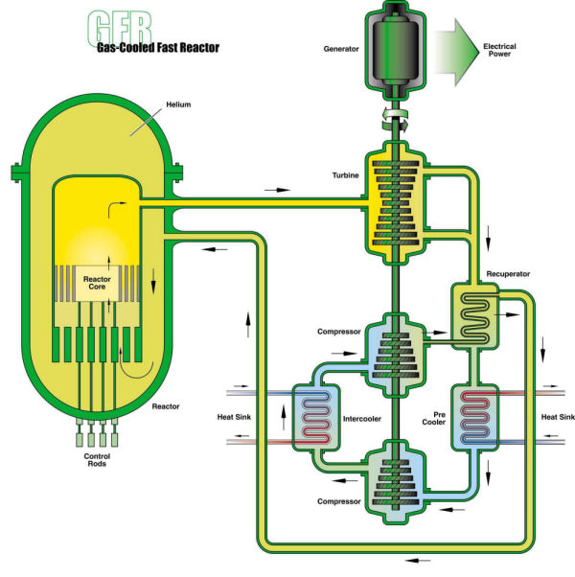
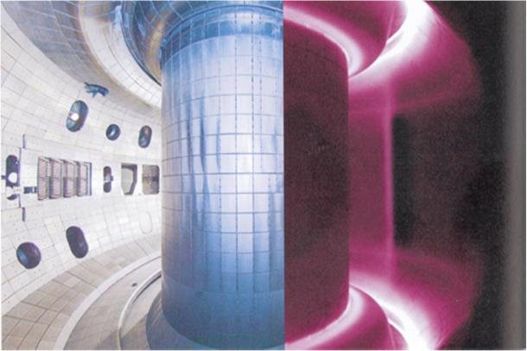
Materials Science for Advanced Fission & Fusion Energy
Advanced fission and fusion reactors will operate at much higher temperatures than typical operating ranges of most materials today.
High temperatures are known to degrade strength over long time
periods, especially when combined with other extreme conditions.
Gas-cooled
nuclear reactor
Tokamak
fusion reactor
Notes:
Left: Gen IV gas-cooled fast reactor diagram (INL).
Right: the DIII-D tokamak (General Atomics).

Slide 51
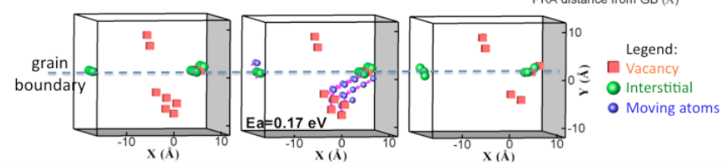
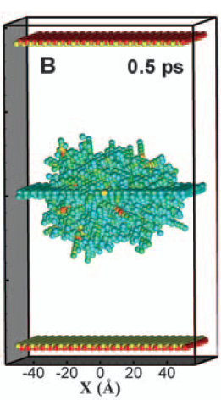
New Radiation Resistant Materials
Time
Interstitials move to grain boundary
Grain boundary
re-emits interstitials
Interstitials annihilate vacancies
A collision cascade displaces atoms, creating vacancies and interstitials (right, showing displaced atoms 0.5 ps after the cascade initiation).
Fast-moving interstitials move quickly to a nearby boundary (above left). Slower-moving vacancies remain.
A grain boundary loaded with interstitials emits them (above center)
Nearby vacancies are annihilated (above right)
This new mechanism may explain the enhanced radiation resistance observed in nanocrystalline materials with large numbers of grain boundaries.
X-M Bai et al., Science 26 March 2010, 327: 1631-1634.
Notes:
Xian-Ming Bai, Arthur F. Voter, Richard G. Hoagland, Michael Nastasi, and Blas P. Uberuaga
Science 26 March 2010 327: 1631-1634 [DOI: 10.1126/science.1183723] (in Reports)
Article abstract: Although grain boundaries can serve as effective sinks for radiation-induced defects such as
interstitials and vacancies, the atomistic mechanisms leading to this enhanced tolerance are still
not well understood. With the use of three atomistic simulation methods, we investigated defect–
grain boundary interaction mechanisms in copper from picosecond to microsecond time scales. We
found that grain boundaries have a surprising “loading-unloading” effect. Upon irradiation,
interstitials are loaded into the boundary, which then acts as a source, emitting interstitials to
annihilate vacancies in the bulk. This unexpected recombination mechanism has a much lower
energy barrier than conventional vacancy diffusion and is efficient for annihilating immobile
vacancies in the nearby bulk, resulting in self-healing of the radiation-induced damage.

Slide 52
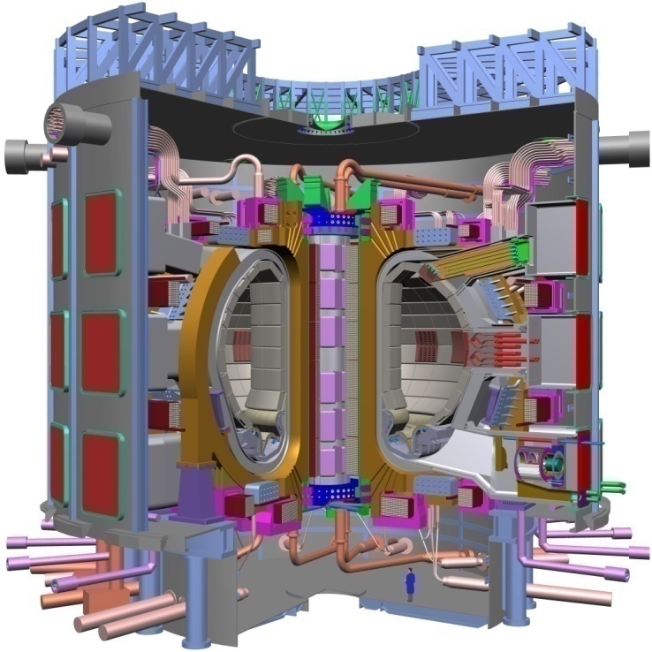
Magnetic Fusion Energy: Controlling the Burning Plasma State
ITER will enable “burning plasmas”
ITER, an international project being built in Cadarache, France, will create the world’s first sustained burning plasma fusion experiment.
Science challenge:
Develop a robust and predictable approach to controlling the dynamics of this plasma state.
Notes:
Edit down and broader context; add NIF ignition

Slide 53


Inertial Fusion Energy: Nearing Ignition
The newly completed National Ignition Facility – the world’s most powerful laser system – recently began full operations
NIF is on track to achieve the first laboratory demonstration of “ignition” or net energy gain
Notes:
Edit down and broader context; add NIF ignition

Slide 54

Conclusion
Let’s get going!
Energy Frontier Research Center (EFRC): Center for Catalytic Hydrocarbon Functionalization
Pushing the frontiers in environmental science, nanoscience, and catalysis
… and, don’t forget fundamental science!
http://www.eia.doe.gov/energyexplained/
Notes:
Add hyperlink to the graphic

Slide 55


